Slide 1
CLINICAL UPDATED MANAGEMENT OF DIABETES MELLITUS
DR H M ABDELRAHIM

Slide 2
OBJECTIVES
• Review basics of diagnosis and when to think beyond type
2& type 1 DM
• Understand how to prescribe the available noninsulin
pharmacologic therapies for type 1&2 diabetes
• Learn how to individualize therapeutic strategies for type 2
diabetes based on comorbidities, goals as well as concerns
and side effects

Slide 3
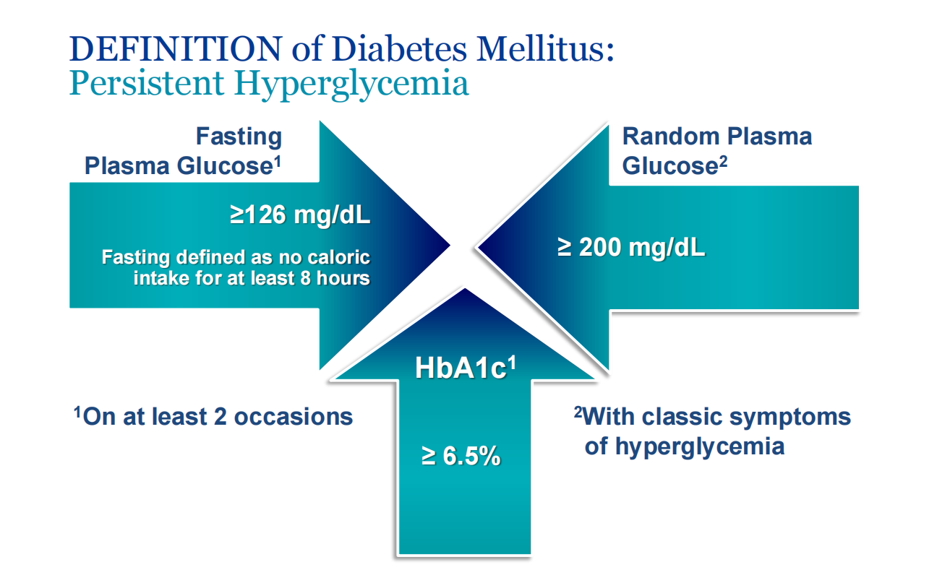

Slide 4
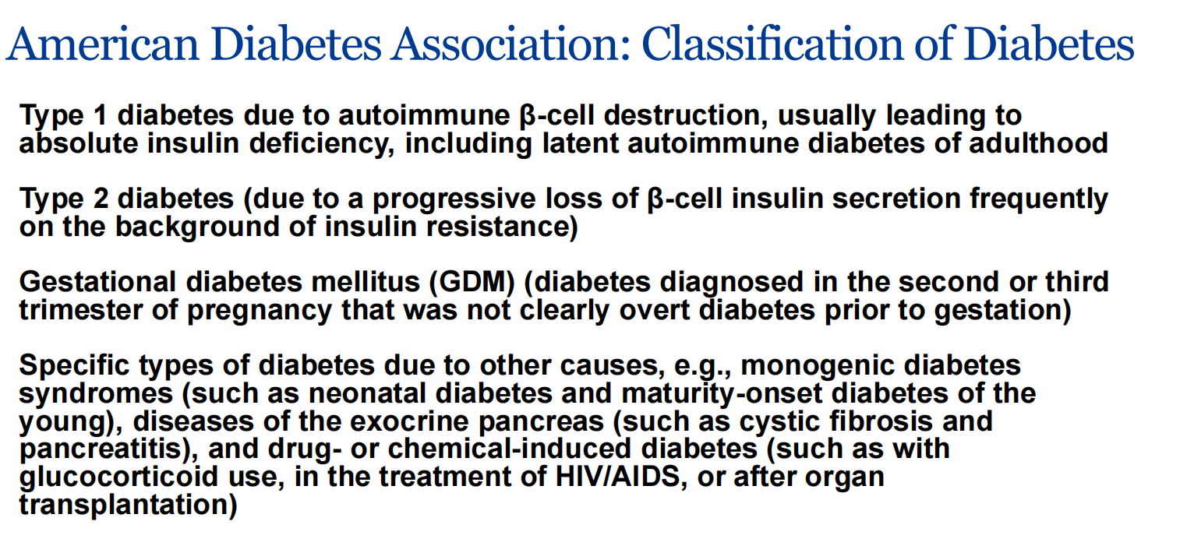

Slide 5
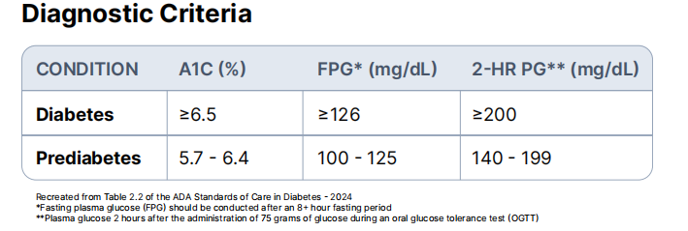

Slide 6
Diabetes - Diagnosis & Classification
Diagnosis of Diabetes with any of :
• Fasting glucose ≥ 7mmol/L (Prediabetes: 6.1-6.9) OR
• HbA1c ≥ 6.5% (Prediabetes: 6.0-6.4%) OR
• 2h 75g OGTT ≥ 11.1 mmol/L (Impaired glucose tolerance: 7.8-11.0) OR
• Random glucose ≥ 11.1 mmol/L
Type of Diabetes:
• Type1: insulin deficiency (pancreatic β cell destruction), DKA prone, Usually Anti-GAD/Anti-Islet Cell +
• Type 2: insulin resistance (tissue resistance, secretory defect), metabolic syndrome
• Latent autoimmune diabetes in adults (LADA): type 2 diabetes who also have immune-mediated loss
of pancreatic β cells
• Monogenic: familial autosomal dominant mutation leading to beta cell defects, neonatal or <25 yo
• GDM: glucose intolerance during pregnancy

Slide 7
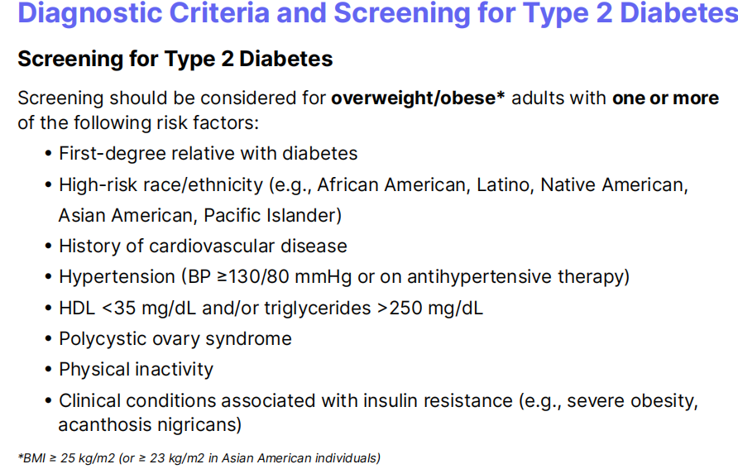

Slide 8
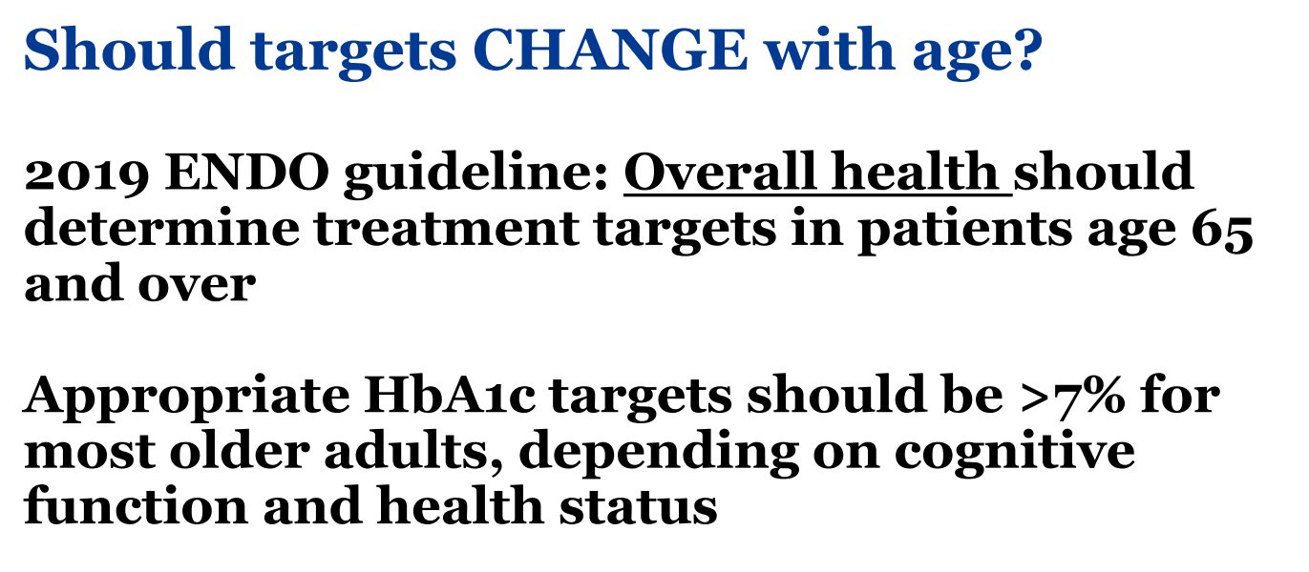

Slide 9
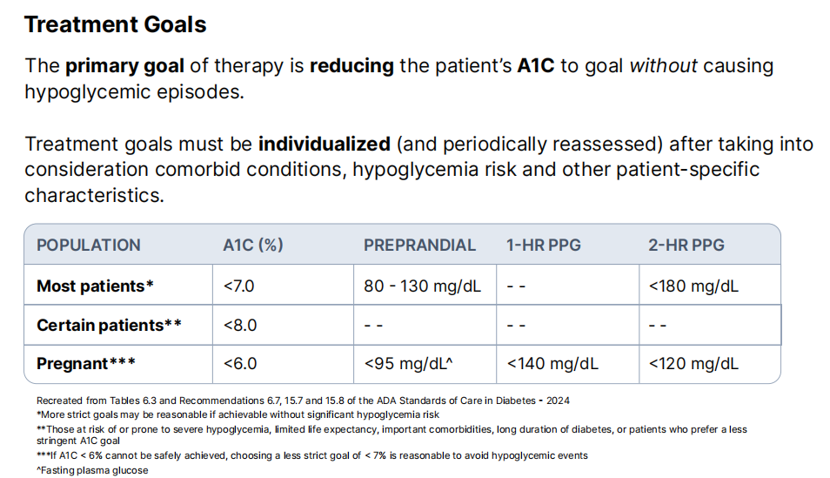

Slide 10
Overview of Hemoglobin A1C
Before discussing the hemoglobin A1C (A1C) lab value itself, it is important to understand the relationship between A1C and hemoglobin. Hemoglobin is an iron containing transport protein found in red blood cells.
Over the lifespan of red blood cells (~120 days) the hemoglobin protein becomes glycated (chemically linked to sugar).
The greater the concentration of glucose in the bloodstream, the greateramount of hemoglobin becomes glycated. The A1C test is a measurement of the percentage of glycated hemoglobin in the bloodstream.

Slide 11
Limitations of Hemoglobin A1C
It is important to note that hemoglobin A1C (A1C) is an indirect measure of a patient’s average blood glucose levels. It does not provide information regarding glycemic variability (i.e., the frequency of hyper- and hypoglycemia) which is why assessing a collection of plasma glucose levels in addition to A1C is necessary to most effectively evaluate glycemic control.
Additionally, hemoglobin abnormalities may falsely increase or decrease A1C lab values. This should be considered when the reported A1C value(s) do not correlate with the patient’s plasma glucose levels.

Slide 12
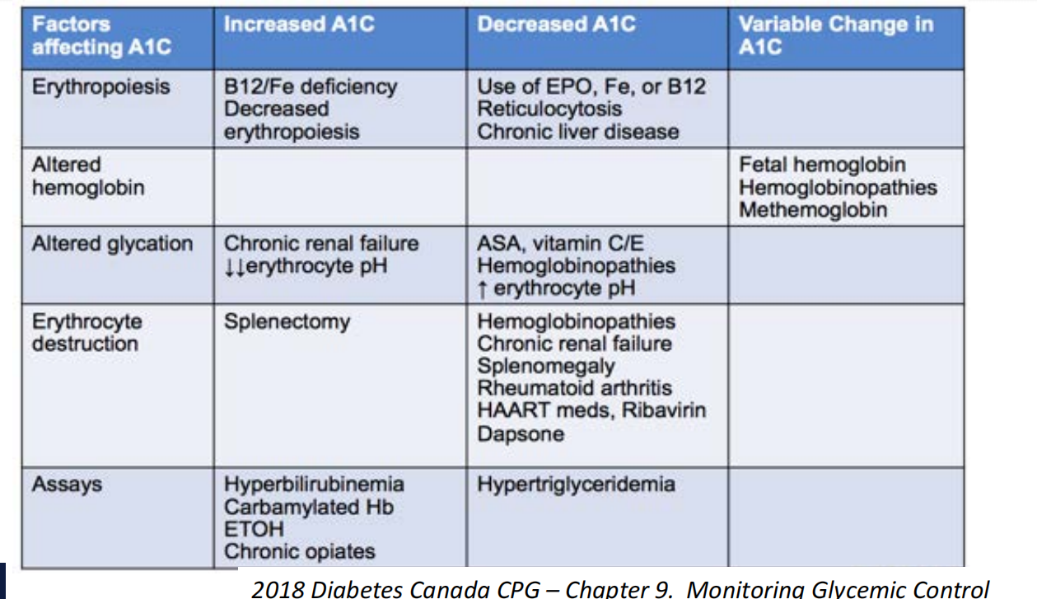
A1C confounders

Slide 13
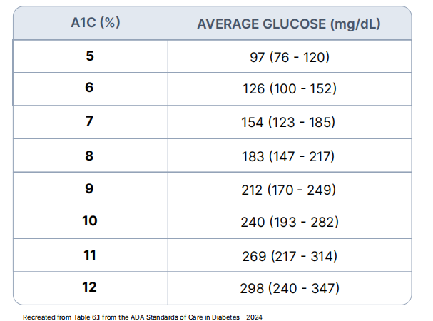

Slide 14
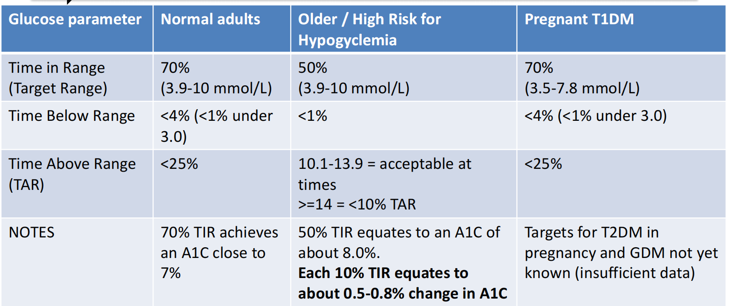
Continuous glucose monitor (CGM) – Targets

Slide 15
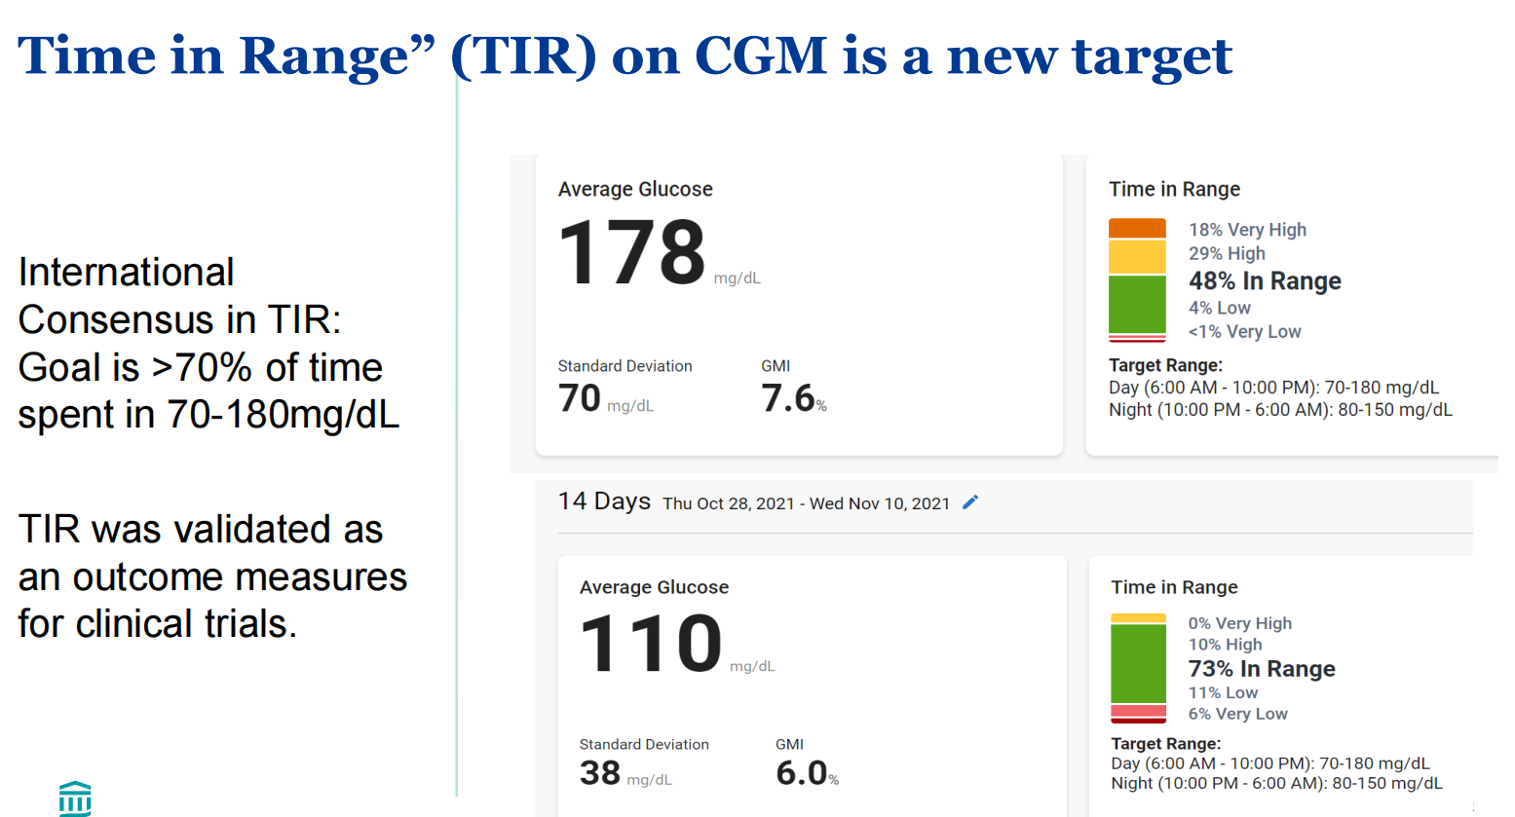

Slide 16
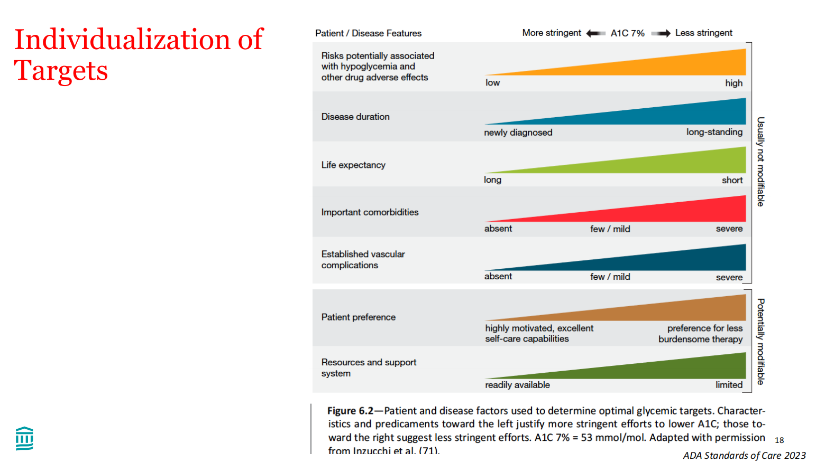

Slide 17
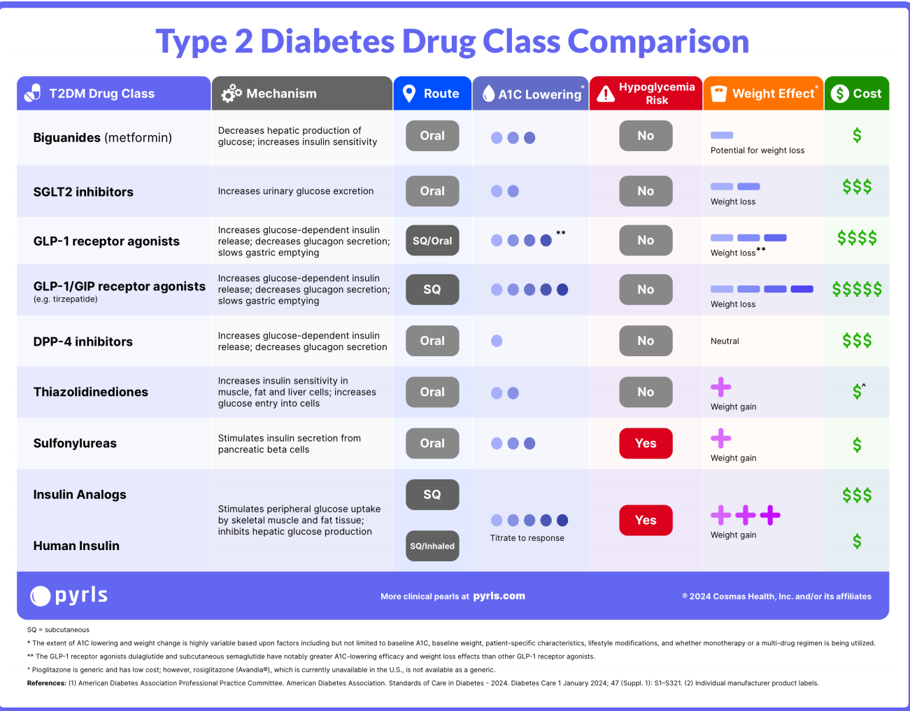

Slide 18
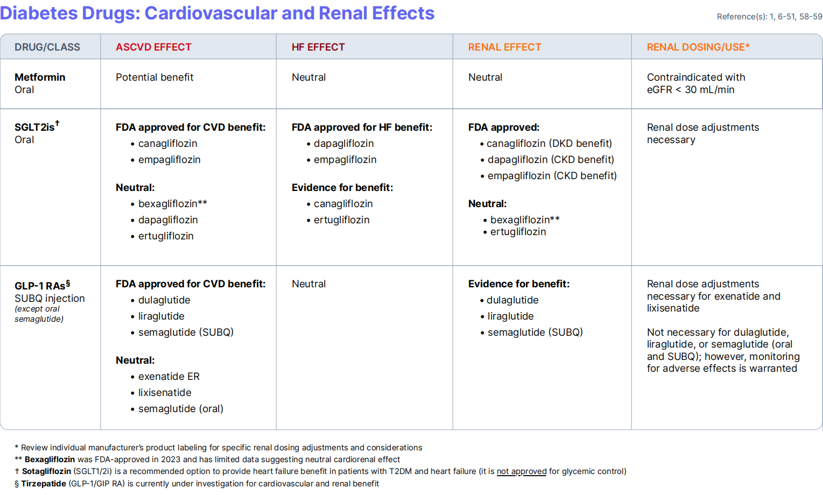

Slide 19
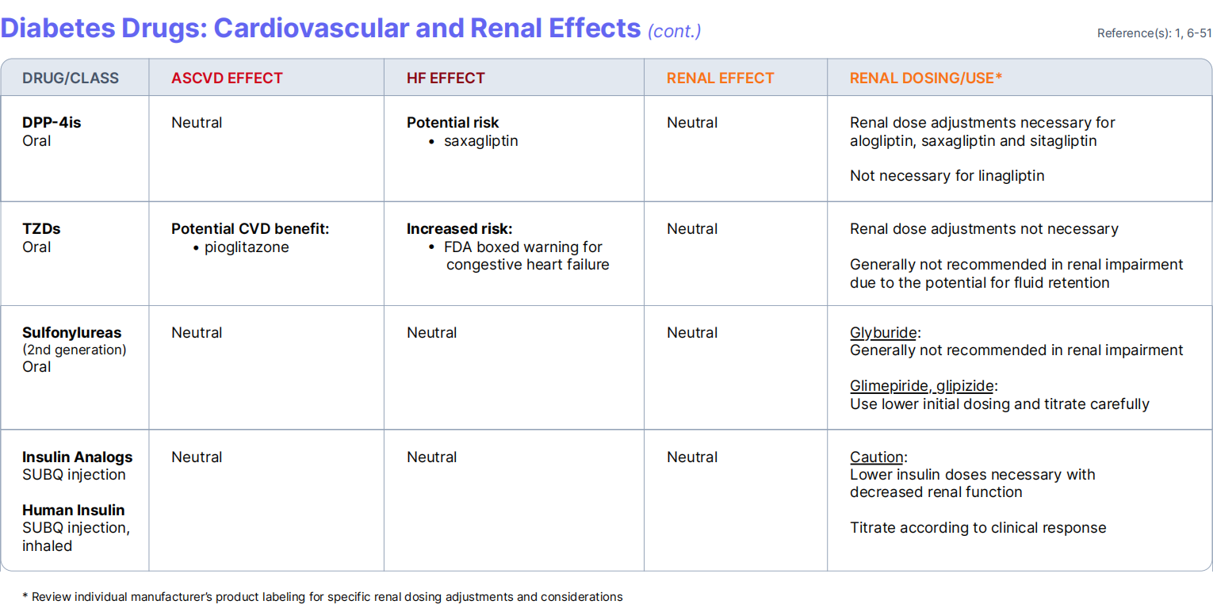

Slide 20
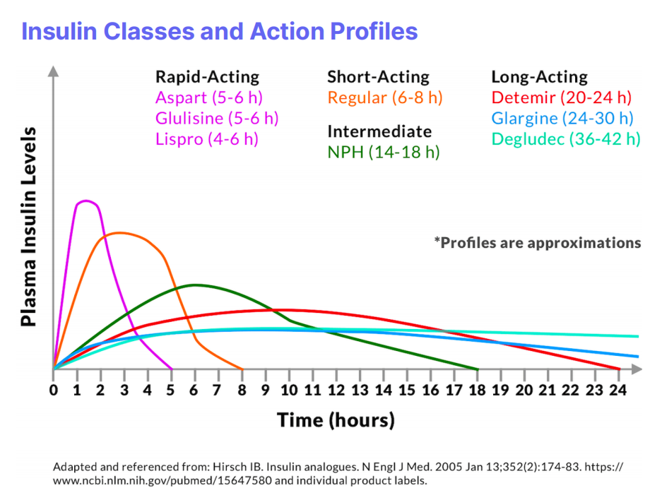

Slide 21
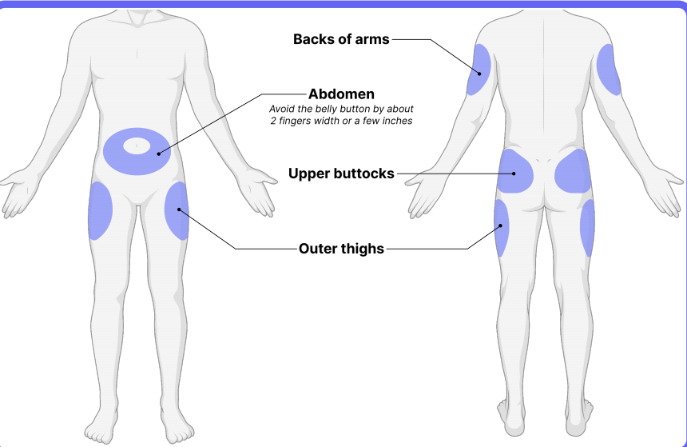

Slide 22
Type 1 Diabetes Management

Slide 23
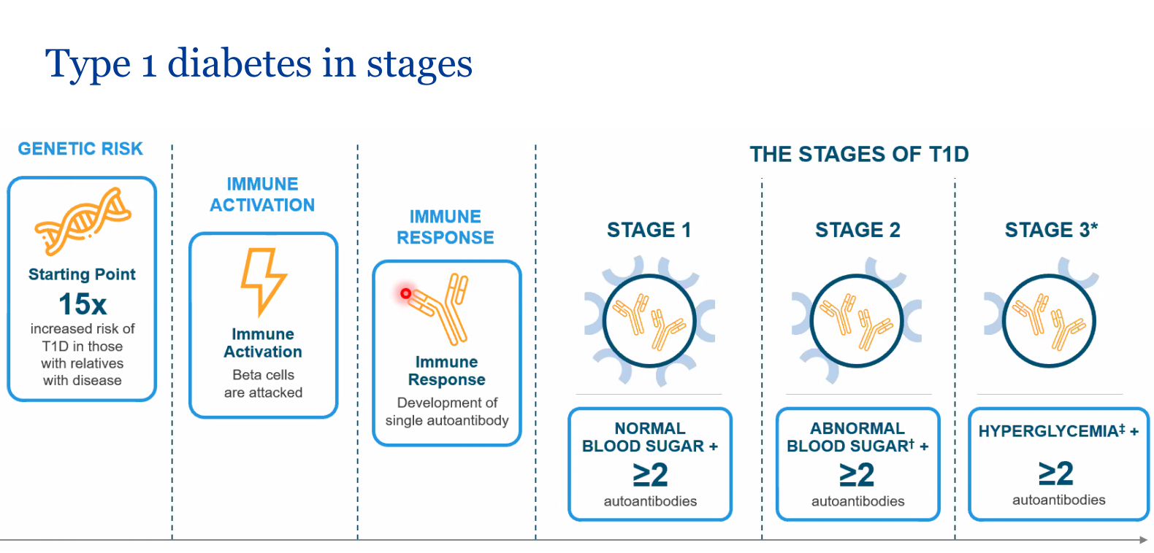

Slide 24
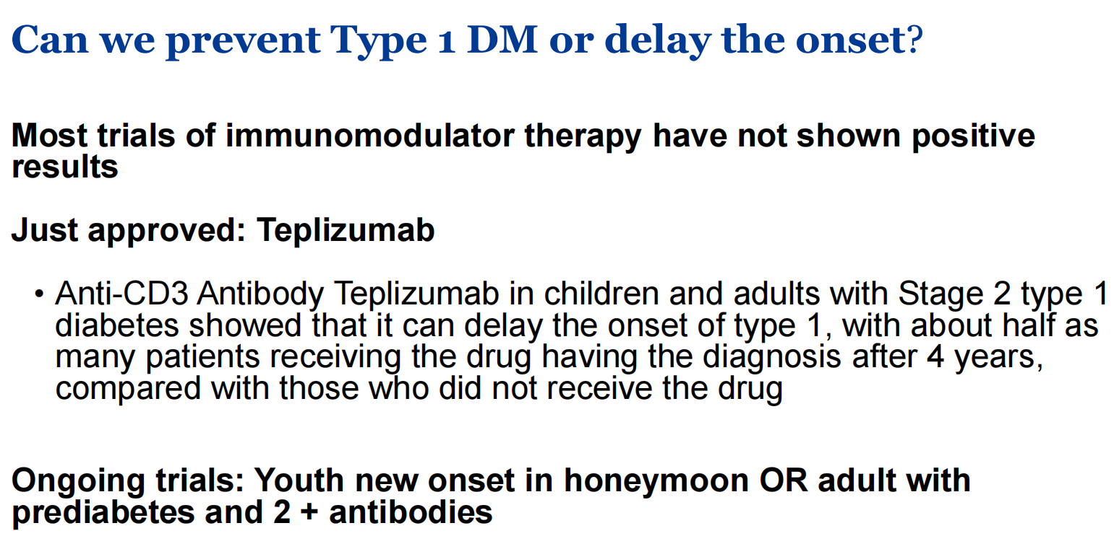

Slide 25
Benefits of Adding CGM to BBI or CSII
Adding Continuous Glucose Monitoring (CGM) with high sensor
adherence can
– ↓ A1C with no increase in hypoglycemia
– ↑ QOL, diabetes distress, fear of hypoglycemia and treatment
satisfaction
Note: Benefits of CGM are only seen when patients are actually
wearing the sensor/CGM at all times = high sensor adherence
(>70% in 14d period)

Slide 26
MDI (Multiple Daily Injections) Regimen Tips
High glucose? Look at the dose before…
– High fasting glucose? May need to increase bedtime basal
– High pre-lunch glucose? May need to increase breakfast bolus
– Exception is GDM where targets are post- prandial, so look at the bolus at that
meal
• Nocturnal Hypoglycemia
– May lower basal
– Use ultra long acting basal (e.g. Tresiba (insulin degludec) –Note make dose
changes every )
– May introduce a mixed meal bedtime snack
– Obtain history re: dinner and dinner bolus

Slide 27
MDI (Multiple Daily Injections) Regimen Tips
• Ratio Basal-bolus
– Individualized, there's no recommended ratio
– e.g. 50:50, 60:40, 40: 60
• Some Math
• Insulin Sensitivity: 100/total daily insulin dose
• Carb ratio : 500/total daily insulin dose
• In Hospital Situations
– Targets BG <12
– Glucocorticoids, TPN

Slide 28
Type 1 Diabetes – Autoimmune Screening
Autoimmune thyroid disease develops in 10% (up to 30% of females)
– Check TSH, anti-TPO Ab at diagnosis and q2-5 years thereafter
• Autoimmune adrenal insufficiency is rare
– Screen if symptoms, unexplained hypoglycemia
• Celiac disease in about 5%, asymptomatic
– Screen if any symptoms, including iron deficiency, unexplained
hypoglycemia, vitamin D deficiency, osteoporosis

Slide 29
Type 2 Diabetes Management

Slide 30
T2DM Treatment: At Time of Diagnosis
Non-pharmacological management (refer to Diabetes Education Centre, Set A1C target, assess CV status, smoking cessation etc)
• Diet/Lifestyle changes for all
• Metformin if A1C ≥ 1.5% above target at diagnosis
– Insulin + Metformin if symptomatic hyperglycemia and/or
metabolic decompensation
• Reassess in 3-6 months

Slide 31
Metabolic Decompensation
What does “symptomatic hyperglycemia with metabolic decompensation” mean?
Suggests a state of relative or absolute insulin deficiency.
• Polyuria
• Polydipsia
• Blurry Vision
• Unintentional Weight loss
• Volume depletion
• Ketosis
• HHS/DKA
SHOULD BE STARTED ON INSULIN +/- metformin until glycemic control is achieved!
(then you back off insulin if you can, while adding on oral agents)

Slide 32
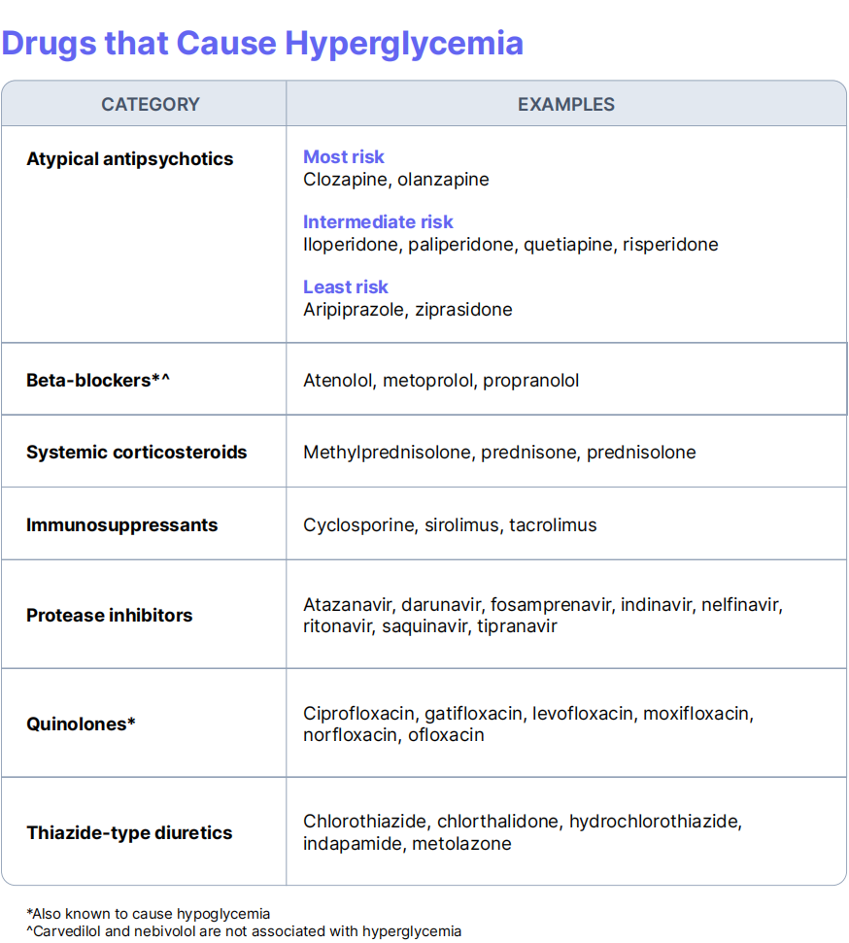

Slide 33
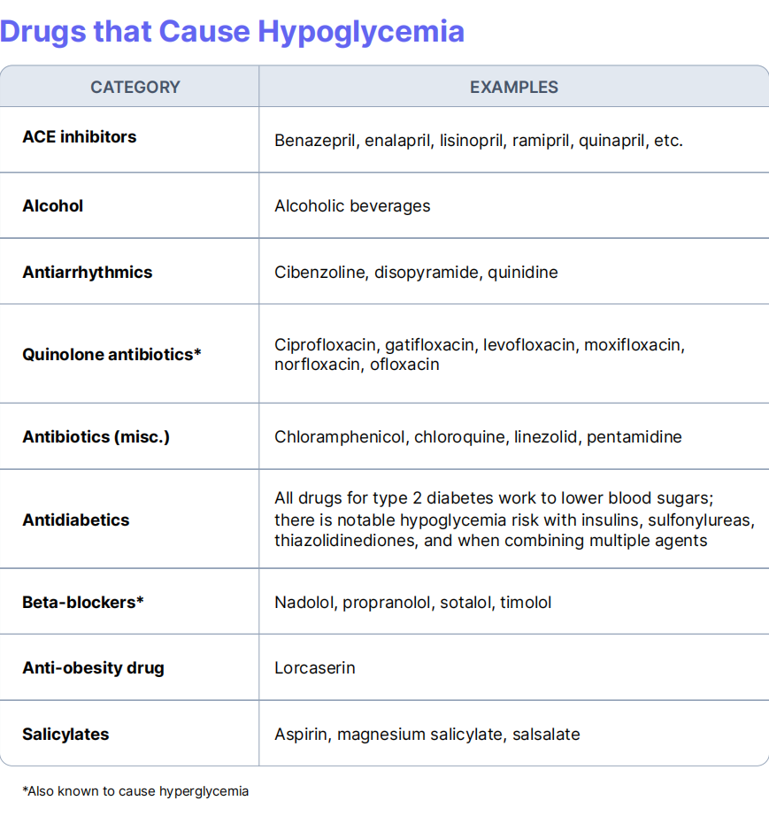

Slide 34
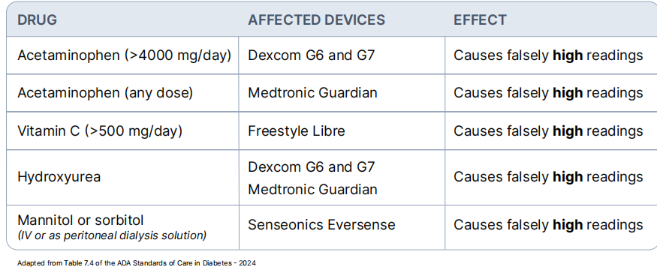

Slide 35
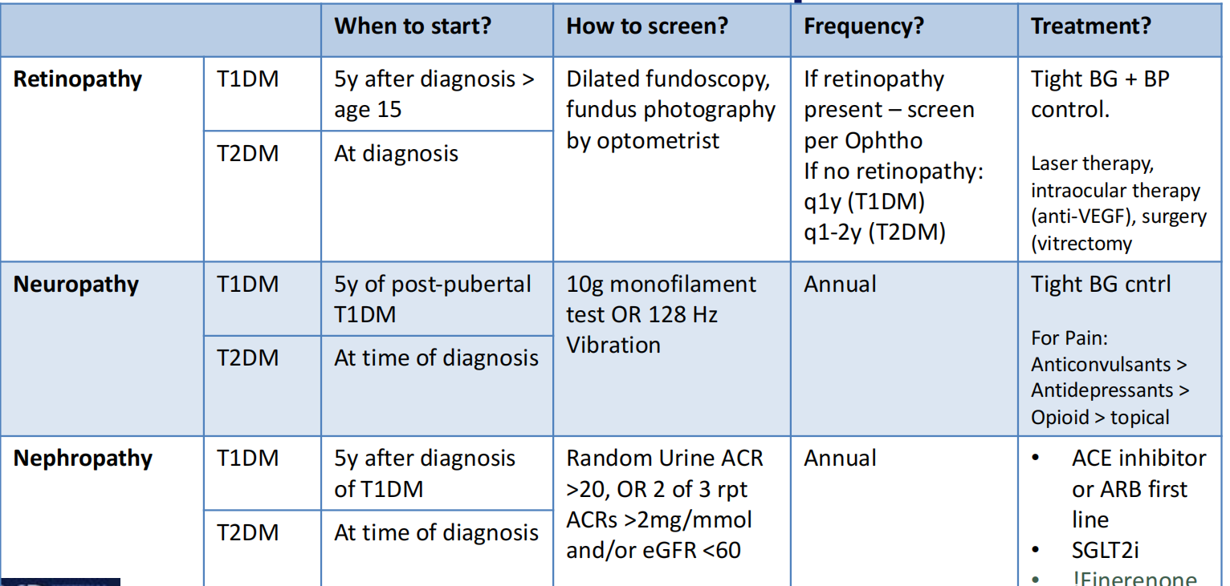
Microvascular Complications

Slide 36
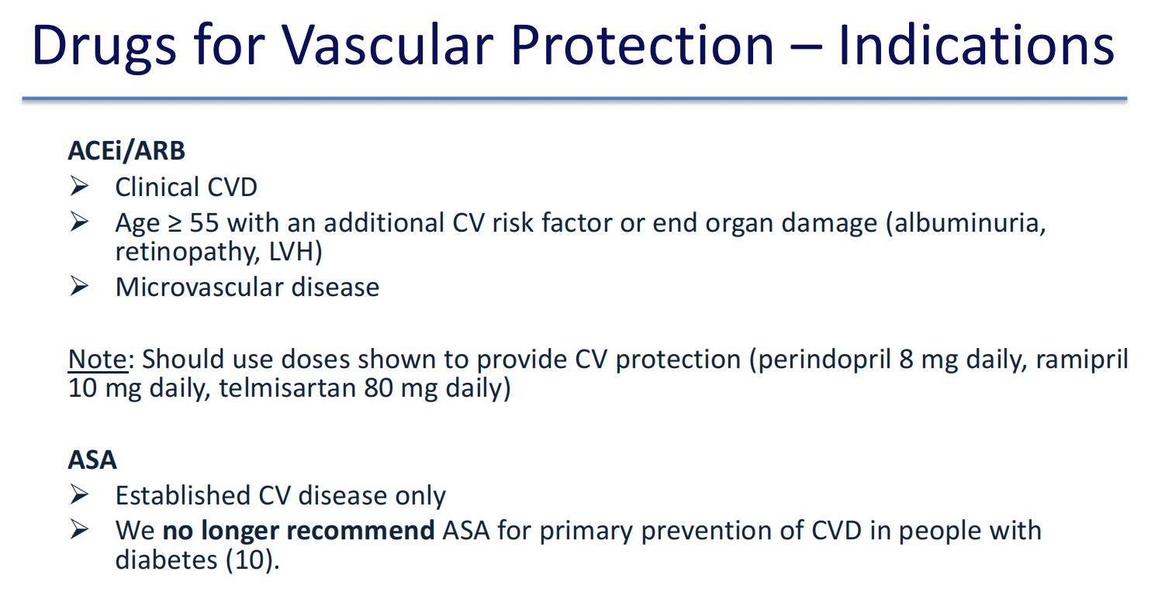

Slide 37
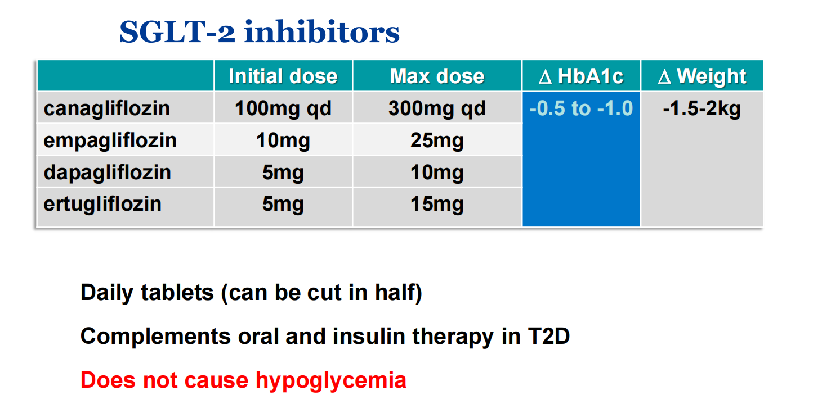

Slide 38
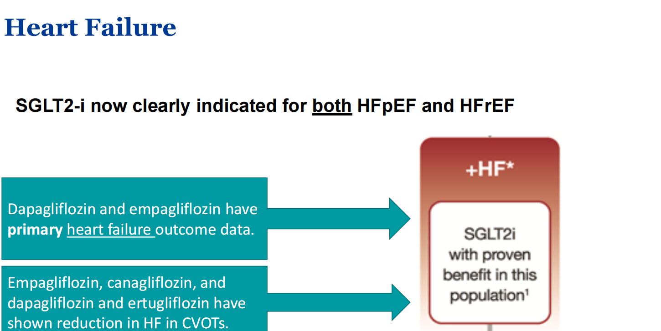

Slide 39
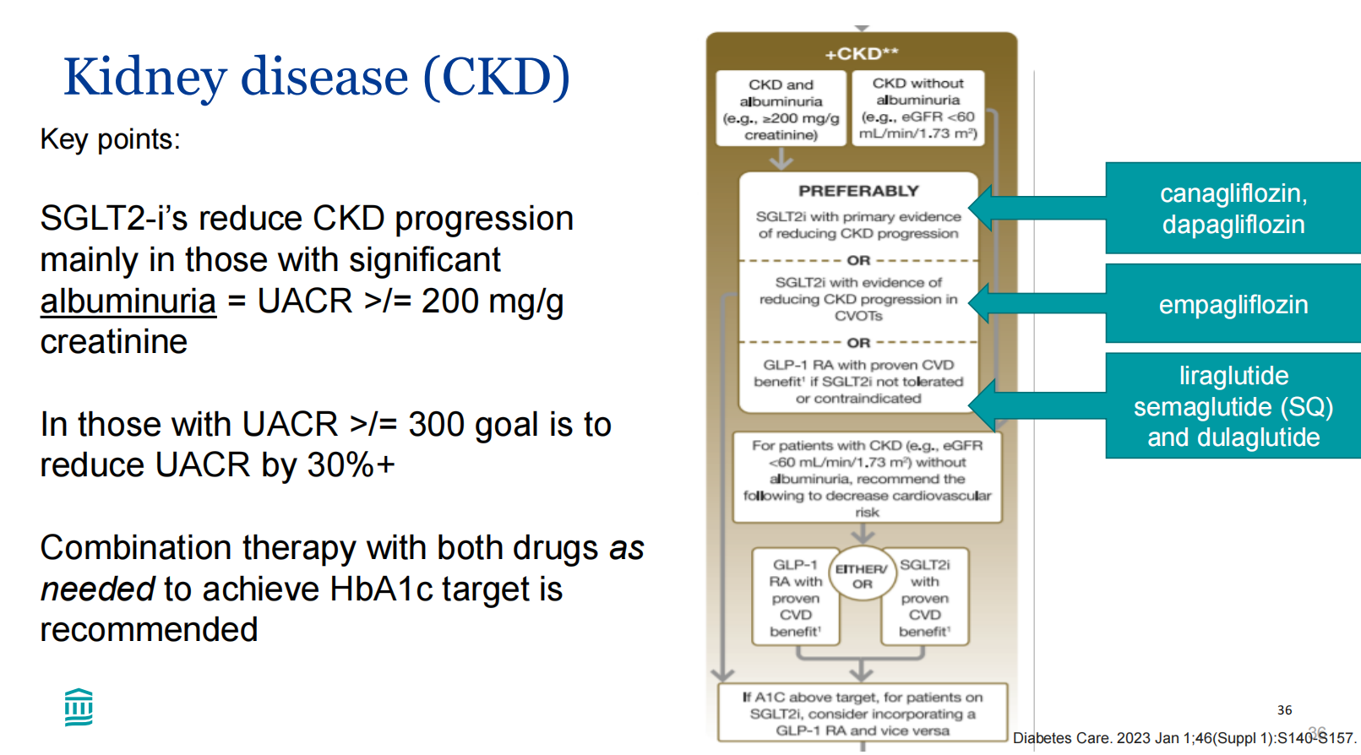

Slide 40
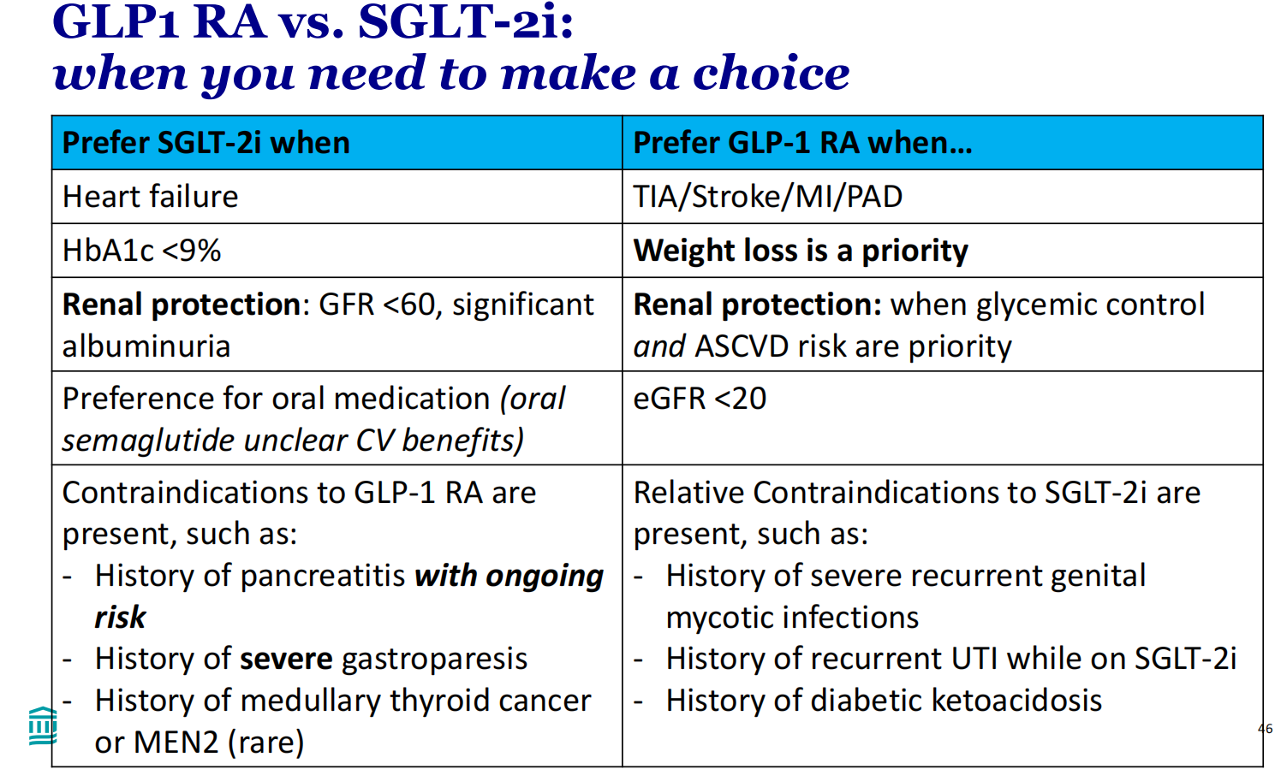

Slide 41
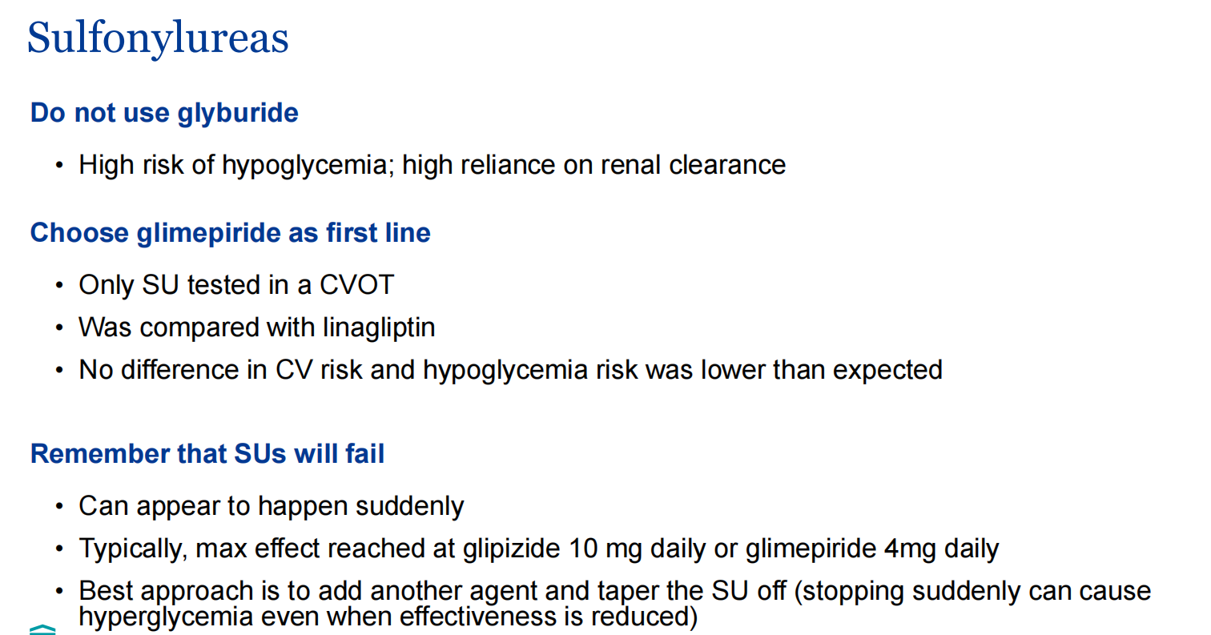

Slide 42
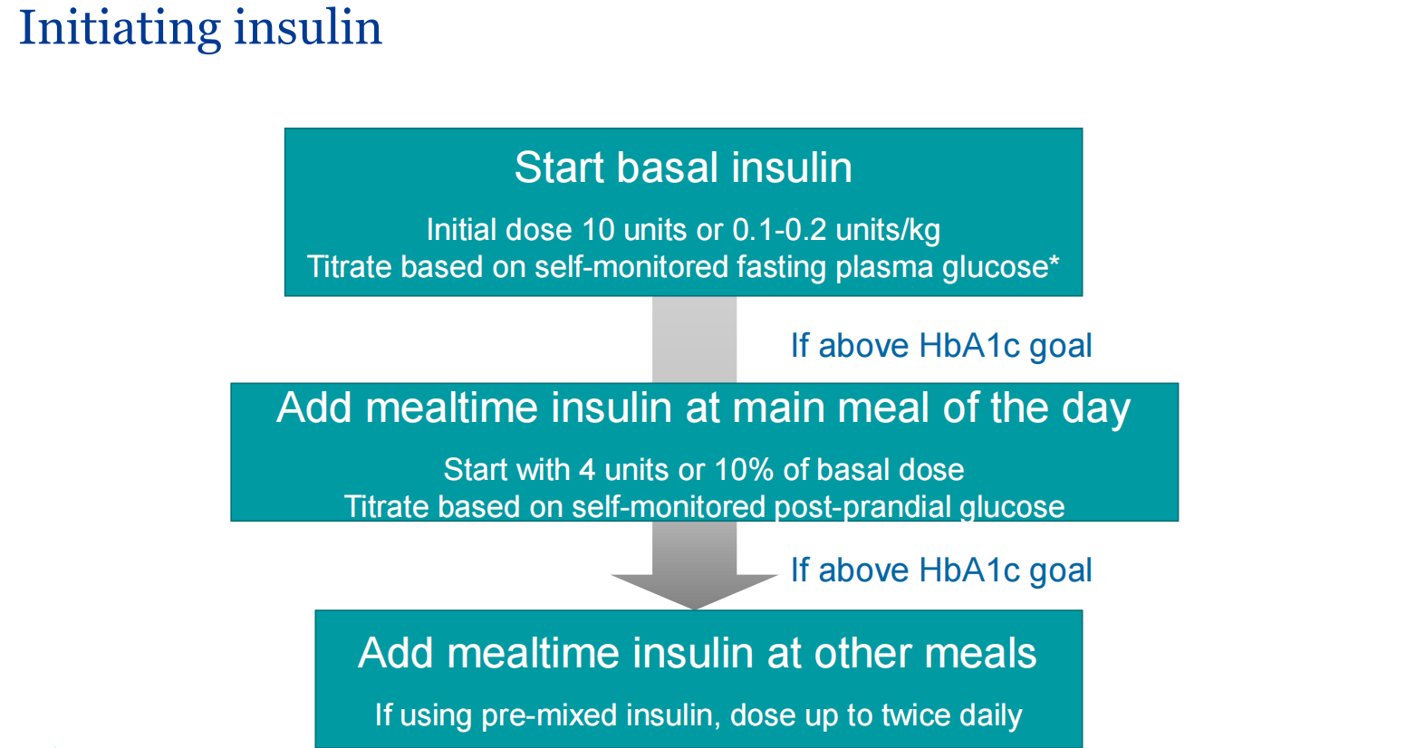

Slide 43
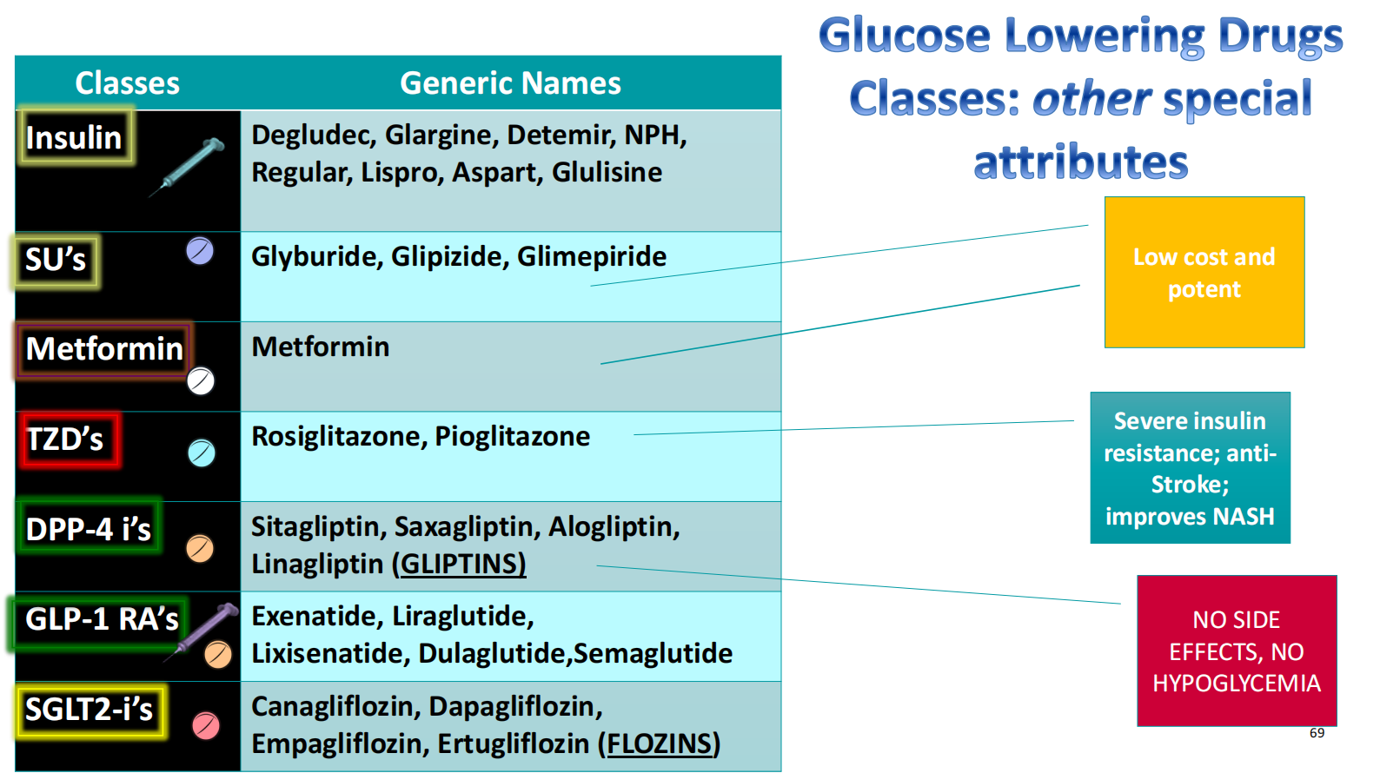

Slide 44
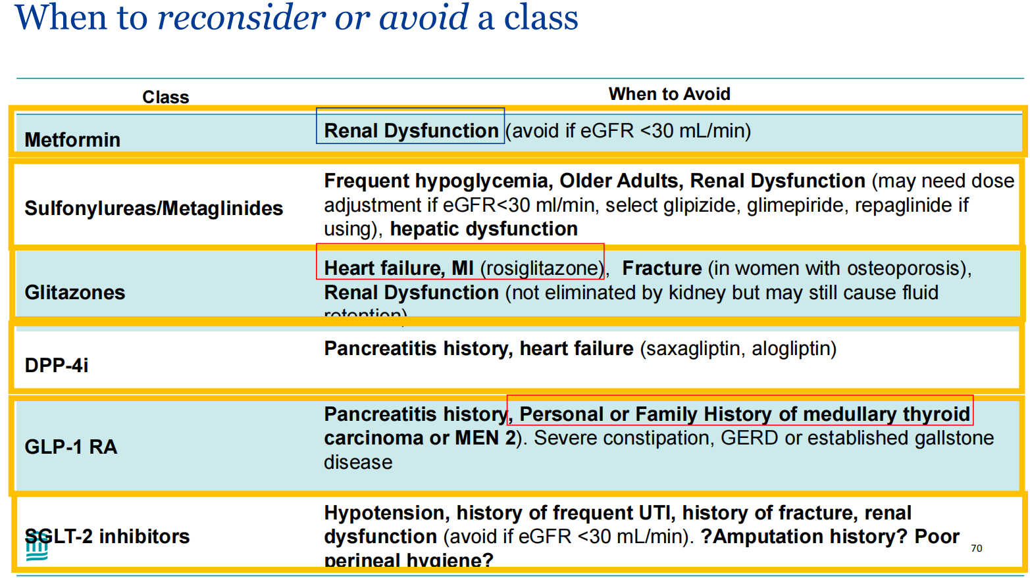

Slide 45
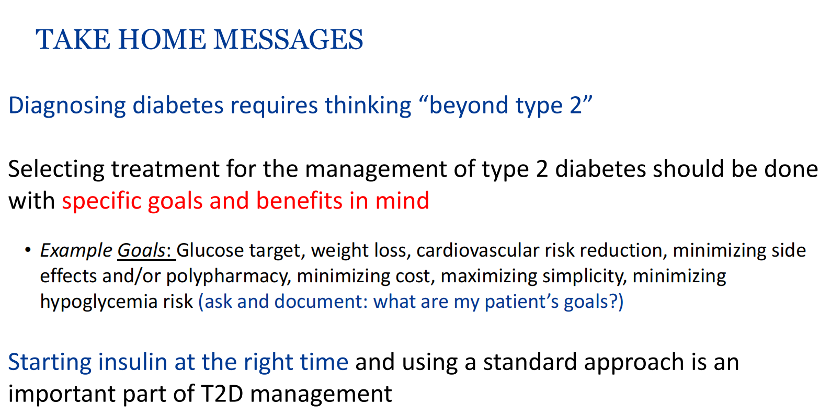

Slide 46


