Slide 1
APPROACH TO CYANOSIS IN
NEONATES
Dr. Mansour ALQurashi

Slide 2
Steps for diagnosis of cardiac disease
in a neonate
Step 1: cyanosis detection. Is your baby cyanotic? Yes or No
Is cyanosis due to cardiac or pulmonary disease?

Slide 3
Cyanosis & CXR:
CXR may suggest lung disease particularly if the findings are asymmetrical.
If the changes are diffuse and symmetric i.e. compatible with pulmonary edema or increased PVM, it is difficult to differentiate between 1ry lung disease or heart disease causing pulmonary edema e.g. TAPVD with obstruction.
PPH can coexist with lung disease and cause severe cyanosis.

Slide 4
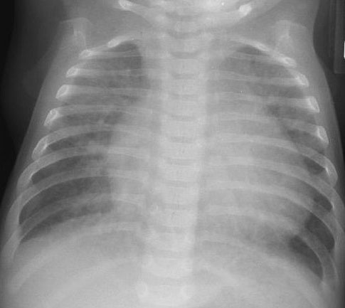

Slide 5
Cyanosis and CO2 retention
  CO2 retention is usually prominent with 1ry lung disease. Some severely cyanotic infants with cardiac disease can have marked hypercarbia.
  Absence of hypercarbia is suggestive of cardiac disease. Some severely cyanotic infants with pulmonary vascular disease have normal PCO2.

Slide 6
Cyanosis & Hyperoxia Test
It is the response of the arterial PO2 to administration of 100% O2.
If PO2 goes above 220 mmHg the patient has lung disease.
If PO2 is less than 100 mmHg the patient is likely to have cardiac disease.
The test is inconclusive if PO2 is between 100 and 220 mmHg.
Transcutaneous O2 saturation is NOT an alternative to arterial PO2.

Slide 7
PDA Dependant Cardiac Lesions
RVOT Obstruction:
e.g. TA, PA, or Severe TOF +/- PA.
They manifest with severe cyanosis
when the pulmonary flow is compromized by a closing DA.
LVOT Obstruction:
e.g. HLHS, Critical AS, Hypoplastic AA, or severe Co A.
They manifest with early CHF as their descending aorta flow is supplied by PDA.
D-TGA:
as PDA is needed for proper mixing of pulmonary and systemic circulations.

Slide 8
Confirmatory Diagnostic Tools
ECG
Echocardiography with Doppler.
Diagnostic Cardiac Catheterization.

Slide 9
Persistent Pulmonary Hypertension of the newborn (PPHN)
PPHN is defined as delay in the normal postnatal decline in pulmonary vascular resistance resulting in associated shunting of de-oxygenated blood across to the systemic circulation, leading to arterial hypoxemia
PPHN (or persistence of the fetal circulation) occurs
in approximately 1 in 1500 live births

Slide 10
Primary PPHN
Classical PPHN
  idiopathic
Hypoxemia develops in a baby with normal lungs.
Breath sounds and CXR are usually normal.

Slide 11
Secondary PPHN
PPHN secondary to lung disease.
  meconium aspiration syndrome
  congenital diaphragmatic hernia
  group B streptococcal pneumonia
  respiratory distress syndrome
  sepsis
  hypoplasia

Slide 12
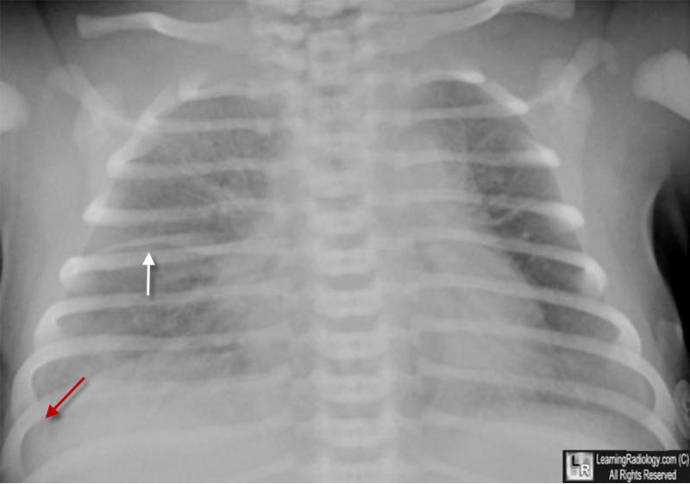
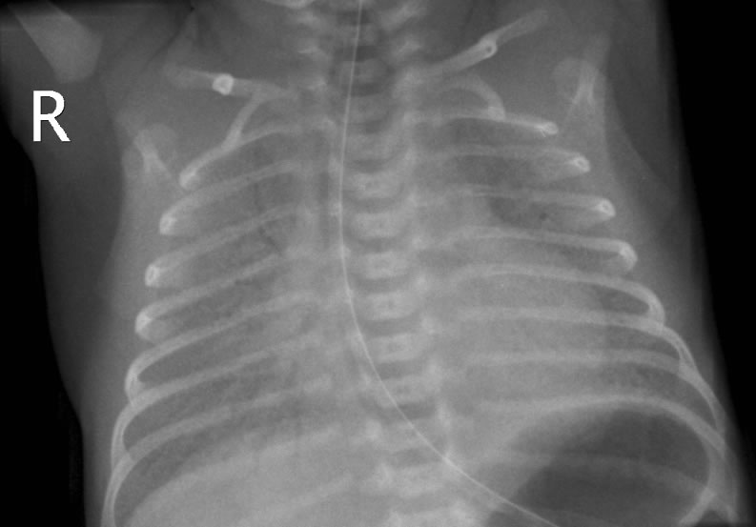

Slide 13
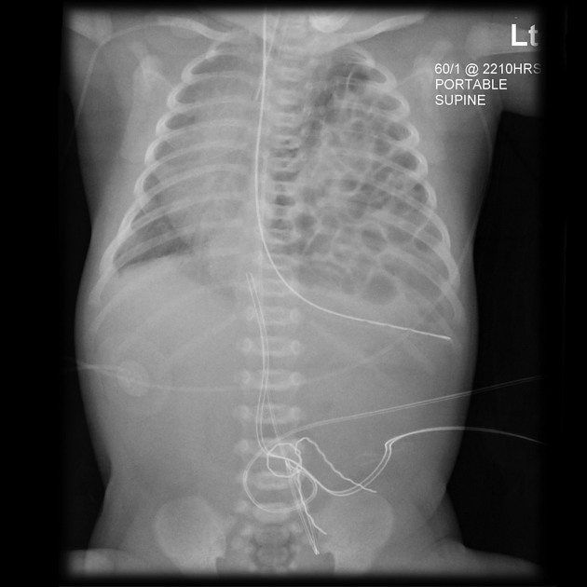
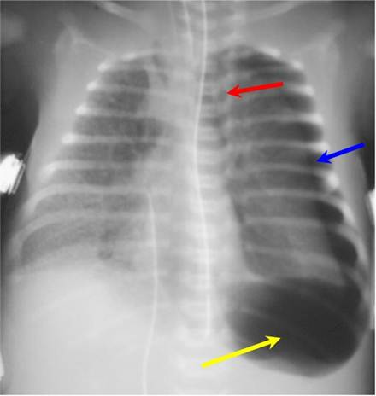

Slide 14
Treatment of PPHN
Initial Therapies
Treat metabolic derangements: correct acidosis, hypoglycemia, hypocalcemia
Optimize lung recruitment: mechanical ventilation, high- frequency oscillatory ventilation, surfactant
Optimize cardiac output and left ventricular function: vasopressors, inotropic agents
Pulmonary Vasodilators
Inhaled nitric oxide.
Other Therapies
Phosphodiesterase Inhibitors (sildenafil)
Inhaled prostacyclin analogs (iloprost, prostacyclin)
Recombinant superoxide dismutase

Slide 15
CONGENITAL CYANOTIC HEART DISEASE
Cyanotic CHD with decrease pulmonary blood flow:
PULMONARY ATRESIA
TRICUSPID ATRESIA
CRITICAL PULMONARY STENOSIS
EBSTEIN’S ANOMALY
TETRALOGY OF FALLOT
Cyanotic CHD with increase pulmonary blood flow:
TRANSPOSITION OF THE GREAT ARTERIES
TOTAL ANOMALOUS PULMONARY VENOUS DRAINAGE.
TRUNCUS ARTERIOSUS.
HYPOPLASTIC LEFT HEART SYNDROME

Slide 16
Transposition of the great arteries
Although dextroposed transposition of the great arteries represents only about 5% of congenital heart defects, it is the most common cyanotic lesion to present in the newborn period .
A history of cyanosis is always present, although it depends on the amount of mixing. Tachypnea and a single S2 are typically present. If the ventricular septum is intact, there may be no murmur.
Children with transposition and a large VSD have improved intracardiac mixing and less cyanosis. They may present with signs of heart failure. The heart is hyperdynamic, with palpable left and right ventricular impulses. A loud VSD murmur is heard. S2 is single.

Slide 17
Case study 1
A 5 hour old male newborn infant was born at 39 weeks gestation via normal vaginal delivery to a 23 year old G2 P2 O+ mother with unremarkable prenatal serology studies. Apgar scores were 8 and 9 at 1 and 5 minutes. His initial physical exam was normal. He stayed in mother's room and breastfed shortly after delivery. At 5 hours of age, with the second feeding, the baby appears tachypneic and cyanotic, and he is therefore taken to the nursery for further evaluation.

Slide 18
Case study 1
Exam: VS T 37.0, HR 145, RR 78, BP 67/38, oxygen saturation 82% in room air. Length 53 cm (50%ile), weight 3.7 kg (50%ile), HC 34 cm (50%ile). He is an alert active, nondysmorphic and mildly cyanotic term male. Tachypnea and mild nasal flaring are present. His heart is regular with a grade 2/6 soft systolic murmur at the upper left sternal border. The precordium is quiet. Lungs are clear bilaterally. No hepatosplenomegaly is noted.

Slide 19
Case study 1
He is placed in an oxygen hood with a fraction of inspired oxygen (FiO2) of 0.7 (70%) with no appreciable rise in his oxygen saturation. A radial arterial blood gas shows pH 7.44, pCO2 35, paO2 39, bicarb 22 in FiO2 0.7 (70%) by hood.
A chest radiograph : cardiomegaly , narrow mediastinum and increased pulmonary vasculature. ECG: RAD and RVH

Slide 20
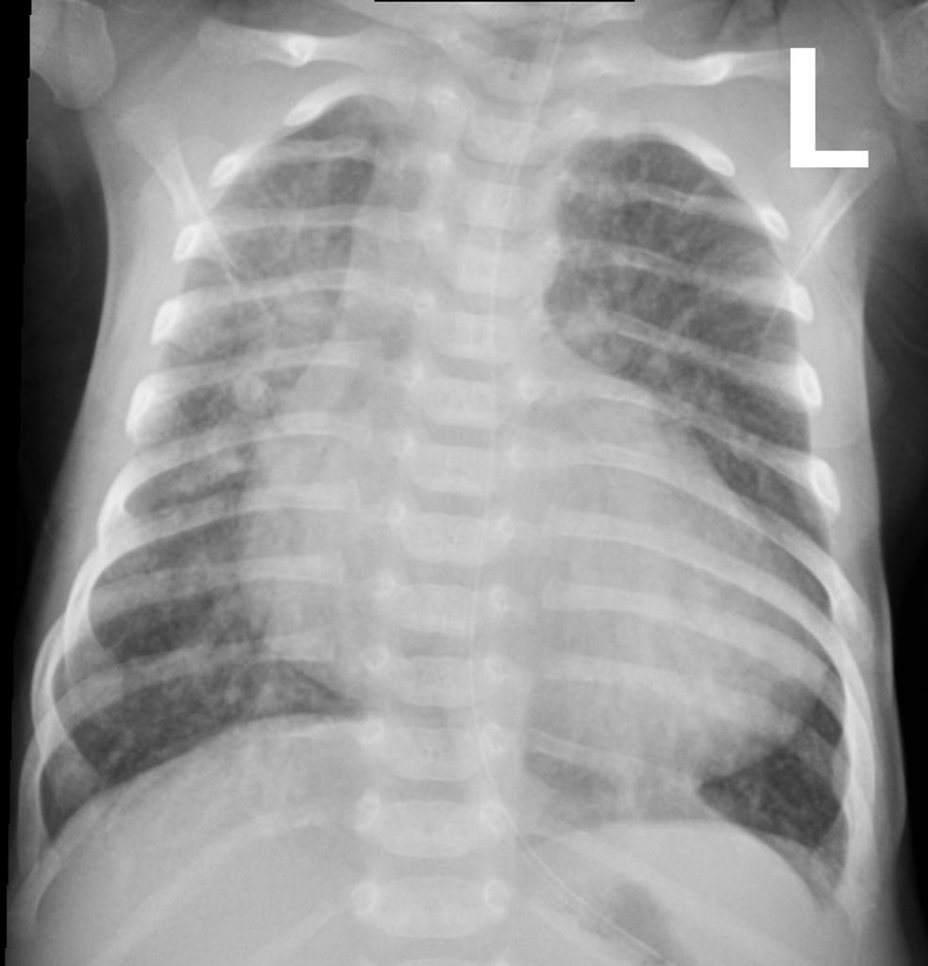

Slide 21
Case study 1
Echocardiography reveals D-transposition of the great vessels with a 5mm ventricular septal defect and patent ductus arteriosus. A prostaglandin E1 infusion is started. The infant is mechanically ventilated and subsequently transported to a pediatric cardiac surgical specialty center. An arterial switch procedure is performed successfully. He is discharged home 3 weeks later.

Slide 22
Initial Stabilization
ABC’s: Volume resuscitation, ionotorpic support, correction of metabolic acidosis, r/o sepsis
Intubate if needed, titrate Fi02 to keep Sp02 80%-85% to prevent pulmonary overcirculation
Placement of umbilical lines
Infants who present in shock within the first 3 weeks of life, consider ductal dependent lesions
Use of PGE1 (0.025 to 0.1mcg/kg/min)

Slide 23
Stabilization for Transport
Reliable vascular access
Intubation if on PGE1, OG placement
Oxygen delivery, Sp02
Monitor HR, tissue perfusion, blood pressure, temp and acid-base status
Calcium and glucose status .

Slide 24
Case study 1
Neonates and infants with central cyanosis or cardiac failure are an emergency – irrespective of their clinical state.

Slide 25
TETRALOGY OF FALLOT
TOF is the most common cyanotic congenital heart defect. ~10%.
Cyanosis pulmonary stenosis.
A pulmonary stenosis murmur.
A single S2 and right ventricular impulse at LSB ,
Hypoxic (Tet) spells:
Hyperpnea occurs with gradually increasing cyanosis and loss of the murmur.
prolonged unconsciousness and convulsions,
hemiparesis, or death may occur
Increased risk for cerebral thromboembolism and Cerebral abscesses.

Slide 26
Case Study
You have responded for a 3 month old male infant because the parent’s state he is having episodes of excessive crying followed by limpness, cyanosis and passing out. He was born at 41 weeks of gestation by C-section because of failure to progress. Apgar scores of 7 and 8 at 1 and 5 minutes, respectively. His cyanosis increases with crying.
On Exam you note that he is alert and active in respiratory distress, with visible cyanosis. His lungs are clear. He has normal peripheral pulses with cyanotic nail beds and mucous membranes. VS: T 37 (98.6), P164, RR 64, oxygen saturation 83% on blow-by oxygen.

Slide 27
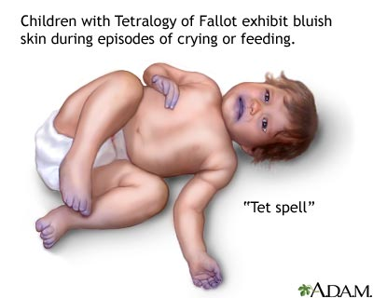
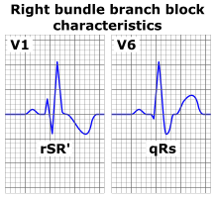
Tetralogy of Fallot
“Tet spell”
  Hyperpnea
  Worsening cyanosis
  Disappearance of murmur
  RBBB pattern on ECG

Slide 28
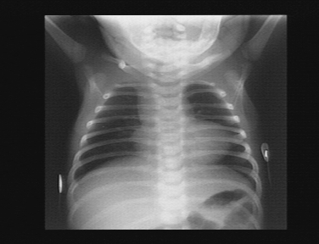
Tetralogy of Fallot
Small to N cardiac silhouette
Decrease pulmonary vasculature

Slide 29
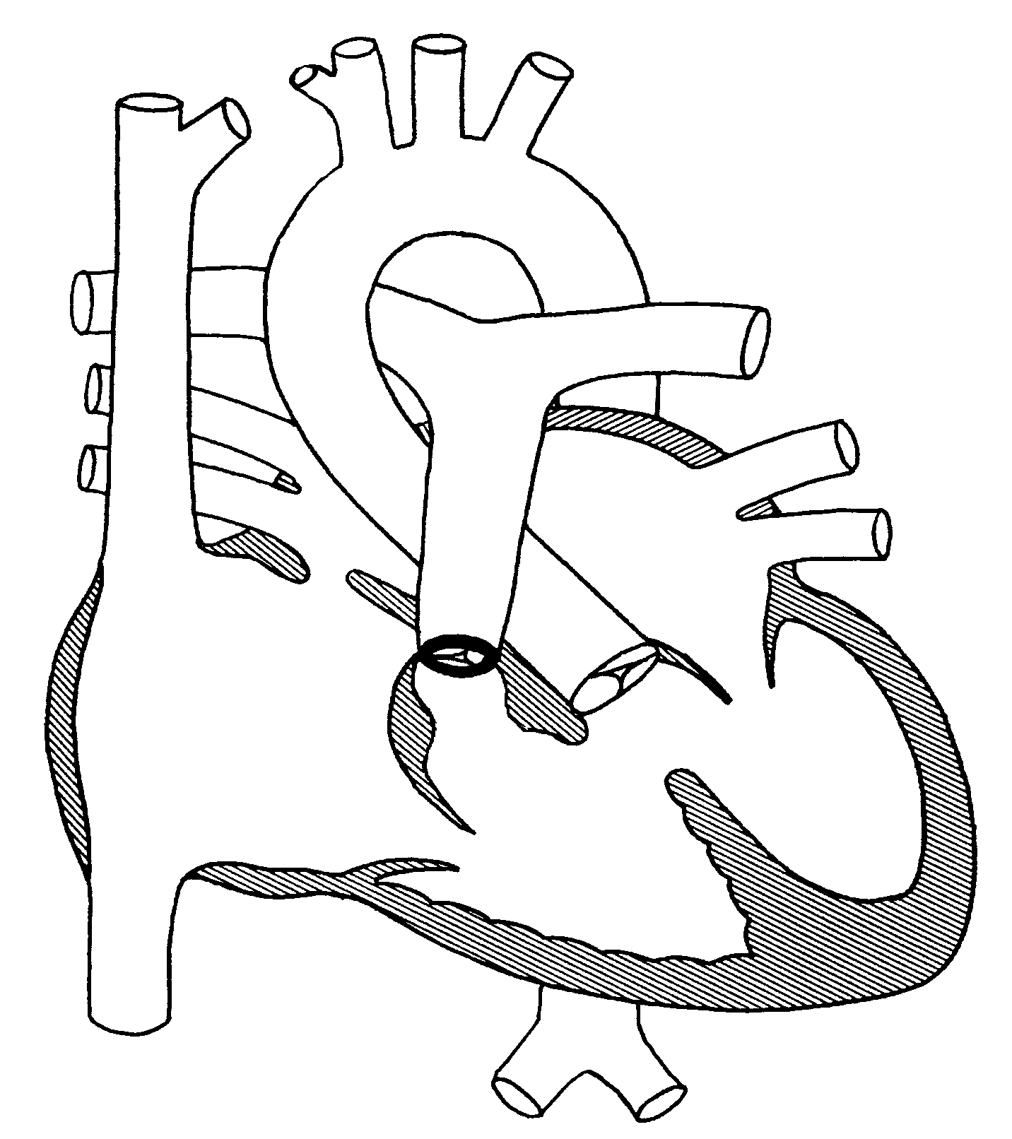
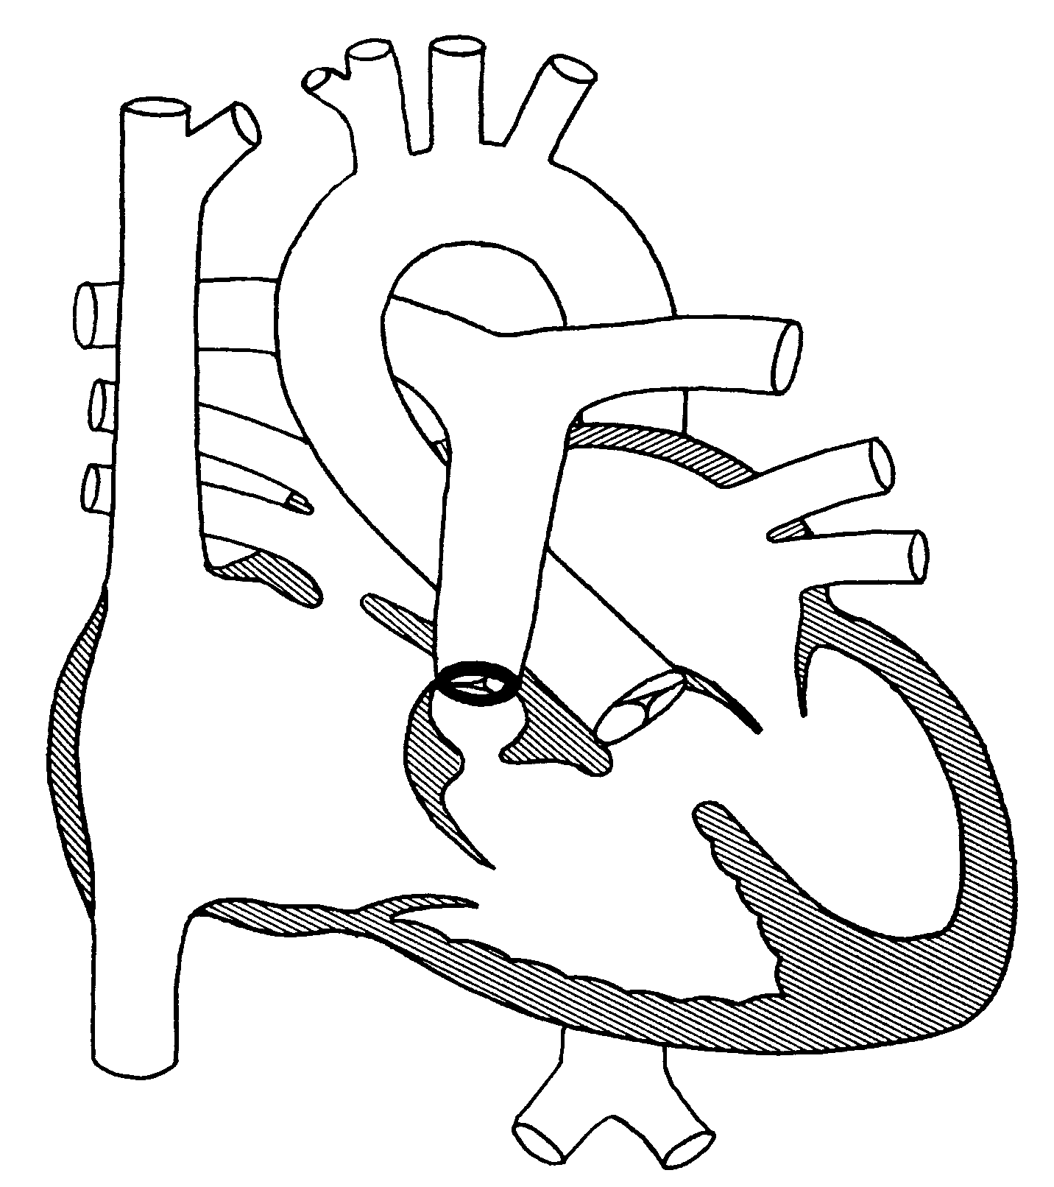

Slide 30
SVR

Slide 31
PVR

Slide 32
Treatment of Tet Spell
Quiet, calm environment
Knee-chest or squatting position
  increases afterload thus increasing systemic resistance
Oxygen
Morphine
  to reduce spasm and/or sympathetic stimulation
Phenylephrine
  increases afterload by promoting systemic vasoconstriction
Crystalloids
  consider small volume challenge (5-10 cc/kg) to increase preload and SVR
NaHCO3
  to treat acidosis
Oxygenate to target saturation levels
Notes:
morphine: start with 0.1 mg/kg IM then start IV once have access
Propranolol 0.05 mg/kg IV
can also consider esmolol 0.5 to 1.0 mg/kg IV
both followed by continuous infusions
Phenylephrine: 10 ug/kg initial followed by infusion

Slide 33
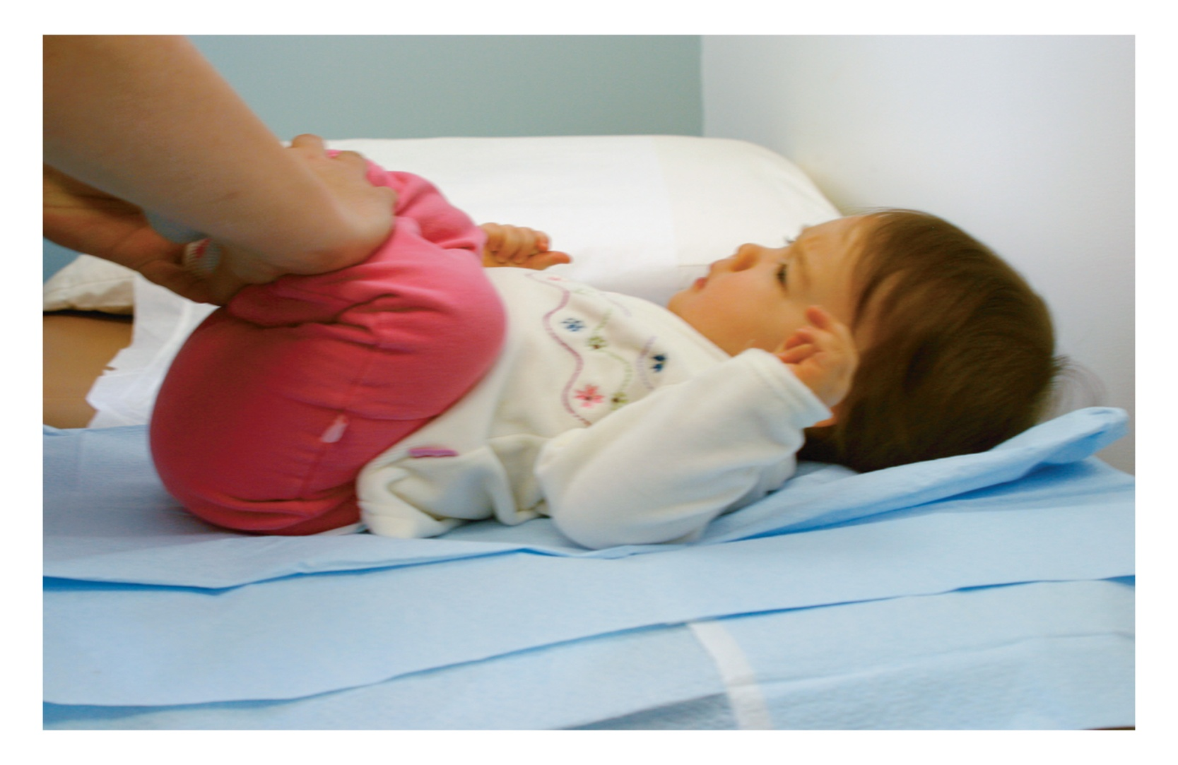

Slide 34
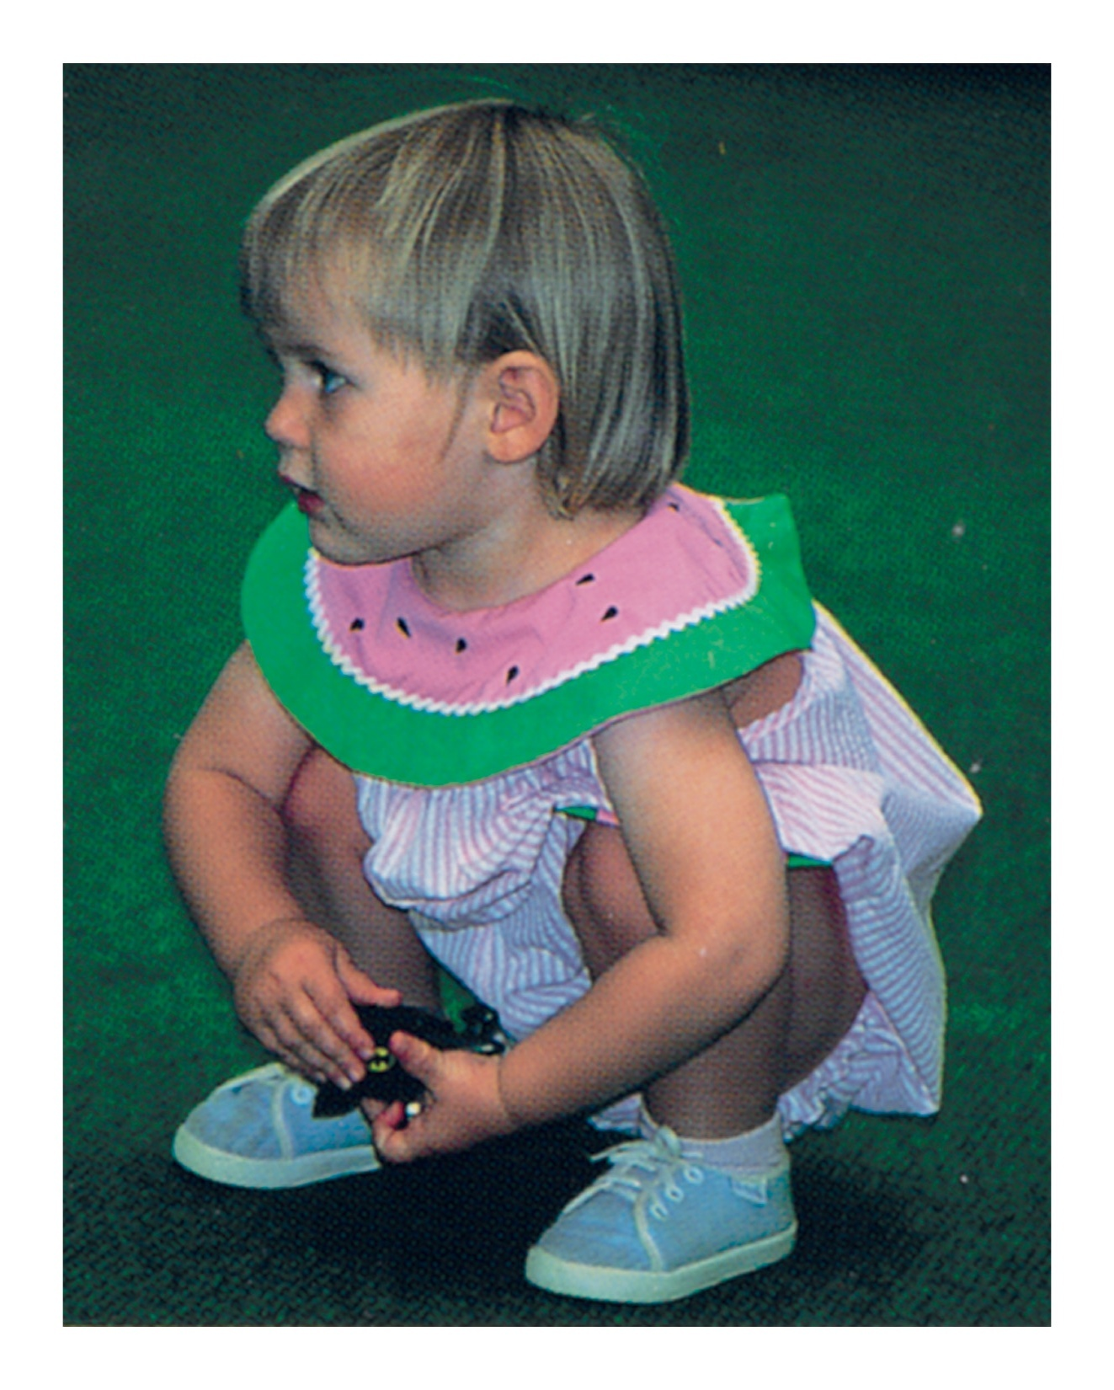

Slide 35
Squatting
Common with unrepaired TOF
Increases oxygen saturations
Angulation and kinking of femoral arteries with increased SVR, decreasing the R->L shunt

Slide 36
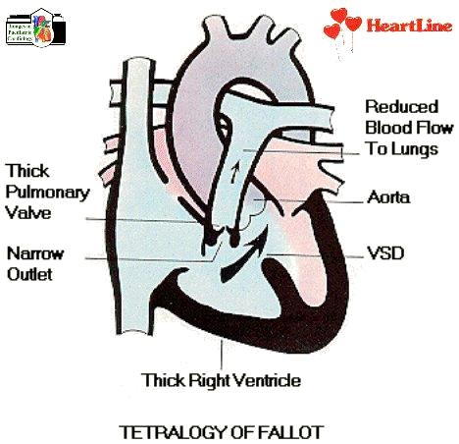
Hypercyanotic Spells ( TET spells)
Morphine
Hypovolemia
Fluid
Syncope
⬆ Agitation
Tachycardia
Oxygen
Impaired RV
filling
⬆ Cyanosis
Knee-chest
⬆Rt➔ Lt
shunt
⬆RVOT
obstruction
⬆ PVR
Phenylepherine
⬆ Age

Slide 37
Cyanotic Spells
Increase systemic vascular resistance
Squat/Knee chest position
Ketamine 1-2mg/kg IV
Neosynephrine 0.02mg/kg IV
Tachycardia Propranolol 0.1mg/ Kg IV
Release of infundibular spasm
Irritability Morphine 0.2mg/ Kg S.C or IM
Hypoxia Oxygen
Dehydration Volume
Acidosis NaHco3 1mEq/ Kg IV

Slide 38
PULMONARY ATRESIA
  Early cyanosis
  Ductus dependant lesion
  Wide PFO or ASD is needed for right to left shunt (Atrial level)
  If VSD is absent, usually hypoplastic RV is found

Slide 39

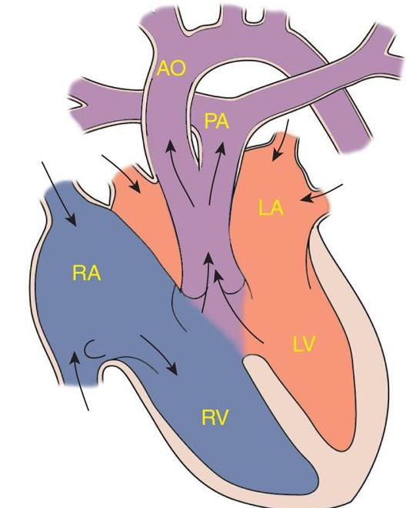
TRUNCUS ARTERIOSUS
less than 1% of CHD

Slide 40
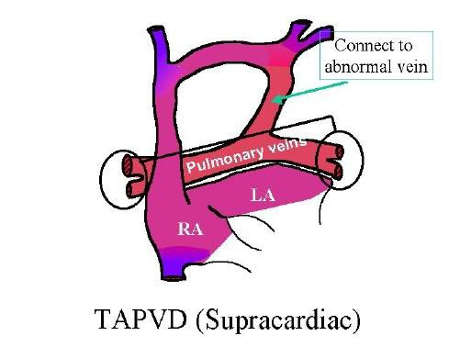
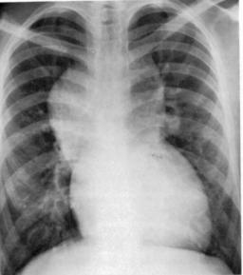
TOTAL ANOMALOUS PULMONARY VENOUS DRAINAGE
Blood flow from Lungs is drained to RA instead of LA.

Slide 41
Management of Neonates with Cyanotic Heart Diseas
Treatment of Shock:
1- A, B, C,…..
  Fluid Therapy and Acidosis Correction.
  IV Vasoactive Drugs:
Dopamine, Dobutamine,
Epinephrine,
Isoproterenol,
Amrinone,
Phenylephrine.

Slide 42
Management of Neonates with Cyanotic Heart Diseas (cont…)
  Prostaglandin E1 infusion:
  Should be started as soon as ductus dependent lesion is suspected even before echocardiography confirming the diagnosis.
Dose: 0.02 – 0.1 micrograms / kg / min.
Side effects as apnea, hypotension, and fever should be anticipated.
Treatment of CHF :
Digoxin,
Furosemide, Chlorothiazide, Spironolactone,
Captopril.

Slide 43
Management of Neonates with Cyanotic Heart Diseas (cont…)
Therapeutic Catheterization:
balloon atrial septostomy,
pulmonary and aortic valvuloplasty,
pulmonary artery angioplasty,
aortic coarctation angioplasty,
closure of systemic-to-pulmonary arterial collateral vessels.
Surgical Procedures:
Palliative surgeries.e.g pulmonary artery banding.
    Corrective surgeries.
    Neonatal heart transplantation.

