Slide 1
Demonstration of proper urine sample collection, using and interpretation of urine dipstick
Prepared by :
Dr. Salma Elgazzar
MRCPI-pediatrics Master’s degree in Pediatrics Alexandria University

Slide 2
Learning objectives
Recognize the value of urine analysis as a screening analysis of renal and non renal disease.
Recognize types of urine specimens & methods of collections.
Differentiate between macroscopic and microscopic urine examination.
Identify reference values for a normal urine analysis.
Interpret the meaning of abnormal values on a urine analysis.
Recognize nursing diagnosis and propose interventions for patients with abnormal urine test findings.

Slide 3

INDICATION OF URINE ANALYSIS
A urine analysis(UA) is a simple, non-invasive diagnostic tool that examines the visual, chemical, and microscopic properties of one’s urine.
It can be used to diagnose and monitor various medical conditions, including kidney disorders and function of the kidney; urinary tract infections; and systemic diseases, such as diabetes mellitus , inborn errors of metabolism , toxicology screening

Slide 4
TYPES OF URINE SPECIMENS & METHODS OF COLLECTION
The most common error in the management of UTI in children is failure to establish the diagnosis properly .
The method of collection depends on patient’s age.
For the child in nappies, urine can be collected by:
• a ‘clean-catch’ sample into a waiting clean pot when the nappy is removed. This is the recommended method.
The child can be encouraged to pass urine by gently rubbing their lower abdomen with gauze, soaked in cold water (Quick-wee technique) .
• an adhesive plastic bag applied to the perineum after careful washing, although there may be contamination from the skin or faeces ( not suitable for urine culture)
• a urethral catheter if there is urgency in obtaining a sample and no urine has been passed
• suprapubic aspiration, when a fine needle attached to a syringe is inserted directly into the bladder just above the symphysis pubis under ultrasound guidance; it may be used in severely ill infants.
In the older child:
urine can be obtained by collecting a midstream sample. Careful cleaning and collection are necessary, as contamination with both white cells and bacteria can occur from under the foreskin in boys, and from reflux of urine into the vagina during voiding in girls.
Notes:
First half of stream serves to flush out contaminating cells and microbes from urethra and perineum.
Early morning sample is preferred for microscopic examination & sediment because of highest concentrations of cells, not affected by exercise.

Slide 5
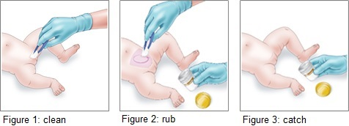
Clean catch urine collection

Slide 6

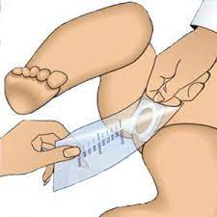
Adhesive bag urine collection

Slide 7
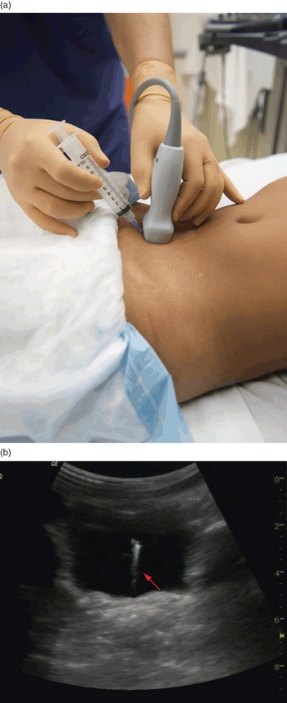
Suprapubic urine collection

Slide 8

Midstream clean catch early morning sample is preferred for microscopic examination of sediment as it contains highest concentration of cells and not affected by exercise.
Collected urine should be evaluated quickly ,no later than 2 hours after collection.
Proper cleaning of genitalia especially in girls.
Notes:
Precautions For Urine Analysis
Urine can be refrigerated for 6 to 8 hours.
At low temperatures, there will be precipitation of amorphous urates or phosphates.
Bring the refrigerated urine to room temperature before testing.
Urine collected for more than 2 hours may be rejected.
The decomposition of urine begins in 30 minutes at room temperature and 4 hours in refrigeration.
For longer periods, boric acid can be used as a preservative.

Slide 9
Macroscopic urinalysis uses a urine dipstick
Assess urine concentration, ph, and the presence of blood, protein, glucose, ketones, and leukocytes (via leukocyte esterase reaction)
Sensitive to presence of hemoglobin (or myoglobin); there are few false-negative test results but many false-positive results.
The nitrite test may detect bacteriuria if the bacteria can reduce nitrate to nitrite and have sufficient urine contact time.
Microscopic urinalysis
Confirm pyuria and hematuria as well as detect casts and crystals.
Proteinuria can be more accurately assessed by a spot urine
Protein/creatinine (upr/cr) ratio in a single urine specimen, preferably from a first-morning void. This value correlates well with 24-hour urine protein excretion.

Slide 10


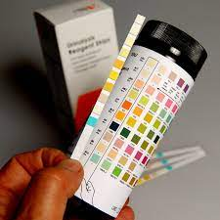

Slide 11
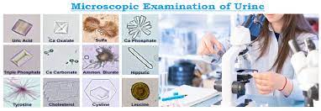

Slide 12
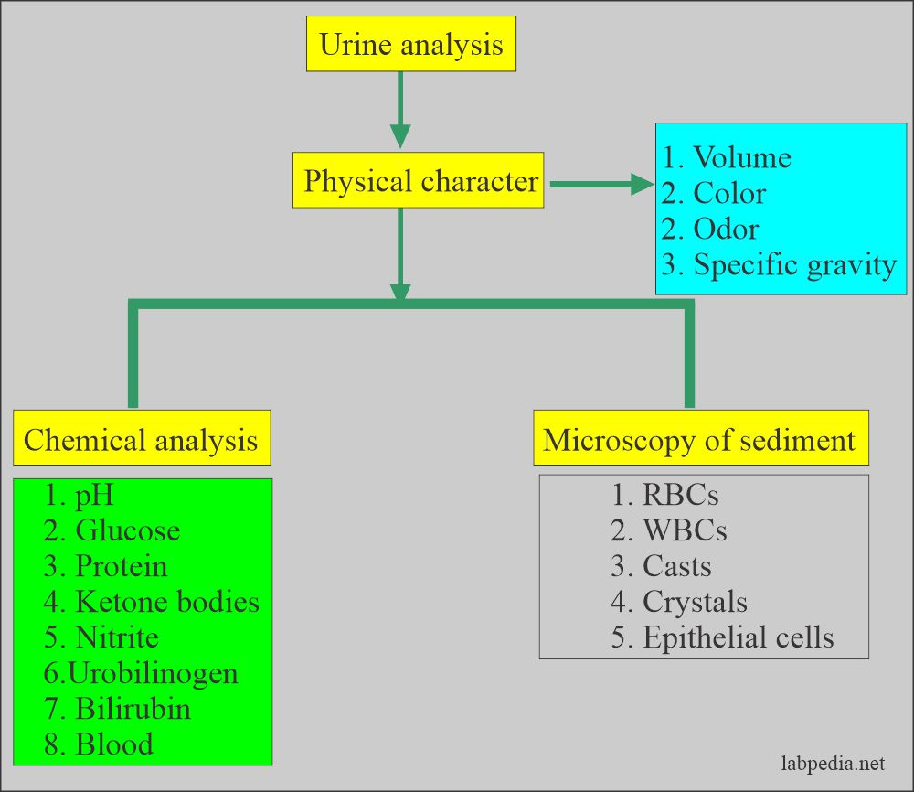

Slide 13
Urine Normal Values Summary
Urine normal values are:
Urine substances to be checked | Normal values | Collection timings | Significance
Physical characteristics
Color | Variable Pale-yellow to dark amber | A random sample | Red color urine Check for hemoglobin
Odor | Faint aromatic | A random sample | Urine from a diabetic patient has a fruity (acetone) odor.
Volume | Normal range = 800 to 2000 mL | A random sample 24-hour urine sample | Polyuria increased urine output Polyuria with normal BUN and creatinine. Oliguria <500 mL
Blood | Negative | A random sample | It is seen in various conditions of the urinary tract

Slide 14
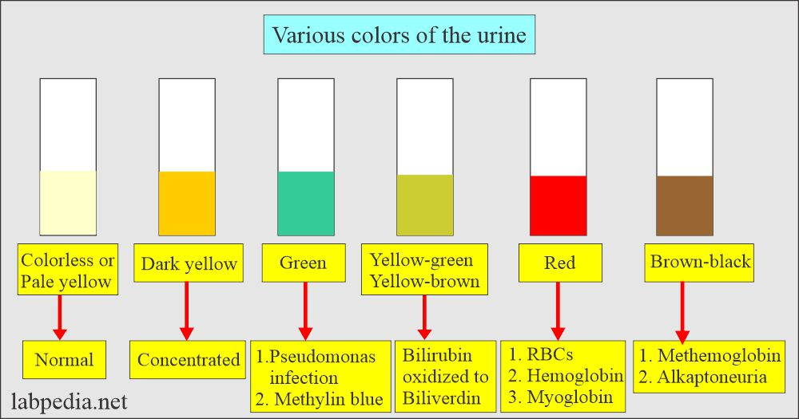

Slide 15
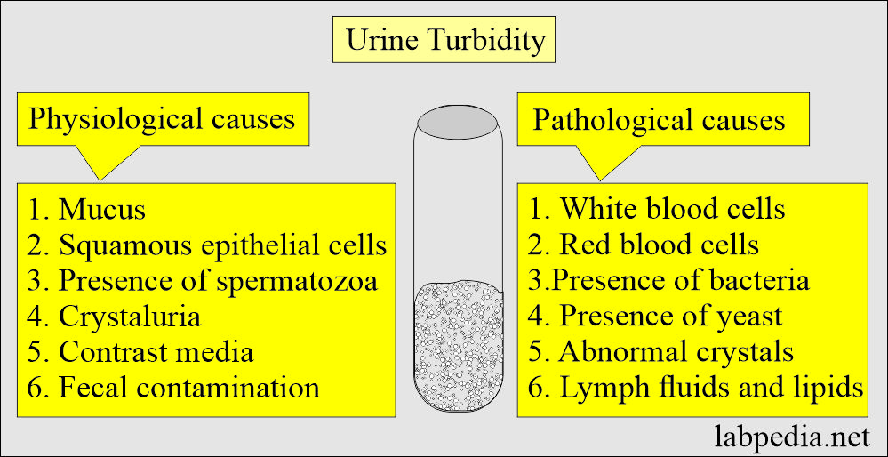

Slide 16
Various causes of the odor of urine:
Various types of odor (smell) | Etiology of the odor
Aromatic | Normal
Fruity, sweet | Ketone (in diabetes mellitus) Starvation Vomiting
Mousy (musty odor) | Phenylketonuria
Foul, ammonia-like | Bacterial contamination Urinary tract infection
Maple syrup | Maple syrup urine disease
Fetid odor | Infection may be due to E.Coli.

Slide 17
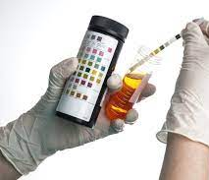
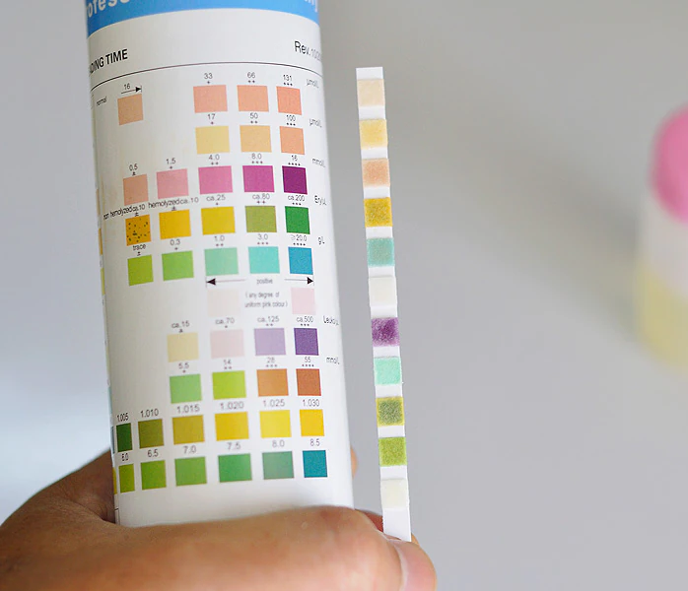
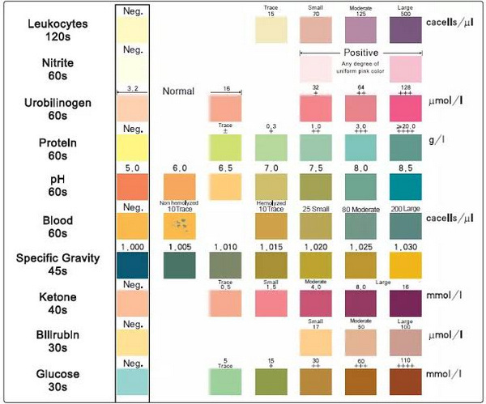
Chemical analysis
The presence of normal & abnormal chemical elements in the urine are detected using dry reagent strips.
The chemical reaction results in a specific color range.
It is a semiquantitive method depends on the degree of the color appears, so it gives estimation of the amount of the substance not accurate measurement.
Notes:
Bilirubin ,glucose ,ketones, proteins, blood, nitrites ,leukocyte esterase are abnormal constituents of the urine

Slide 18
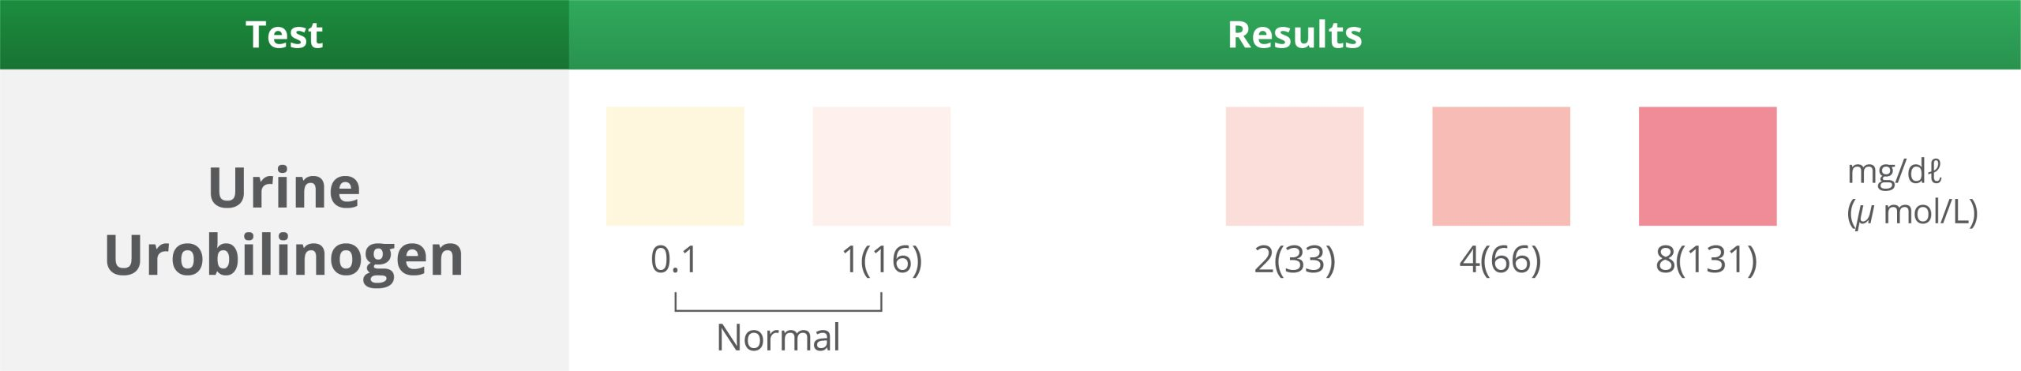
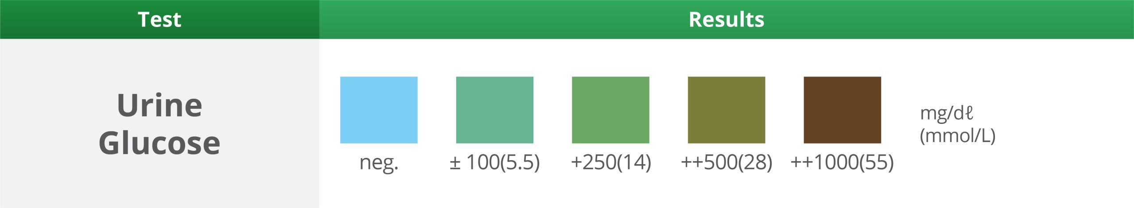
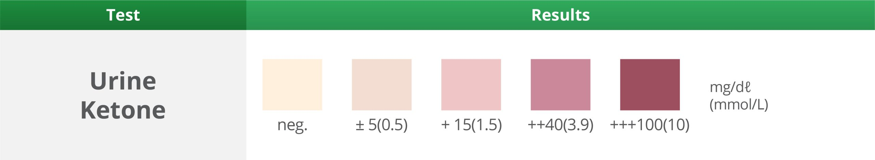

Slide 19
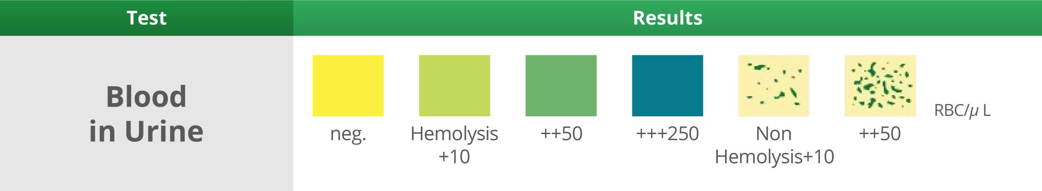
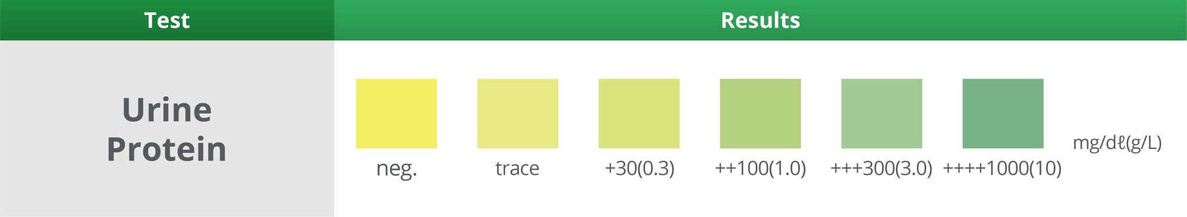

Slide 20

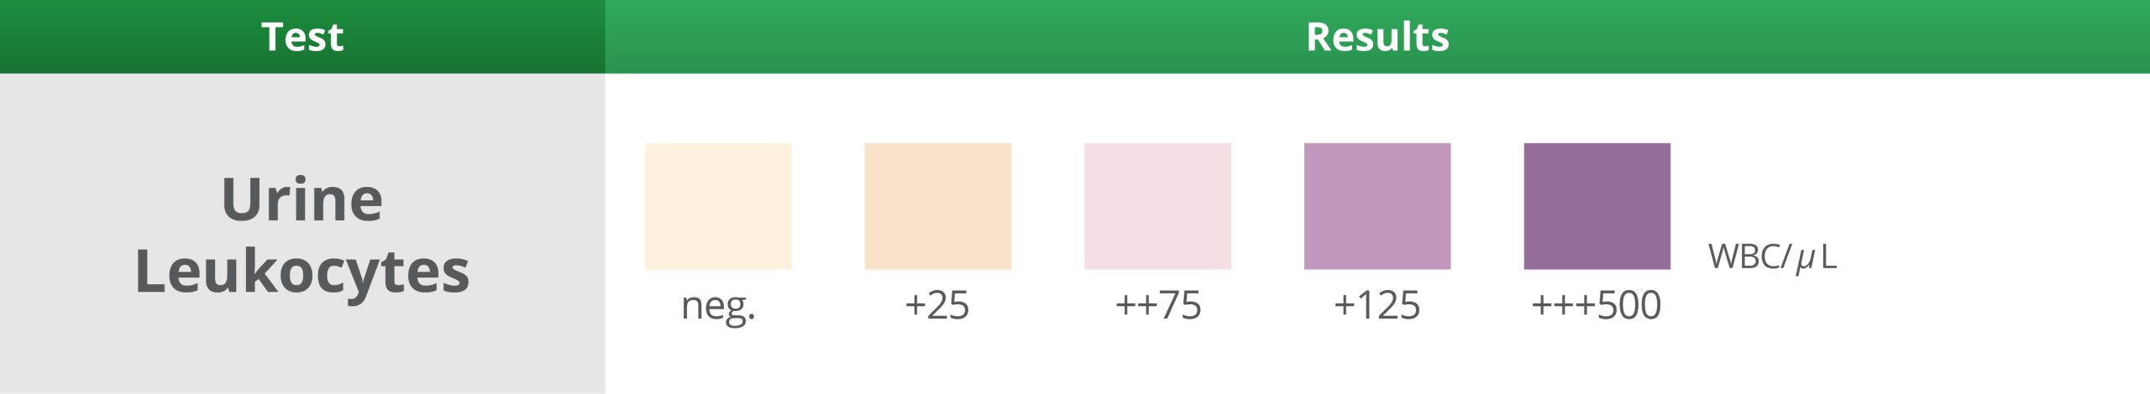

Slide 21
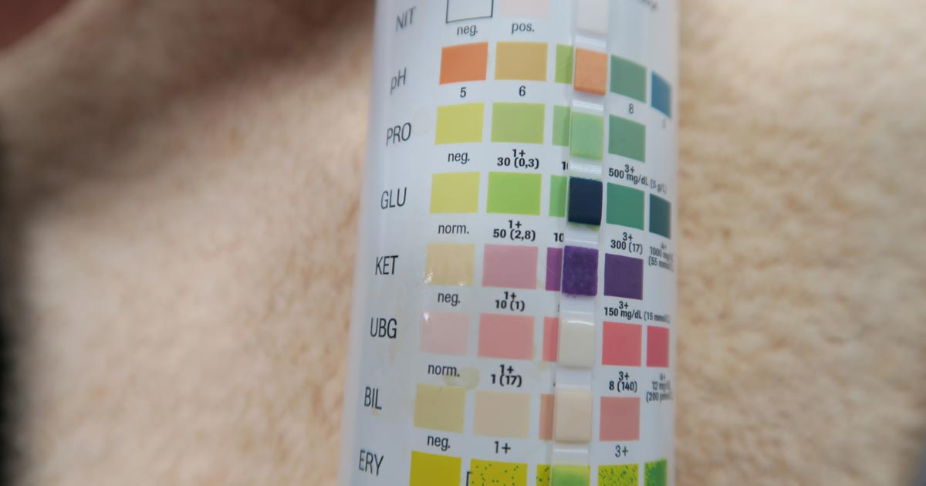

Slide 22
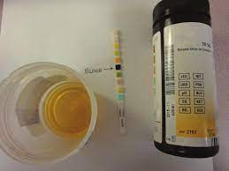
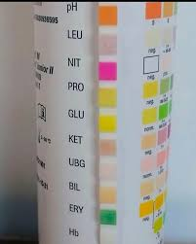

Slide 23
Urine substances to be checked | Normal values | Collection timings | Significance
pH | 4.7 to 7.7 Average = acidic 6.0 | A random and fresh sample | Urine pH never reaches 9 In the case of pH 9, test the fresh sample | Acidic urine: High protein diet Metabolic and respiratory acidosis 2.Alkaline urine: Vegetarians Metabolic and respiratory alkalosis Bacteria which split urea to ammonia ( alkaline)
Specific gravity | 1.008 to 1.030 Average = 1.018 1.012 to 1.025 Concentrated urine = 1.025 to 1.030+ Dilute urine =1.001 to 1.010 Infant <2 years = 1.001 to 1.018 | A Random sample 24-hour urine sample | Specific gravity is the measurement of the kidneys’ ability to concentrate urine. | Low: Tubular disordres Polyuria High: dehydration
protein | Qualitative =nil Quantitative = 0 to 0.1 g/24 hours | 24-hour urine sample | Indicate renal disease May be transient

Slide 24
Normally glucose is not present in urine
Causes of glucosuria:
Diabetes mellitus ( with high blood glucose level)
Proximal tubular disorders ( normal serum blood glucose level)
Normally ketones are not present in the urine
Causes of ketonuria:
DKA
Starvation states ( prolonged fasting , anorexia nervosa)
Dipsticks detect mainly albuminuria and are less sensitive for other forms of proteins.
It offers only a rough qualitative and semi-quantitative measurement of urinary protein excretion, so it should be confirmed by additional testing.

Slide 25
A positive dipstick for blood may be :
Hematuria
Hemoglobinuria ( intra vascular hemolysis)
Myoglobinuria ( muscle injury or disease)
This means positive dipstick test for blood should be followed by microscopic examination to detect RBCs

Slide 26
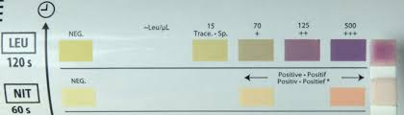
leucocyte esterase & nitrite

Slide 27
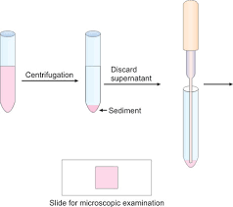
MICROSCOPIC EXAMINATION
We will examine for:
Cells
Casts
Crystals
Microorganisms

Slide 28
Cells:
RBCs ( number & dysmorphic RBCs)
WBCs ( number), may indicate inflammation or infection
Epithelial cells ( epithelial cells may appear in urine after being shed from anywhere within the genitourinary tract), present in urine in few numbers.

Slide 29
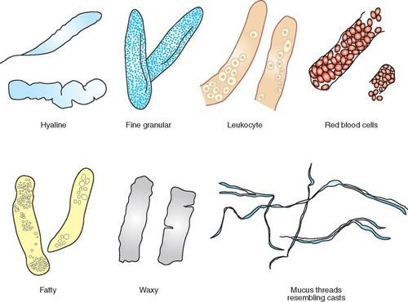
Casts:
Cylindrical structures formed in the renal tubules.
Formed only in distal convoluted tubules and collecting ducts.

Slide 30
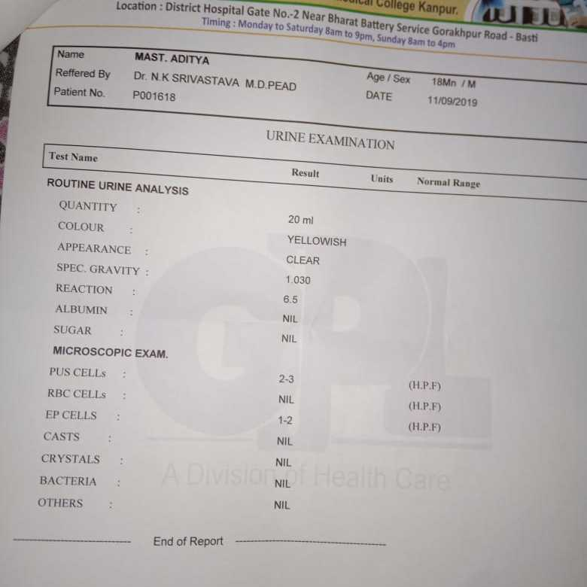

Slide 31
THANK YOU

