Slide 1
Development and behavior
Dr Faten Zaidan

Slide 2
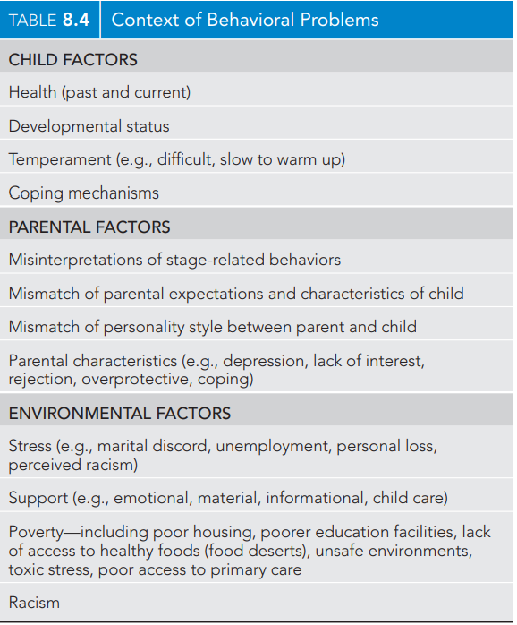
Factors to be considered while assessing development
Definition of normal development:
Parallel to the changes in the developing brain (i.e., cognition, language, behavior) are changes in the physical development of the body.

Slide 3
The history
Screening is based on the :
history
physical and developmental examination
interpretation and comparison to normal child at the same age
General history:
Birth weight and duration of gestation.
Prenatal risk factors e.g. infectious, hypertension. •
Genetic factors: mental sub normality. •
Familial pattern of development. •
Perinatal factors e.g. fetal distress.
Condition at birth.
Postnatal development e.g. when beginning to smile. Sucking or swallowing difficulties, irritability etc.
Major illnesses, emotional deprivation, etc.
The previous development: Is he showing accelerated development ? or slowing of development (i.e. loss of attained functions) e.g. neurodegenerative diseases?
Developmental history:
Assess the mother’s understanding and memory.
Ask whether the baby shows a particular skill (e.g. smiles) and when he began to show it.

Slide 4
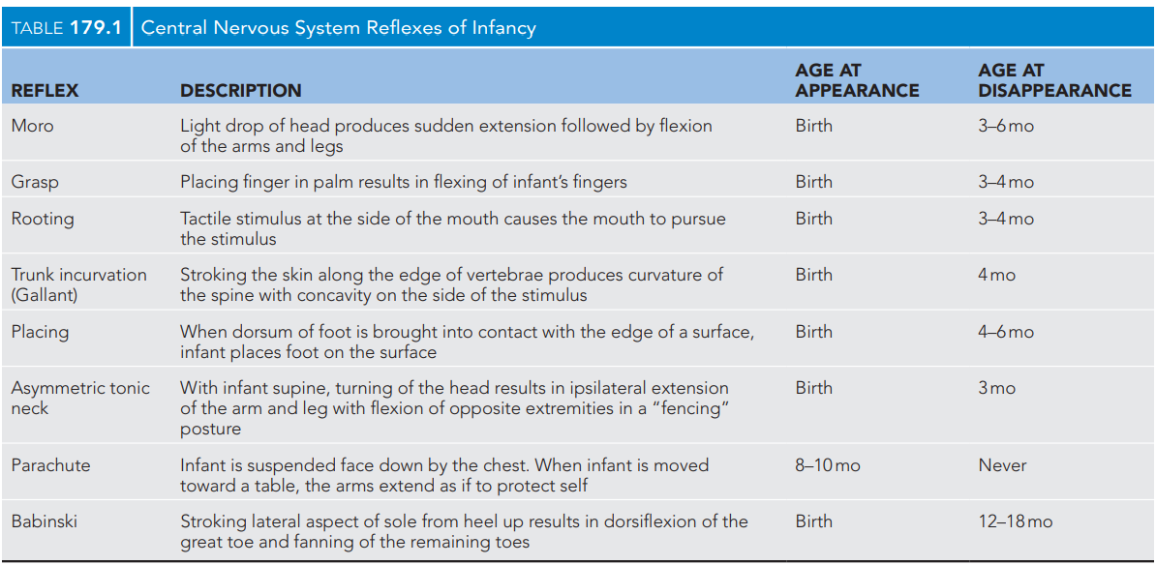
Primitive reflexes
Examination of the primitive reflexes provides assessment of the functional integrity of the brainstem and basal ganglia, indicating the normal maturation of descending inhibitory cerebral influences. Asymmetry or persistence of the primitive reflexes may indicate focal brain or peripheral nerve lesions

Slide 5
Moro reflex
The Moro reflex is elicited by allowing the infant’s head to gently move back suddenly (from a few inches off of the mattress onto the examiner’s hand), resulting in a startle, then abduction and upward movement of the arms followed by adduction and flexion. The legs respond with flexion.
1
2

Slide 6
Grasp reflex

Slide 7
Rooting reflex
The rooting reflex is elicited by touching the corner of the infant’s mouth, resulting in lowering of the lower lip on the same side with tongue movement toward the stimulus. The face also turns toward the stimulus.

Slide 8
Gallant reflex

Slide 9
Placing reflex

Slide 10
Asymmetric tonic neck
The asymmetric tonic neck reflex is elicited by placing the infant supine and turning the head to the side. This placement results in ipsilateral extension of the arm and the leg into a “fencing” position. The contralateral side flexes as well.

Slide 11
Parachute reflex
1
2

Slide 12
Babinski reflex

Slide 13
Sucking reflex
The sucking reflex occurs with almost any object placed in the newborn’s mouth. The infant responds with vigorous sucking. The sucking reflex is replaced later by voluntary sucking.

Slide 14
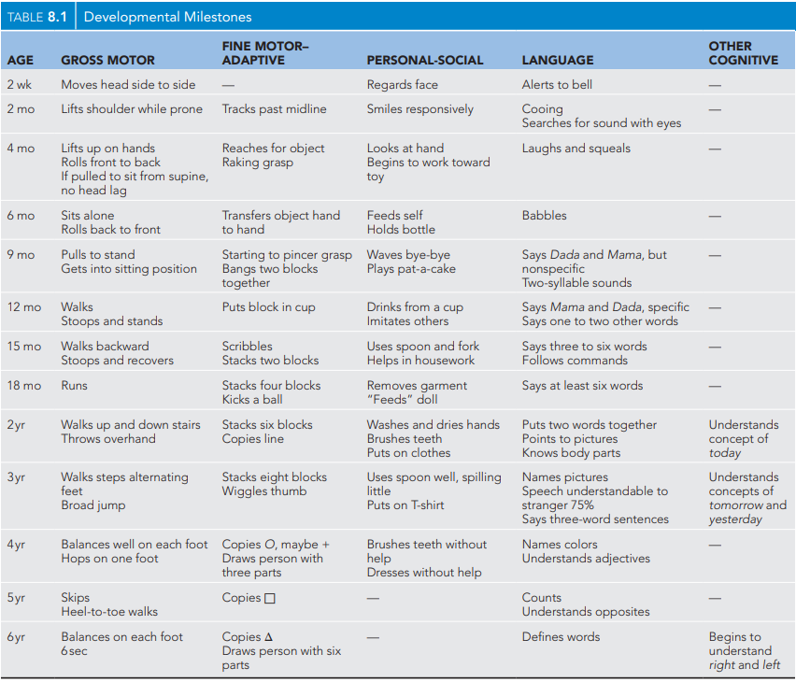

Slide 15
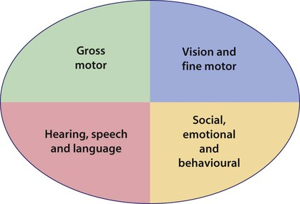

Slide 16
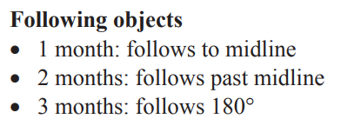
4 months old

Slide 17
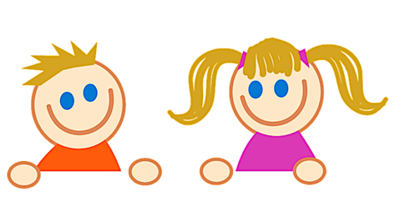
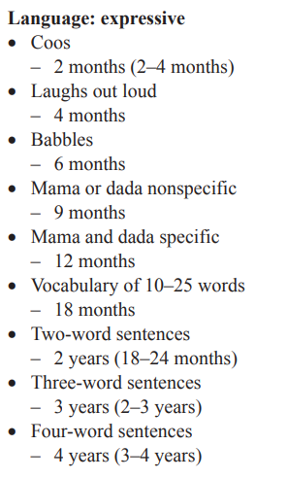
Speech and language

Slide 18
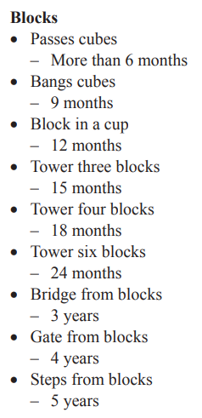
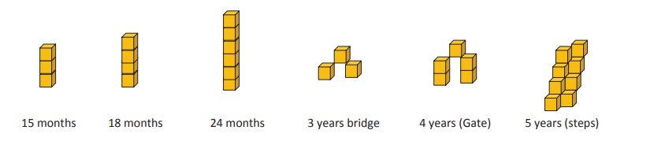
cubes

Slide 19
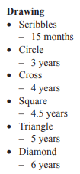
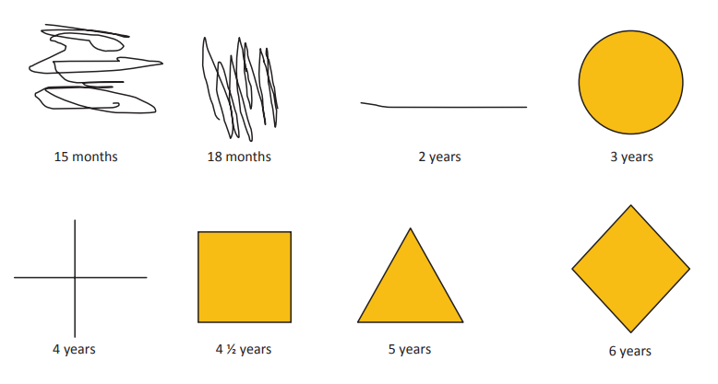
drawing

Slide 20
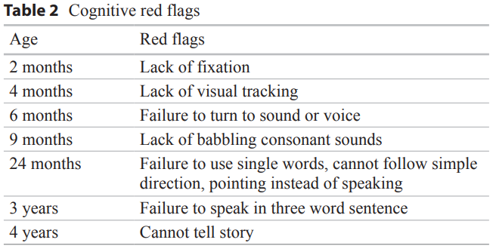
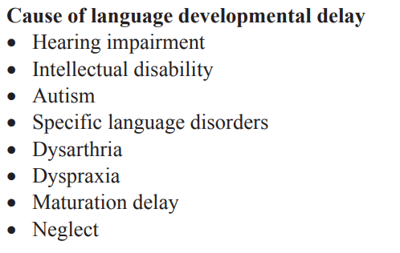
Red flags in development as per age

Slide 21
Bicycle & Scooter

Slide 22
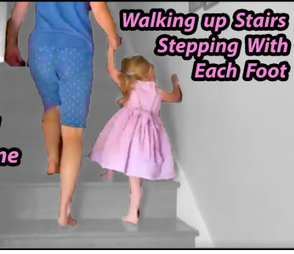
stairs
A) Going up:
18 months old: Two feet on each step with support
2 years old: Two feet on each step without support
3 years old: One foot on each step
B) Going down :
2 years old: 2 feet on each step
3 years old: one foot on each step without support

Slide 23
Behavioral Disorders

Slide 24
Infantile Colic
Infantile colic is defined as episodes of uncontrollable crying or fussing in an otherwise healthy infant
described as paroxysmal and may be characterized by facial grimacing, leg flexion, and passing flatus.
Peeks at age of 6 weeks and resolves at age of 3-4 months
It is diagnosis of exclusion
Fewer than 5% of infants evaluated for excessive crying have an organic etiology.
It has been associated with shaken baby syndrome, postpartum depression, parental guilt, and multiple physician visits
Infantile Colic 2016 ROME IV criteria
Age <5 months when the symptoms start and stop
Recurrent and prolonged periods of crying, fussing, or irritability that start and stop without obvious cause and cannot be prevented or resolved by caregivers
No evidence of poor weight gain, fever, or illness
Caregiver reports of crying/fussing for ≥3 hours per day on ≥3 days/week in a telephone or face-to-face interview
Total daily crying confirmed to be ≥3 hours when measured by at least one prospectively kept 24-hour

Slide 25
Full Examination is a must
The diagnosis of colic is made only when the physical examination reveals no organic cause for the infant’s excessive crying.
A thorough inspection may identify possible sources of pain (differential diagnosis):
skin lesions
corneal abrasions
hair tourniquets >>
nonaccidental trauma such as bruising or fracture
Cow’s milk protein intolerance
gastroesophageal reflux disease (GERD)
maternal substance use including nicotine
poor infant regulation including fatigue, hunger, parental anxiety, and chaotic and disruptive environmental conditions,

Slide 26


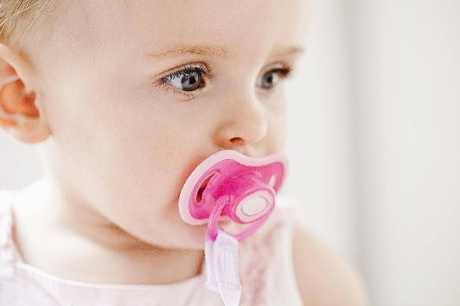
Approach
education (including the natural history and features of colic),
demystification, and a discussion of its natural course.
Techniques for calming infants include Dr. Harvey Karp’s “5 Ss”:
1- swaddling
2- side or stomach holding
3- soothing noises (such as shushing, singing, or white noise)
4- swinging or slow rhythmic movement (such as rocking, walking, or riding in a car)
5- sucking on a pacifier

Slide 27
Temper Tantrums
brief episodes of extreme or unpleasant behavior that appear disproportionate to the situation, typically in response to frustration or anger. Behaviors vary and may include whining, crying, screaming, stomping, flailing, head banging, hitting, throwing objects, and biting. Tantrums can instigate breath-holding spells in some children
It is normal because of increase in desiring independence,children are often unable to effectively communicate physical needs and emotions. Common triggers of temper tantrums include fatigue, hunger, discomfort, and frustration
Temper tantrums usually begin around the age of 12 to 18 months, worsen until 3 years of age, and taper off as children develop increased ability to control emotions, gain independence, and communicate wants and needs. Temper that continues past age of 4 years, last more than 15 minutes, or include harming self or others, is considered abnormal.
Tantrums can be more frequent, as well as more aggressive, in children with language delays or underlying conditions. Children with intellectual disability may exhibit tantrums when their developmental age is comparable to 3 to 4 years.

Slide 28
Separation anxiety disorder (SAD)
Separation anxiety is developmentally normal: in infants and toddlers until approximate age 3–4 years
Separation anxiety disorder: symptoms usually present after the age of 6 years
Excess worrying about own or parent’s safety, there will be Nightmares with themes of separation, somatic complaints, and school refusal
Social phobia – Feeling scared or uncomfortable in one or more social settings (discomfort with unfamiliar peers and not just unfamiliar adults), or performance situations

Slide 29
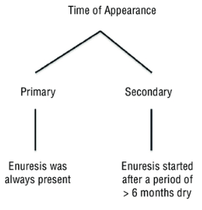
Enuresis
Repeated voiding of urine into clothes or bed at least twice a week for at least three consecutive months in a child who is at least 5 years of age
Types:
At 2–4 year, the child is developmentally ready to begin toilet training
Girls usually attain bladder control before boys
Bowel control typically is achieved before bladder control
INVESTIGATIONS
For most children with enuresis, the only laboratory test recommended is a clean catch urinalysis with specific gravity to screen for UTI, renal disease, and diabetes mellitus.
Urine culture, is based on the urinalysis, to look for UTI
A renal ultrasound and/or voiding cystourethrogram (VCUG) is indicated in children with daytime symptoms, recurrent UTI, or concerns for underlying urologic abnormality
MRI spine for neurologic findings (urinary retention, constipation, tingling sensation in lower limbs, back pain)

Slide 30
Causes of secondary enuresis:
chronic or recurrent UTI
diabetes mellitus or insipidus
Seizures
Constipation
neurogenic bladder
posterior urethral valves, ectopic ureter, vesicoureteral reflux
sleep disturbance such as OSA
pinworm infection
Psychosocial stressors (more common in primary enuresis)
mass impinging on the urinary system
Combined nocturnal and diurnal enuresis: usually due to congenital urinary tract anomalies.
Diurnal incontinence: the most common cause is a paediatric unstable bladder. May occur in girls with a history of sexual abuse.

Slide 31
Management
A) First line : Behavioural
Parent–child education and behavioral approach
Charting with rewards for dry nights
Voiding before bedtime
Night awakening 2–4 h after bedtime, while at the same time making sure that parents do not punish the child for enuretic episodes
If behavioural approach fail, Enuresis alarms is indicated for a period of 8–12 weeks
B) Second line : Medicine
Desmopressin acetate (DDAVP)
  Side effects:
  Relapse is high after discontinuation –
  Hyponatremia and may cause seizure due to water intoxication. patient must be educated not to consume an excess of fluids on any evening in which desmopressin is administered. A maximum of one cup of fluid should be offered at the evening meal, and no fluid at all within the 2 h preceding bedtime
Treat the cause and refer if needed
treat constipation if present

Slide 32
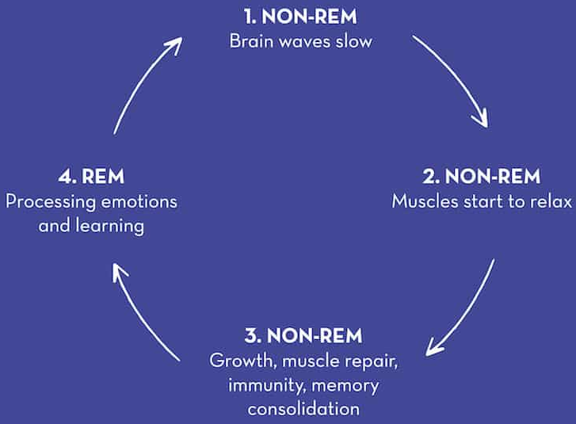
Abnormal Sleep patterns
Four stages
of sleep
Nightmares | Occur during REM sleep Child will wake up oriented and will remember the dream Reluctant to return to sleep Easy to arouse
Night terrors | Occur during stage 4 NREM sleep, first third of the night The child is screaming, unresponsive for few minutes, then fall back asleep again, and Will not recollect the episode in the morning Parents should provide reassurance during the episode and not vigorously that may awaken the child Rapid return to sleep
Sleepwalking and sleep talking | Stage 4 NREM sleep events, with no recalling in the morning
>> non-rapid eye movement (NREM)

Slide 33
Thank you

