Slide 1
Head Abnormalities
Dr Faten Zaidan

Slide 2
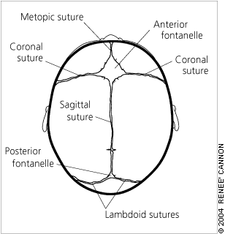
Normal Measurements First
Average of Head circumference at birth : 35 cm
Rate of growth :
1-3 months : 2cm/month
4-6 months : 1cm/month
6-12 months : 0.5cm/month
Anterior fontanelle closes between 9-18 months
Diameter is <3.5 cm
Posterior fontanelle closes between 2-4 months of age
Diameter is about fingertip in size

Slide 3
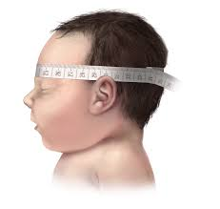
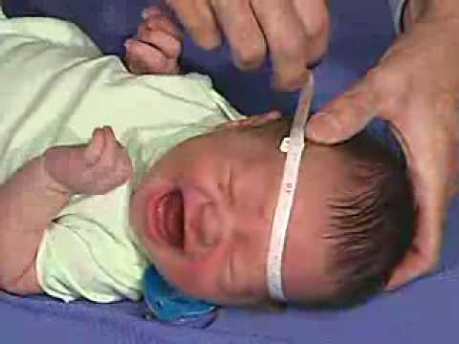
How to examine head circumference

Slide 4
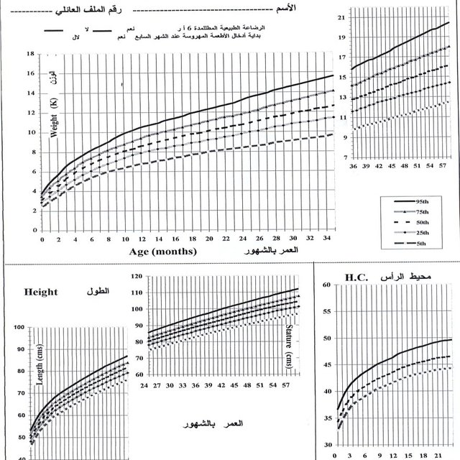

Slide 5
How can head growth be affected?
1) Early closure of sutures leading to asymmetrical head shape and stunted growth of brain.
>> CRANIOSYNOSTOSIS
2) Congenital diseases or syndromes characterized by either small head diameter or large head diameter
>> MICROCEPHALY
>> MACROCEPHALY
3) Obstruction in CSF flow causing enlargement of brain thus delayed closure of sutures
>> HYDROCEPHALUS

Slide 6
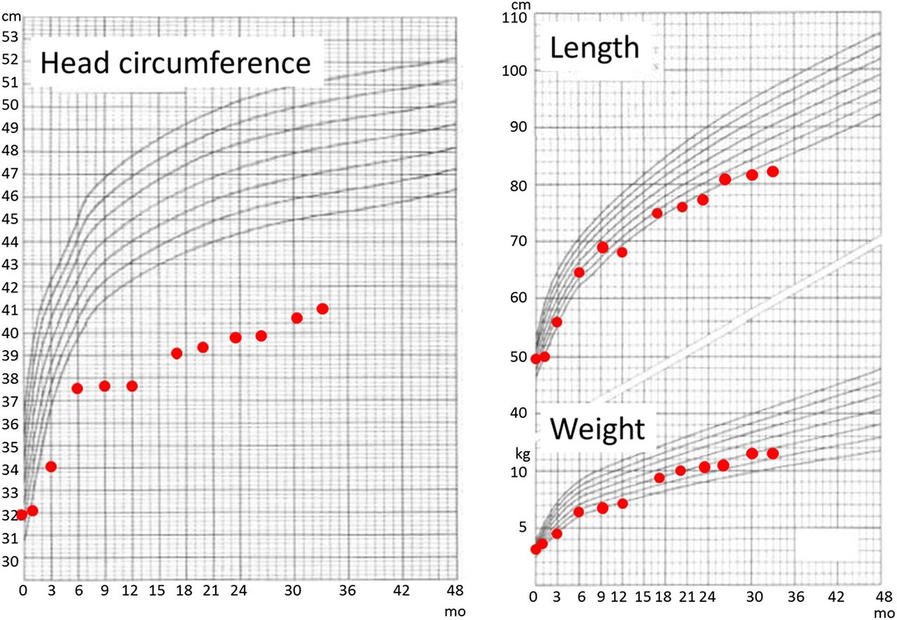
Microcephaly
Definition:
Head circumference below two
standard deviations below mean for
a given age and gender (≤ 5th percentile).

Slide 7
causes
1-Primary:
Trisomies :
Down Syndrome (Trisomy 21)
Patau (13) and Edward (18) Syndromes
Syndromes
Example: Cornelia de Langue Syndrome
2- Secondary:
- TORCH
Traumatic brain Injury
Post natal infections
Alcohol ( Fetal Alcohol Syndrome)

Slide 8
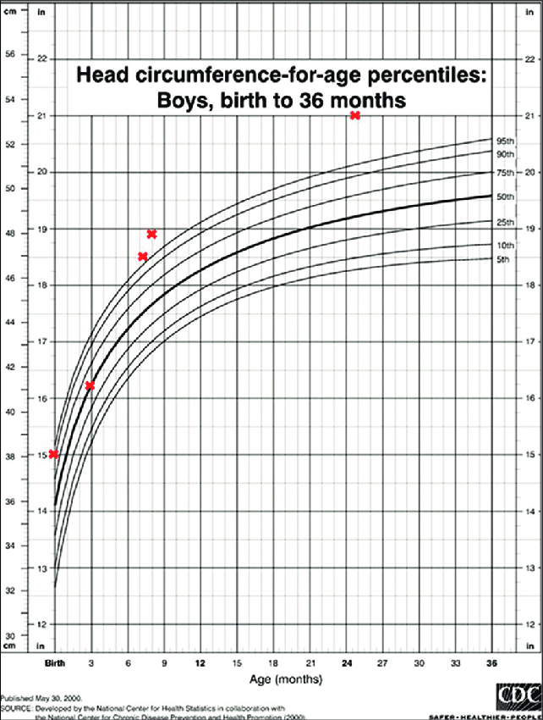
Macrocephaly
Definition:
Head circumference greater than
two standard deviations above mean
for a given age and gender (≥ 95th percentile).

Slide 9
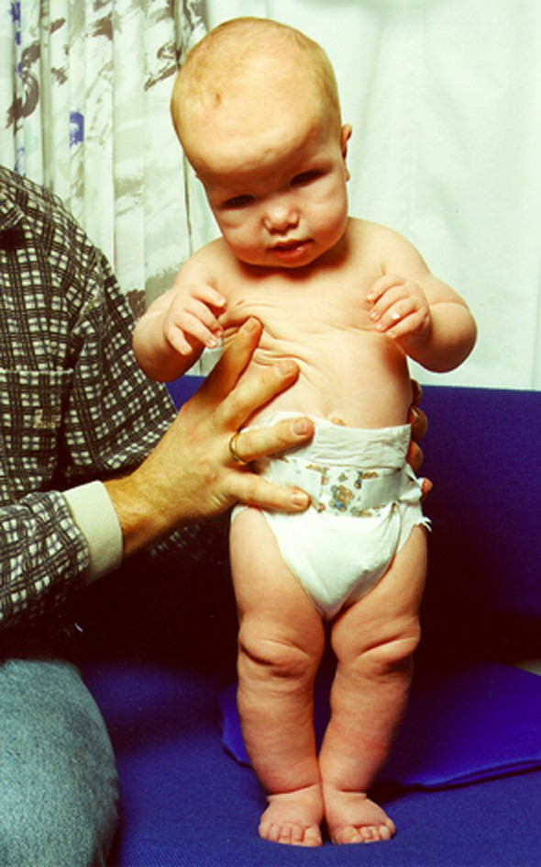
causes
1- Benign Familial Macrocephaly
Have a look at the Parents !
(head circumference will remain parallel to the expected growth line over serial measurements, normal intelligence)
2- Hydrocephalus
3-Megalencepahly (Syndromic)
Excess brain tissue due to either large brain cells or extra cells
Example : Sotos Syndrome (cerebral Gigantism)
4- Skeletal Dysplasia
Thickening of the skull caused by anemia, rickets.

Slide 10
HYDROCEPHALUS
Definition:
Excessive volume of intracranial cerebrospinal fluid causing ventricular dilatation.
Three main categories for pathophysiology:
Increase production of CSF
Obstruction in CSF Flow tract
Decrease Absorption of CSF
Remember:
CSF is produced in choroid plexus & spinal subarachnoid space (400-500 ml per day)
CSF is absorbed in arachnoid granulations

Slide 11
hydrocephalus
Obstructive
NonObstructive
Definition:
Type of hydrocephalus in which there is blockage somewhere in ventricular system causing accumulation of CSF

Slide 12
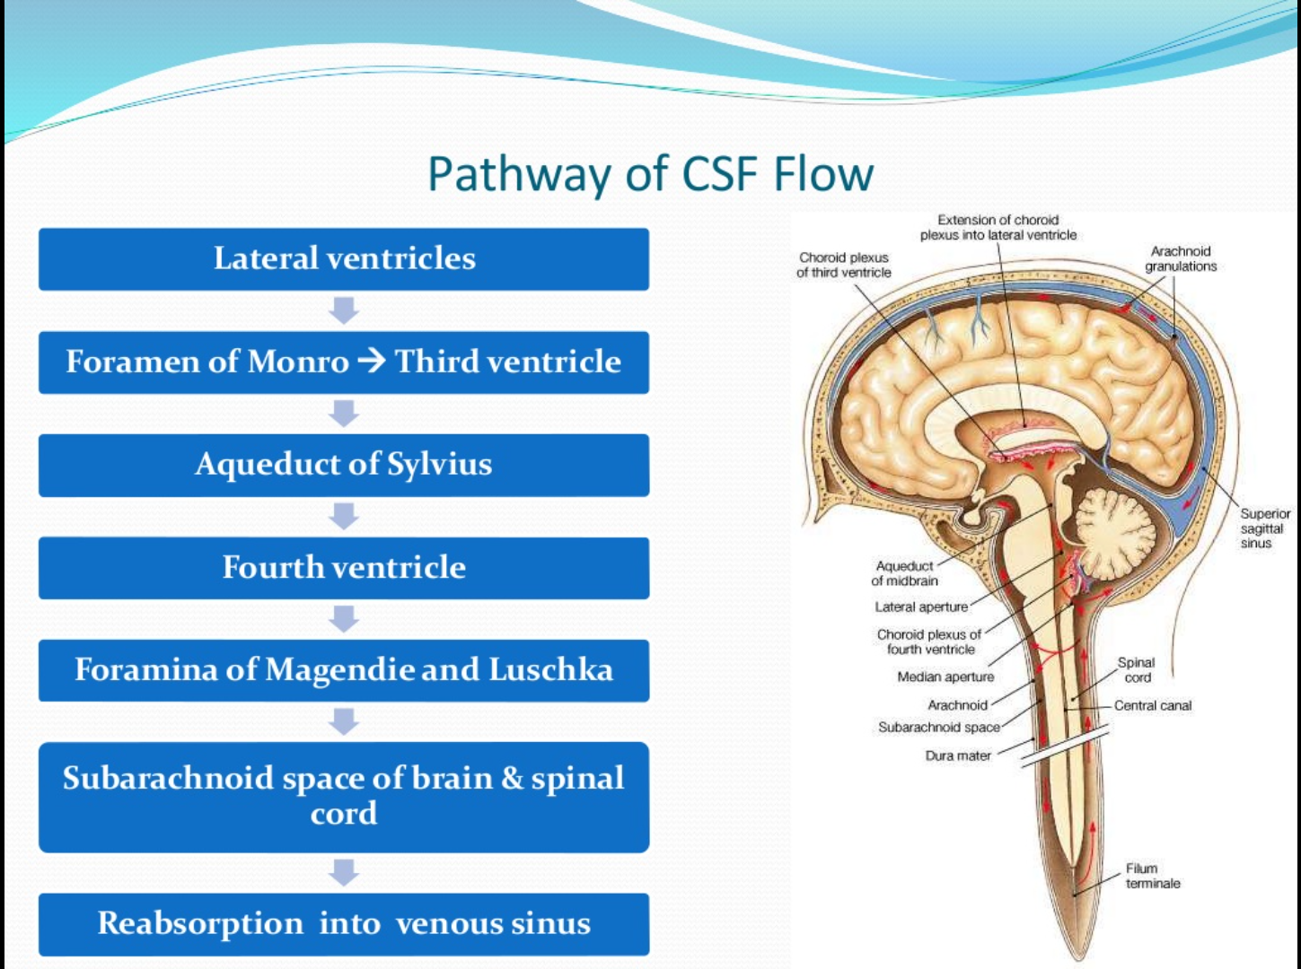
Obstructive
(Noncommunicating)

Slide 13
Causes of obstructive hydrocephalus
Acquired:
Posterior fossa tumor (These patients will present with ataxia, papilledema, headache)
Intraventricular clot
Abscess
Intraventricular hemorrhage (common in low birth preterm)
Congenital:
Congenital aqueduct stenosis
Dandy walker malformation

Slide 14
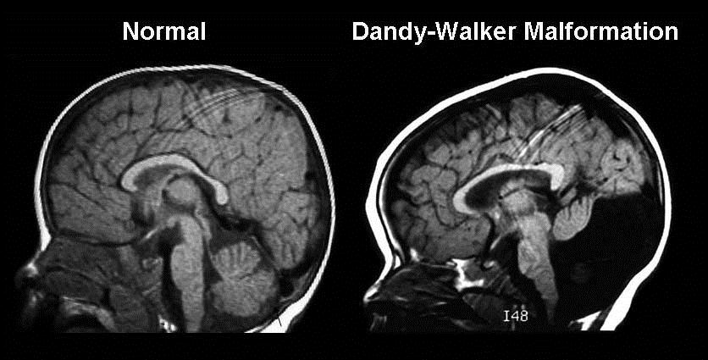
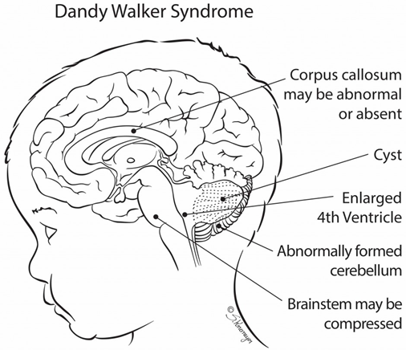
Dandy walker malformation
Consists of posterior fossa cyst connecting to the fourth ventricle
Along with complete or partial absence of cerebellar vermis
Causing hydrocephalus

Slide 15

hydrocephalus
Obstructive
NonObstructive
Definition:
Type of hydrocephalus is which there is either abnormality in CSF absorption (which occurs Arachnoid granulations) or overproduction of CSF.
CSF is freely flowing between ventricles and subarachnoid space

Slide 16
NonObstructive
(communicating)

Slide 17
Nonobstructive hydrocephalus
Causes of impaired CSF absorption
Meningitis
Example : CMV, Toxoplasmosis, TB, Bacterial
Subarachnoid hemorrhage
Intraventricular hemorrhage (common in low birth preterm)
Metabolic conditions
Management : treat based on the cause

Slide 18
Nonobstructive hydrocephalus
Causes of excessive CSF production
Choroid plexus papilloma
Carcinoma
Management
Surgical Removal
Posthemorrhagic hydrocephalus may occur post surgical removal due to high nature of blood vessels of these tumours.
Serial Xray follow ups along with permanent shunting will be required

Slide 19
Signs and symptoms of hydrocephalus
Symptoms:
decrease in activity or irritability
Lethargy
Drowsiness
Poor feeding
Poor weight gain
Most common symptom in older children is:
early morning headache with vomiting

Slide 20
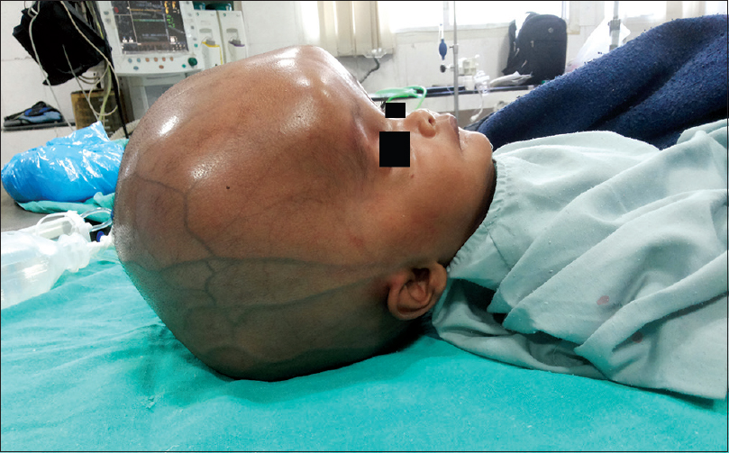

Signs and symptoms of hydrocephalus
Signs (neonates):
Excessive head growth rapidly crossing percentiles
Frontal bossing
Tense anterior fontanelle
Dilated scalp veins
Sun-set eyes

Slide 21
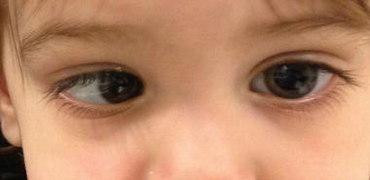
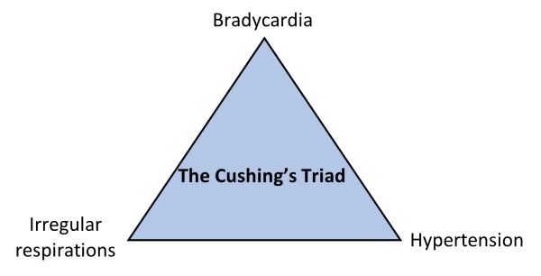
Signs and symptoms of hydrocephalus
Signs (older children):
Hyperreflexia
Hypertonia
Developmental Delay
Sixth nerve palsy
Cushing Triad (presenting high intracranial pressure)

Slide 22
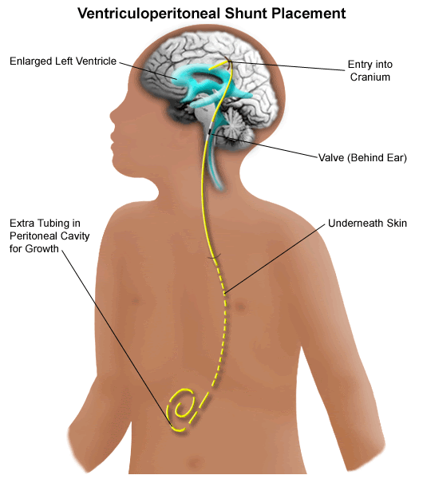
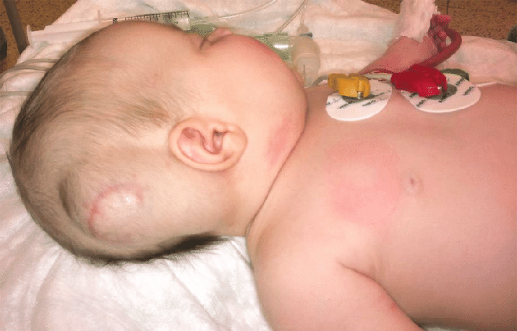
Management
Initially, patients should have regular follow up for serial head measurements and plot it on growth chart to make diagnosis.
Brain US through anterior fontanel for infants and MRI for older children are done to confirm hydrocephalus
Ventriculoperitoneal Shunting is the main treatment for hydrocephalus
Parent's counseling should be offered every clinic visit to observe for any early signs of VP malfunction

Slide 23
Complications of VP Shunt
Ventriculitis
Patient will present with fever and seizures. If VP shunt malfunctions, hydrocephalus signs will be also seen.
Most common organism
Staphylococcus Epidermidis
> Vancomycin

Slide 24
History
You will cover all parts of history focusing on :
1)Maternal history (fever, use of antibiotics, regular antenatal follow ups, result of antenatal US)
2)Neonatal History (admission in NICU, past medical and surgical)
3)Family History (any similar cases in family, family history of metabolic diseases or syndromes or developmental delay)

Slide 25
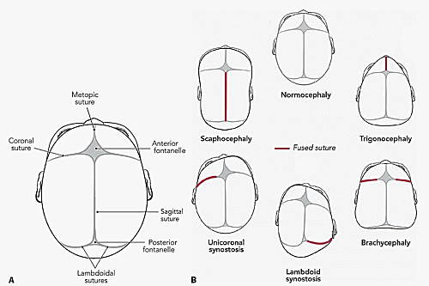
Abnormal Head Shape
CRANIOSYNOSTOSIS
The Skull will grow perpendicular to the suture line

Slide 26
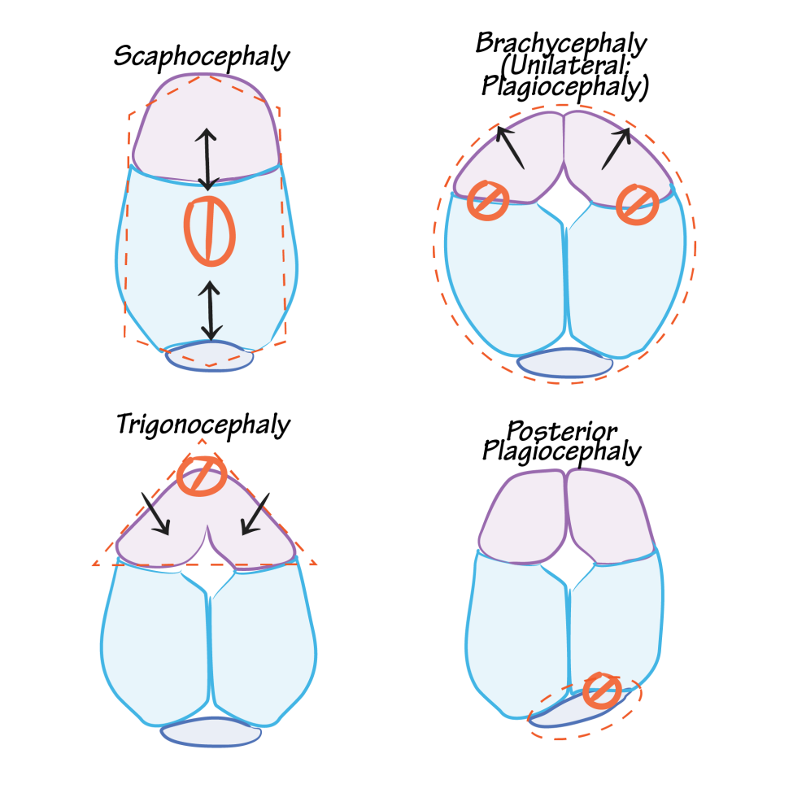
Approach
On Examination , you will feel “ridging” of the fused sutures
There will be increased density of the bone along the suture
Management:
Referral
Confirm with CT Skull
Linear craniectomy : Removal of the fused suture
If it is not treated early especially before 12 months of age , brain will not grow causing developmental delay and neurological sequalae.

Slide 27
Thank you

