Slide 1
Neonate with respiratory Distress
Case Based Discussion
Dr Faten Zaidan

Slide 2
Case 1
35 week gestational age infant is born by cesarian delivery to a mother with placenta previa. The infant girl is vigorous after delivery wit APGAR score of 8 at 5 minutes. Fifteen minutes later she started to experience worsening respiratory distress with tachypnea, retractions and mild grunting. CPAP at 40% FiO2 was started and admitted to NICU.
Her Chest xray is shown below. Name three findings.
What is your diagnosis ?
What is the definite treatment?

Slide 3
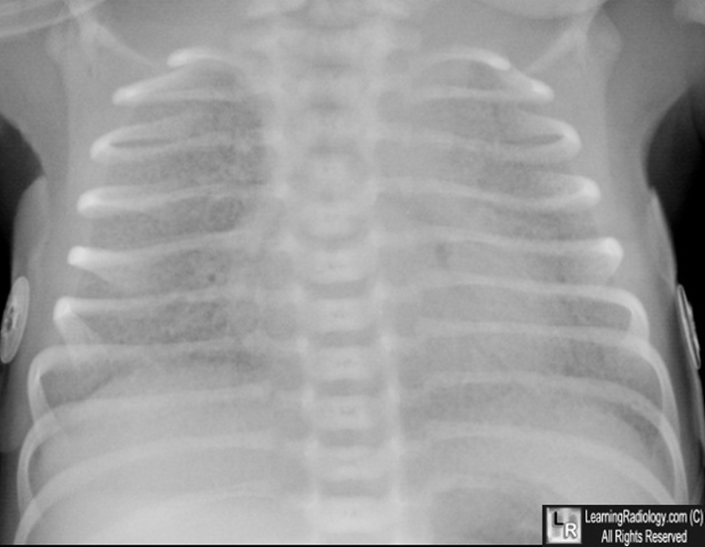

Slide 4
Case 2
39 week gestational age is born after prolonged rupture of membranes. The mother presented with fever of 39C, foul smelling amniotic fluid, and severe abdominal pain. She was started on antibiotics shortly before delivery. The infant is born by CS due to consistent fetal tachycardia and transferred to NICU]. tHe infant started to have respiratory distress, apneic episodes, mild retractions and grunting.
What is your diagnosis?
What is your course of treatment ?

Slide 5
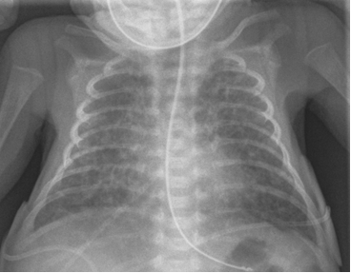

Slide 6
Case 3
A postterm 42 3/7 week gestational age inafnt is born after induced vaginal delivery . Meconium-stained fluid was noted after rupture of membranes approximately 6 hours before delivery. Th infant head was delivered easily however infant’s body delivered 4 minutes after delivery of head causing shoulder dystocia. The infant at 5 minutes was cyanosed, weak cry, mild flexion of the limbs, no spontaneous s movements, with heart rate of 160.
Calculate his APGAR score

Slide 7
Case 4
A postterm 42 3/7 week gestational age infant is born after induced vaginal delivery . Meconium-stained fluid was noted after rupture of membranes approximately 6 hours before delivery. Th infant head was delivered easily however infant’s body delivered 4 minutes after delivery of head causing shoulder dystocia. The infant was cyanosed and apneic and therefore intubated and shifted to NICU .
What do you expect the cause of respiratory distress
Name two possible complictaions

Slide 8
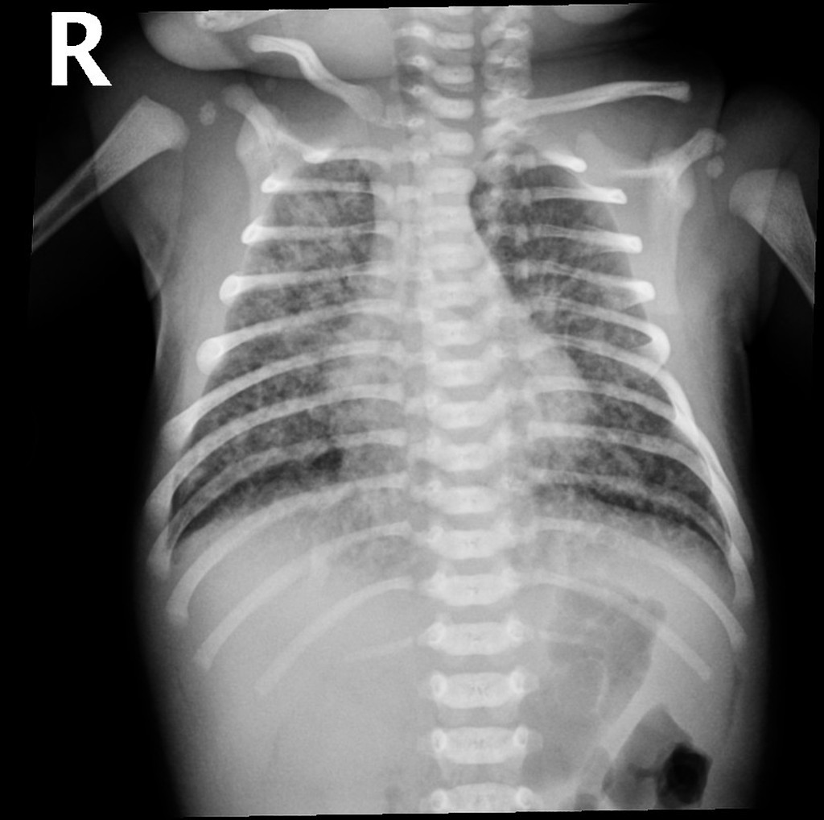

Slide 9
Case 5 (same patient of case 4)
The infant has been on ventilator for about 6 hours when you are called to the bedside for sudden decompensation with decreased saturations as low as 30%, bradycardia and absent breath sounds on the right.
What do you expect happened?
What s your immediate action

Slide 10
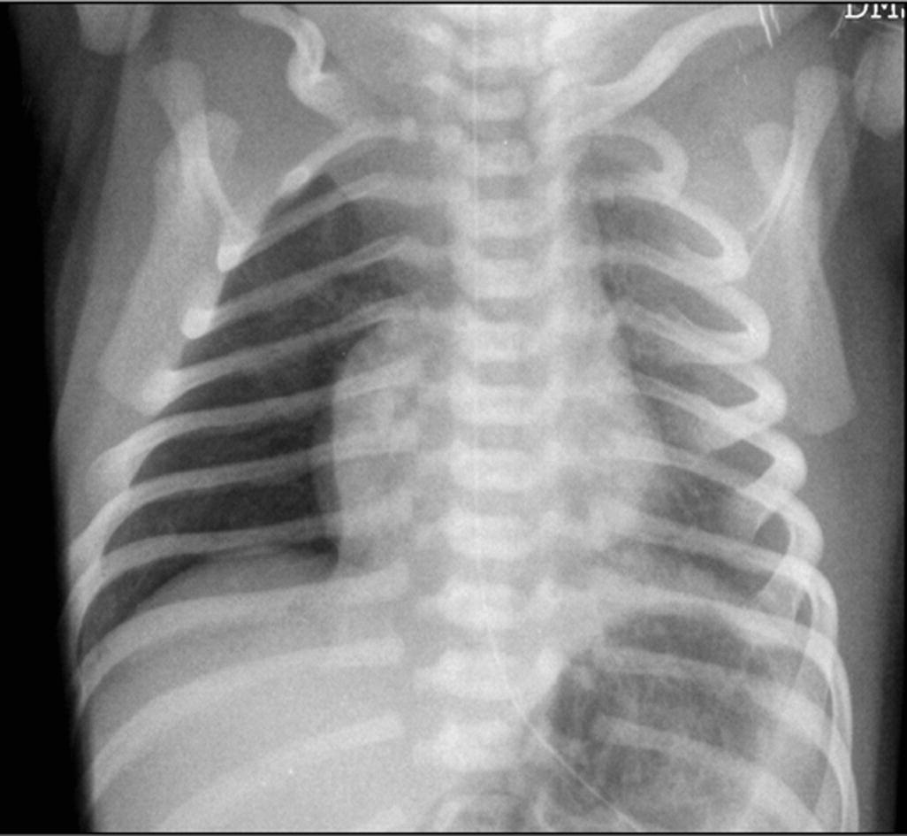

Slide 11
Case 6
A preterm infant born at 25 week gestation is now 6 weeks old. The infant has ben stable for past few weeks, breathing in room air, and receiving full enteral feedings that consists of fortified maternal breast milk and some formula supplementation. Yesterday the infant had few large gastric residuals with feeding but otherwise well. Today you were called for new onset of apneic spells, increased abdominal distension, poor urine output , lethargy and hypothermia.
What is your spot diagnosis
What labs you will ask for
What is your action

Slide 12
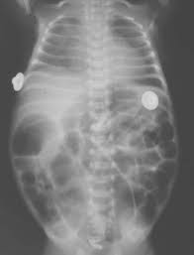

Slide 13
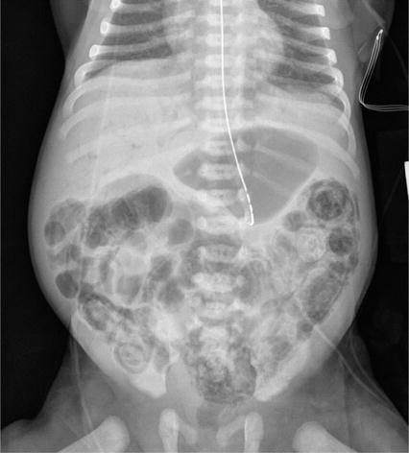
Despite your treatment, patient deteriorated and admitted to NICU
What is your action

Slide 14
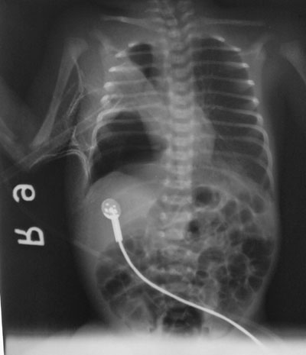
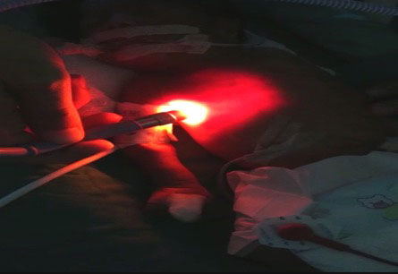

Slide 15
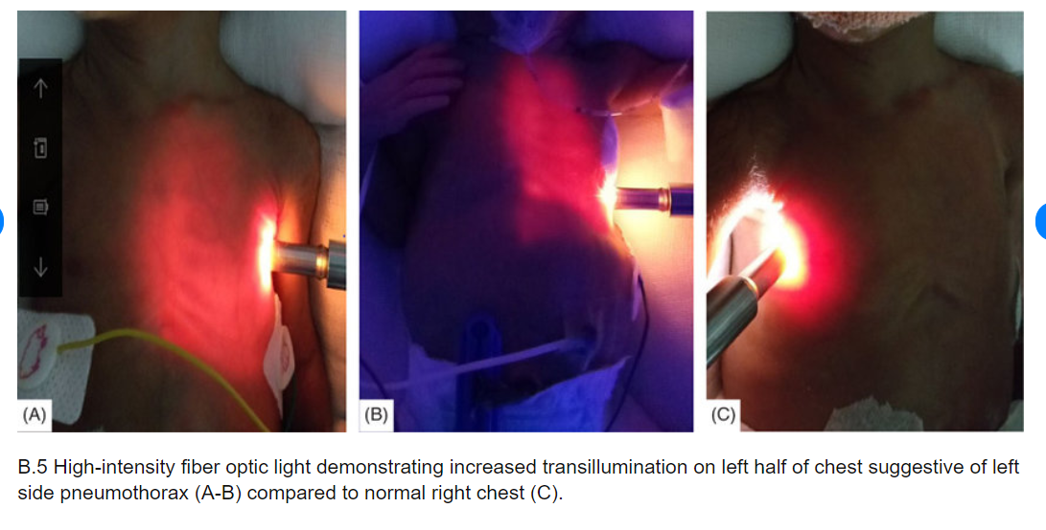

Slide 16
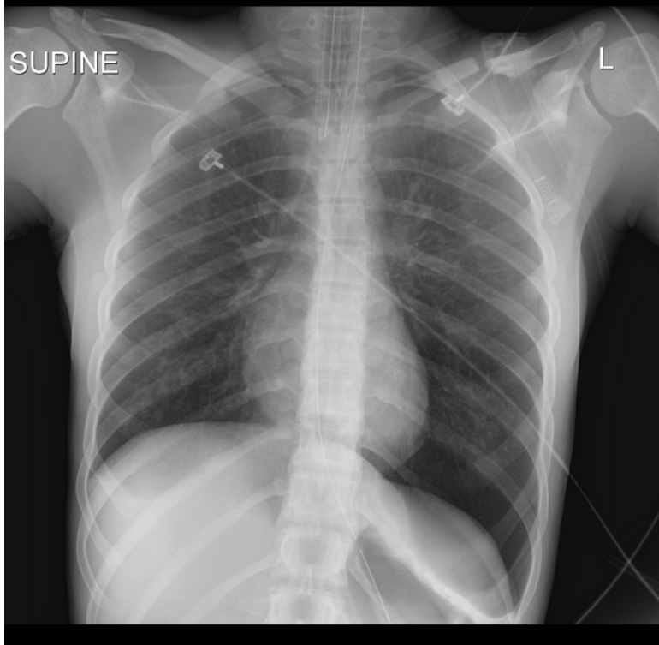
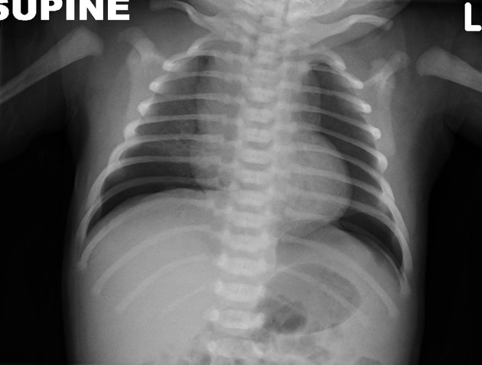
Notice “deep sulcus line” indicating pneumothorax

Slide 17
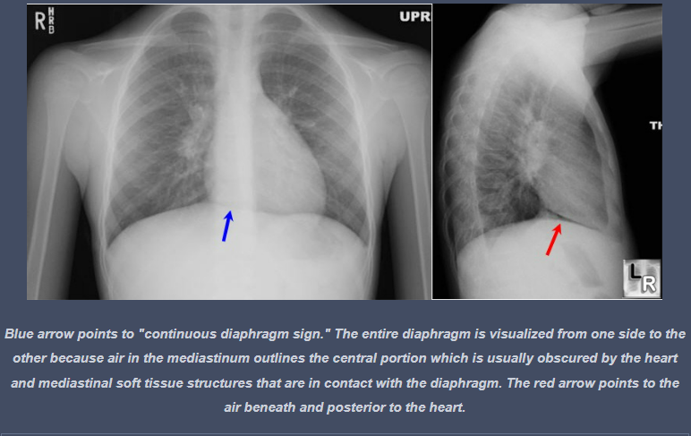
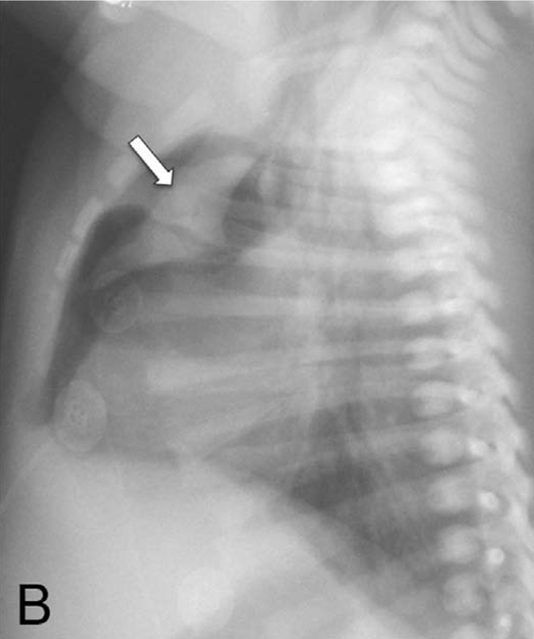
pneumomediastinum elevating the thymus causing “spinnaker sail” sign
Notice also “continuous diaphragm line”

Slide 18
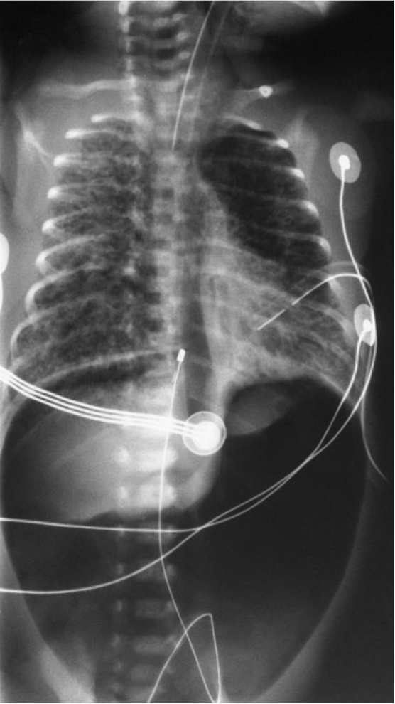
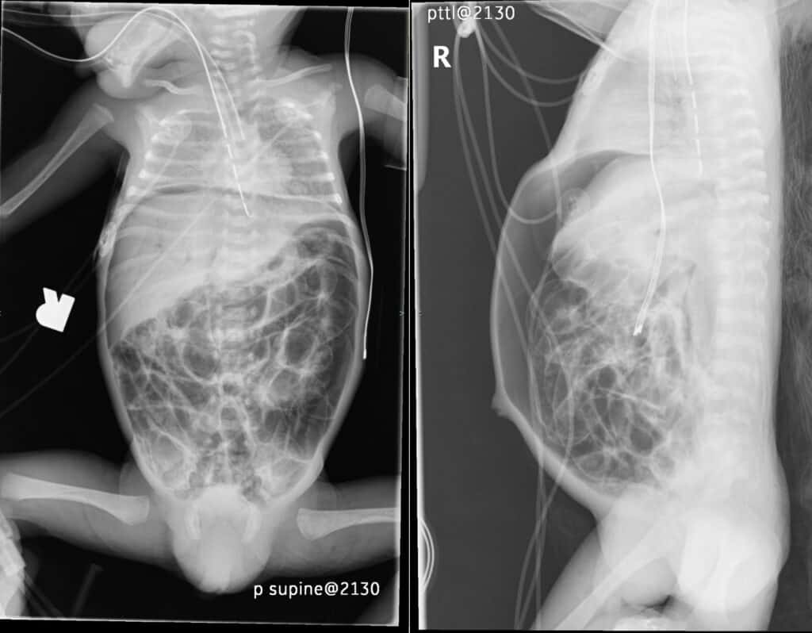
Pneumoperitoneum.

Slide 19
Thank you

