Slide 1
The Paediatric Physical Examination
Dr MANSOUR ALQURASHI

Slide 2
GENERAL PRINCIPLES
Review the patient's record and confirm the identity of the patient & others in the room.
An appropriate distance should be maintained during the history-taking portion.
The examiner should wash hands thoroughly before & after the examination.
Infants younger than six months who have no stranger anxiety and children older than 36 months who are familiar with the examining clinician generally cooperate during the examination without being held by their caregiver.
Physical examination of 5- to 12-year-old children usually is easy to perform because these children are not typically apprehensive and tend to be cooperative

Slide 3
Physical examination
Gain paediatric patient cooperation. (toys, distracting objects, and pictures). chewable snacks or liquid refreshments can be used .
If child >4 Y fails to cooperate for an examination, even in the presence of caregiver, it may be due to earlier traumatic encounter between the patient and another examiner or a failure on the part of the current examining clinician to use the correct approach or an underlying psychosocial problem .
For patients old enough to understand but who appear apprehensive, the examiner should explain what is going to be done during the examination and allow them to look at and touch any of the instruments to be used. Older patients should be warned in advance of potential pain or discomfort.

Slide 4
Physical examination …cont
Nurse should be present and parent’s are asked to leave for the examination of the anorectal , genital areas or breasts or examination of suspected child abuse.
Patient privacy should be respected. If a patient objects to being unclothed allow him or her to remain clothed until a specific part of the anatomy must be checked. the patient should be asked to remove or pull free the garments that are hindering visualization, palpation, or auscultation.

Slide 5
Physical examination …cont
For an infant , begin by examining the eyes, noting the red-light reflex, extraocular eye muscle movements, and visual tracking and then move to other parts of the body or organ systems before finally performing the often sensitive ear examination.
For the older child, the examination begin at the head and progress down the body, with the neurologic examination performed last.
In general, the portions of the examination that require the most patient cooperation, such as BP measurement, lung and heart auscultation, and eye and neurologic examinations, are performed initially.
followed by the more bothersome portions, including abdominal and ear examinations and measurement of head circumference.
If the patient has a localized complaint, sign, or symptom, that part of the examination should be performed last. As an example, right-lower-quadrant abdominal pain thought to be attributable to appendicitis; by not examining that part of the body first, the clinician may be able to divert the patient's attention away from the involved area and rule out other possible causes for the pain.

Slide 6
PEDIATRICS PHYSICAL EXAMINATION
1. IMPORTANT HINTS:
Avoid irritating the child and prevent him from crying (if possible).
Examine the child in the most comfortable way according to his age (exam table, mother’s hands, mother’s lap, while playing with a toy, while nursing…).
Postpone the painful and/or irritating examination (temp/throat/ears).

Slide 7
PEDIATRICS PHYSICAL EXAMINATION
2. Vital signs
. Temperature.
. Heart Rate.
. Respiratory Rate.
. Blood Pressure.
. O2 Saturation.
. CR time.

Slide 8
PEDIATRICS PHYSICAL EXAMINATION
3. Measurements (Wt, Ht, HC).
Always use growth charts and indicate the percentiles.
Use appropriate scale for age to measure the weight.
Naked weight (when possible)
Measure recumbent length till 2 years of age and then standing length (height) after that.
HC is the occipitofrontal circumference and measures the circumference passing through the most distal points on the occiput and the frontal area.

Slide 9
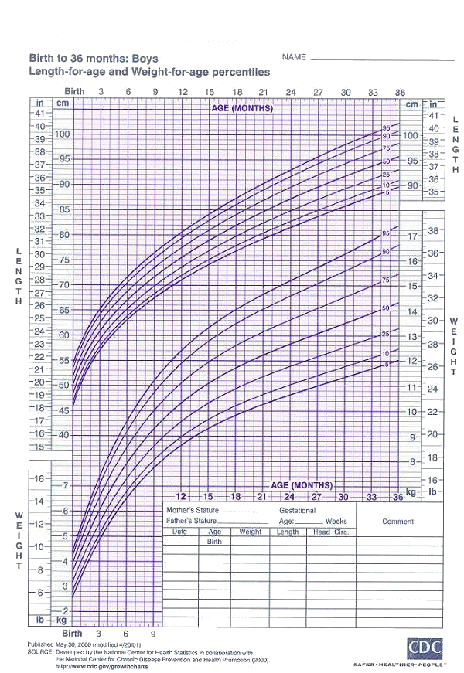
Reasons/Benefits to Breastfeeding

Slide 10
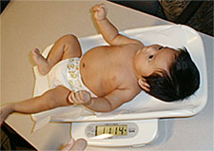
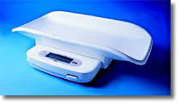
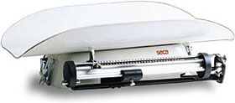
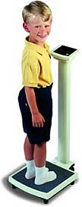
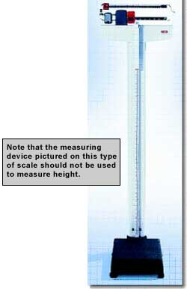
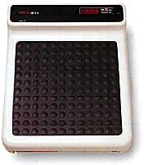

Slide 11
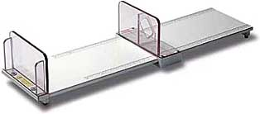
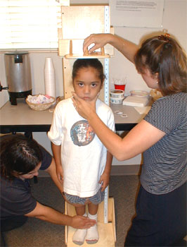

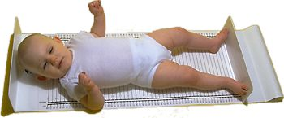
Stadiometers for Measuring Children and Adolescents

Slide 12
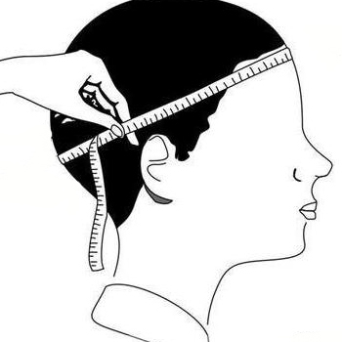
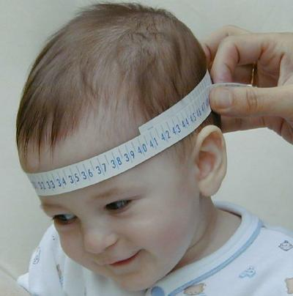

Slide 13
4-General Appearance
The examiner may gain significant insight into important social and family dynamics by observation alone when entering the patient's room:
State of alertness/ level of consciousness.
Degree of comfort (calm, nervous, shy)/ Awareness to environment
State of well-being (normal, ill-appearing, distressed) /Facial expression.
Activity level (sedate, alert, active, fidgety),
Physical appearance (neat, disheveled, unkempt),
Behavior and attitude (happy, sad, irritable, combative),
Body habitus (overweight, underweight, short, tall), and nutritional status (malnourished, normal, corpulent).
Any special decubitus.
The possibility of neglect should be considered if the child and caregiver make no eye contact or the patient lacks animation and has no social smile.

Slide 14
General Appearance …Cont
If a child appears ill, lies completely still on the examination table, verbally responsive, but noticeably change position may have an acute abdomen.
A dyspneic patient who is sitting upright and slightly forward with the arms extended and hands resting on the knees might be experiencing an exacerbation of asthma.
If an infant is crying , the pitch and intensity of the cry should be noted. A boisterous hardy cry is somewhat reassuring, whereas a weak and listless cry may indicate a seriously ill infant.
A high-pitched cry could indicate increased intracranial pressure, painful injury, toxic reaction, strangulated inguinal hernia, or other serious disorders.

Slide 15
General Appearance …Cont
Note the patient's breathing pattern and skin color:
If the patient has rapid, shallow respiration yet appears to be in no acute distress, the underlying cause could be primary pulmonary disease or respiratory compensation for metabolic acidosis.
The examiner should evaluate the developmental status before touching the child:
The patient's motor function, interaction with surrounding objects and people, response to sounds, and speech pattern give clues about whether the patient is normal or is in need of extensive developmental assessment.

Slide 16
PEDIATRICS PHYSICAL EXAMINATION
5. Skin, Hair, and nails:
Skin: - Color, elasticity, texture, rash
Hair: - Texture, color, distribution, areas of hair loss.
Nails: - Color, texture, shape.

Slide 17
PEDIATRICS PHYSICAL EXAMINATION
6. Head and neck
Head: - size, shape, fontanelles, sutures, craniotabes
Face: - shape, complexion (pallor, cyanosis, jaundice),
Edema.
Eyes: - degree of slanting, sclera, eyelids, spacing,
epicanthal folds, palpebral fissure, eyelashes, squint,
sunken, sunset.
Ears: - size, position, deformity, discharge, ext canal &
Tympanic membranes (shape, color, position,light reflex).
Mouth: - mandible, size, lips, tongue, gum, teeth, palate,
Throat and uvula.
Neck: - Length, pulsations, thyroid, webbing, LN, torticollis.

Slide 18
PEDIATRICS PHYSICAL EXAMINATION
7. Lymph nodes:-
. Examine all groups (occipital, cervical, axillary,
groin)
. Size, consistency, matting, attachment to skin,
tenderness.
8. Lungs and thorax
(inspection, palpation, percussion, auscultation).
9. Heart
(inspection, palpation, auscultation).

Slide 19
PEDIATRICS PHYSICAL EXAMINATION
10. Abdomen and genitalia
. (inspection, palpation, percussion, auscultation).
. Examine for ascites.
11. Back and spine
(inspection and palpation)
12. Extremities
(musculoskeletal, joints, and peripheral vessels)
13. Neurological and psychiatric.

Slide 20
CVS EXAMINATION
cc

Slide 21
Examination
General appearance:
higher functions
distress cyanosis pallor clubbing dysmorphic features activity monitors lines
reaction parents attitude....
Growth chart:

Slide 22
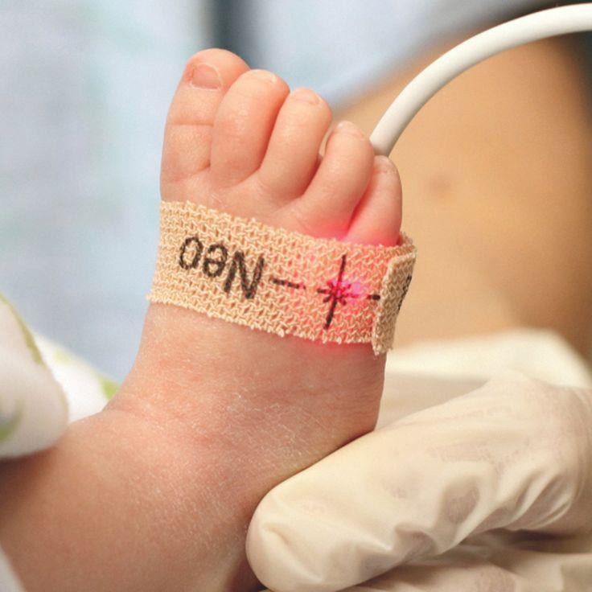
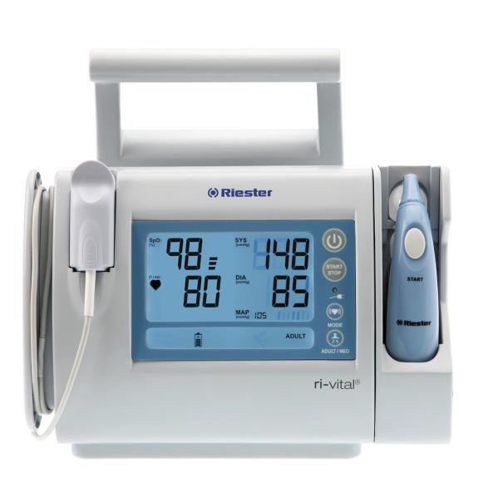
Examination (cont)
Vital signs:
Pulse all four limbs:
Blood pressure all four limbs:
Pulse Oxymetry:

Slide 23
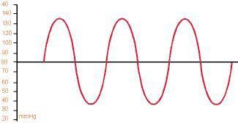
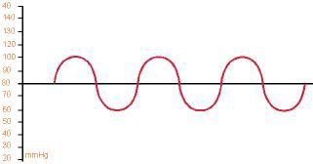
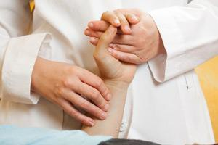
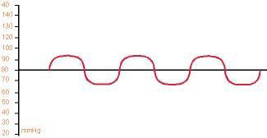
Examination (cont)
Pulses:
Pulses are the result of difference between systolic and diastolic status of the vasculature.
Increase in the difference between systole and diastole results in a more pronounced pulse

Slide 24
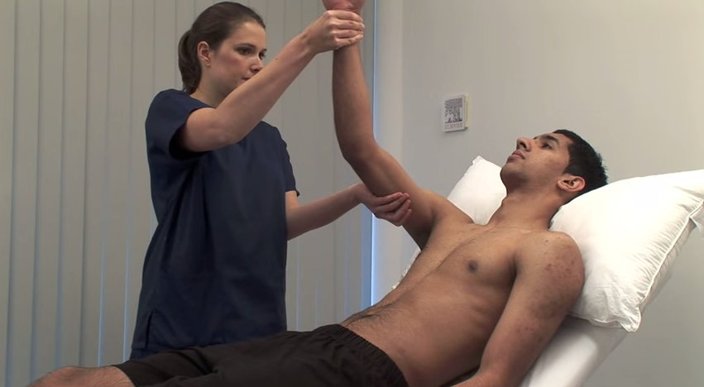
Examination (cont)
Examine for a collapsing pulse by placing your fingers across the anterior aspect of patient’s forearm and applying just enough pressure to occlude the radial pulse.
Confirm that the patient has no pain in their shoulder, and then elevate their arm above their head whilst maintaining the position of your hand.
You are feeling for a forceful knocking sensation that is typical of aortic regurgitation, commonly known as the ‘collapsing’ or ‘water-hammer’ pulse.

Slide 25
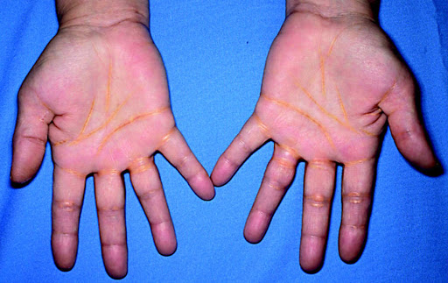
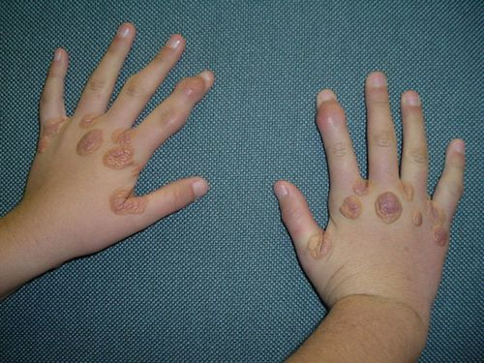
Examination ..cont
Hands Inspect
Temperature
Capillary refill (at level of heart)
Colour (peripheral cyanosis)
Clubbing – perform Shamroth’s window test and consider cardiac causes
Congenital cyanotic heart disease; endocarditis
Blood glucose testing on fingertips
Tendon xanthomata (hyperlipidaemia)
Palmar xanthomata
Tendon xanthomata

Slide 26
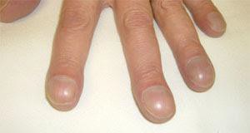
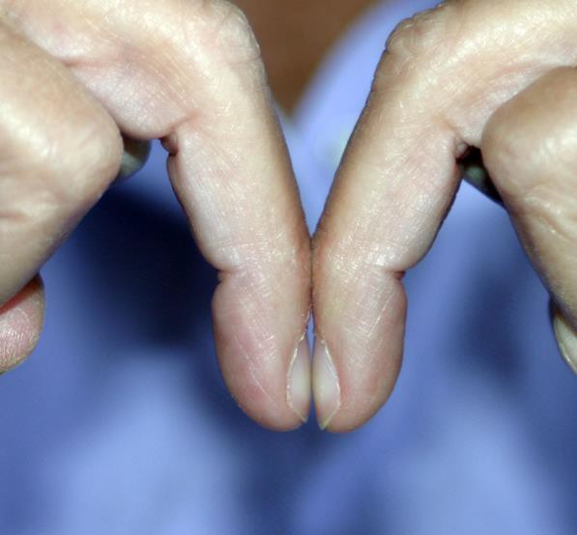
Examination (cont)
Clubbing :
This is enlargement of the tips of digits caused by hypoxia to peripheral tissue due to poor cardiac output and/or cyanosis.
Peripheral tissue compensate by forming more capillaries to improve oxygenation, this results in swelling of the peripheries of digits.

Slide 27
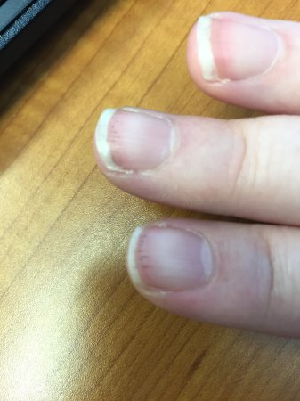
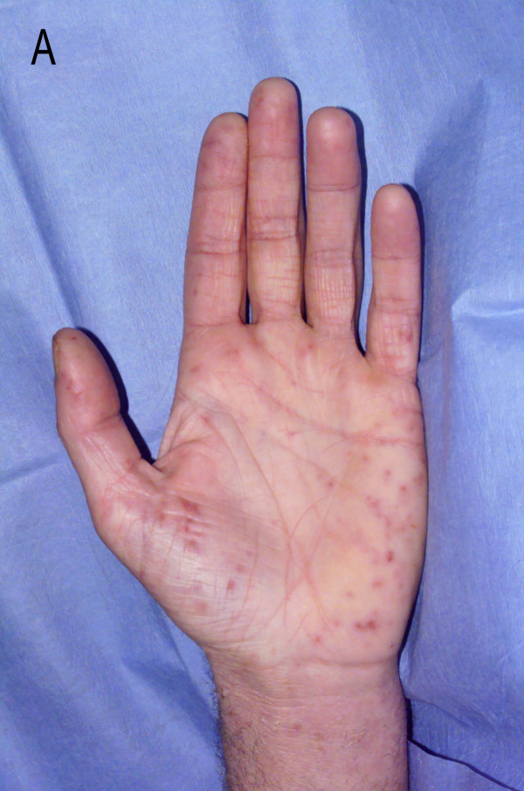
Janeway lesions (endocarditis)
Osler nodes (endocarditis)
Splinter haemorrhages
trauma, vasculitis, endocarditis
Pale palmar creases (anaemia)
Palmar erythema
Hyperthyroidism; polycythaemia
Arachnodactyly (Marfan’s syndrome)
Splinter haemorrhages
Erythematous macular non-blanching skin rash

Slide 28
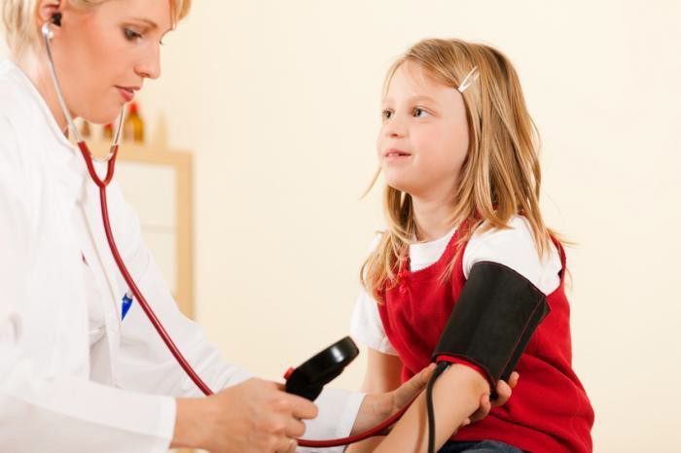
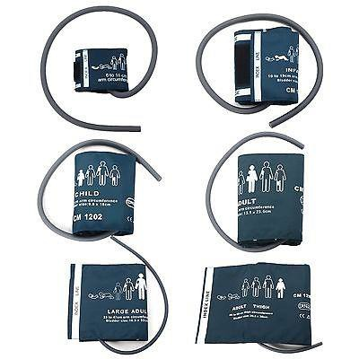
Formulas and General Rules
Rough Approximations
Pulse or Heart Rate HR
Infant Pulse: 160
Preschool Pulse: 120
Adolescent Pulse: 100
Systolic Blood Pressure( SBP)
Infant SBP: 80
Preschool SBP: 90
Adolescent SBP: 100
Respiratory Rate RR
Infant RR: 40
Preschool RR: 30
Adolescent RR: 20

Slide 29

Examination (cont)
Cardiovascular:
Inspection:
Palpation:
Percussion?
auscultation
1st and 2nd heart sounds
3rd (gallop) and 4th
murmur: site, phase, duration, radiation, Intensity, grade
clicks
bruit: liver, renal, brain

Slide 30
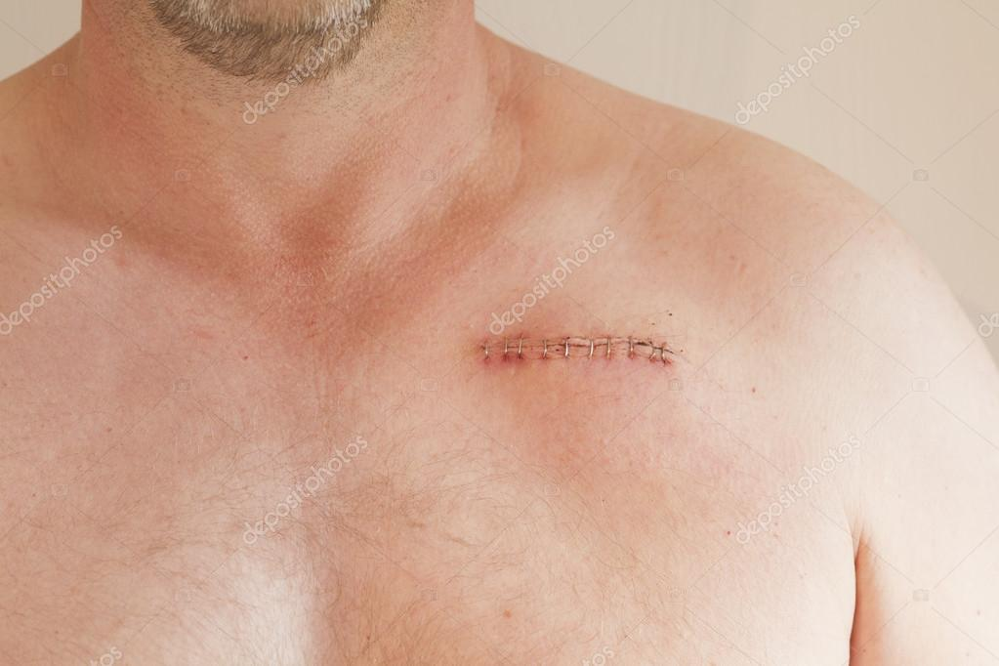
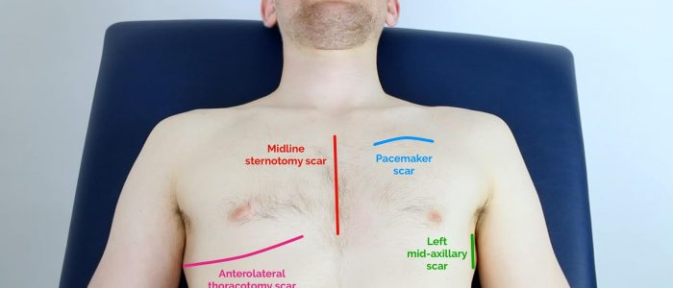
Examination (cont)

Slide 31
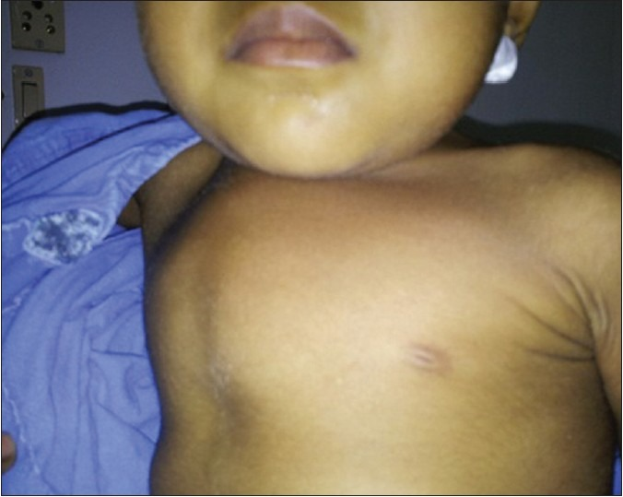
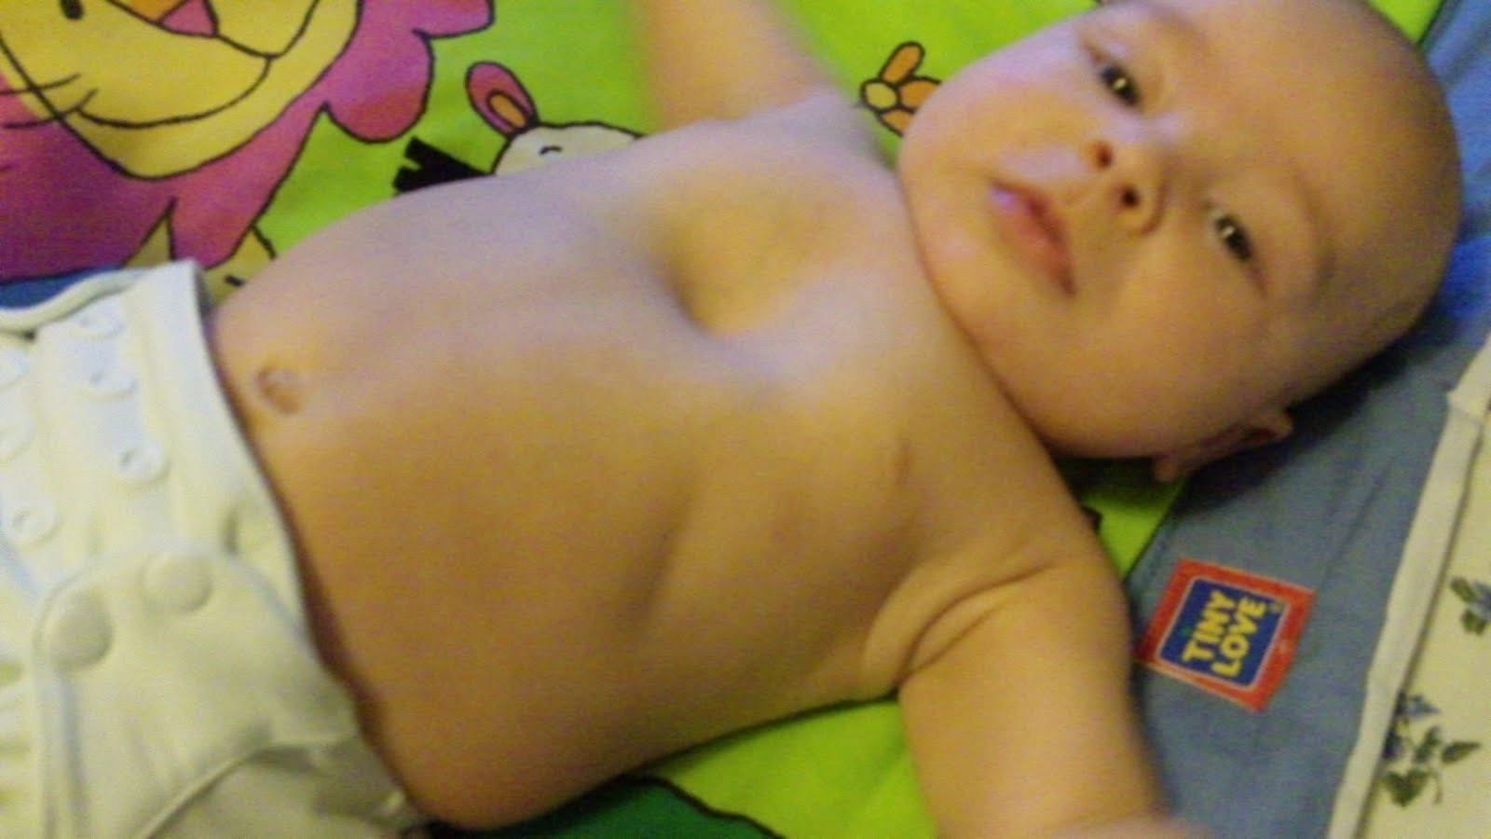
Examination (cont)

Slide 32
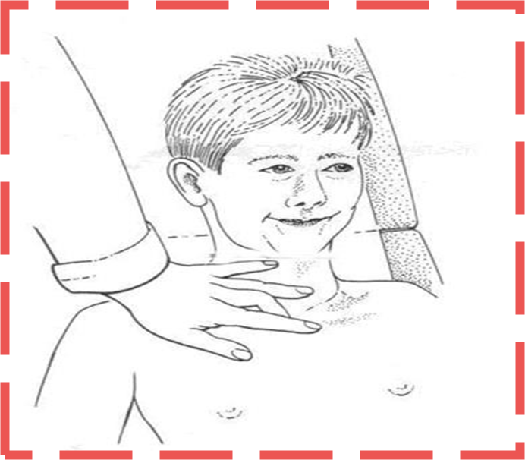
Examination (cont)
Assess tracheal position
Gently assess the position of the trachea, which should be central in healthy individuals:
1. Ensure patient’s neck musculature is relaxed by asking them to position their chin slightly downwards.
2. Dip your index finger into the thorax beside the trachea.
3. Gently apply side pressure to locate the border of the trachea.
4. Compare this space to the other side of the trachea using the same process.
5. A difference in the amount of space between the sides suggests the presence of tracheal deviation.
Causes of tracheal deviation:
Away : tension pneumothorax and large pleural effusions.
Towards lobar collapse and pneumonectomy.
Palpation of the trachea can be uncomfortable, so warn the patient and apply a gentle technique.

Slide 33
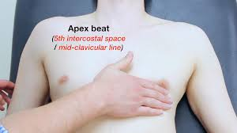
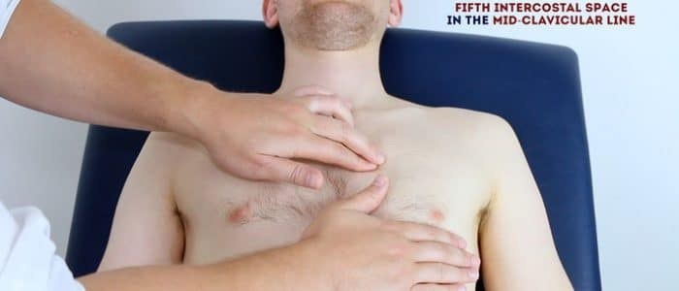
Palpate
Apex beat
Normal: 5th intercostal space, mid-clavicular line
Forceful: LVH, aortic stenosis
Heaving/thrusting: aortic regurgitation, mitral regurgitation
Tapping: mitral stenosis
Double: HOCM
LV and RV heave (ventricular hypertrophy)
Thrills (palpable murmur)

Slide 34
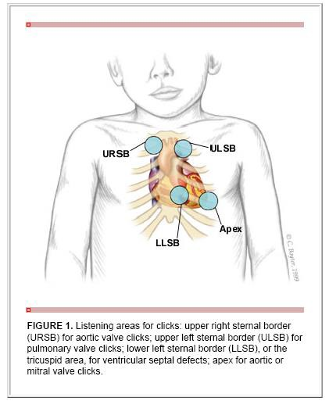
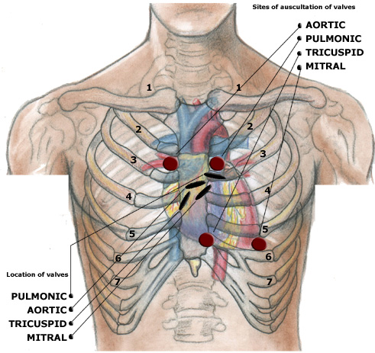

Slide 35

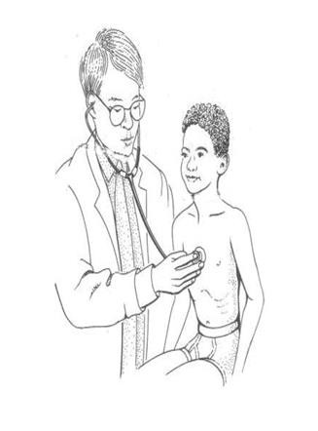
Examination (cont)
Maneuvers with auscultation:
Supine, sitting and standing:
Increase pre-load in supine……. Exaggerating flow murmurs
Valsalva maneuver:
Increase intensity of MVP
Decrease intensity of innocent heart murmurs
Respiratory cycle
Inspiration......increase blood flow to right heart
Expiration........increase blood flow to left heart

Slide 36
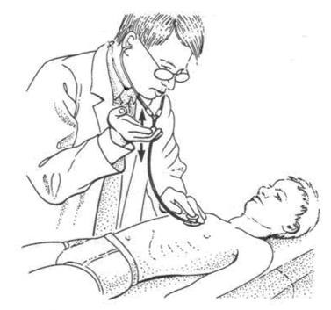
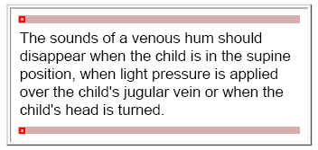
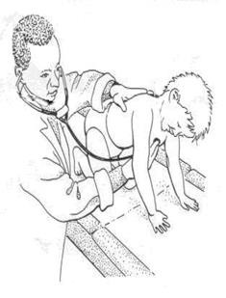
Examination (cont)

Slide 38
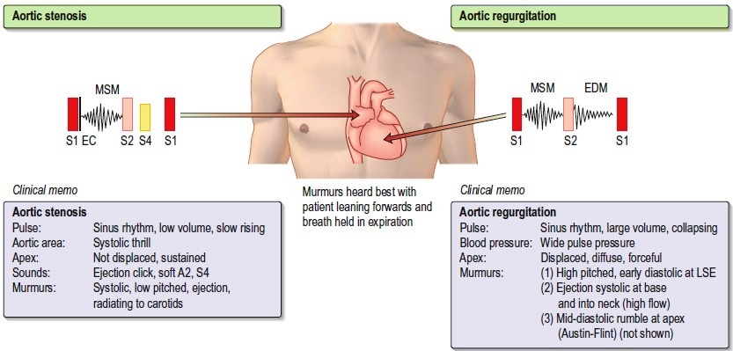
Examination (cont)

Slide 39
INNOCENT MURMURS
Murmur | Description | Proposed etiology | Common age prevalence
Still’s murmur | Systolic Grade 1 to 2 Low frequency, such as a twanging string, musical Heard between sternal border (mid to lower position) and apex Most common murmur in children | Unknown, theories include resonant phenomena of blood movement into the aorta, or movement across a chordae tendinae | 3 to 6 years, should disappear by adolescence
Pulmonary ejection/ flow murmur | Systolic Slightly grading in contrast to vibratory Heard over left upper sternal border, no significant radiation | Exaggeration of normal ejection vibration within the pulmonary vasculature | 5 to 14 years, most common in adolescents
Venous hum | Continuous, diastolic portion subtly louder Grade 1 to 2 Best heard infraclavicular and supraclavicular Only audible when patient is upright Can dissipate or exacerbate by head movements or obstruction of the ipsilateral jugular veins | Vibration of the veins carrying the blood from the head and upper body to the superior vena cava | 3 to 6 years

Slide 40
Innocent Physiologic, no heart disease |  | Pathologic Underlying heart disease
No cardiac symptoms Normal investigations | Clinical | Cardiac symptoms Abnormal investigations:Echo,x ray
Systolic | Timing | Diastolic, holosystolic. Systolic
Soft/vibratory | Quality | Harsh/blowing
Grade II or less | Intensity | Grade III or higher (possible thrill)
Exercise, anemia, fever Usually change with position | Louder with | Usually NO change with position
NO extra sounds | Other sounds | Click or opening snap, S3, S4
Normal S2, physiologic split on inspiration | 2nd Heart Sound | Fixed split S2

Slide 41
Examination (cont)
The back
Deformities thrill murmur
Neck:
JVP , visible pulsation and thrill,
web neck short
Liver and spleen:
Respiratory:
Air entry asymmetry wheezes
basal crepetations

Slide 42
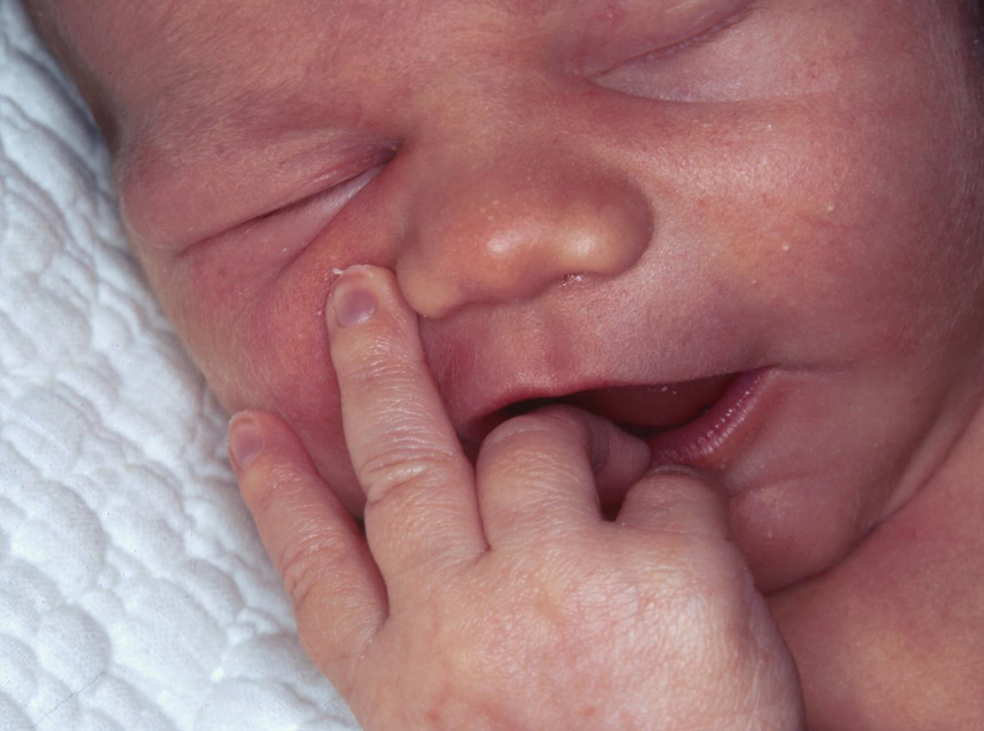
Examination (cont)
Cyanosis :
This is best determined by examining the patient in sunlight.
Artificial light may alter patient color.

Slide 43
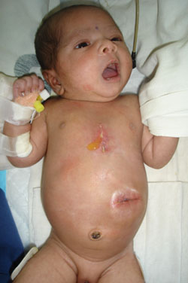
Examination (cont)

Slide 44
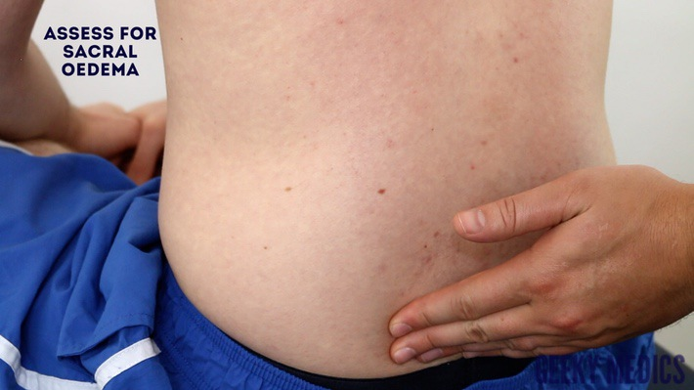
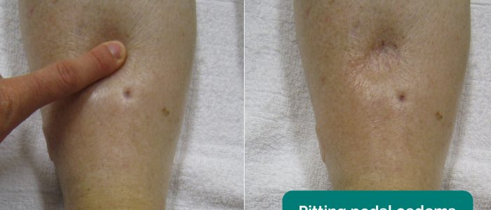
Examination (cont)

Slide 45
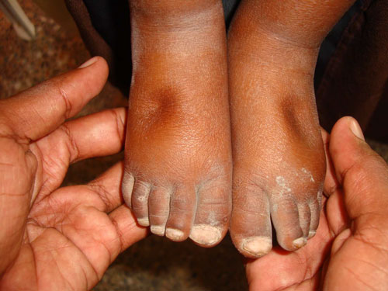
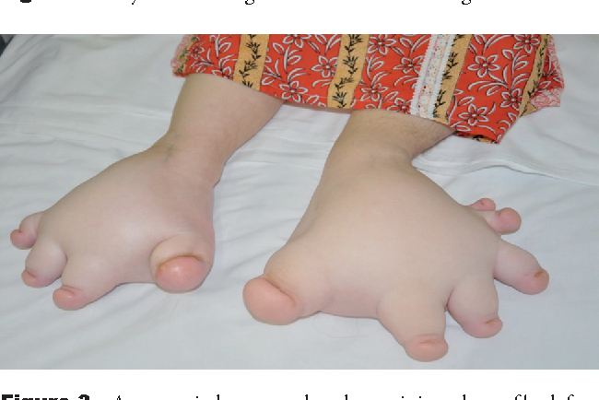
Examination (cont)

