Slide 1

PEDIATERICS ABDOMINAL EXAMINATION
Prepared by/
Dr.Salma Elgazzar
MRCPI - pediatrics
Masters’ degree in pediatrics Alexandria University

Slide 2
INTRODUCTION
Wash your hands and don PPE if appropriate.
Introduce yourself to the parents and the child, including your name and role.
Confirm the child’s name and date of birth.
Briefly explain what the examination will involve using patient-friendly language: “Today I’d like to perform an examination of your child’s abdomen, which will involve first observing your child, then gently feeling their tummy.”
Gain consent from the parents/carers and/or child before proceeding: “Are you happy for me to carry out the examination?”

Slide 3
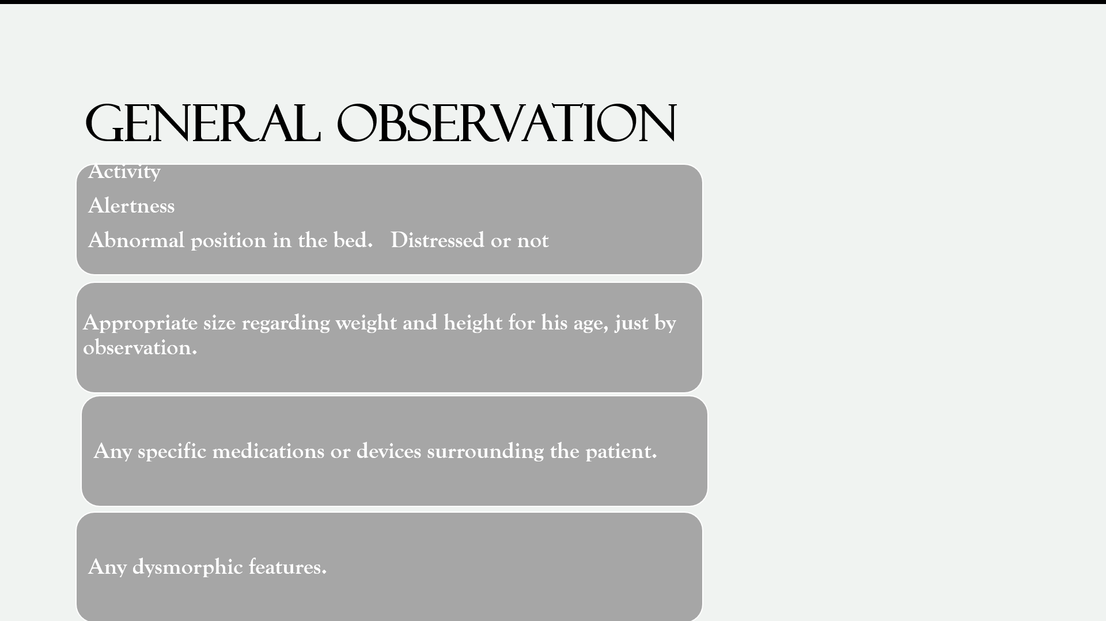

Slide 4
HANDS
General observations
Inspect the hands for clinical signs relevant to the gastrointestinal system:
Pallor: may suggest underlying anaemia (e.g. malignancy, gastrointestinal bleeding, malnutrition)
Peripheral oedema: associated with nephrotic syndrome (loss of albumin) and liver disease (reduced production of albumin).
Nail signs
Koilonychia: spoon-shaped nails, associated with iron deficiency anaemia (e.g. malabsorption in Crohn’s disease).
Leukonychia: whitening of the nail bed, associated with hypoalbuminaemia (e.g. nephrotic syndrome, protein-losing enteropathy).
Finger clubbing
Finger clubbing involves uniform soft tissue swelling of the terminal phalanx of a digit with subsequent loss of the normal angle between the nail and the nail bed. Finger clubbing is associated with several underlying disease e.g.cystic fibrosis and inflammatory bowel disease.

Slide 5
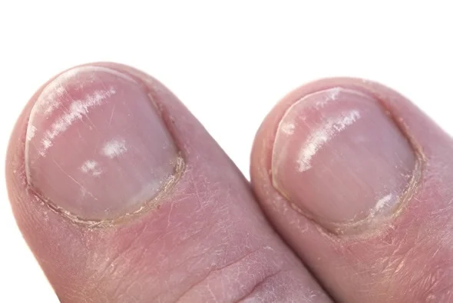
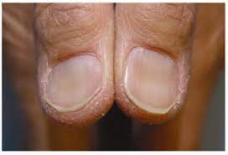
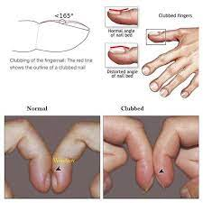
Leukonychia
Koilonychia
Clubbing nails

Slide 6
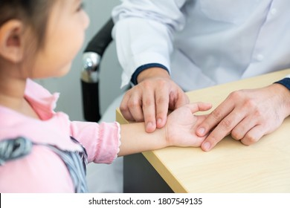
PULSE
Radial pulse
Palpate the child’s radial pulse, located at the radial side of the wrist, with the tips of your index and middle fingers aligned longitudinally over the course of the artery.
Once you have located the radial pulse, assess the rate and rhythm.
In babies, assess the femoral pulse instead.

Slide 7
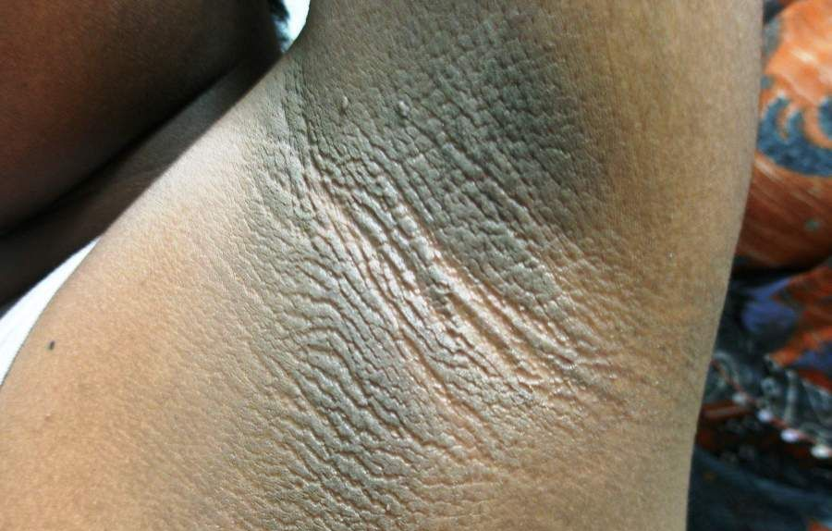
ARM:
Deseferral injection pump, cannulation , etc.
AXILLA:
Puberty ,acanthosis nigricans.

Slide 8
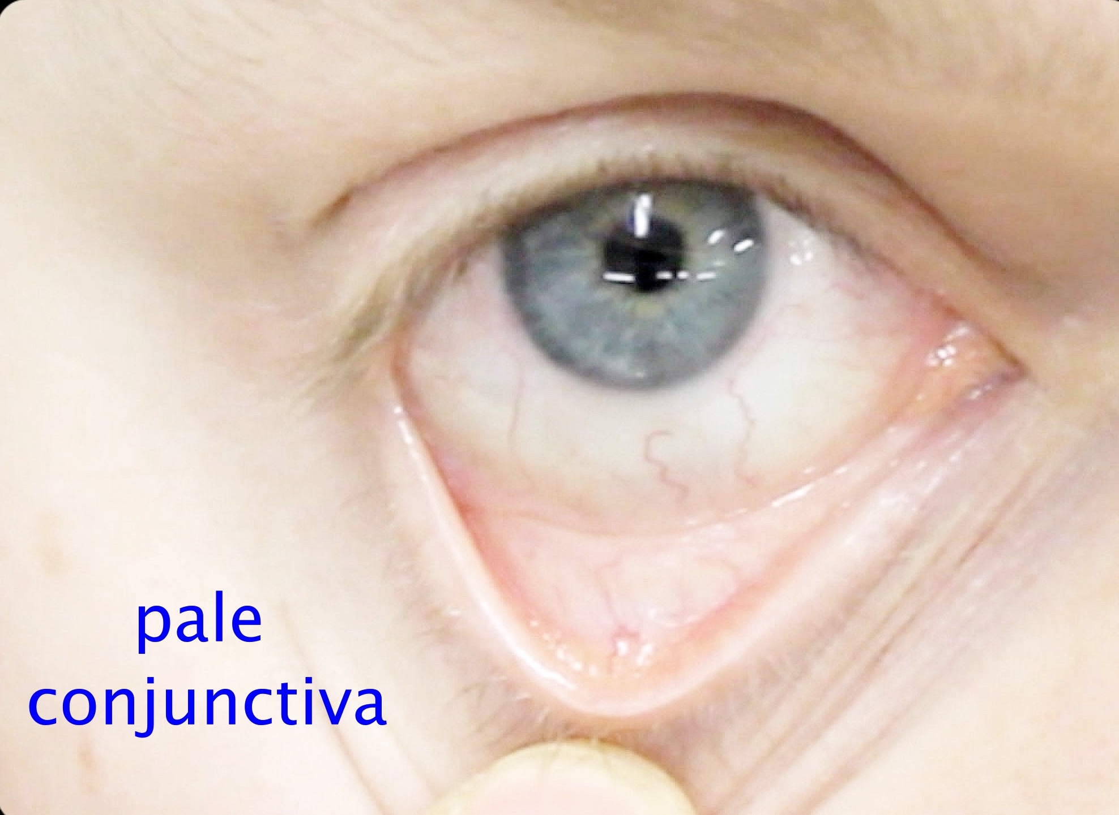
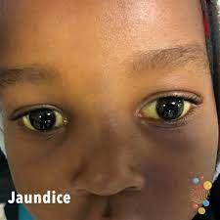
FACE
Observe the child’s facial complexion and features, including their eyes and mouth.
Facial edema

Slide 9
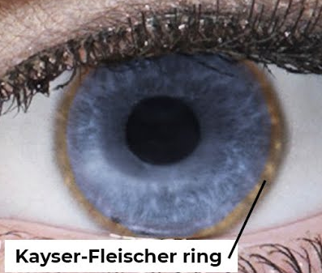
Anirdia
Xanthelasma in a 9-year-old child

Slide 10
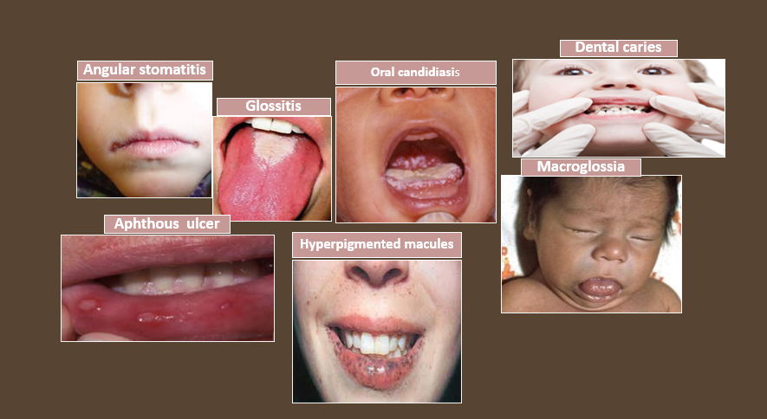

Slide 11
NECK
The left supraclavicular lymph node (known as Virchow’s node can be one of the first clinical signs of metastatic intrabdominal malignancy.
The right supraclavicular lymph node receives lymphatic drainage from the thorax and therefore lymphadenopathy in this region can be associated with metastatic oesophageal cancer (as well as malignancy from other thoracic viscera).
Palpate the supraclavicular fossa on each side, paying particular attention to Virchow’s node on the left for evidence of lymphadenopathy.
Acanthoysis nigricans
V
virchow’s lymph node

Slide 12
CLOSE INSPECTION OF THE ABDOMEN
Inspect the child’s abdomen for ::
Scars: there are many different types of abdominal scars that can provide clues as to the child’s past surgical history .
Abdominal distension: can be caused by a wide range of pathology including constipation, Hirschsprung’s disease, ascites, organomegaly and malignancy.
Caput medusae: engorged paraumbilical veins associated with portal hypertension (e.g. liver cirrhosis).
Hernias: observe for any protrusions through the abdominal wall (e.g. umbilical hernia, incisional hernia).
Drains/tubes/stomas: gastrostomy, central venous catheter, ileostomy and colostomy.
The abdomen is normally protuberant in toddlers and young children.

Slide 13
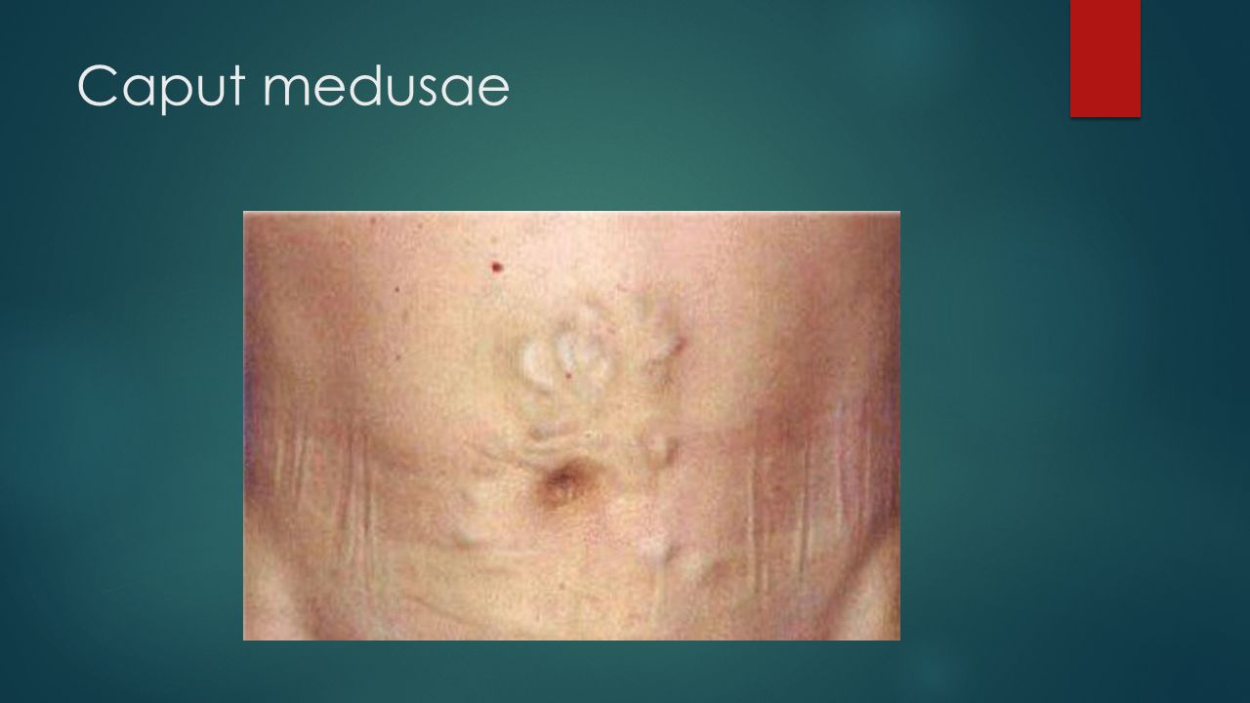
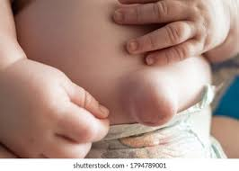
Caput Medusae
Umbilical Hernia

Slide 14
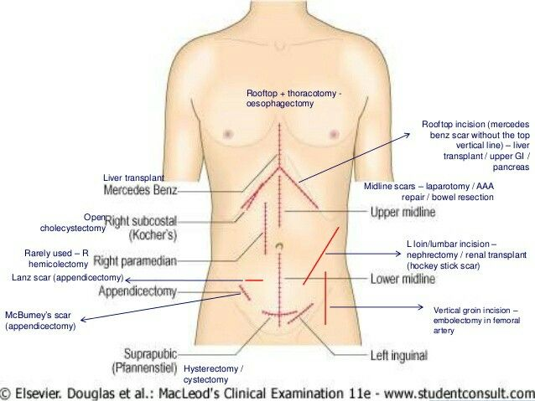

Slide 15
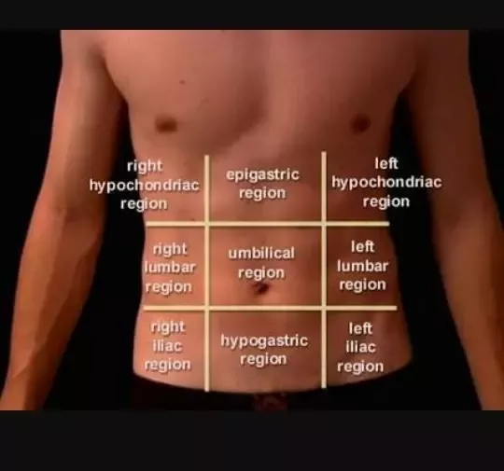
EXAMINING THE ABDOMEN
Light palpation
Perform anticlockwise light palpation of the nine abdominal regions, whilst looking at the child’s face and assessing for rigidity, tenderness, guarding and palpable masses.
Guarding is suggestive of peritonitis and indicates the need for urgent surgical review.

Slide 16
DEEP PALPATION
Localized in appendicitis (RIF), hepatitis (RUQ) and pyelonephritis (flank).
Generalized in mesenteric adenitis and peritonitis.
Guarding
Pain on coughing, moving about/walking/bumps during a car journey suggests peritoneal irritation.
A child walking, whilst being flexed forwards suggests psoas irritation (e.g. appendicitis).
Incorporating play may be used to elicit more subtle guarding:
“Can you jump up and down?” – a child will not be able to jump on the spot if they have localized guarding.
“Blow out your tummy as big as you can, then suck it in as far as you can” – this will elicit pain if there is peritoneal irritation.
Abnormal masses
Wilm’s tumour typically presents as a renal mass which is sometimes visible and does NOT cross the midline.
Neuroblastoma typically presents as an irregular firm mass which may cross the midline. The child is usually very unwell.
Faecal masses are typically mobile, non-tender, indentable and often located in the LIF.
Intussusception typically presents with a palpable mass in the RUQ (most commonly) in the context of an acutely unwell child.

Slide 17
LIVER PALPATION AND PERCUSSION
Palpate from the right iliac fossa and locate the edge of the liver with the tips or sides of your fingers (ask the child to take deep breaths if appropriate).
The liver edge may be soft or firm and you will be unable to get above it. The edge will move with respiration.
Measure in centimetres the extension of the liver edge below the costal margin in the mid-clavicular line.
Percuss downwards from the right lung to exclude downward displacement due to lung hyperinflation (i.e. in bronchiolitis).
Dullness to percussion can help delineate the upper and lower border. Record the span of the liver (in cm).
Tip: Young children may be more cooperative if you palpate first with their hand or by putting your hand on top of theirs.

Slide 18
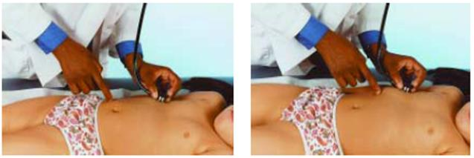
Hepatomegaly is an enlargement of the liver beyond age-adjusted normal values. It can be due to intrinsic liver disease or associated with systemic diseases seen in infants and children.
Normal liver size
Depends on age, gender, and body size
Average liver span is 4.5 to 5 cm (neonates), 6 to 6.5 cm (12-year-old girls), 7 to 8 cm (12-year-old boys), and up to 16 cm (adults).

Slide 19
Causes of hepatomegaly
There are several potential causes of hepatomegaly including:
Infection: congenital, infectious mononucleosis, hepatitis, malaria
Haematological: sickle cell anaemia, thalassaemia
Malignancy: leukaemia, lymphoma, neuroblastoma, Wilm’s tumour, hepatoblastoma
Metabolic: glycogen and lipid storage disorders, mucopolysaccharidoses
Cardiovascular: heart failure
Apparent hepatomegaly: chest hyper-expansion (e.g. bronchiolitis/asthma)

Slide 20
Splenic palpation and percussion
A palpable spleen is at least TWICE its normal size.
Palpate from the right iliac fossa towards the left upper quadrant (ask the child to take deep breaths if appropriate). The edge is usually soft and you will be unable to get above it. The splenic notch is occasionally palpable if markedly enlarged. The spleen should move with respiration.
Measure the degree of extension below the costal margin (in cm) in the mid-clavicular line.
Percuss to delineate the lower border (splenic tissue will be dull to percussion).
Causes of splenomegaly
There are several potential causes of splenomegaly including:
Infection: infectious mononucleosis, malaria, leishmaniasis
Haematological: haemolytic anaemia
Malignancy: leukaemia, lymphoma
Other: portal hypertension, Still’s disease
Apparent splenomegaly: chest hyper-expansion (e.g. bronchiolitis/asthma)

Slide 21
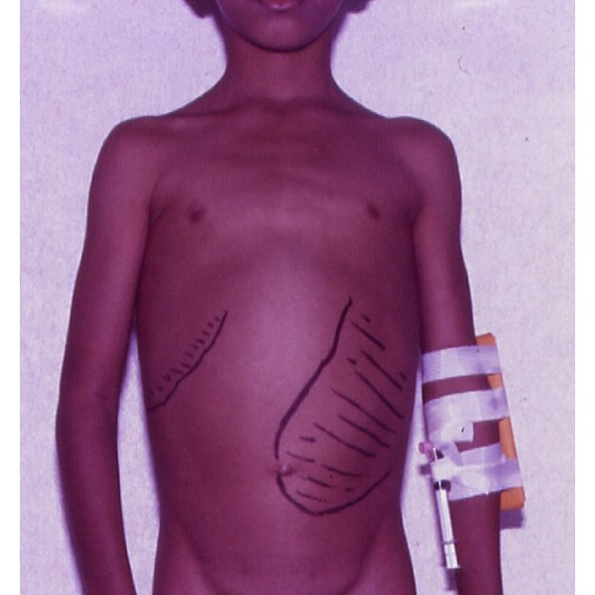
an enlarged spleen in a child with sickle cell anemia.

Slide 22
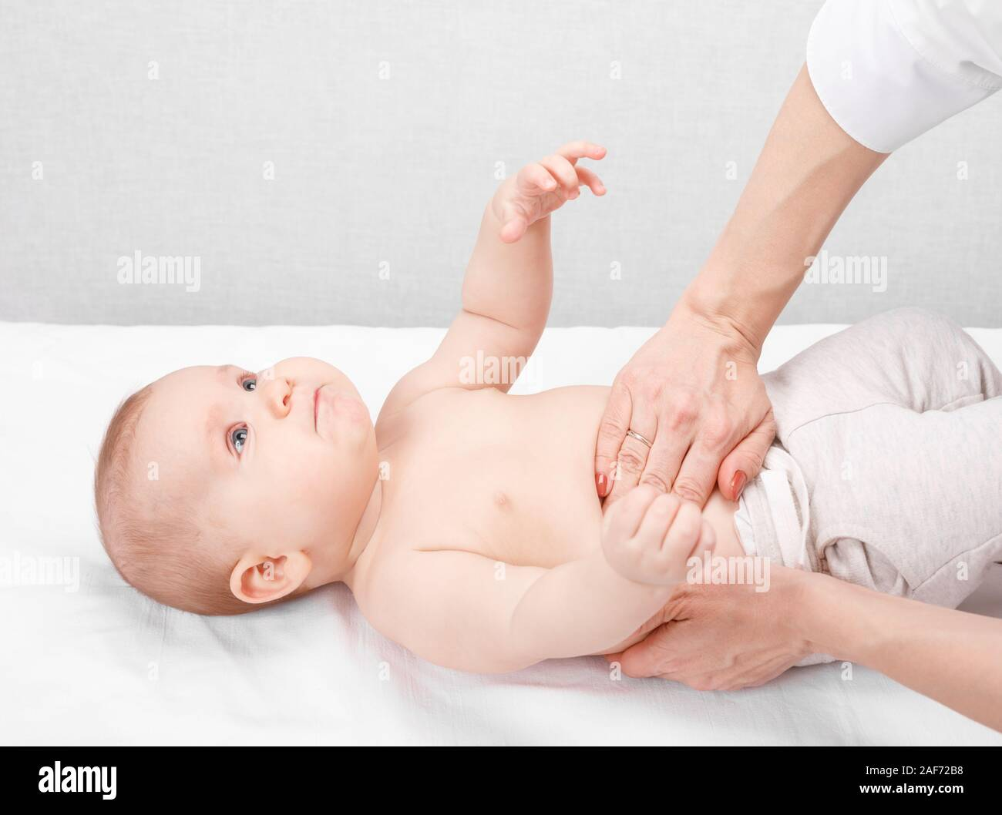
KIDNEYS
The kidneys are not usually palpable beyond the neonatal period unless they are enlarged or the abdominal muscles are hypotonic.
Palpate the kidneys by balloting bi-manually in each hypochondrium. You can ‘get above them’ (unlike the spleen or liver) and tenderness implies inflammation.
CAUSES OF KIDNEY ENLARGEMENT
Unilaterally enlarged: hydronephrosis, cyst, tumour
Bilaterally enlarged: hydronephrosis, kidney stones, polycystic kidneys

Slide 23
ASCITES
Ascites may be present in cirrhosis, hypoalbuminaemia, infection or malignancy.
The presence of shifting dullness is highly suggestive of ascites.
ASSESSING FOR SHIFTING DULLNESS
It is usually not possible to formally assess for shifting dullness in young children, due to issues with co-operation. However, in older children, it may be possible.
1. Percuss from the umbilical region to the child’s left flank. If dullness is noted, this may suggest the presence of ascitic fluid in the flank.
2. Whilst keeping your fingers over the area at which the percussion note became dull, ask the child to roll onto their right side (towards you for stability).
3. Keep the child on their right side for 30 seconds and then repeat percussion over the same area.
4. If ascites is present, the area that was previously dull should now be resonant (i.e. the dullness has shifted).

Slide 24
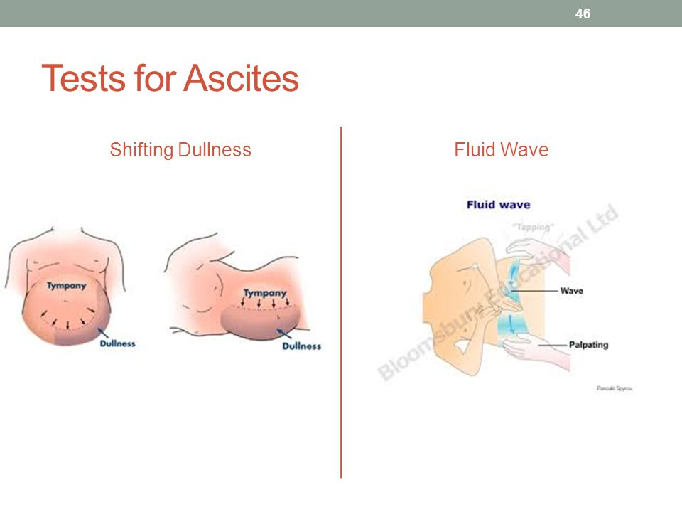

Slide 25
AUSCULTATION OF THE ABDOMEN
GENITAL EXAMINATION
RECTAL EXAMINATION
Not routinely performed and if indicated, it should be performed by a specialist who has experience interpreting findings.
The rectum may be inspected to identify relevant abnormalities:
Imperforate anus
Anal skin tags (Crohn’s)
Anal prolapse
Staining of underwear (may suggest constipation)
LOWER LIMB

Slide 26
THANK YOU
Notes:
https://www.youtube.com/watch?v=l3YCGakspo8

