Slide 1

Pediatric Seizures
Dr Mansour alqurashi

Slide 2
LEARNING OBJECTIVES
Common definitions in neurology (seizures, epilepsy. Status epilepticus, aura, ictal and post ictal phase).
Discuss and categorize the various etiologies of seizures in infancy and childhood.
Describe the different types of seizure disorders in children.
Discuses the clinical presentation of various epileptic syndromes in pediatrics.
List the diagnostic criteria for the establishment of febrile seizure.
Describe the general management and prognosis of febrile seizures.

Slide 3
Definitions
Seizure:
A sudden, involuntary, time-limited alteration in behavior, motor activity, autonomic function, consciousness, or sensation, accompanied by an abnormal electrical discharge in the brain
(due to abnormal neuronal activity and sudden biochemical imbalance at the cell membrane).
Epilepsy
- The tendency to have recurrent, unprovoked( reflex) seizures .
(At least two unprovoked ( reflex) seizures occurring >24h ).
- One unprovoked (or reflex) seizure and a probability of further seizures similar to the general recurrence risk (at least 60%) after two unprovoked seizures, occurring over the next 10 years.
- Diagnosis of an epilepsy syndrome.

Slide 4
Definitions
Reflex epilepsies
evoked by specific external sensory stimuli(Photosensitive epilepsies), internal cognitive and emotional
processes, or activity of the patient (reading).
An epilepsy syndrome:
Represents a complex of signs and symptoms that together define a distinctive clinical seizure
disorder eg, West syndrome or Lennox-Gastaut syndrome.
Acute symptomatic (provoked) seizure:
A seizure occurring in the setting of some systemic provoking factor (normal brain,
Unprovoked seizure: occurs in the absence of a potentially responsible clinical condition or occurs in
relation to a preexisting brain lesion or progressive nervous system disorder beyond the time interval recognized for acute symptomatic seizure

Slide 5
Provoked = occurs during the course of acute illness
Common causes :
Febrile seizures
Metabolic events (hypoglycemia)
Acute CNS infections
Drug in toxification
Head trauma
Other causes:
Post infectious or post vaccinal encephalopathy.
Inborn errors of metabolism

Slide 6
INCIDENCE/ PREVELANCE
Acute Symptomatic seizures (Provoked seizures):
0.5-1%
Epilepsy:
Incidence rates of epilepsy in childhood range from 0.5 to 8 per 1,000 person-years .
An estimated 1 percent of children and adolescents in the United States will experience at least one unprovoked seizure by age 14 years.
In Saudi Arabia
6.54 /1000 population have active epilepsy.

Slide 7
Clinical Presentation: Motor Changes
Parents/caregivers may report seeing:
Repetitive non-purposeful movements
Staring
Lip-smacking
Falling down without cause
Stiffening of any or all extremities
Rhythmic shaking of any or all extremities
Seizure activity cannot be interrupted with verbal or physical stimulation.

Slide 8
Clinical Presentation: Sensory and Autonomic
Parents/caregivers may report the child is:
Feeling nauseated
Feeling odd or peculiar
Losing control of bowel or bladder
Feeling numbness, tingling
Experiencing odd smells or sounds

Slide 9
Clinical Presentation: Consciousness
Consciousness is the usual alertness or responsiveness.
Parents/or you may observe the child to have :
Baseline alertness
Diminished level of consciousness
Unresponsive and unconscious

Slide 10
Events That Mimic Seizures
Apnea
Breath Holding spells
Dizziness
Myoclonus
Psychogenic Seizures/Pseudo seizures
Benign neonatal sleep myoclonus.
Night terror 2–3 hours after a child falls asleep. (non-REM)
Rigors
Shuddering attacks
Jitteriness
Syncope
Tics
Dystonia
Transient Ischemic Attacks

Slide 11
 | Epilepsy | Syncope
Precipitating factors | Rare | Common
Occurrence | Awake , sleep | Awake
Onset | Abrupt | Gradual
Duration | 60-90 sec | 10-15 sec
Jerking limbs | Yes | Occasional
Facial colour | Flushed | Pale
Perspiration | Hot, sweaty | Cold, clammy
Post ictal recovery | Slow | Rapid
Post ictal confusion | Common | Uncommon
EEG & prolactin | Positive | Negative

Slide 12
Helpful tools for diagnosis
Accurate history and description of events
Ask family member to “act out” event
Ask family to videotape event
Provoking factors (Medications, genetic factors, electrolyte abnormalities, sleep state, infections, brain inflammation, or injury).
EEG/ VEEG (photic stimulation & hyperventilation, sleep deprivation)

Slide 13
Seizure Classifications
Generalized | Partial
 | Complex | Simple
Involves BOTH hemispheres of the brain | Involves motor* or autonomic# symptoms with altered level of consciousness | Can involve motor,* autonomic# or somatosensory⁺ symptoms
Always involves loss of consciousness | May start in one muscle group and spread | May start in one muscle group and spread
Types: Tonic or clonic movements or combination (grand mal) Absence (petit mal) Myoclonic Atonic (e.g., drop attacks) Infantile spasms | Types of symptoms: 1) Motor* - head/eye deviation, jerking, stiffening 2) Autonomic# - pupillary dilatation, drooling, pallor, change in heart rate or respiratory rate 3) Somatosensory⁺ - smells, alteration of perception (déjà vu)
Notes:
Seizures are classified with respect to where the abnormal neuronal activity occurs. With generalized seizures, both hemispheres of the brain are involved and there is loss of consciousness. Movements are tonic or clonic or a combination. Absence seizures are also generalized. Partial seizures may be simple or complex, and involve only one hemisphere of the brain. In complex partial seizures, there is altered level of consciousness, while in simple partial seizures there is NO loss of consciousness; however, there may be transient cognitive impairments. Movements begin with a single muscle group and then spread in both complex and simple partial seizures. The different types of symptoms that may occur include motor symptoms such as - head/eye deviation, jerking, stiffening; autonomic symptoms, such as - pupillary dilatation, drooling, pallor, change in heart rate or respiratory rate, as well as somatosensory symptoms, such as smells and/or alteration of perception (for example déjà vu).

Slide 14
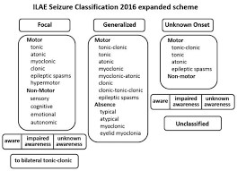

Slide 15
Generalized seizure types
Myoclonic | Sudden, <100 ms involuntary contraction of muscle(s) or muscle groups
Clonic | Repetitive, rhythmic myoclonus at 2-3 Hz
Tonic | Sustained muscle contraction for seconds to minutes
Generalized tonic-clonic | Bilateral symmetrical tonic contraction, then bilateral clonic contractions
Atonic | Sudden, brief, 1–2 s decrease in tone without preceding myoclonic or tonic event
Astatic | Loss of posture (=drop) due to atonic, myoclonic, or tonic event
Spasm | Axial contraction, may be asymmetric

Slide 16
Seizure type
- Simple
(Normal consciousness)
- Complex
(Impaired consciousness)
Partial
(Only a portion
of the brain)
Generalized
(Both hemispheres are
involved)

Slide 17
Generalized Tonic-Clonic Seizures
Typically have no evidence of any localized, regional, or diffuse brain abnormality on history, physical, or neurologic examination; clinical laboratory testing; or imaging studies.
The awake EEG of patients with generalized tonic-clonic seizure may be normal.
In generalized seizure patients, photic stimulation and/or hyperventilation during an EEG may produce spikes or even seizures.

Slide 18
Generalized Tonic-Clonic Seizures
Patients may have prodrome, occurring hours or days before a seizure:
mood changes, sleep disturbances, lightheadedness, anxiety, irritability, difficulty concentrating.
Patients do not have auras. An aura represents a simple partial seizure/focal aware seizure.
In nocturnal seizures, it may be hard to distinguish a primary generalized seizure from a partial seizure with secondary generalization (focal seizure evolving to a bilateral tonic-clonic seizure).

Slide 19
Generalized Tonic-Clonic Seizures
Tonic phase:
10-20 seconds, begins with flexion of the trunk and elevation and abduction of the elbows. Subsequent extension of the back and neck is followed by extension of arms and legs.
Can be accompanied by apnea, which is secondary to laryngeal spasm. Air being forced past the vocal cords causes a cry or groan.
The child loses consciousness and falls to the floor.
Clonic phase:
clonic convulsive generalized movements . This is because phases of atonia alternate with repeated violent flexor spasms.
Each spasm is accompanied by pupillary contraction and dilation. Some patients may bite their tongue or cheek.
Voiding may occur at the end of the clonic phase as sphincter muscles relax. The atonic period lasts about 30 seconds. The patient continues to be apneic during this phase.

Slide 20
Generalized Tonic-Clonic Seizures
The convulsion, including tonic and clonic phases, lasts around 1-2 minutes.
Postictal state:
a variable period of decreased consciousness during which the patient becomes quiet and breathing resumes.
The patient gradually awakens, often after a period of stupor or sleep, and often is confused, with some automatic behaviour.
Headache and muscular pain are common.
The patient does not recall the seizure itself.

Slide 21
Complex Partial Seizures
Commonly temporal lobe focus
Begins in one area, then spreads enough to impair consciousness, but not to evoke a generalized tonic-clonic seizure
Staring is often part of the initial spread
Also can see automatisms…

Slide 22
Automatisms
Coordinated involuntary movements
Consciousness impaired
Patient does not recall activity
Simple
Lip smacking, chewing, sounds, picking, tapping, walking straight or in circles
Complex (behavior involved)
Undressing, chewing inedible objects, wandering, aggression

Slide 23
Epilepsy auras
Some people may describe their auras as:
• a ‘rising’ feeling in the stomach or déjà vu (feeling like you’ve ‘been here before’);
• getting an unusual smell or taste;
• a sudden intense feeling of fear or joy;
• a strange feeling like a ‘wave’ going through the head;
• stiffness or twitching in part of the body, (such as an arm or hand);
• a feeling of numbness or tingling;
• a sensation that an arm or leg feels bigger or smaller than it actually is;
• visual disturbances such as coloured or flashing lights or hallucinations

Slide 24
ABSENCE SEIZURE
4-12 years of age
common in girls than boys
Ceases at puberty
Abrupt lapses of consciousness lasting a few seconds. (5-10)
No alteration in muscle tone
May go unrecognised
Abrupt in onset , no aura and Amnesia.

Slide 25
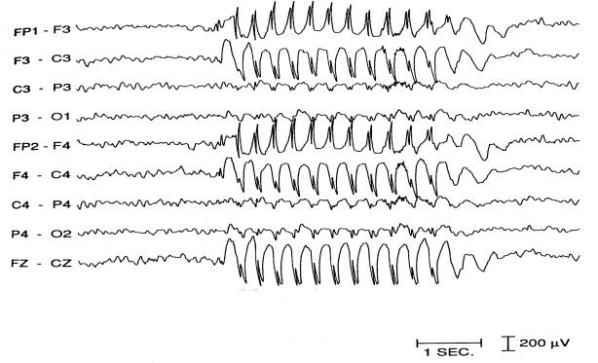


Slide 26
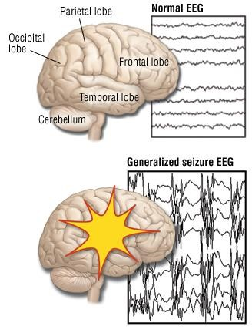

Slide 27
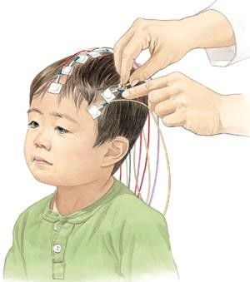

Slide 28
DIAGNOSTIC EVALUATION
History collection
Physical examination
Laboratory investigations
- Serum glucose & calcium levels
• Lumbar puncture – Ist febrile seizures

Slide 29
Main Periods according to Age
Neonates:
Subtle seizures , non-febrile
Deviation of the eyes
Eyelids are flickering
Swimming or pedaling movements
Apnoeic spells
Tonic
Clonic
Myoclonic
Seldom tonic clonic seizures

Slide 30
Main Periods according to Age
Infancy and early childhood (3 months to 3 years)
Febrile seizures
Infantile spasms
Lennox Gastaut
Myoclonic seizures
Status epilepticus
Partial complex

Slide 31
Main Periods according to Age
Childhood to early adolescence
Cryptogenic
Absences
Benign rolandic epilepsy
Nine years to adulthood
Primary generalized epilepsy
Focal epilepsy with brain injury

Slide 32
STEPS IN MANAGEMENT
§Step I – confirm diagnosis
§Step II – establish seizure type & syndrome
§Step III – evaluate the need for treatment
§Step IV – select AED
§Step V – start monotherapy (start slow go slow policy)
§Step VI – switch to another monotherapy

Slide 33
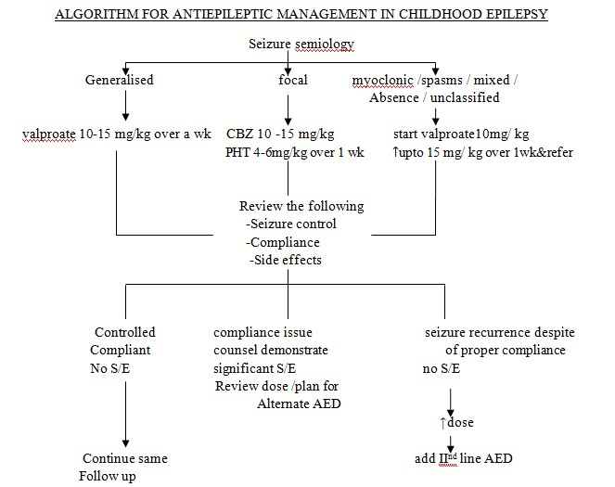


Slide 34
TREATMENT OF A NEWLY DIAGNOSED CASE OF EPILEPSY
seizure therapy:
Ist monotherarpy
IInd monotherapy/ combination therapy
ketogenic diet
Intractable epilepsy
Combination therapy, Vagus nerve stimulation (VNS).
Surgery

Slide 35
Status Epilipticus

Slide 36
Status Epilepticus: Definitions
Seizures that persist without interruption for more than 5 minutes
Two or more sequential seizures without full recovery of consciousness between seizures
This is a life threatening emergency that requires immediate treatment.

Slide 37
Status Epilepticus
Commonly occurs in children with epilepsy (9 -27% over time) .
Complications from Status Epilepticus result from both the impact of the convulsive state on the body systems (such as the cardiac and respiratory systems) and the neuronal cellular injury which leads to cell death
Rapid termination of the seizure activity protects against neuronal injury

Slide 38
Status Epilepticus: Types, Incidence & Description
Type | Incidence | Description
Remote Symptomatic SE | 33% | Status Epilepticus (SE) with no immediate event but the child had a previous history of CNS malformation, traumatic brain injury or chromosomal disorder
Acute Symptomatic SE | 26% | SE with concurrent acute illness (e.g., meningitis, encephalitis, hypoxia, trauma, intoxication)
Febrile SE | 22% | SE with a febrile illness but not a Central Nervous System infection (e.g., sinusitis, sepsis, upper respiratory infection)
Cryptogenic SE | 15% | SE with no identifiable cause
Notes:
The four most common types of status epilepticus are remote symptomatic, acute symptomatic, febrile, and cryptogenic. Each description shows identifiable causes, except for cryptogenic which has no identifiable cause.

Slide 39
Febrile Seizure

Slide 40
Febrile Seizure
Caused by the increase in the core body temp more than 38 C.
(the maximum height of a fever, rather than the rate of rise).
Threshold of temp which trigger seizures is unique to each individual.
,lower in infants and is modified by certain medications / water and electrolyte imbalances.
Seizure accompanied by fever .
Most often occur within 24 hours of the onset of a fever.
Febrile Seizure can be the first sign of illness in 25 - 50% of patients.
Children presenting with a first-time febrile seizure have 30 percent chance of having another
febrile seizure during early childhood.

Slide 41
Febrile Seizure: Characteristics
Are benign / .(2 - 5% of children ),
Occurrence: between 6 months to 5 years of age , Peak 12 - 18 months.
Febrile seizures are a common cause of convulsions in young children
Majority (65- 90%) of these are simple febrile seizure
Seizure accompanied by fever without any :
Central nervous system infection
Metabolic disturbance
History of previous seizure disorder

Slide 42
Febrile Seizure -RISK FACTORS
Viral infections :
Human herpesvirus 6(HHV-6) is commonly associated.
Administration of certain vaccines:
Diphtheria, tetanus toxoid and whole-cell pertussis (DTwP);
Measles, mumps, and rubella (MMR).
Susceptibility to febrile seizures has been linked to several genetic loci in different families.(AD)
Prenatal exposure to nicotine. Iron deficiency/ atopic diseases.

Slide 43
Febrile Seizure: Two Types
Simple Febrile
Includes all of the following:
Seizure last less than 15 minutes.
Generalized seizure.
Occurs once in a 24-hour period.
No previous neurologic problems.
Complex Febrile
One or more of the following
Prolonged (last more than 15 minutes)
Focal seizure
Occurs more than once in 24 hours.
Postictal paresis
Patient has known neurologic problems, e.g developmental delay

Slide 44
Risk factors for later epilepsy
Complex febrile seizure
Family history of epilepsy
Neurodevelopmental abnormality (e.g., cerebral palsy, hydrocephalus)
Ethnicity, sex, family history of febrile seizures, age at first febrile seizure, and height of fever are not risk factors for the subsequent development of epilepsy
5-10% of children with complex febrile seizures subsequently developed an afebrile seizure disorder.(1-2% in simple febrile seizures).

Slide 45
Febrile Seizure: ED Assessment
Baseline assessment
Vital signs (antipyretic if high temp).
Assess neurological status (AVPU).
Assess the A, B, C, Ds
Continue documenting seizure and providing aspiration precautions.
Febrile seizures that continue for more than five minutes should be treated. Intravenous benzodiazepines or lorazepam are effective in aborting seizure in many cases.
buccal midazolam is an effective alternative. Intranasal lorazepam is also an option.
The child's respiratory and circulatory status should be monitored carefully.( respiratory depression).
Physical exam
Check blood glucose
If blood glucose < 60 mg/dL, treat as appropriate

Slide 46
Febrile Seizure: ED Assessment (cont.)
Full History
Obtain seizure history from a dependable witness:
When did the seizure occur?
How long was the seizure and what did it look like?
How was the child acting immediately before the seizure?
History of previous seizures (child and family)?
History of developmental delay/recent loss of milestones?
Does the child have a current illness/fever/ day care attendance?
Any indications of trauma or abuse?
Length of postictal state?
Immunization history?
Presence of chronic illness?
List current medications
Include any antipyretics given (time and dose)/ recent antibiotic therapy.

Slide 47
Simple Febrile Seizure: ED Ongoing Management
Reassess temp and consider giving antipyretic if not previously administered.
As source of fever is identified, treat appropriately.
If still having a seizure, follow Status Epilepticus protocol.( Phenytoin)

Slide 48
Febrile Seizure: ED Management
Complete physical exam – to identify the source of fever
Lab testing – direct toward identifying the source of fever (As source of fever is identified, treat appropriately).
A complete blood count and measurement of serum electrolytes , blood sugar, calcium, and urea nitrogen.
If a decision to perform an LP has been made, blood culture and serum glucose testing should be performed concurrently.
Neuroimaging (CT/MRI) :
History or examination suggestive of trauma, or a possible structural defect (eg. microcephaly or spasticity), Focal seizures.

Slide 49
Lumbar Puncture indication
when there are meningeal signs or symptoms or other clinical features that suggest possible meningitis /encephalitis .
Infants between 6 - 12 months of age, if the immunization status for Haemophilus influenzae type b (Hib) or Streptococcus pneumoniae is deficient or undetermined
Current treatment with antibiotics ( antibiotics can mask the signs and symptoms of meningitis).
Febrile status epilepticus (FSE)
Seizures that occur after the second day of a febrile illness/ Focal

Slide 50

Simple Febrile Seizure: Diagnostic Testing
 | EEG | CT/MRI
Simple Febrile Seizure | Should not be performed in a neurologically healthy child. Results are not predictive of recurrence or development of epilepsy | Not indicated
Notes:
The American Academy of Pediatrics’ guidelines recommend neuroimaging should not be performed as part of a routine evaluation of a child with a simple febrile seizure. If the child has a complex febrile seizure, an EEG and CT or MRI can be helpful, but this can be performed as an outpatient.

Slide 51

LONG TERM MANAGEMENT
§
Current guidelines do not recommend the use of continuous or intermittent therapy with phenobarbital or benzodiazepines after a simple febrile seizure.
No medication reduce the risk afebrile seizure after simple febrile seizure.

Slide 52
Simple Febrile Seizure: Family Education
Here are some frequently asked questions parents/caregivers may have prior to discharge:
Is my child brain damaged?
There is no evidence of impact on learning abilities after seizure from SFS.
Will this happen again?
If child is under 12 months of age at time of first seizure, recurrence rate is 50%
If child is greater than 12 months of age at time of first seizure, recurrence rate is 20%.
Most recurrences(50-75% )occur within 12 months of the initial febrile seizure.

Slide 53
Simple Febrile Seizure: Family Education (cont.)
Will my child get epilepsy?
For simple febrile seizures, there is no increased risk of epilepsy
Why not treat for possible seizures or fever?
Anticonvulsants can reduce recurrence. However potential side effects of medications outweigh the minor risk of recurrence
Prophylactic use of antipyretics does not have impact on recurrence
For complex febrile seizures, there is a slight increase in the risk of epilepsy.

Slide 54
Simple Febrile Seizure: Family Education(cont.)
Instruct parent/caregivers to prevent injury during a seizure:
Position child while seizing in a side-lying position
Protect head from injury
Loosen tight clothing about the neck
Prevent injury from falls
Reassure child during event
Do not place anything in the child’s mouth
Rectal Diazepam, Given for seizures lasting longer than 5 minutes.

Slide 55
Simple Febrile Seizure: Disposition
Prior to discharge home…
Educate regarding use of:
Thermometer
Antipyretics for fever management
When to contact 9-1-1 or ambulance 997
Call after 5 minutes of seizure activity
Identify a Primary Care Provider for follow-up appointment and stress importance of follow-up
Provide developmentally appropriate explanation of event for child and family members.
Provide family with rectal Diazepam

Slide 56
Rolandic epilepsy
An idiopathic focal epilepsy , evidence for genetic basis, Onset ages 2-12 yrs, peak 5-10 yrs,
Characteristic of the seizures :
Infrequent simple partial seizures. usually last less than 2 minutes.
Twitching, usually in the face, but it can include the arms and/or legs
Numbness and tingling in the face or tongue. Drooling, problems speaking.
If awake, full awareness during the seizure
In early morning or before bedtime. (can happen during sleep), Rarely generalized tonic–clonic seizur in sleep.
Characteristic EEG : high voltage centrotemporal spikes, usually bilateral. MRI is normal.
Treatment : Respond to many drugs, may not be necessary . Resolve by puberty.

Slide 57
Infantile epileptic spasms syndrome (IESS)
Incidence 1 in 3,000 children.
Onset in the first year of life, mainly 4-8 months of age.
Causes of IESS. (70%):
Congenital malformation of the brain.(Cortical dysplasia, lissencephaly, holoprosencephaly)
Birth asphyxia.
Meningitis/ Encephalitis .
Mutation in a gene & chromosomal abnormalities . Common in down syndrome.
Neurocutaneous syndromes mainly tuberous sclerosis.
Inborn errors of metabolism ( Phenylketonuria,
congenital infections affecting the CNS (toxoplasmosis, syphilis, cytomegalovirus, and Zika virus )
Idiopathic ( 30 %).
West syndrome : The triad of epileptic spasms, arrest of psychomotor development, and EEG pattern known as hypsarhythmia .

Slide 58
Infantile epileptic spasms syndrome (IESS)
Characteristic of the seizures:
Brief axial contractions
usually bilateral, may be asymmetrical
typically flexor, may be extensor
usually in clusters, less likely random
typically on awakening, or when drowsy
EEG shows hypsarrhythmia ( In West syndrome):
multifocal spikes
high voltage, chaotic background.
Treatment : Respond to prednisolone/ ACTH IM/ Vigabatrin.

Slide 59
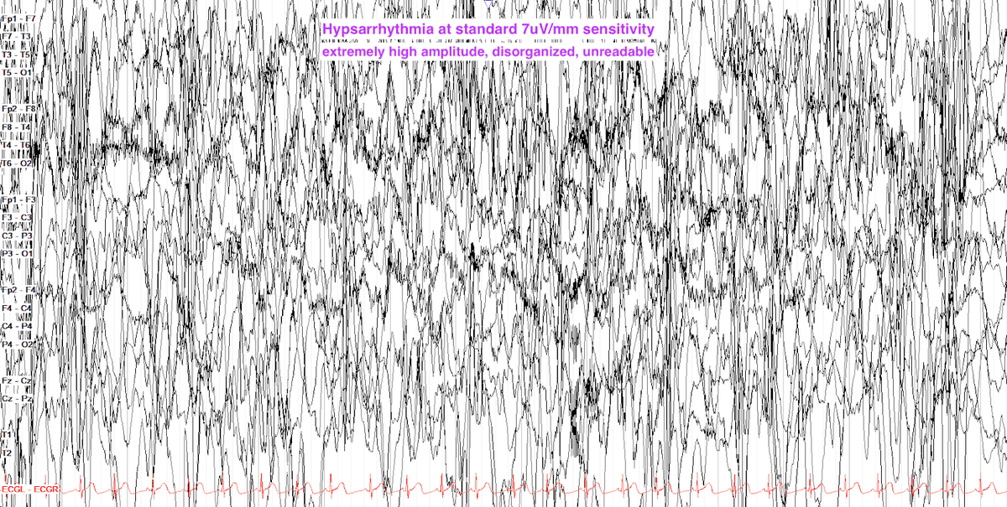

Slide 60
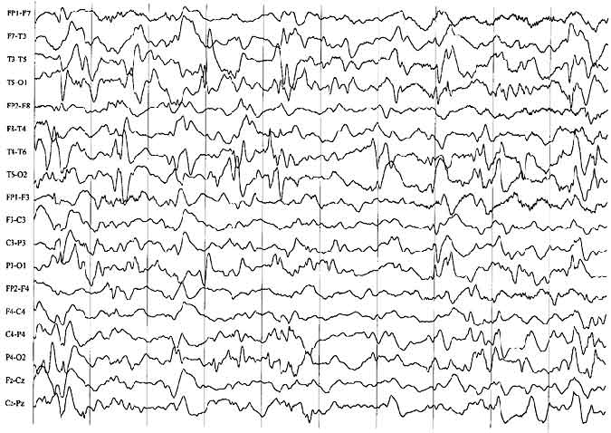
Hypsarrhythmia. This is a pattern of disorganized background activity and high-voltage spikes and slow waves.

Slide 61
JUVENILE MYOCLONIC EPILEPSY (JME)
It is the most common generalized epilepsy syndromes of childhood , occurs in healthy adolescents.
with one or more of the following seizure types:
●Myoclonic jerks (most frequent in the morning, within the first hour after awakening).
●Absence seizures ("typical" petit mal seizures that often precede the other seizures).
●Generalized tonic-clonic seizures, which also tend to occur upon awakening.
Seizures are usually controlled with a broad-spectrum antiseizure medication.

Slide 62
LENNOX-GASTAUT SYNDROME
Itis a lifelong, severe developmental epileptic encephalopathy
Onset of seizures in childhood usually in the first seven years of life.
Associated with treatment-resistant epilepsy, intellectual disability and often with behavioral impairments.
Characterized by multiple seizure types, particularly tonic and atonic seizures.
An atypical, slow spike-wave pattern on electroencephalogram (EEG).

Slide 63
Thank you

