Slide 1
Approach to Hemolytic Anemia
DR Mansour ALQurashi

Slide 2
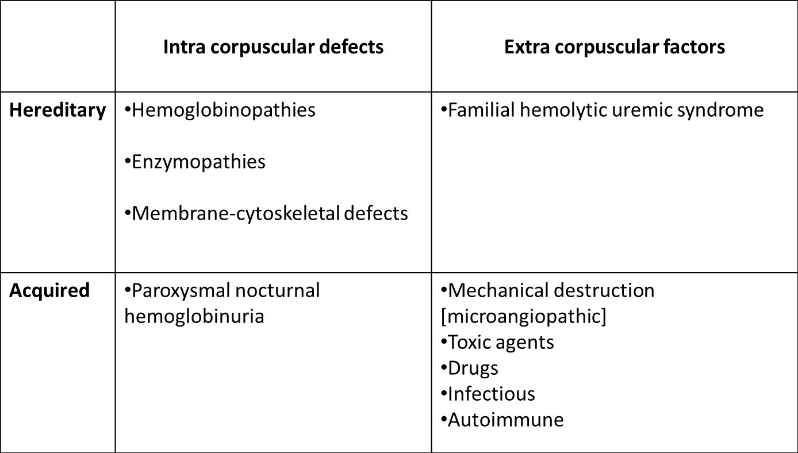
CLASSIFICATION OF HEMOLYTIC ANEMIAS

Slide 3
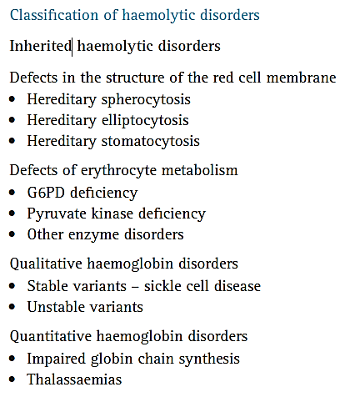

Slide 4
How is Hemolytic Anemia Diagnosed?
Two main principles
Confirm hemolysis
Determine the etiology

Slide 5
The Key To The Etiology Of Hemolytic Anemia
The history
The peripheral blood film

Slide 6
How to diagnose hemolytic anemia
New onset pallor or anemia
Jaundice
Splenomegaly
Gall stones-Calciumbilirubinate stones
Dark colored urine (hemoglobinuria)
Leg ulcers (poor circulation and microinfarcts, healing is delayed and infection becomes established).

Slide 7
Patient History
Acute or chronic
Medication/Drug precipitants
G6PD
AIHA
Family history
Concomitant medical illnesses
Clinical presentation

Slide 8
GENERAL FEATURES OF HEMOLYTIC DISORDERS
General Examination - Jaundice, Pallor, Bossing Of Skull
Physical Findings - Enlarged Spleen
Hemoglobin - From Normal To Severely Reduced
MCV - Usually Increased
Reticulocytes - Increased
Bilirubin - Increased[mostly Unconjugated]
LDH - Increased
Haptoglobulin - Reduced To Absent

Slide 9
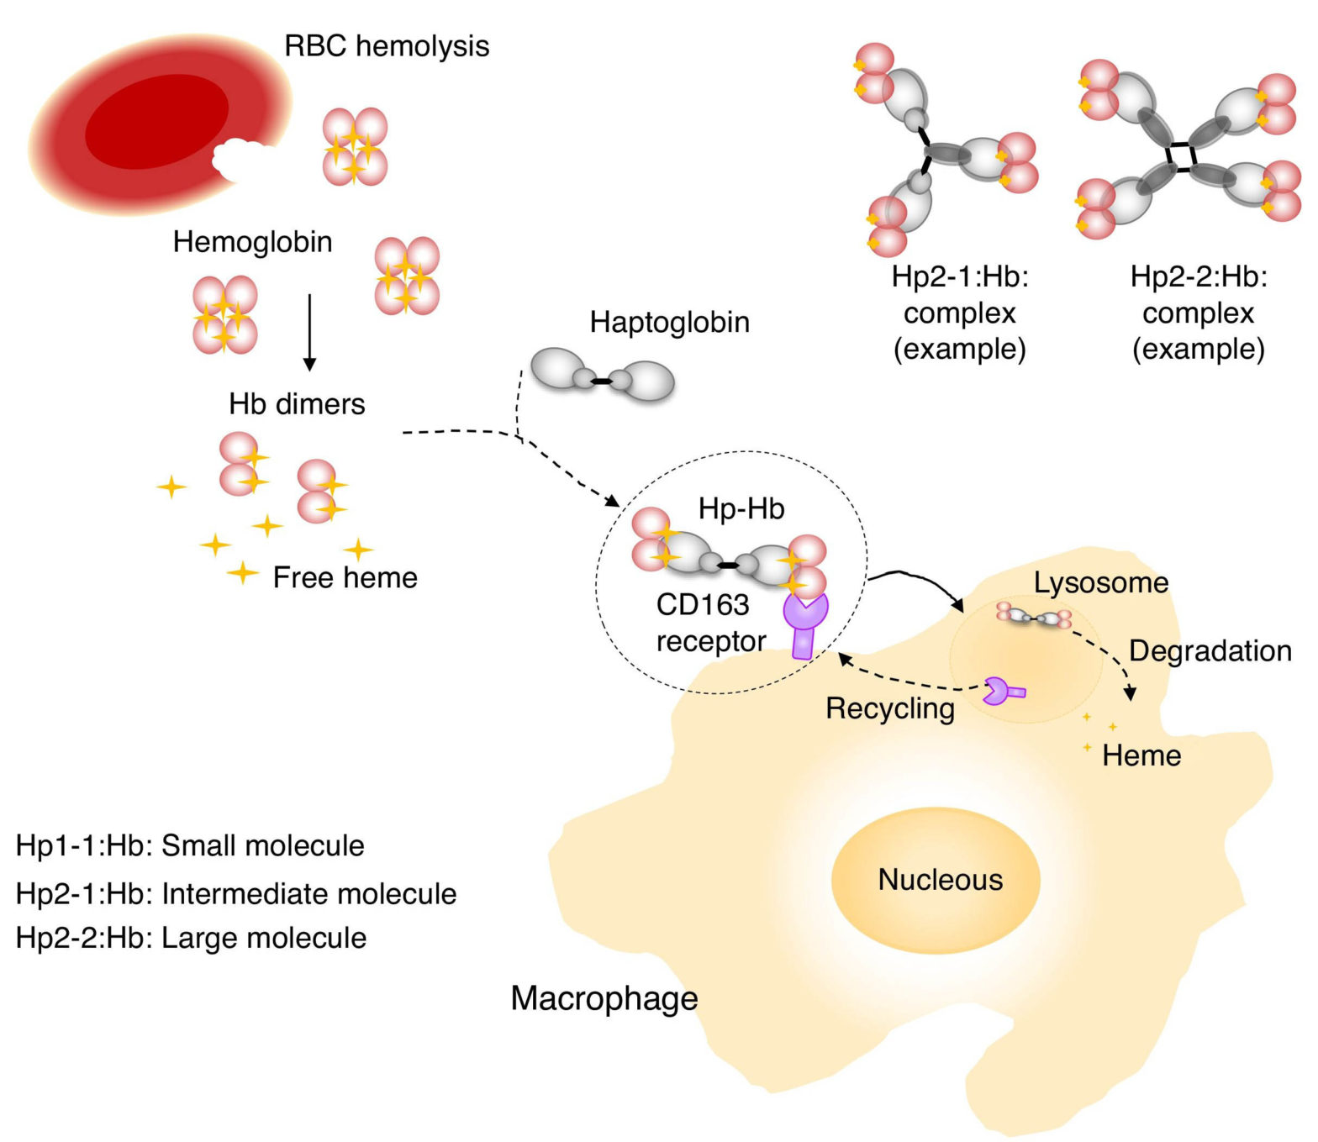

Slide 10
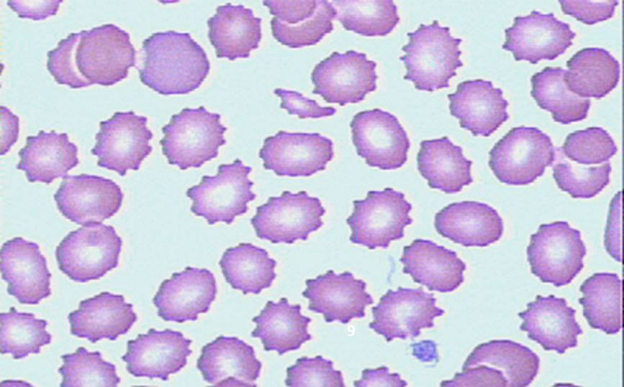
Laboratory Diagnosis of Hemolytic Anemia:
Evidence for Red cell Destruction
PERIPHERAL BLOOD SMEAR →
Burr Cell
Tear drop cell Intravascular Hemolysis
Fragmented cell
Spherocytes → H. spherocytosis
Malaria → Malaria parasite
Sickle cells → Sickle cell anemia
ii) Plasma haptoglobin & Plasma hemopexin → ↓
iii) Plasma Hb ↑
iv) Serum LDH & Serum Carboxy Hb → ↑
v) Indirect bilirubin & urobilinogin → ↑
vi) Red cell survival → ↓ Using Chromium 52

Slide 11
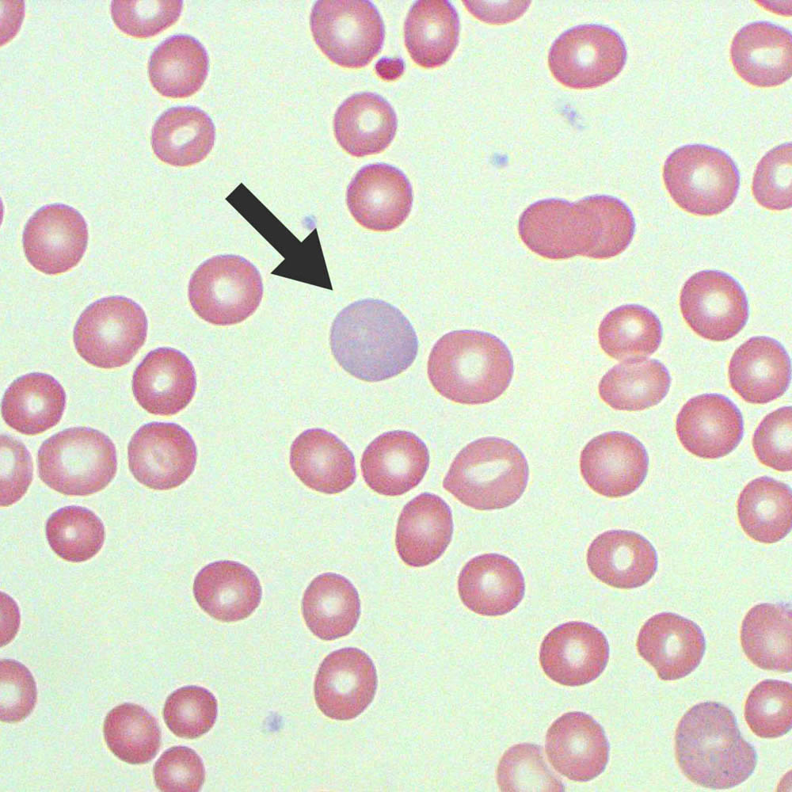
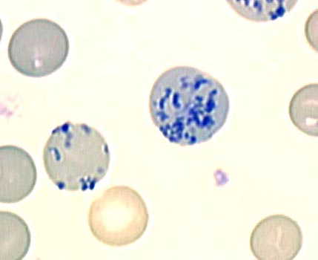
Evidence of Red cell Generation:
1) Peripheral blood smear
Polychromasia
&
Nucleated red cells
2) Reticulocyte count → ↑
POLYCHROMATOPHILIC CELLS

Slide 12
Laboratory Evaluation of Hemolysis
 | Extravascular | Intravascular
HEMATOLOGIC
Routine blood film Reticulocyte count Bone marrow examination | Polychromatophilia Erythroid hyperplasia | Polychromatophilia Erythroid hyperplasia
PLASMA OR SERUM
Bilirubin Haptoglobin Plasma hemoglobin Lactate dehydrogenase | Unconjugated , Absent N/ (Variable) | Unconjugated Absent (Variable)
URINE
Bilirubin Hemosiderin Hemoglobin | + 0 0 | + + + → severe cases

Slide 13
Thalassemia

Slide 14
Thalassemia sydromes are a heterogenous group of inherited anemias characterised by reduced or absent synthesis of either alpha or Beta globin chains of Hb A.
Most common single gene disorder
Autosomal recessive
Beta thal - point mutations on chromosome 11

Slide 15
BASICS - 3 types of Hb
1. Hb A - 2 α and 2 β chains forming a tetramer
97% adult Hb
Postnatal life Hb A replaces Hb F by 6 months
2. Fetal Hb – 2α and 2γ (gamma) chains
1% of adult Hb
70-90% at term. Falls to 25% by 1st month and progressively
3. Hb A2 – 2 α and 2 δ chains (delta)
1.5 – 3.0% of adult Hb

Slide 16
Classification
If synthesis of α chain is suppressed – level of all 3 normal Hb A
(2α ,2β), A2 (2α ,2 δ), F(2α ,2γ) reduced – alpha thalassemia
Hb H (β₄)
Hb-Bart’s (ץ₄)
If β chain is suppressed - adult Hb is suppressed - beta thalassemia
β⁺ thal : reduced synthesis of β globin chain, heterozygous
β ⁰ thal : absent synthesis of β globin chain, homozygous----Hb A - absent
Hb F (α₂ ץ₂)
Hb A₂ (α₂ δ₂)

Slide 17
Beta Thalassemia

Slide 18
EFFECTS OF MARROW EXPANSION
Pathological fractures due to cortical thinning
Deformities of skull and face
Sinus and middle ear infection due to ineffective drainage
Folate deficiency
Hypermetabolic state -> fever, wasting
Increased absorption of iron from intestine
JAUNDICE
Unconjugated hyperbilirubinemia - hemolysis
Hepatitis - transfusion, hemochromatosis
GB stones - obstructive jaundice
cholangitis

Slide 19
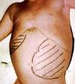
HEPATOMEGALY
Extra medullary erythropoeisis
Iron released from breakdown of endogenous or transfused RBCs cannot be utilized for Hb synthesis – hemosiderosis
Hemochromatosis
Infections – transfusion related - Hep B,C, HIV
Chronic active hepatitis
SPLENOMEGALY
Extra medullary hematopoeisis
Work hypertrophy due to constant hemolysis
Hypersplenism (progressive splenomegaly)

Slide 20
INFECTIONS
Poor nutrition
Increased iron in body
Blockage of monocyte-macrophage system
Hypersplenism- leukopenia
Infections associated with transfusions

Slide 21
ACCUMULATION OF IRON
Deposition in pituitary - endocrine disturbance, short stature, delayed puberty, poor sec. sexual characteristics
Hemochromatosis - cirrhosis of liver
Cardiomyopathy (cardiac hemosiderosis) -cardiac failure, sterile pericarditis, arrythmias, heart block
Deposition in pancreas -diabetes mellitus
Lungs: restrictive lung defects
Adrenal insufficiency
Hypothyroidism, hypoparathyroidism
Increased susceptibity to infections (iron favours bacterial growth) espc : Yersinia infections

Slide 22
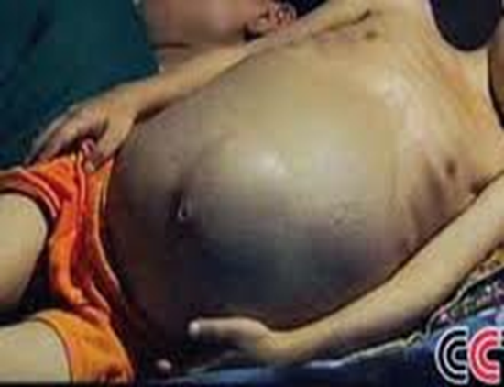
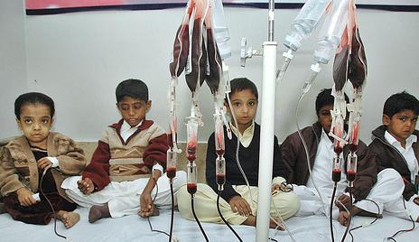
Clinical manifestations of Thalassemia Major
INFANTS:
Age of presentation: 6-9 mo (Hb F replaced by Hb A)
Progressive pallor and jaundice
Cardiac failure
Failure to thrive, gross motor delay
Feeding problems
Bouts of fever and diarrhea
Hepatosplenomegaly
BY CHILDHOOD:
Growth retardation
Severe anemia-cardiac dilatation
Transfusion dependant
Icterus
Changes in skeletal system

Slide 23

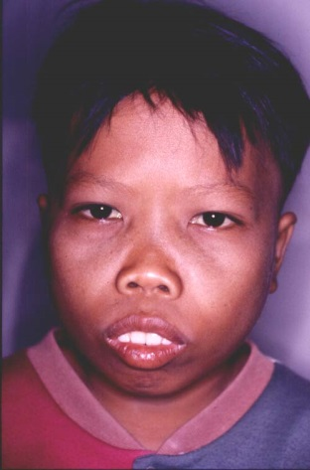
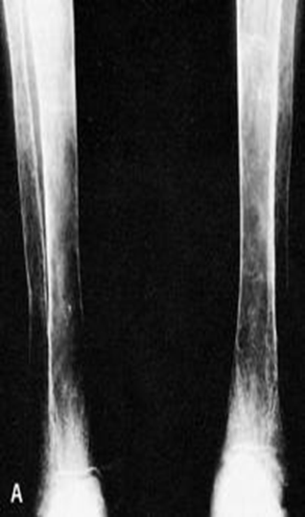

SKELETAL CHANGES
CHIPMUNK FACIES (HEMOLYTIC FACIES):
Frontal bossing, maxillary hypertrophy,
depression of nasal bridge , Malocclusion of teeth
PARAVERTEBRAL MASSES:
Broad expansion of ribs at vertebral attachment
Paraparesis
PATHOLOGICAL FRACTURES:
Cortical thinning (in long bones)
Increased porosity of long bones
DELAYED PNEUMATISATION OF SINUSES
PREMATURE FUSION OF EPIPHYSES -Short stature

Slide 24
Other changes
Delayed menarche
Gall-stones, leg ulcers
Evidence of hypersplenism

Slide 25
Clinical Features of Thalassemia Intermedia
Moderate pallor, usually maintains Hb >6gm%
Anemia worsens with pregnancy and infections (erythroid stress)
Less transfusion dependant
Skeletal changes present, progressive splenomegaly
Growth retardation
Longer survival than Thal major

Slide 26
Clinical Features Of Thalassemia Minor
Usually ASYMPTOMATIC
Mild pallor, no jaundice
No growth retardation, no skeletal abnormalities, no splenomegaly
MAY PRESENT AS IRON DEFICIENCY ANEMIA (Hypochromic microcytic anemia)
Unresponsive/ refractory to Fe therapy
Normal life expectancy

Slide 27
Lab Findings and investigations
Hb Electrophoresis
Beta thalassemia major | Beta thalassemia intermedia | Beta thalassemia minor
HbF - 90-96 HbA2- 3.5 %- 5.5% HbA - 0 % | HbF - 20-100% HbA2 -3.5%-5.5% HbA – 0-30% | HbF-1-5% HbA2-3.5-7.5% HbA-80-95%
Hb A- 97% adult Hb (2α and 2β chains) Postnatal life Hb A replaces Hb F by 6 months Hb F -1% of adult Hb (2α and 2γ chains) 70-90% at term. Falls to 25% by 1st month and progressively Hb A2- 1.5 – 3.0% of adult Hb (2 α and 2 δ chains)

Slide 28
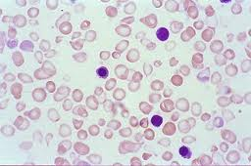
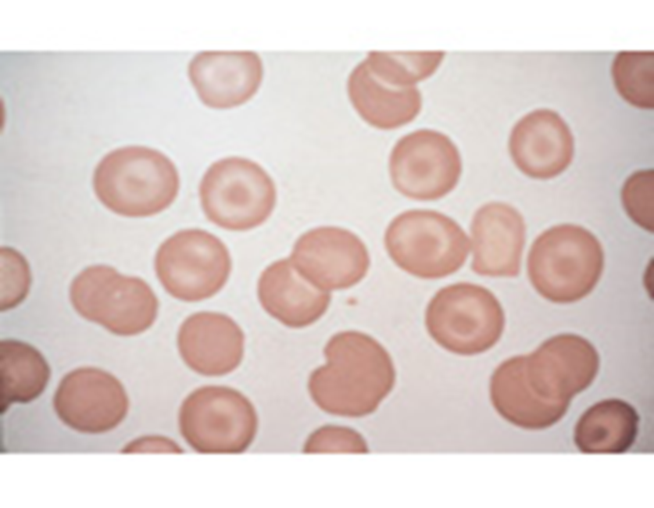
Peripheral smear
Target cells
peripheral blood film shows – anemia, high reticulocytes, numerous nucleated cell, microcytosis

Slide 29
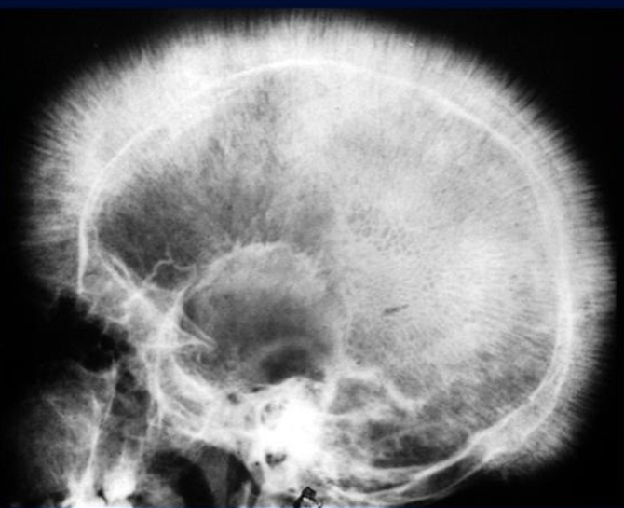
Unconjugated bilirubin- increased
Serum ferritin and transferrin – elevated
X- ray- bone marrow hyperplasia, Skull – interrupted porosity gives hair on end appearance
DNA analysis - confirm, prenatal diagnosis, detection of carrier
Liver function test
Infection screen- HIV, Hepatitis B and C, VDRL (before first transfusion)
HLA typing ( for all patient with unaffected siblings)

Slide 30
Treatment
Bone marrow transplant(cure!)
HLA- matched siblings
Blood transfusion……………… life-long
Goal : Hb – 9.5 g/dl( Post)
Maintain : Hb 12-12.5g/dl and <15.5g/dl (mean post)
Interval : 2-6 weekly interval( mean 4)
Volume : 15-20ml/kg (max) over 4 hours.
Hypertransfusion: Maintaining the Hb above a minimum of 10 g/dL.
Normotransfusion: Promotes normal growth and development, prevents the onset of severe hepatosplenomegaly and hemolytic facies, lowers the absorptionof gastrointestinal iron and reduces the anemia/ cardiomyopathy changes

Slide 31
Supertransfusion: Maintain pre-transfusion Hb of above 12 g/dL.
Moderate transfusion: In Europe, a newer regimen has been adopted and recommended by the Thalassemia International Federation. In this regimen, pretransfusion Hb is maintained between 9 g/dL and 10.5 g/dL.
Assess Iron Overload via :
S. Ferritin Urinary Fe excretion
Liver biopsy Chemical analysis of tissue Fe
Endomyocardial biopsie Myocardial MRI indexes
Ventricular function – ECHO, ECG

Slide 32
Iron Chelation Therapy ( Prevent hemosiderosis, haemochromatosis)
When- > 2years old and serum ferritin reaches 1000ng/ml (10-20 tranfusions)
Deferoxamine(Desferal) : Aim: Serum ferritin <1000ng/ml.
-> SC over 10-12 hours via continuous infusion pump
-> 5-7 days per week (severity dependent)
Deferiprone/L1( Kelfer/Ferriprox) Given: oral
Dosage : 75-100mg/kg/day in 3 doses/daily
Deferasirox (Exjade)-new
Targets: >2years
Dosage: 20-30mg/kg/day in liquid dispersible tablet ( once!)
Splenectomy
Indications: a)T. Intermediate- falling steady state Hb
b) Transfused- Rising transfusion needs

Slide 33
Newer therapies:
GENE MANIPULATION AND REPLACEMENT
Remove defective β gene and stimulate γ gene
5-azacytidine increases γ gene synthesis
Hb F AUGEMENTATION
Hydroxyurea
Myelaran
Butyrate derivatives
Erythropoetin in Thal intermedia

Slide 34
Monitoring
Each time
Clinical assessment : Height, Weight, Liver and Spleen size
Pre transfusion Hb, platelet , Post transfusion(half hour)
Volume transfused
Every 3-6 months
1 Growth &Development
2.Serum Ferritin
3.LFT

Slide 35
Every year (/more)
Growth &Development
Endocrine assessment( RBS,T4/TSH,Ca(PTH and vit D,Po4)
Pubertal and Sexual (>10years)
FSH,LH,Estrogen and testosterone
Infection screen (Hep B and C , HIV, VDRL) (6 monthly)
Cardiac assessment- ECG, Echo
Liver Iron store

Slide 36
IDA vs THALASSEMIA
Iron deficiency anaemia
Thalassemia
Low ferritin.
High TIBC.
Normal or low retics.
High RDW
Normal or high ferritin.
normal or low TIBC.
High retics.
Normal RDW
The following findings are noted in individuals with alpha thalassemia trait :
asymptomatic/ mild anemia
Hemoglobin level - Within the reference range
Reticulocyte count - Normal
MCV - 65-75 fL (80–100 fl)
MCH - Around 22 pg (27 to 31)

Slide 37
Sickle Cell Disease
“Sickle cell disease (SCD) is a term used for a group of genetic disorders characterized by production of Hb “S”.
Sickle cell hemoglobinopathy occurs due to mutation of beta-globin gene situated on short arm of chromosome 11, where adenine is replaced by thymine in base of DNA coding for the amino acid in the sixth position in
beta-globin chain.

Slide 38
Pathophysiology
The “sol” (soluble) form of Hb changes to “gel” form, when Hb “S” is deoxygenated
↓
In gel form the Hb crystallizes to small, rigid, boat-shaped objects known as ‘’tactoids’’. These tactoids polymerize forming insoluble structure, deforming the RBC to sickle shape
↓
The RBC membrane becomes more fragile
↓
The polymerization is facilitated by increased concentration of Hb “S”, acidic pH, low oxygen saturation, stasis of blood flow, decreased levels of Hb”F”
↓

Slide 39
Upon reoxygenation the sickle cell initially resumes normal configuration, but with repeated cycles of sickling and unsickling, fixation of membrane occurs in sickled configuration, leading to irreversible sickle cell formation, and hemolysis.
↓
Platelets aggregate over the adherent red cells and damaged endothelium, causing blockage of microvasculature and ischemia of the tissue.
↓
Infarction of liver, spleen, muscles & bones. (Hepatomegaly & Jaundice, abd. Pain & fibrosis & ↓ spleen size, bone & joint pain).

Slide 40
Sickle cells sequestered in RE cells and are hemolysed → Anemia
Chronic Hypoxia → * Clubbing of fingers & toes
* Chronic Leg ulcer
* Growth retardn.
↑Bilirubin turnover → Pigment stones

Slide 41
Vaso-Occlusive Crisis
Hand-Foot Syndrome
Obstruction of capillaries of BM causes ischemic necrosis and death of BM, and initiates inflammatory response, increasing intramedullary pressure
Clinically there is swelling over the affected bones with severe pain and tenderness
In younger children, this process is most marked in small bones of hands and feet, causing “Hand-foot syndrome” or dactylitis . Above 5 years the pain distribution reflects articular areas of long bones.

Slide 42
Avascular Necrosis
Avascular necrosis of bone occur secondary to vasoocclusion of nutrient artery. Femoral head, humerus, upper-third of tibia can be affected, but weight bearing makes femoral head necrosis more likely to cause severe disability.
Painful Abdominal Crisis
Painful abdominal crisis occurs due to localized areas of bowel dysfunction due to vaso-occlusion .There is severe abdominal pain and signs of peritoneal irritation. Persistence of bowel sound differentiates its acute abdomen from requiring surgical exploration. It usually resolves in a period of 3–5 days. The management consists of bowel rest, maintenance of hydration by intravenous fluids. (obstruction of small blood vessels in intestine)

Slide 43
Acute Chest Syndrome
It occurs due to vaso-occlusion of pulmonary vessels leading to infarction and pulmonary sequestration. Superadded infection complicates the issue. It is an important cause of mortality and morbidity in children under 3 years of age.
Stroke
Common age group is 3–10 years. Around 70–90% patients experience repeated episode of stroke within 36 months unless they are on transfusion regimen maintaining Hb”S” level below 30%.
Priapism
Priapism is persistent painful penile erection. Recurrent acute episodic attacks last from few minutes to several hours. It usually subsides spontaneously. Impotency may be a sequel. Blood transfusion is indicated if pain, engorgement persists for 24–48 hours.

Slide 44
Other Features of Vaso-occlusive Crisis
Epistaxis is a frequent complaint
Retinal infarcts, retinal detachment, vitreous hemorrhage may occur
Non-healing chronic leg ulcers

Slide 45
Sequestration Crisis
The event is characterized by sudden trapping of large amount of blood in spleen or less commonly in liver. presents with profound anemia and shock.
Dramatic regression of splenomegaly and increase in Hb level occurs with prompt correction of hypovolemia and blood transfusion.
Splenic dysfunction occurs due to obstruction of sinusoidal blood flow, causing diversion of blood through intrasplenic shunts, bypassing phagocytic reticuloendothelial element of the spleen.
Children with palpable spleen at 6 months of age are at high risk of pneumococcal septicemia.
Emergency condition
To prevent recurrence> splenectomy

Slide 46
Aplastic Crisis
The causative organism is Parvovirus B19, leading to destruction of erythroid precursors in BM. The child presents with acute anemia, without reticulocytosis. The condition is always self-limiting with duration of 7–10 days. Megaloblastic Crisis
It occurs due to sudden arrest of erythropoiesis due to folate depletion. Chronic erythroid hyperplasia drains the folate reserve and folate deficiency occurs. The Hb level can drop to 2–3 g/dl. Treatment is by oral folate supplementation.

Slide 47
Clinical Features
Moderate to severe anemia.
Mild jaundice.
Non healing leg ulcers.
Decreased physical growth & delayed puberty.
Clubbing of fingers & toes.
Enlarged heart and hemic murmur.
Hepatomegaly
Splenomegaly in the beginning.
Sickle cell crisis – Pains & aches
↑ jaundice
↑ anemia
fever

Slide 48
Complications:
Bones → Dactylytis and chronic osteomyelitis,
→ Aseptic necrosis of head of femur
Eyes → Sudden blindness
Brain → Neurological deficits & emotional disturbances

Slide 49
Diagnosis
Screening test of older children can be done sickling test
Diagnosis can be confirmed by Hb electrophoresis, globin DNA analysis.
Antenatal diagnosis can be done at 8–10 weeks of gestation, with chorionic villus biopsy, or amniocentesis. DNA analysis using PCR.

Slide 50
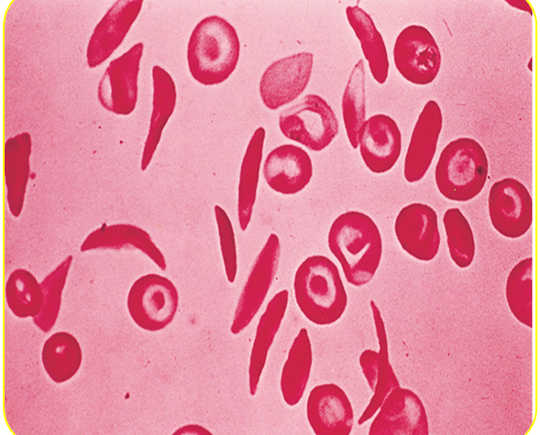
Peripheral smear: Deformed sickle shaped red cells

Slide 52
Treatment
Painful Crisis
Mild pain: codeine, aspirin, ibuprofen, acetaminophen, naproxen.
Severe pain: meperidine, tolmetin, oxycodone. Ketamine.
Vasodilators : Pentoxifylline, nifedipine, and buflomedil increase microvascular circulation.
Hydration
Blood transfusion: may be appropriate if pain is accompanied by another complication such as stroke or ACS.
Hydroxyurea: leads to increase in Hb“F”, which ameliorates the severity of SCD

Slide 53
Prevention
Avoid precipitating factors for crisis- Exposure to hypoxia, dehydration, extreme cold, extreme heat, change in altitude, infections
Avoid Dehydration and loss of electrolytes may lead to red cell dehydration precipitating sickling process
Parent’s education
Immunization: pneumococcal and Influenzae (Hib) vaccine. Hepatitis B vaccine
Hemoglobin levels should be maintained at 10–12 g/dl.
Folate supplementation
Genetic counseling and mass education of high-risk
Oral penicillin prophylaxis . Oral penicillin should be given to children up to the age of 5 years

Slide 54
Newer Treatment:
Agents stimulating Hb F
Hydroxy urea
5 – aza cytidene
Butyrates
Agents ↓ Hbs concentration
DDAVP : a synthetic version of antidiuretic hormone
Nifedepine, verapamil
Membrane active agents – Zinc
Hb solubility increasing agents
Cyanate
Urea
Phenyl alanine
A life-long cure for SCD is available only through hematopoietic stem cell transplantation

Slide 55
G6PD Deficiency Hemolytic Anemia

Slide 56
“It is an inherited disease characterized by hemolytic anemia caused by inability to detoxify oxidized agents”.
Inherited X-linked recessive disease
Most common enzyme-related hemolytic anemia
Highest prevalence: Middle East, Tropical Africa Asia and Mediterranean

Slide 57
Mode of inheritance
It is X- linked recessive genetic disorder (gene is carried on X chromosome).
The inheritance follows specific pattern:
Males have one X chromosome
So, they will be diseased if they have the affected gene (xY)
Females have 2 X chromosomes
may be homozygous or heterozygous
Homozygous: are diseased (xx)
Heterozygous: are not diseased BUT: carriers (Xx) & can transfer the disease to their sons

Slide 58
The function G6PD in the red cell is to generate NADPH → reduced glutathione → protect the RBCs from the oxidative damage by H₂O₂
Reduction of amounts of NADPH in RBCs in G6PD deficiency causes decrease
in reduction of oxidized glutathione to reduced glutathione.
Role of reduced glutathione in RBCs:
1- Reduced glutathione gets rid of ROS including hydrogen peroxide.
2- Reduced Glutathione helps to keep sulfhydryl groups of hemoglobin
protein in the reduced state.

Slide 59
Reduction of production of reduced glutathione results in:
1- A decrease in detoxication of peroixides. This causes damage to RBCs
membrane and hemolysis (ending in hemolytic anemia).
2- Hemoglobin protein is denatured forming insoluble masses (Heinz
bodies). Heinz bodies attach to red cell membranes. Membrane proteins are also oxidized. Accordingly, red cells become rigid and removed from the circulation by macrophages in the spleen and liver ending in anemia.
Deficiency of G6PD occurs in all cells of affected individual. It is severe in RBCs because the only pathway to form NADPH in RBCs is pentose phosphate pathway (using G6PD).

Slide 60
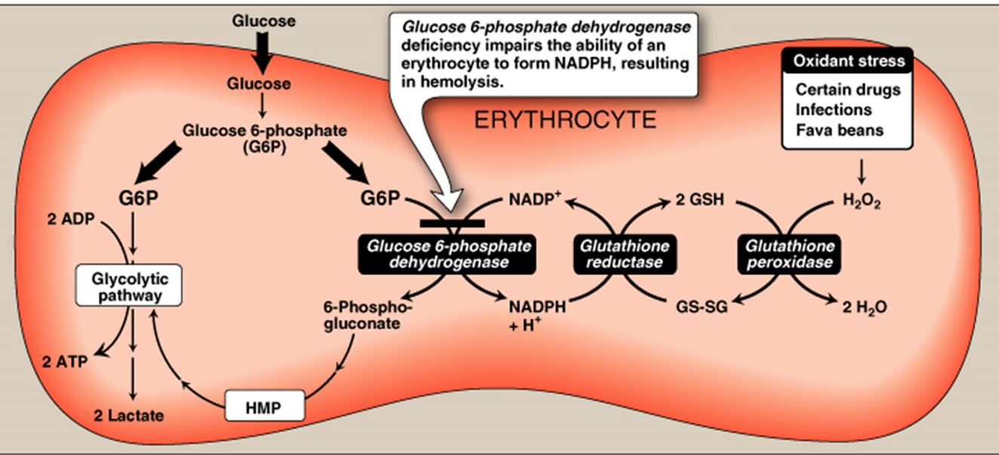
Biochemical Basis of G6PD Deficiency Hemolytic Anemia Decreased amounts of reduced glutathione due to decreased production of NADPH

Slide 61
In G6PD deficiency ; younger RBC contain 6% of the normal amount of enzyme, sufficient to provide reducing power for every day needs.
G6PD deficiency usually does not cause any symptoms unless the patient takes one of a number of drugs, such as the anti-malarial primaquine. The administration of one of these drugs causes rapid and often severe hemolysis and jaundice

Slide 62
Clinical Features:
Acute hemolysis: red blood cells no longer transport oxygen effectively
Drugs, infections , diabetic acidosis
Favism: Some G6PD deficient individuals are allergic to fava beans and the smell of the fava pollen.
Neonatal jaundice:
Jaundice most often appears within the first 24 hours of life in (Class I variants).
Some G6PD-deficient neonates, if undiagnosed soon after birth, could present later in the first week of life with generalized jaundice, poor feeding, lethargy, breathing difficulty, or seizures. can lead to kernicterus. Class II or III.

Slide 63
Clinical Features
Other conditions caused by G6PD deficiency:
Chronic nonspherocytic hemolytic anemia: male , history of neonatal jaundice present with anemia, unexplained jaundice, or gallstones later in life. , severe deficiency (eg, activity <10 percent at baseline). neutrophil dysfunction
Abdominal& back pain, dizziness, irregular breathing, and palpitations.
G6PD deficient patients have increased resistance to Infestation by fal malaria

Slide 64
 | Definitive risk | Possible risk | Doubtful risk
antimalarials | Primaquine Dapsone cholrproguanil | chloroquine | quinine
Sulphonamides/ sulphones | Sulphametoxazole Dapsone | Sulfasalazine Sulfadimidine | Sulfisoxazole Sulfadiazine
Antibacterials/ Antibiotics | Cotrimoxazole Nalidixic acid Nitrofurantoin | Ciprofloxacin Norfloxacin | Cholramphenicol p-Aminosalicylic acid
Antipyretic/ Analgesics | Acetanilide Phenazopyridine [pyridium] | Acetylsalicylic acid High dose[>3g/d] | Acetylsalicylic acid [<3g/d] Acetaminophen

Slide 65
Diagnosis
Diagnosis of hemolytic anemia: CBC and reticulocytic count
Peripheral smear: bite cells, heinz bodies (Oxidation of sulfhydryl groups of proteins inside RBCs causes protein denaturation and formation of insoluble masses ), and polychromasia
Screening: Qualitative assessment of G6PD enzymatic activity (UV-based test), if initial testing is negative and a suspicion for G6PD deficiency remains, testing should be repeated approximately three months after the hemolytic episode has resolved.
Confirmatory test: Quantitative measurement of G6PD enzymatic activity
Molecular test:
Detection of G6PD gene mutation

Slide 66
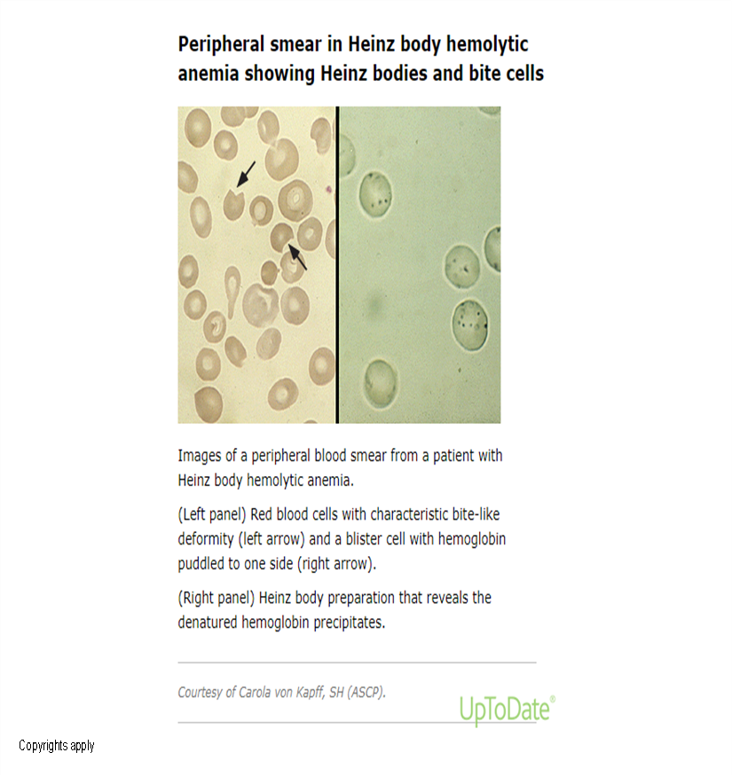
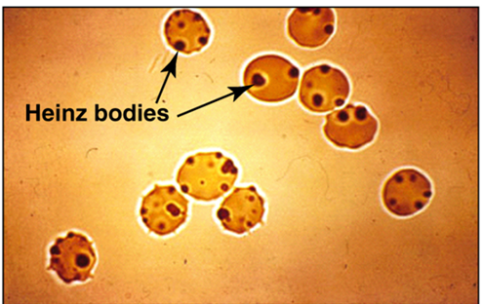

Slide 67
A1C values underestimate blood glucose in G6PD deficiency
Glycated hemoglobin (A1C) estimates average blood glucose over time. When red blood cell turnover increases, as in hemolytic anemias, there is less time for hemoglobin to be glycosylated, and the A1C underestimates glycemia.

Slide 68
Treatment
Scientists can genetic engineer fava bean, so that it will no longer react to G6PD individual’s red blood cells.
The best treatment now is prevention: G6PD deficient people should not eat fava beans or take drugs that contain oxidizing agent.

Slide 69
Hereditary Spherocytosis

Slide 70
Red Cell Membrane Defects
Hereditary Spherocytosis
inherited as AD disorder
Defect: Deficiency of Beta Spectrin or Ankyrin → Loss of membrane surface area→ becomes more spherical→ Destruction in Spleen

Slide 71
“Characterized by Hemolysis, intermittent jaundice, splenomegaly with the spherocytes in the peripheral smear being its morphologic hallmark”.
may present in the newborn period with anemia and severe hyperbilirubinemia
prone to aplastic crisis following parvovirus infection, or megaloblastic crisis due to folate deficiency
Some patients may develop or rarely even present with symptomatic gallstones

Slide 72
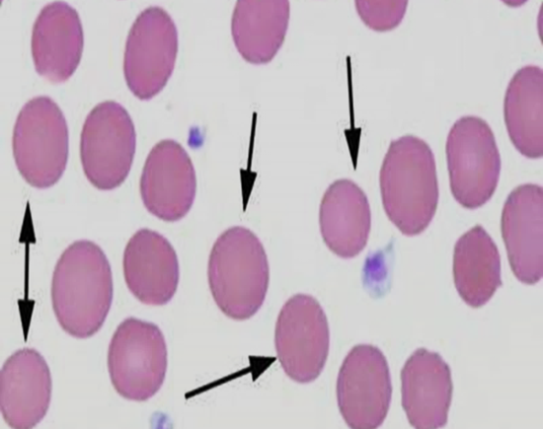
Laboratory Features
Hb mildly decreased or normal, normal MCV, high MCH content
Marked reticulocytosis
Peripheral smear: hyperchromatic spherocytes

Slide 74
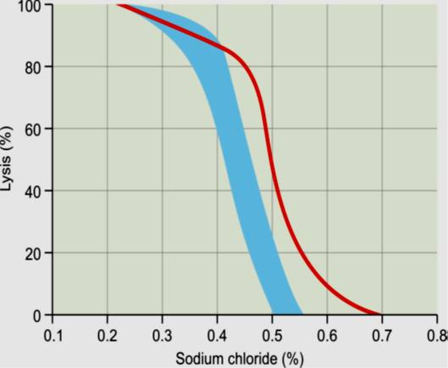
Osmotic fragility test
The most common diagnostic screening test used is osmotic fragility test. Red cells in HS show increased osmotic fragility when incubated with hypotonic NaCl solutions in vitro, yielding a diagnostic osmotic fragility curve
fresh RBCs are incubated in hypotonic buffered salt solutions of various osmolarities, and the fraction of hemoglobin released (due to hemolysis) is measured. spherocytic RBCs have reduced surface area to volume (SA/V) ratio.

Slide 75
Neonates with HS
Neonates with HS tend to have an elevated MCHC (typical range in HS, 35 to 38 g/dL) . This is a useful discriminator between HS and hemolytic disease of the fetus and newborn (HDFN). Increased RDW.
EMA binding Assay: high sensitivity; rapid turnaround time (approximately two hours); and need for only a minimal amount of blood (a few microliters),
it detects loss mainly of band 3 and Rh-related proteins from the RBC membrane, using EMA, an eosin-based fluorescent dye, that binds to those RBC membrane proteins.
reduction in fluorescence can be detected in a flow cytometry-based assay

Slide 76
Quantitation of membrane proteins, especially spectrin content is possible by flow cytometric or gel electrophoretic analysis.
Osmotic gradient ektacytometry – Osmotic gradient ektacytometry (OGE) .
definitive diagnosis of HS can be made on the basis of family history, red cell indices and morphology and a positive screening test
Screen family members : Hereditary spherocytosis can be an autosomal recessive or autosomal dominant trait

Slide 77
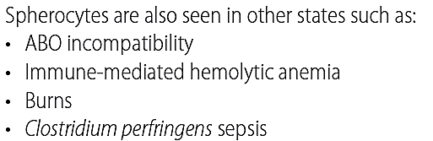
Differential diagnosis of Spherocytes

Slide 78
Management
Basic supportive care is advised to all patients
• Lifelong folate supplementation
• Prevention of iron deficiency
• Prompt treatment of infections.
• Blood transfusion may be required on a regular basis in
severe episodes of acute hemolysis, or during aplastic crisis.
Erythropoietin :may be helpful in reducing the need for
transfusion in some infants .
• Regular follow-up is recommended to monitor growth,
spleen size, Hb trend, and occurrence of gall stones

