Slide 1
BREASTFEEDING AND ALTERNATIVE TO BREASTFEEDING prepared by:DR.SALMA ELGAZZAR
MRCPI-pediatrics
Master’s degree in Pediatrics Alexandria University

Slide 2
LEARNING OBJECTIVES:
Identify the major differences between human milk and commonly available formulas.
Describe the advantages of breastfeeding and recognize common difficulties experienced by breastfeeding mothers.

Slide 3


Slide 4
ADVANTAGES OF BREAST FEEDING
Breastfeeding, also known as nursing, is the feeding of babies and young children with milk from a woman’s breast.
Advantages of breastfeeding for the baby
Superior nutrition ,perfectly balanced and nutritionally complete food for babies.
Breast milk is sterile ,always fresh, self regulated and at proper temperature.
There is an increased resistance to infections.
Decreased risk of allergies ( atopic eczema ,allergic rhinitis ,asthma and allergic gastroenteropathy ) and lactose intolerance .
Baby experiences less nappy rash and thrush .
Baby experiences fewer stomach upsets and constipation .
Breastfed infants tend to have fewer cavities .

Slide 5
Breastfeeding promotes the proper development of baby’s jaw and teeth.
Breastfed infants tend to have higher IQs due to good brain development early in life .
Babies benefit emotionally, because they are held more.
Breastfeeding promotes mother-baby bonding
In the long term, breastfed babies have a decreased risk of malnutrition, obesity and heart disease compared to formula fed babies.
Breast milk contains anti-inflammatory properties.

Slide 6
Advantages of breastfeeding for the mother
The baby's sucking causes a mother’s uterus to contract and reduces the flow of blood after delivery
During lactation, menstruation ceases, offering a form of contraception
Mothers who breastfeed tend to lose weight and achieve their pre-pregnancy figure more easily than mothers who bottle feed
Mothers who breastfeed are less likely to develop breast cancer & ovary cancer later in life
Breastfeeding is more economical and convenient than formula feeding
There are less trips to the doctor and less money is spent on medications
Breastfeeding promotes mother-baby bonding
Hormones released during breast-feeding create feelings of warmth and calm in the mother

Slide 7
The stages of lactation can be summarized as follows :
Mammogenesis:
Mammary (breast) growth occurs. The size and weight of the breast increase.
Lactogenesis
In lactogenesis, the mammary gland develops the capacity to secrete milk.
Stage 1 occurs by mid pregnancy. In stage 1, the mammary gland becomes competent to secrete milk.
Lactose, total protein, and immunoglobulin concentrations increase within the secreted glandular fluid, whereas sodium and chloride concentrations decrease.
The gland is now sufficiently differentiated to secrete milk, as evidenced by the fact that women often describe drops of colostrum on their nipples in the second or third trimester.
High circulating levels of progesterone and estrogen hold the secretion of milk in check.

Slide 8
Stage 2 of lactogenesis
Occurs around the time of delivery. It is defined as the onset of copious milk secretion.
Blood flow, oxygen, and glucose uptake increase, and citrate concentration increases sharply.
Increased milk citrate is considered a reliable marker for the second stage of lactogenesis.
Galactopoiesis (later than 9 d after birth to beginning of involution): Established secretion is maintained. Autocrine system control continues.
Involution
(average 40 d after last breastfeeding):
Milk secretion decreases from the buildup of inhibiting peptides.

Slide 9
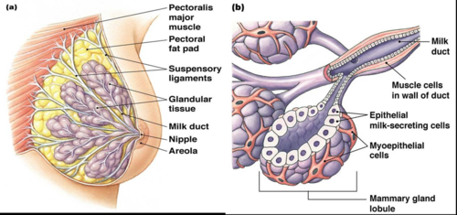

Slide 10
BREAST FEEDING REFLEXES
A- MATERNAL REFLEXES:
Initiated via suckling of the mother’s nipple by the baby
Nipple erection reflex
Prolactin reflex: Sensory stimuli to hypothalamus stimulate the anterior pituitary to secrete prolactin which is transported by blood stream to the glandular cells (cuboidal cells in the acini) of the breast alveoli where it stimulates the secretion of milk.
Oxytocin reflex ( let-down reflex or milk-ejection reflex)
Similarly ,oxytocin is reflexly secreted from posterior pituitary and stimulates the contraction of the myoepithelial cells surrounding the alveoli thus forcing milk into larger ducts

Slide 11
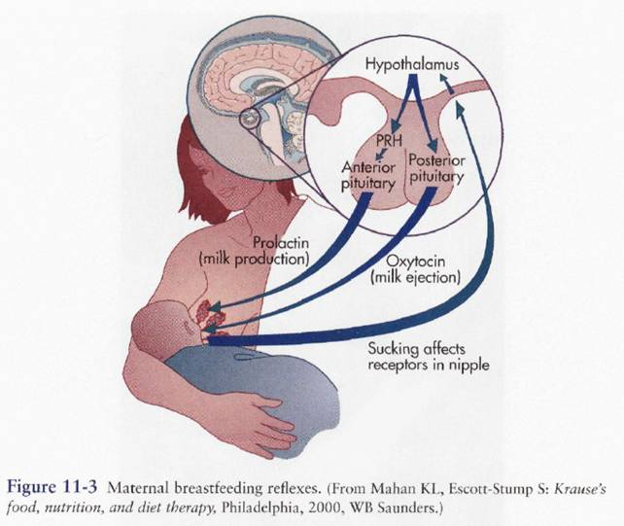
PHYSIOLOGY OF LACTATION

Slide 12
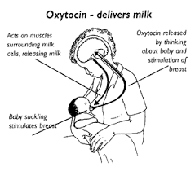
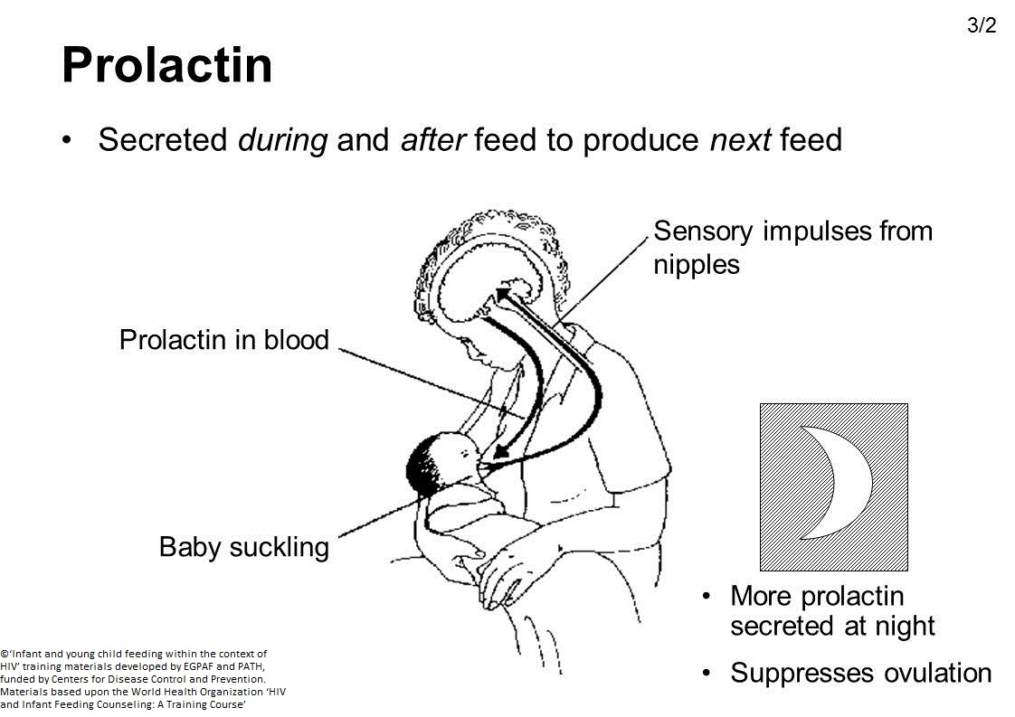

Slide 13
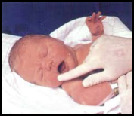

B- NEONATAL FEEDING REFLEXES:
Rooting reflexes: Touching of the cheek or circumoral area leads to turning the head to the side of the stimulus & opening the mouth as the baby is seeking for the nipple.
Sucking (or suckling) reflex:
The tactile stimulus caused by the nipple and areolar tissue filling the mouth leads to a milking action by the tongue against hard palate.

Slide 14
3-swallowing reflex:
Follows suckling and allows interruption of breathing to prevent chocking secretion

Slide 15
FACTORS INFLUENCING MILK PRODUCTION AND EJECTION
Endocrinal
Autocrine control:
If the milk is not regularly removed from the breast , an inhibitory peptide will accumulate leading to stoppage of milk secretion ,after few weeks ,the amount of milk production becomes proportionate to the extent of breast evacuation.
Psychological:
No factor is more important than a happy relaxed state of mind.
Let-down reflex can be initiated by maternal emotional factors as sight or sound of the hungry baby or even the thought of nursing the baby.
Let-down reflex is suppressed by worry ,fear and unhappiness.
Adequate balanced maternal nutrition.
Sufficient rest

Slide 16

Drugs & smoking:
Chlorpromazine may enhance milk secretion.
Estrogen-containing contraceptive,diuretics and smoking may suppress lactation.
Domperidone is the most effective medicine used to improve breast milk supply by stimulating the release of prolactin, which in turn stimulates breast milk production.

Slide 17
COMPOSITION OF BREAST MILK
Breast milk contains complex proteins, lipids, carbohydrates and other biologically active components. The composition changes over a single feed as well as over the period of lactation.
1- Variability according to stage of lactation:
A- Colostrum.
B- Transitional milk :
follows the colostrum.
C-mature milk:
Is secreted by the 10th-20th day after delivery

Slide 18
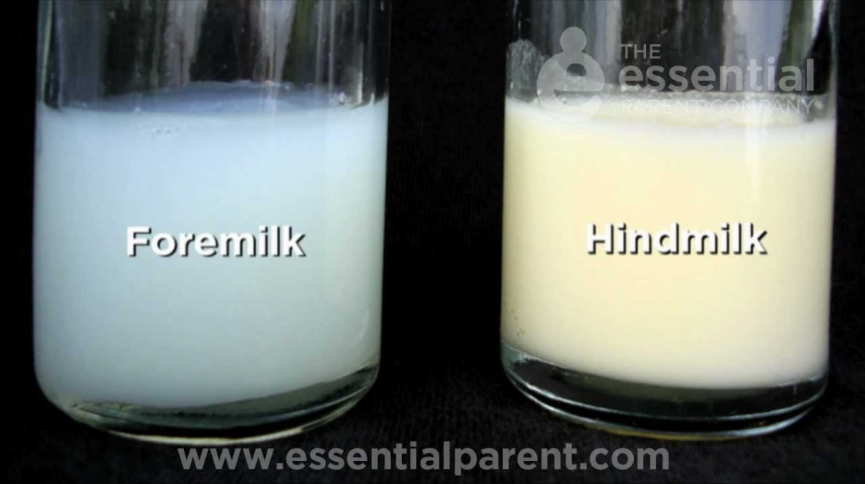
2- Diurnal variation:
Fat contents at midday is 2.5 fold that in early morning or night
3- Variation within each feed:
Fat content of the last amount of milk in each feed ( hind-milk) is 3 fold that in first drops (fore-milk).
This helps in achieving baby’s satiety ,thus preventing overfeeding and obesity in breast-fed infants.
4- Variation according to gestational age:
In case of premature baby, the protein and mineral contents are increased.

Slide 19
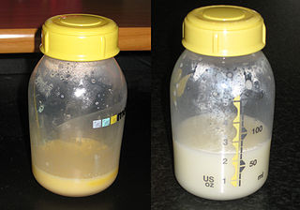
COLOSTRUM
Secreted during the first few days ( 5 days) after delivery.
It is rich in protein & antibodies (especially secretory IgA )that provide passive immunity to the baby (the baby's immune system is not fully developed at birth).
More rich in cholesterol ,macro- minerals (Na,K,…) , microminerals , vit. A
Rich in leukocytes (macrophages and lymphocytes) and anti bacterial factors (lactoferrin & lysozyme)
Colostrum also helps the newborn's digestive system to grow and function properly.

Slide 20
COMPOSITION OF BREAST MILK
Human milk contains 0.8% to 0.9% protein, 4.5% fat, 7.1% carbohydrates, and 0.2% ash (minerals).
CARBOHYDRATES
Are mainly lactose.
Several lactose-based oligosaccharides have been identified (as minor components) which act as prebiotics to promote growth of lactobacilli.
THE FAT FRACTION
contains specific triglycerides of palmitic and oleic acid (O-P-O triglycerides), and also lipids with trans bonds .
The lipids are vaccenic acid, and Conjugated linoleic acid (CLA) accounting for up to 6% of the human milk fat.
High contents of cholesterol helps myelination of nervous system and protects against atherosclerosis and coronary disease in later life.
Breast milk is rich in lipase that can digest 90% of milk triglycerides in the bile in intestine.

Slide 21
PROTEINS
Most of proteins 70% is soluble easily digested whey protein
Whey : casein ratio is 60:40
The principal proteins are alpha-lactalbumin, lactoferrin (apo-lactoferrin), IgA, lysozyme, and serum albumin.
In an acidic environment such as the stomach, alpha-lactalbumin unfolds into a different form and binds oleic acid to form a complex called HAMLET that kills tumor cells. This is thought to contribute to the protection of breastfed babies against cancer.
Non-protein nitrogen-containing compounds, making up 25% of the milk's nitrogen, include urea, uric acid, creatine, creatinine, amino acids, and nucleotides.
VITAMINS AND MINERALS
Low phosphate content prevents neonatal hypo calcemic convulsions
Low renal solute load (minerals content is ¼ that of cow’s milk)
Low sodium content prevents hypernatremia & sudden infant death.
Low risk of iron deficiency anemia during the 1 st 6 months of life due to better iron absorption ( acidic bowel medium and the presence of large amounts of vit.C,E & copper

Slide 22
ANTI-INFECTIVE PROPERTIES
Humoral
Secretory IgA comprises 90% of immunoglobulin in human milk ,provides mucosal protection.
Bifidus factor promotes growth of lactobacillus bifidus ,which metabolises lactose to lactic acid and acetic acids , the resulting low PH may inhibit growth of gastrointestinal pathogens.
Lysozyme bacteriolytic enzyme
Lactoferrin iron-binding protein inhibits growth of Escherichia coli
Interferon antiviral agent.
Cellular
Macrophages phagocytic synthesise lysozyme ,lactoferrin ,C3,C4
Lymphocytes T cells may transfer delayed hypersensitivity responses to infant
B cells synthesise Ig A

Slide 23
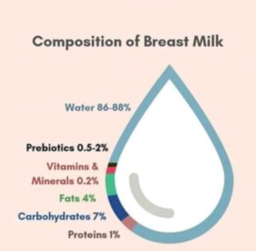
Composition of human breast milk
Fat (g/100 ml)
total | 4.2
fatty acids - length 8C | trace
polyunsaturated fatty acids | 0,6
cholesterol | 0,016
Protein (g/100 ml)
total | 1.1
casein | 0.4
a-lactalbumin | 0.3
lactoferrin (apo-lactoferrin) | 0.2
IgA | 0.1
IgG | 0.001
lysozyme | 0.05
serum albumin | 0.05
ß-lactoglobulin | -
Carbohydrate (g/100 ml)
lactose | 7
oligosaccharides | 0.5
Minerals (g/100 ml)
calcium | 0.03
phosphorus | 0.014
sodium | 0.015
potassium | 0.055
chlorine | 0.043

Slide 24
Breastfeeding Policy of the Department of Health
The Department of Health is committed to protecting, promoting and supporting breastfeeding through advocacy; implementation of“Ten Steps to Successful Breastfeeding”
Ten Steps to Successful Breastfeeding
Have a written breastfeeding policy that is routinely communicated to all healthcare staff.
Train all healthcare staff in skills necessary to implement this policy.
Inform all pregnant women about the benefits and management of breastfeeding.
Help mothers to initiate breastfeeding within a half-hour of birth.
Show mothers how to breast feed, and how to maintain lactation even if they are separated from their infants.
Give newborn infants no food or drink other than breastmilk, unless medically indicated.
7.Practise rooming-in, allow mothers and infants to remain together 24 hours a day.
8. Encourage breast feeding on demand.
9. Give no artificial teats or pacifiers(also called dummies or soothers)to breastfeeding infants.
10. Foster the establishment of breastfeeding support groups and refer mothers to them on discharge from the hospital or clinic.

Slide 25
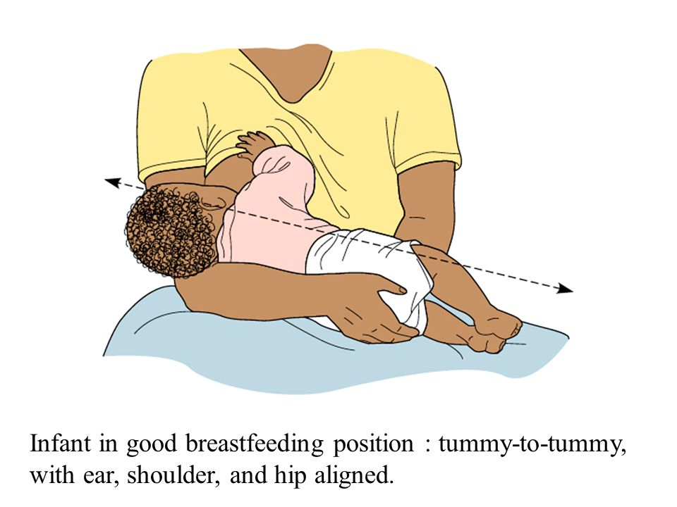


Slide 26
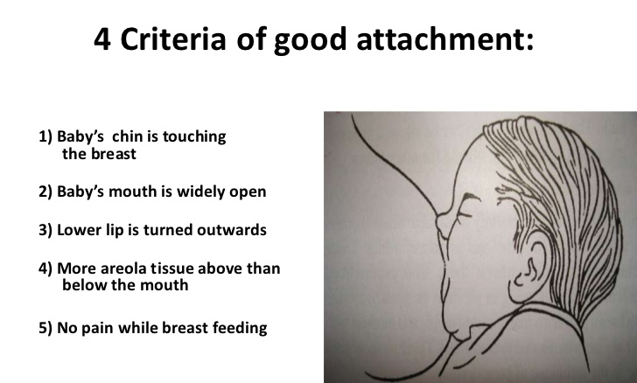

Slide 27
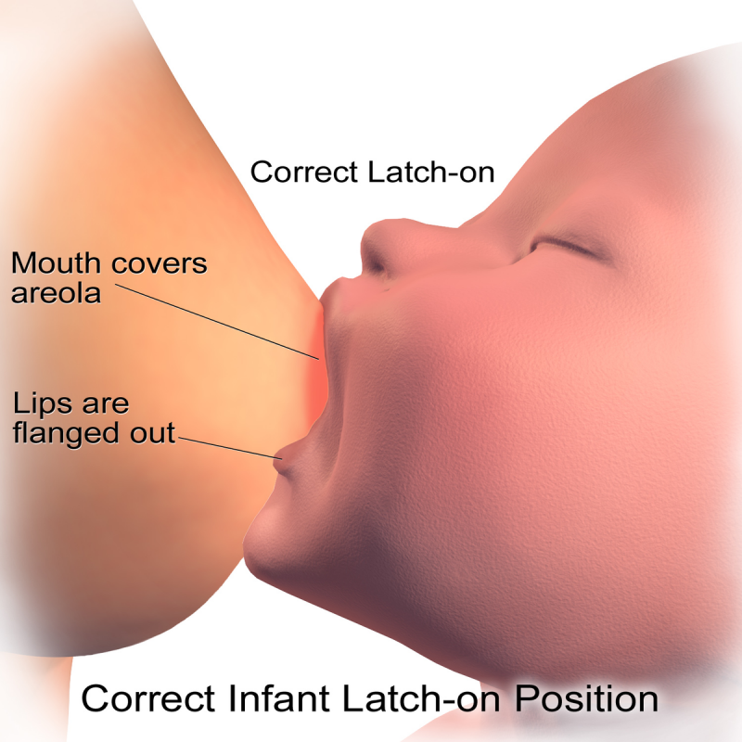
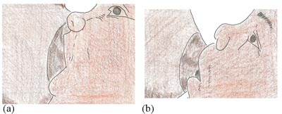

Slide 28
COMMON DIFFICULTIES DURING BREAST FEEDING
1-Breast engorgement:
Symptoms:
The breasts are swollen and edematous, and the skin looks shiny and diffusely red.
The whole of both breasts are affected, and they are painful.
Fever that usually subsides in 24 hours.
The nipples may become stretched tight and flat which makes it difficult for the baby to attach and remove the milk.
Cause:
Failure to remove breast milk, especially in the first few days after delivery.
The common reasons why milk is not removed adequately are delayed initiation of breastfeeding, infrequent feeds, poor attachment and ineffective suckling.

Slide 29
Management:
The mother must remove the breast milk.
If the baby can attach well and suckle, then she should breastfeed as frequently as the baby is willing.
If the baby is not able to attach and suckle effectively, she should express her milk by hand or with a pump a few times until the breasts are softer, so that the baby can attach better, and then get him or her to breastfeed frequently.
She can apply warm compresses to the breast or take a warm shower before expressing, which helps the milk to flow.
She can use cold compresses after feeding or expressing, which helps to reduce the oedema.

Slide 30
2-Mastitis :
Symptoms:
Hard swelling in the breast, with redness of the overlying skin and severe pain.
Usually only a part of one breast is affected.
Fever and feeling ill.
Mastitis is commonest in the first 2–3 weeks after delivery but can occur at any time.
Causes:
An important cause is long gaps between feeds, for example when the mother is busy or resumes employment outside the home, or when the baby starts sleeping through the night.
Other causes include poor attachment, with incomplete removal of milk; unrelieved engorgement; frequent pressure on one part of the breast from fingers or tight clothing; and trauma.
Mastitis is usually caused in the first place by milk staying in the breast, or milk stasis, which results in non-infective inflammation.
Infection may supervene if the stasis persists, or if the woman also has a nipple fissure that becomes infected.
The condition may then become infective mastitis.

Slide 31
Management:
Improve the removal of milk and try to correct any specific cause that is identified.
Advise the mother to rest, to breastfeed the baby frequently and to avoid leaving long gaps between feeds.
No stop of breastfeeding.
Analgesics (if available, ibuprofen, which also reduces the inflammation of the breast; or paracetamol).
If symptoms are severe, if there is an infected nipple fissure or if no improvement is seen after 24 hours of improved milk removal, the treatment should then include penicillinase-resistant antibiotics (e.g., flucloxacillin).
N.B antibiotics will not be effective without improved removal of milk.

Slide 32
3-Breast abscess
Symptoms:
A painful swelling in the breast, which feels full of fluid. There may be discoloration of the skin at the point of the swelling.
Cause: Usually secondary to mastitis that has not been effectively managed.
Management:
An abscess needs to be drained and treated with penicillinase-resistant antibiotics.
When possible drainage should be either by catheter through a small incision, or by needle aspiration (which may need to be repeated).
Placement of a catheter or needle should be guided by ultrasound.
A large surgical incision should be avoided.
The mother may continue to feed from the affected breast. However, if suckling is too painful or if the mother is unwilling, she can be shown how to express her milk, and advised to let her baby start to feed from the breast again as soon as the pain is less, usually in 2–3 days.
She can continue to feed from the other breast. Feeding from an infected breast does not affect the infant .
Sometimes milk drains from the incision if lactation continues.
This dries up after a time and is not a reason to stop breastfeeding.

Slide 33
4-Sore or fissured nipple
Symptoms:
The mother has severe nipple pain when the baby is suckling.
There may be a visible fissure across the tip of the nipple or around the base.
The nipple may look squashed from side-to-side at the end of a feed, with a white pressure line across the tip.
Cause:
The main cause is poor attachment.
This may be due to the baby pulling the nipple in and out as he or she suckles, and rubbing the skin against his or her mouth; or it may be due to the strong pressure on the nipple resulting from incorrect suckling.
Management:
The baby can continue breastfeeding normally.
There is no need to rest the breast – the nipple will heal quickly when it is no longer being damaged.
Always start feeding with a healthy breast that does not have an injury.
Enhancing the baby's position and attachment, demonstrate to the mother the criteria for good attachment and ensure her understanding.
After feeding let the nipples air dry to speed up healing
Anti-sore cream containing lanolin can be applied
Applying cold backs between feeds can help reduce pain and swellings
If nipple pain is preventing the baby from emptying the breast, a breast pump can be used to empty the breast to give the nipple a chance to heal and prevent engorgement

Slide 34




Slide 35
5- Perceived insufficiency and low breast-milk production
Symptoms which make a mother think that her breast milk is insufficient include:
The baby crying a lot, and seeming not to be satisfied with feeds.
The baby wanting to feed very often or for a long time at each feed.
The breasts feeling soft.
Not being able to express her milk.
These symptoms can occur for other reasons, and they do not necessarily show that a baby's intake is low.
If a mother is worried about her milk supply, it is necessary to decide if the baby is taking enough milk or not.
LOW BREAST-MILK INTAKE
Signs:
There are two reliable signs that a baby is not getting enough milk:
Poor weight gain.
Low urine output.

Slide 36
Poor weight gain
Soon after birth a baby may lose weight for a few days.
Most recover their birth weight by the end of the first week, if they are healthy and feeding well.
All babies should recover their birth weight by 2 weeks of age.
From 2 weeks, babies who are breastfed may gain from about 500 g to 1 kg or more each month.
The baby should be checked for illness or congenital abnormality and urine output.
The technique and pattern of breastfeeding, and the mother-baby interaction should also be assessed, to decide the cause of poor weight gain.
Low Urine Output
An exclusively breastfed baby who is taking enough milk usually passes dilute urine 6-8 times or more in 24 hours.
If a baby is passing urine less than 6 times a day, especially if the urine is dark yellow and strong smelling, then he or she is not getting enough milk.

Slide 37
Reasons why a baby may not get enough breast milk
BREASTFEEDING FACTORS | MOTHER: PSYCHOLOGICAL FACTORS | MOTHER: PHYSICAL CONDITION | BABY'S CONDITION
■ delayed start | ■ lack of confidence | ■ Contraceptive pill, diuretics | ■ Illness
■ Feeding at fixed times | ■ depression | ■ Pregnancy | ■ Abnormality
■ Infrequent feeds | ■ Worry, stress | ■ severe malnutrition
■ no night feeds | ■ dislike of breastfeeding | ■ Alcohol
■ short feeds | ■ Rejection of baby | ■ smoking
■ Poor attachment |  | ■ Retained piece of placenta
■ Bottles, pacifiers |  | ■ Pituitary failure (rare)
■ other foods or fluids (water, teas) |  | ■ Poor breast development (very rare)
THESE ARE COMMON |  | THESE ARE NOT COMMON

Slide 38
6-SHORT-TERM SEPARATION SUCH AS EMPLOYMENT OUTSIDE THE HOME
The commonest reason for a mother being separated from her baby for part of the day is because she is employed outside the home.
Management
She should be encouraged to breastfeed the baby as much as possible when she is at home, and to consider expressing her milk to leave for someone else to give to her baby.
How to maintain her milk supply
Breastfeed her baby whenever she is at home, such as at night and weekends.
Sleep with her baby, so that she can breastfeed at night and early in the morning.
Express milk in the morning before she leaves for work.
Express her milk while she is at work to keep up the supply.
She can refrigerate the milk if this is possible, or keep it for up to 8 hours at room temperature and bring it home.
If this is not possible, she may have to discard it. She needs to understand that the milk is not lost – her breasts will make more. If a mother does not express when at work, her milk production will decrease.

Slide 39
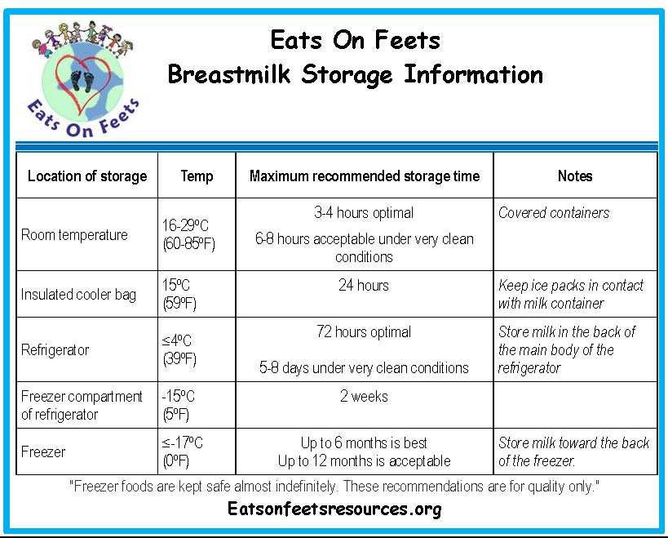

Slide 40
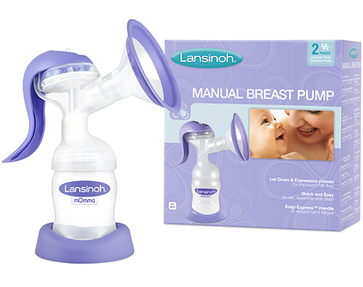
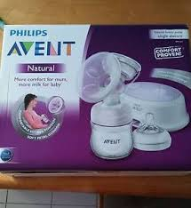

Slide 41
Alternative to breast feeding
(formula feeding)
Breastfeeding for all infants is the best, but if it is impossible , a formula as compositionally close to breast milk as possible is desirable
INDICATIONS OF FORMULA FEEDING
Death of mother.
Institutes and nurseries.
Absolute contraindications to breast feeding (e.g. galactosemia and maternal AIDS )
Failure of lactation : no or very little milk.
Supplemental feeding (both breast milk and formula):
Suitable for employed mothers ( as a second option after expressed breast milk ) ,multiple delivery or if the amount of breast milk is inadequate.

Slide 42
FORMULA FEEDING
Created in a lab, and in most cases, is commercially altered cow’s milk.
Formula does not contain the same antibodies found in breast milk.
There are substances added to formula to help protect babies from illness but these are not as easily absorbed by baby as breast milk and do not offer the same kind of protection. Higher concentrations of vitamins and minerals in formula make it more difficult to digest and more likely that your baby will suffer:
      Gas
      Constipation
      Upset stomach
Formula fed babies have a higher risk of SIDS.
Formula is expensive.
A 2013 World Health Organization report found formula fed babies scored lower on IQ tests than those who were breastfed.
Formula must be prepared following certain guidelines to ensure it is sterile , Bottles must always be thoroughly cleaned and sanitized.

Slide 43
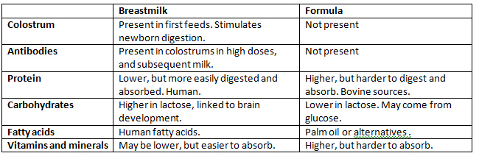

Slide 44
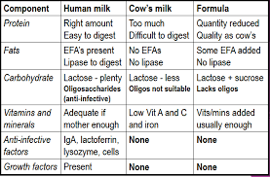

Slide 45
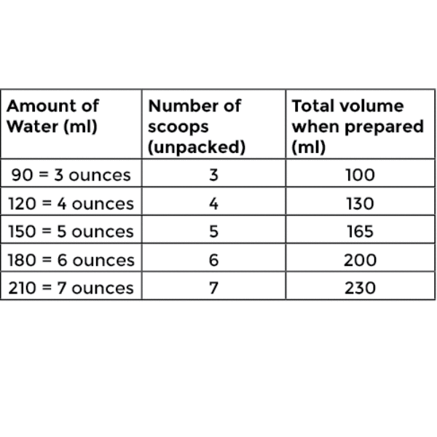
HOW MUCH TO FEED?
The amount of formula needed is calculated according to weight as follows:
Daily needs=150 ml formula/kg /day , then the calculated amount is divided by the number of feeds per day (6 to 8 feeds)
Amount of formula per feed=(150 ml X body wt in kg) / number of feeds per day

Slide 46


Slide 47
THANK YOU

