Slide 1

GENETIC & DYSMORPHOLOGY
Prepared by:
Dr.Salma Elgazzar
MRCPI in pediatrics
Master’s degree in pediatrics
Lecturer of pediatrics / Almaraffa University

Slide 2
L
Learning objectives
Recognize the various genetic disorders and have a basic knowledge of the appropriate diagnostic tests and clinical course for common disorders such as:
Trisomy 13,Trisomy 18 ,Trisomy 21 ,Turner syndrome , Klinefelter syndrome , Marfan syndrome, Achondroplasia and William’s syndrome.

Slide 3
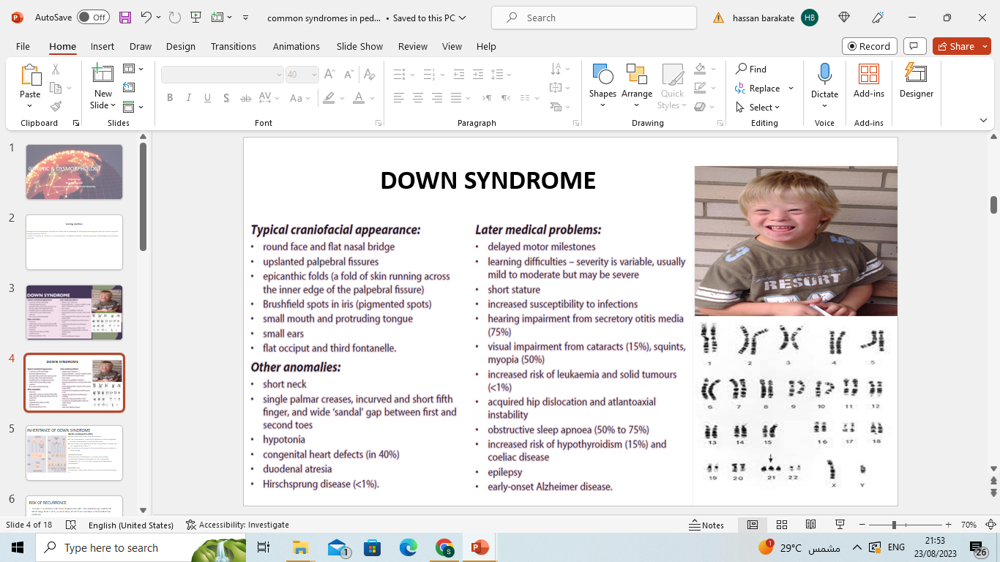

Slide 4
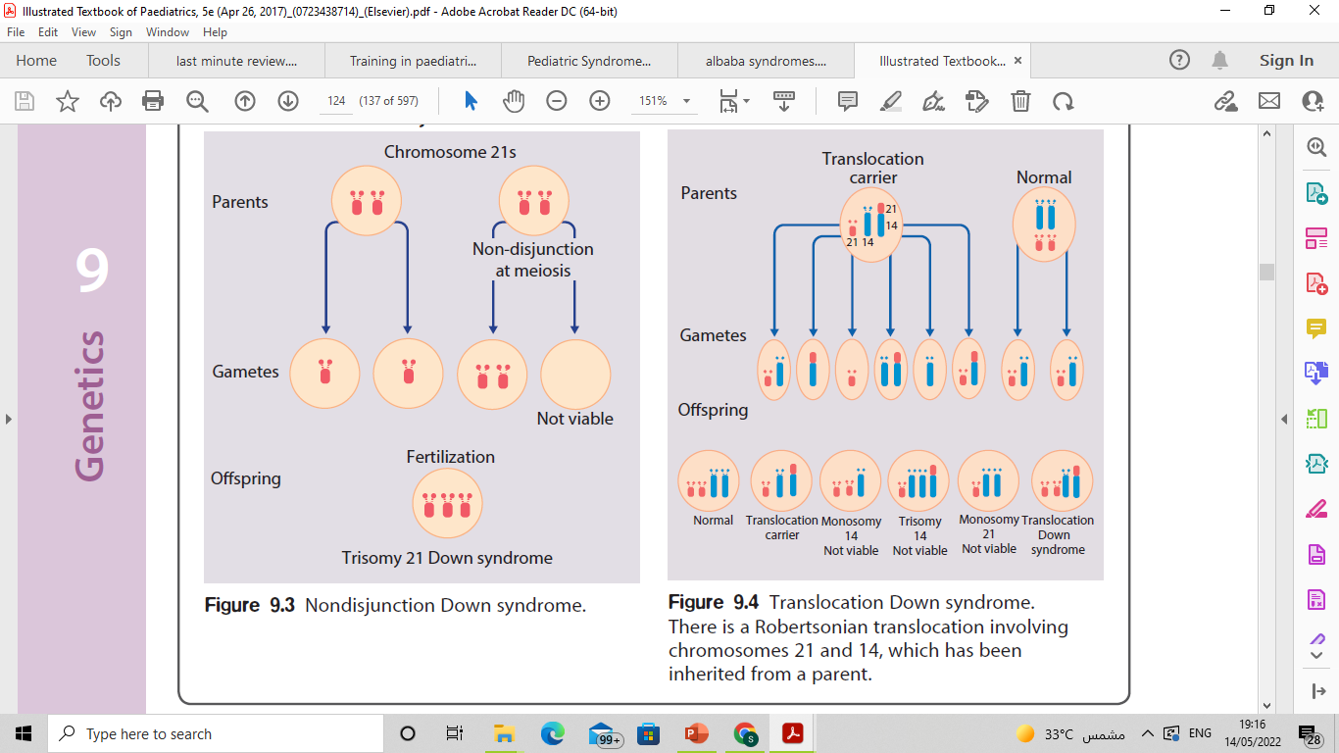
INHERITANCE OF DOWN SYNDROME
Meiotic nondisjunction (94%)
Most cases result from an error at meiosis
The chromosome 21 pair fails to separate, so that one gamete has two chromosome 21s and one has none
Fertilization of the gamete with two chromosome 21s gives rise to a zygote with trisomy 21
The incidence of trisomy 21 due to nondisjunction is related to maternal age
Translocation (5%)
When the extra chromosome 21 is joined onto another chromosome (usually chromosome 14, but occasionally chromosome 15, 22, or 21), this is known as a Robertsonian translocation.
Mosaicism (1%)
In mosaicism, some of the cells are normal and some have trisomy 21.

Slide 5
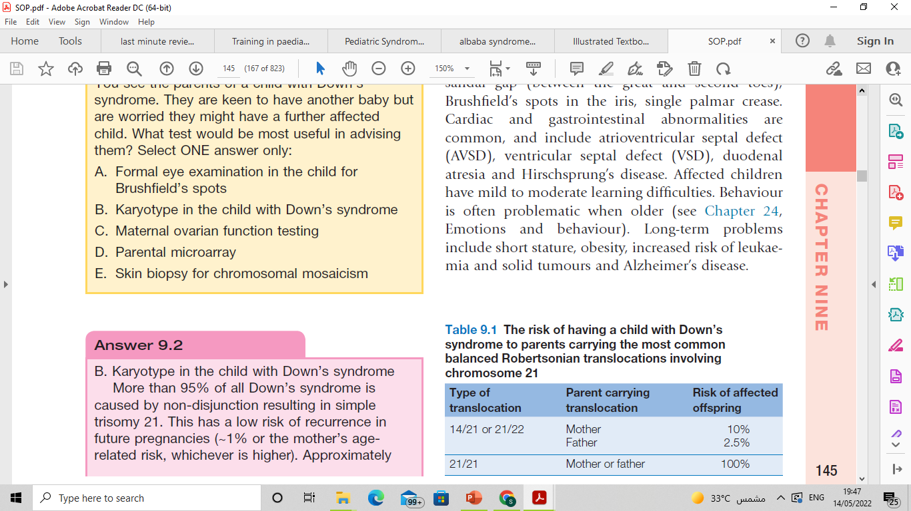
RISK OF RECURRENCE
Trisomy 21 recurrence risk if non disjunctional add 1 %to maternal age related risk which range from 1–4 %, so most likely 96–99 % will not have a child with Down syndrome
Risk of recurrence in Robertsonian translocation
If the mother is a carrier 14q:21q translocation; the
risk is 15 % with amniocentesis and 10 % for a liveborn child with Down Syndrome.
If the mother is 21q:21q translocation the risk of recurrence is 100 %

Slide 6
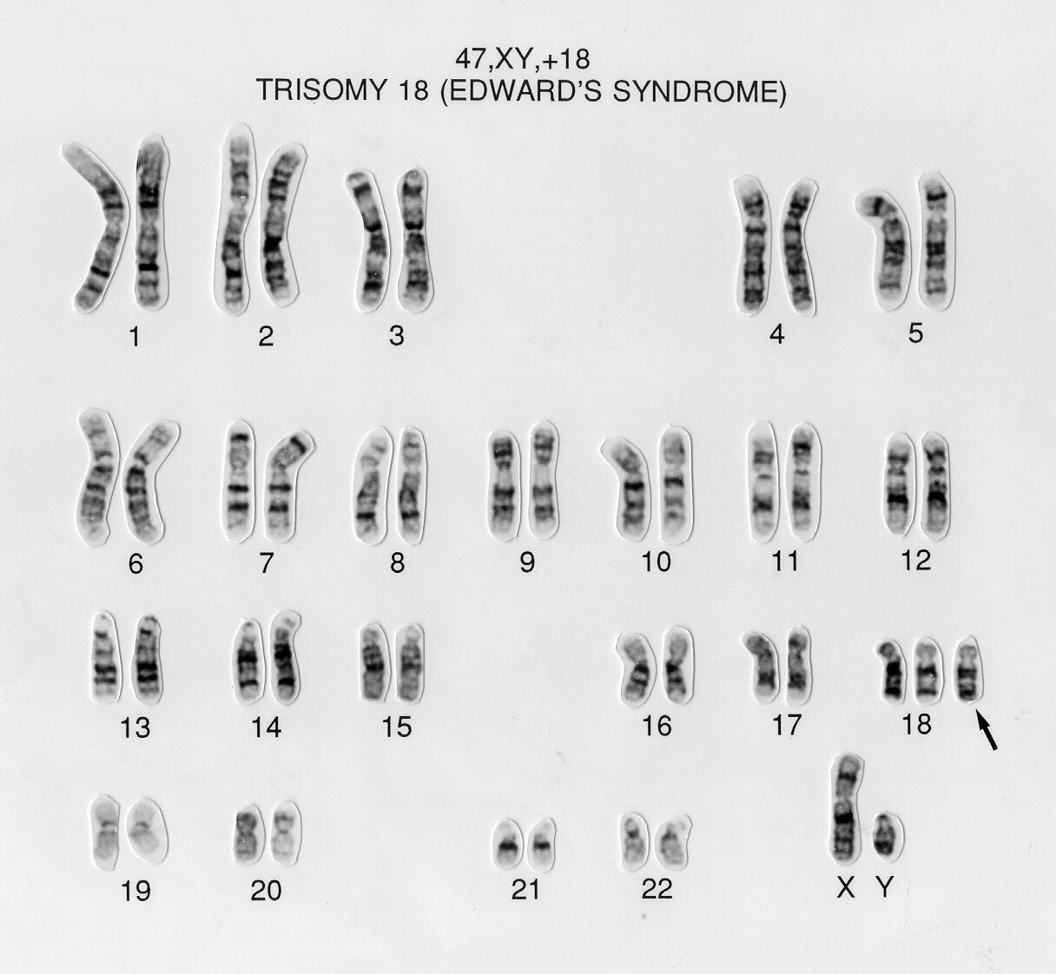
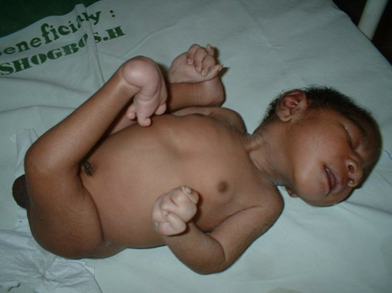
TRISOMY 18 (EDWARD SYNDROME)
Trisomy 18 is the second most common autosomal trisomy .
Risk of recurrence in future pregnancy is less than 1 %.
The risk is higher with increased maternal age.
Clinical Presentation
Apneic episodes
Poor feeding
Marked failure to thrive
Intrauterine growth retardation (IUGR)
Microcephaly
High forehead
Intellectual disability
Rocker bottom feet
Clubfoot/clenched fist
Overlapping fingers
Hypoplastic nails
Ventricular septal defect (VSD) is most common (90 % have structural heart defect).,ASD,PDA as well
Notes:
Prognosis:
50% die in the 1St week
90% die by 1 year of age

Slide 7
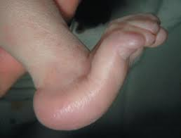
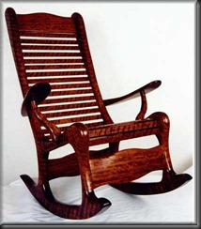
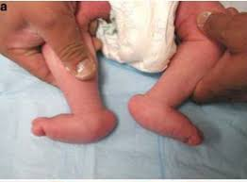
Rocker bottom feet

Slide 8
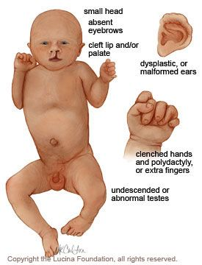
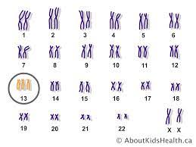
TRISOMY 13 (PATAUA SYNDROME)
It is the least common and most severe of the viable autosomal trisomies.
Risk of recurrence < 1 %.
The risk is higher with increased maternal age.
Clinical presentation
Cleft lip
Cleft palate
Polydactyly (postaxial)
Microcephaly
Microphthalmia
Scalp defects (cutis aplasia)
Omphalocele
Hernias
Neural tube defects
Cardiac defects occur in 80 % of cases, e.g., Patent ductus arteriosus (PDA) or VSD
Genital anomalies
Prognosis
Median survival is only 2.5 days; 82 % die within 1 month, and 95 % die within 6 months.

Slide 9
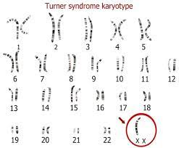
TURNER SYNDROME 45X0
The frequency is approximately 1 in 2000 live-born female infants.
As many as 15 % of spontaneous abortions have a 45,X karyotype.
Turner syndrome is caused by the absence of one set of genes from the short arm of one X chromosome.
45,X karyotype (about two thirds are missing the paternal X chromosome)
Short female is considered Turner syndrome until otherwise
is proved.

Slide 10
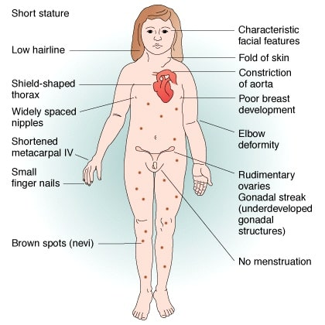
CLINICAL PRESENTATION
Short stature
Lymphedema of hands & feet
Shield chest
Cubitus valgus
Low posterior hairline
Posterior rotated ears
Webbed neck
Short 4 th metacarpal bone
Normal intelligence (except Math)
Short stature (SHOX gene)
Ovarian dysgenesis (High FSH ,High FSH/LH ,Low estradiol)
Cardiac defect:
1. Bicuspid aortic valve
2. Coarctation of aorta
common renal anomaly:
Horseshoe kidney
Double collecting system
Increases risk of : Hypothyroidism ,Hashimoto disease, Celiac disease Inflammatory bowel disease ,Gonadoblastoma.

Slide 11
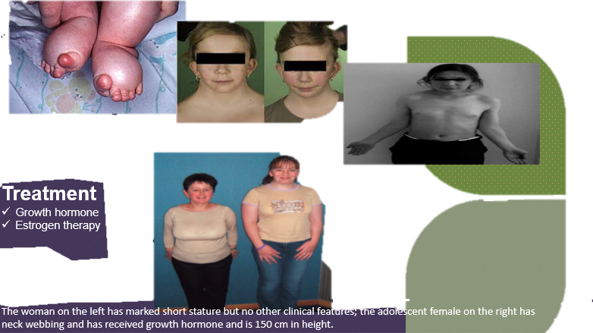

Slide 12
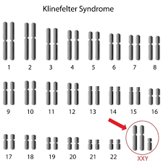
KLIENFILTER SYNDROME 47 ,XXY
The most common chromosomal disorder associated with male hypogonadism and infertility.
It is defined classically by a 47,XXY karyotype with variants that demonstrate additional X and Y chromosomes
Clinical presentation
Language impairment
Academic difficulty
Poor self-esteem
Behavioral problems
Fatigue and weakness
Osteoporosis
Hypogonadism (pathognomonic)
Subnormal libido
Erectile dysfunction
Small penis
Infertility (azoospermia)
Delayed secondary sexual characteristics
Tall with gynecomastia
Risk of cancers
Increased risk of extra testicular germ cell tumors and possibly increased risk of breast cancer.
Increases risk of :Pulmonary disease ,Varicose vain ,ADHD

Slide 13
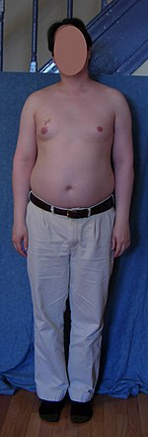
Laboratory (typical patient with Klinefelter syndrome presents with):
Low serum testosterone levels.
High luteinizing hormone (LH) and follicle stimulating hormone (FSH) levels, and, often, elevated estradiol levels.
The decline in testosterone production is progressive over the life span, and not all men suffer from hypogonadism.
Treatment:
Testosterone replacement therapy

Slide 14
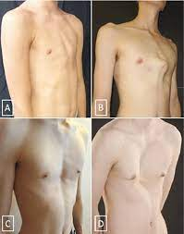
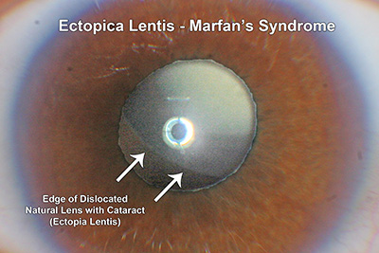
MARFAN SYNDROME
It is heritable genetic defect of connective tissue.
Autosomal dominant mode of transmission.
Boys and girls are equally affected.
Major criteria
Skeletal system
Pectus carinatum (pigeon breast)
Pectus excavatum (funnel chest)
Wrist sign (overlapping of the thumb and 5th finger when encircling the wrist
Scoliosis > 20 %
Reduced extension of the elbow (< 170 %)
Protrusio acetabuli (inward bulging of acetabulum)
Ocular system
Ectopia lentis (upward displacement of the lens or dislocated lens)
Cardiovascular
Dilatation of the ascending aorta
Dissection of the ascending aorta
Dura
Lumbosacral dural ectasia (dilatation)

Slide 15
Minor Criteria
Skeletal
High arched palate
Moderate pectus excavatum
Joint hypermobility
Cardiovascular
Mitral valve prolapse
Pulmonary
Dilatation of the main pulmonary artery
Spontaneous pneumothorax
Apical blebs
Skin
Striae atrophicae
Recurrent incisional hernias
Monitoring:
.Annual echocardiogram .
Most common cause of death:
Cardiovascular complications
Rupture aortic root dilatation

Slide 16
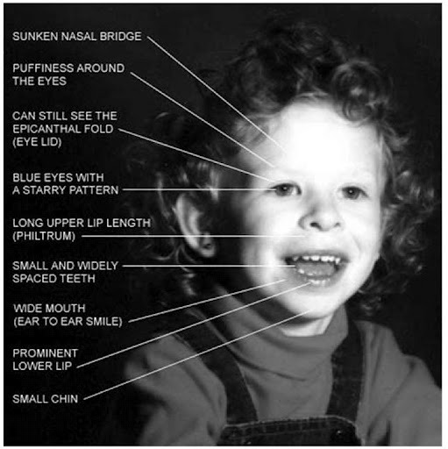
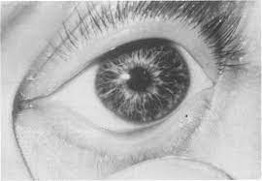
WILLIAM SYNDROME (7q11.23)
Due to a deletion at chromosome band 7q11.23
Clinical features of Williams syndrome
• Short stature
• Characteristic facies
• Transient neonatal hypercalcaemia (occasionally)
• Congenital heart disease(supravalvular aortic stenosis)
• Mild-to-moderate learning difficulties
Failure to thrive
•Periorbital fullness with downturned, prominent lower lip
•Friendly “cocktail party” personality
•Stellate pattern of the iris
•Strabismus, and cataract
•Sensorineural hearing loss
Diagnosis
Fluorescent in situ hybridization (FISH) for the 7q11.23 elastin gene deletion

Slide 17
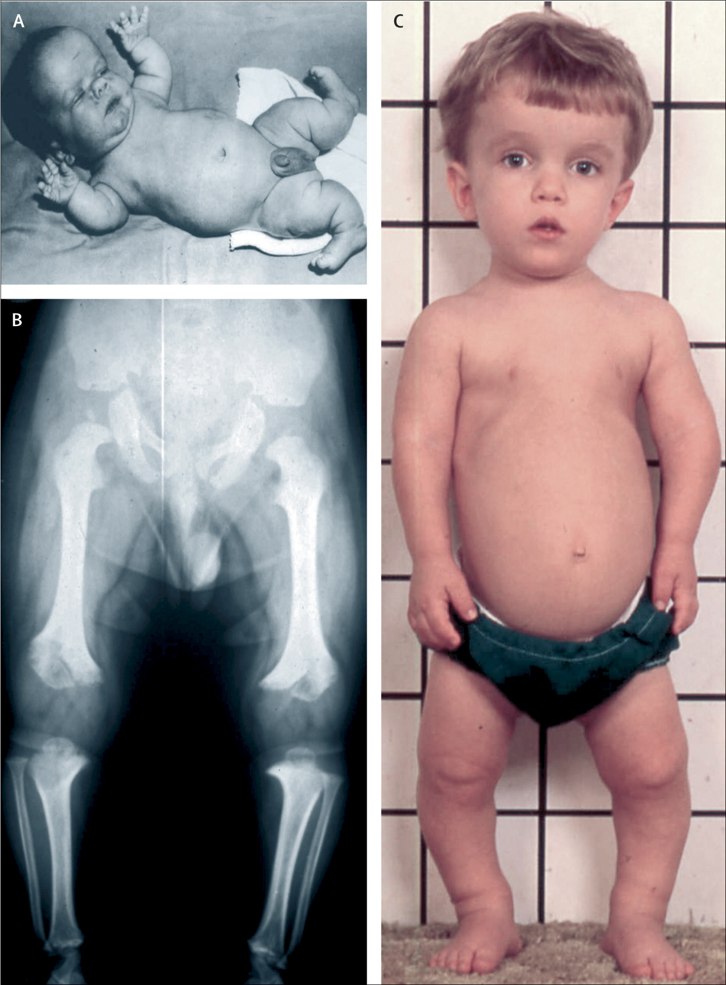
ACHONDROPLASIA
Mutation in the gene for fibroblast growth factor receptor 3 (FGFR3) on chromosome 4.
Inheritance is autosomal dominant, but about 50% are new mutations.
Achondroplasia is the most common type of short limb disproportionate dwarfism.
Clinical features :
Short stature .
Marked shortening of the limbs.
Rhizomelic Shorting (Short proximal long bones)
A large head, frontal bossing.
Depression of the nasal bridge
The hands are short and broad.
A marked lumbar lordosis develops.
Hydrocephalus sometimes occurs.
Management
Growth hormone is currently being used to augment the height of patients with achondroplasia
Limb lengthening

Slide 18
THANK YOU

