Slide 1
LOWER RESPIRATORY TRACT INFECTIONS (BRONCHIOLITIS&PNEUMONIA.)
Prepared by :
DR. SALMA ELGAZZAR
MRCPI in pediatrics
Master’s degree in Pediatrics Alexandria University

Slide 2
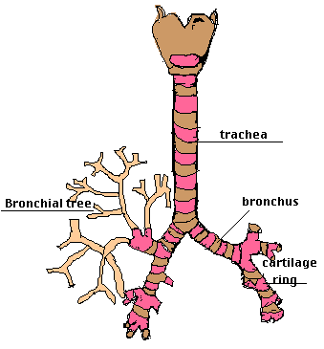
BRONCHIOLITIS
INTRODUCTION :
Bronchiolitis is a lower respiratory tract infection that occurs in children younger than two years old,with peak incidence at around 6 months
Usually caused by a virus → inflammation of the small airways (bronchioles) .
Bronchiolitis can cause serious illness in some children(very young Infants , born early, lung or heart disease).

Slide 3
ETIOLOGY
Bronchiolitis is typically caused by a virus.
Respiratory syncytial virus (RSV) is the most common cause in ˃ 50% of cases.
Common in winter and early spring.
First 2 years of life , more in males and in non breastfed.
Children who are older than two years typically do not develop bronchiolitis, but can be infected with RSV.
RSV infection is common in children older than two years. It usually causes symptoms similar to those of the common cold or mild wheezing and at times the illness is significant enough to require evaluation by a health care provider.
OTHERS:
Parainfluenza virus, adenovirus ,influenza virus, mycoplasma

Slide 4
PATHOGENESIS
Acute infection → respiratory obstruction of the small airways.
Viral invasion of the smaller radicles of the bronchial tree → edema+ accumulation of mucus and cellular debris → bronchiolar obstruction.
↓
↓
↙ ↘
↙ ↓
↓
↓
↓
ACCUMULATION OF MUCUS
CELLULAR DEBRIS
EDEMA
VIRAL INVASION OF BRONCHIOLES
Narrowing of the bronchiolos →wheezes
BRONCHIOLAR OBSTRUCTION
INCOMPLETE OBSTRUCTION (BALL VALVE)
COMPLETE OBSTRUCTION
EARLY AIR TRAPPING DURING EXPIRATION
HYPER INFLATION
ATELECTASIS
HYPOVENTILATION
IMPAIRED AIR EXCHANGE & HYPOXIA
HYPERCAPNEA

Slide 5
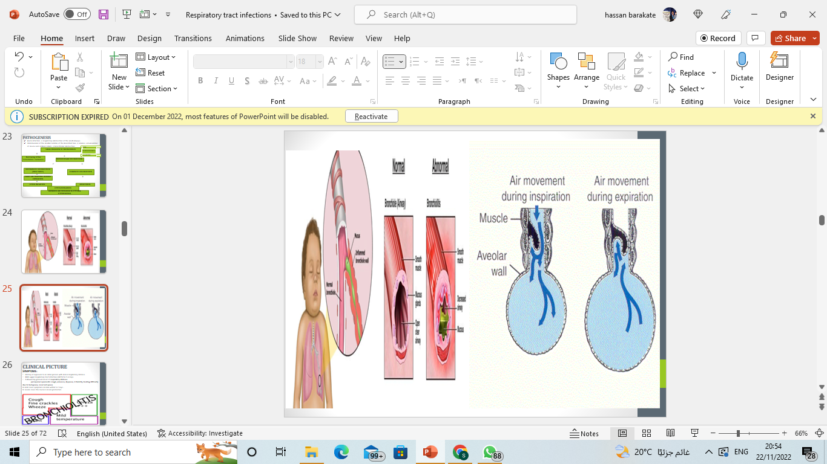

Slide 6
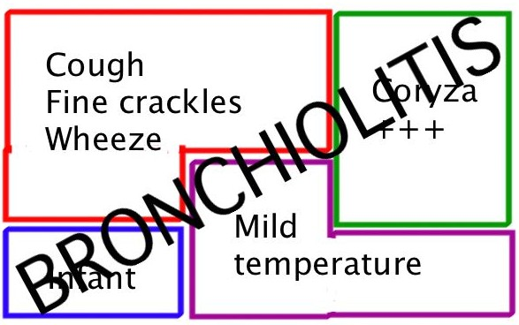
CLINICAL PICTURE
SYMPTOMS :
History of exposure to an older person with minor respiratory distress.
Mild upper respiratory tract infection (URTI) for 2-3 days.
Followed by gradual onset of respiratory distress:
paroxysmal spasmodic cough, wheezes, dyspnea, irritability, feeding difficulty due to tachypnea, recurrent apnea
In mild cases symptoms resolve within 5-7 days .
In severe cases the course is more protracted.

Slide 7
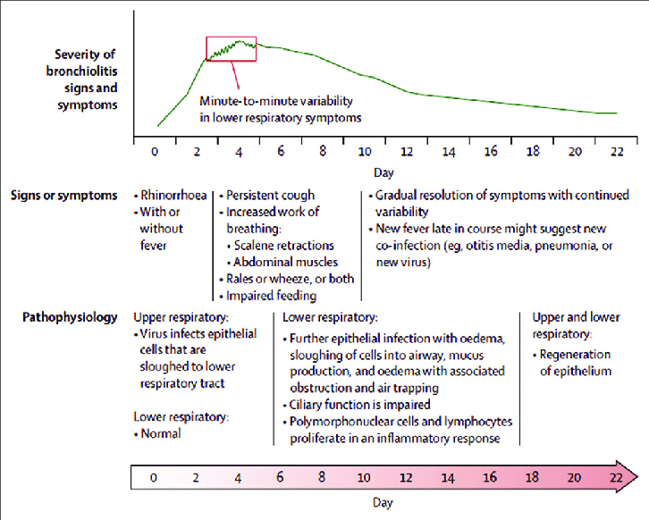

Slide 8
SIGNS :
INSPECTION:
-Fast ,shallow respiration. - R.R.60-80/minute.
-Flaring ala nasi. - Chest indrawing. -Intercostal retraction.
-Air hunger. - Restlesness . - Cyanosis.
- Hyperinflation of the chest (prominent sternum ,liver displaced downwards )
AUSCULTATION:
↓air entry.
Harsh vesicular breathing with prolonged expiration.
Inspiratory and expiratory wheezes.
Inspiratory widespread fine crackles.
PERCUSSION:
Hyper resonant note due to over inflated lungs.
TACHYPNEA RESPIRATORY DISTRESS WHEEZES HYPERINFLATION

Slide 9
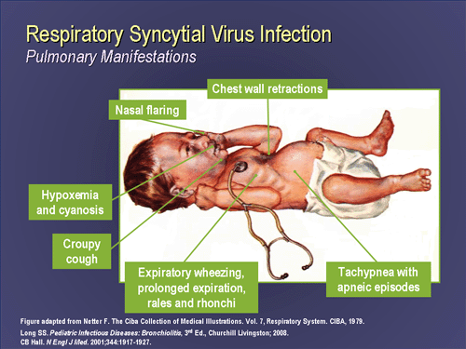

Slide 10
DIAGNOSIS
Young infant with mild URI followed by :
Respiratory distress + wheezes+ over inflated chest
LAB FINDINGS:
The diagnosis of bronchiolitis is based upon a history and physical examination. Blood tests and x-rays are not usually necessary.
Leukocytic count normal or mild increase.
PO2, PCO2 and PH may be measured to assess the severity of the disease.
RSV may be demonstrated in nasopharyngeal secretions by immunofluroscence or PCR
Rising antibodty titre to RSV in serum.

Slide 11
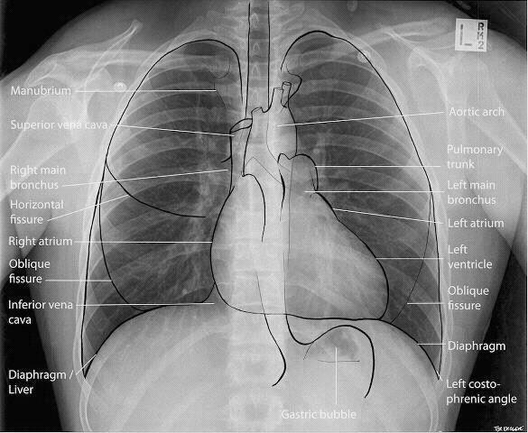
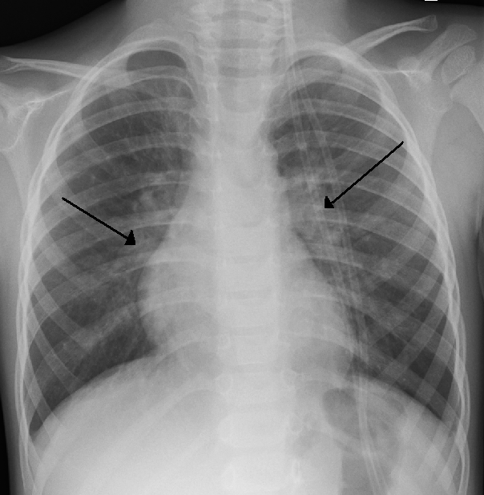
X-ray finding hyperinflated lungs. In 30% scattered areas of opacity dt consolidation or atelectasis.
An X-ray of a child with RSV showing the typical bilateral perihilar fullness of bronchiolitis.

Slide 12
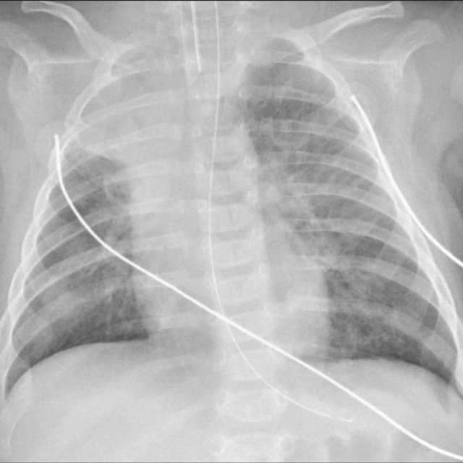
Chest radiograph of a 3-month-old infant with severe RSV bronchiolitis: demonstrating a collapsed right upper lobe, hyperinflated left lung and bilateral perihilar, peribronchial thickening. The patient is intubated and has a nasogastric tube in situ.

Slide 13
DIFFERENTIAL DIAGNOSIS
Bacterial bronchopneumonia
Cystic fibrosis
Congestive heart failure
Organophosphorus poisoning.
Recurrent viral-induced wheeze
Early asthma
Pertussis
Recurrent aspiration
Foreign body in trachea
Congenital lung anomaly
COMPLICATIONS
Bacterial superinfection uncommon.
Cardiac failure rare
Death due to severe course
Recurrent apnea is a serious complication especially in young infants.

Slide 14
TREATMENT
The healthcare provider must determine if the child's illness is severe or if there is a risk of complications.
In these cases, hospitalization is generally recommended to closely monitor the child and provide intravenous fluids or supplemental oxygen.
Discharge to home:
Most children who require hospitalization are well enough to return home within three to four days.
Children who require ventilator usually need to stay in the hospital for four to eight days or longer before they are ready to go home.

Slide 15
AT HOME
There is no cure for bronchiolitis, so treatment is aimed at the symptoms (eg, difficulty breathing, fever).
Semi-sitting position (30-40 degrees) makes the infant more comfortable.
Fever control : acetaminophen ,Ibuprofen
Nose drops or spray
Encourage fluids
Other therapies :
such as antibiotics, cough medicines, decongestants, and sedatives, are not recommended.
Monitoring at home involves observing the child periodically for signs or symptoms of worsening ( increased rate of breathing, worsening chest retractions, nasal flaring, cyanosis, a decreased ability to feed or decreased urine output).

Slide 16
SUPPORTAIVE TREATMENT
Semi-sitting position (30-40 degrees) makes the infant more comfortable.
Oxygen:
Cool humidified oxygen by nasal cannula, or by placing a face mask over the nose and mouth. For infants, an oxygen head box (a clear plastic box) may be used.
If a child is severely ill and unable to breathe adequately on his or her own, or if the child stops breathing, an endotracheal tube may be inserted and connected to a ventilator that breathes for the child at a regular rate.
The use of an endotracheal tube and ventilator is a temporary measure that is discontinued when the child improves.
Fluids : parental + oral .
In case of respiratory acidosis ,suitable I.V. fluids are given to adjust PH and electrolytes.
Avoid sedatives.
Good nutrition
Antiviral ( ribavarin) is given only to those with documented sever RSV disease or high risk infants.it is given by continuous inhalation by aerosol generator 10-12hr/day for 3-4 days.

Slide 17
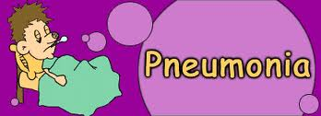

Slide 18
DEFINATION AND EPIDEMIOLOGY
PNEUMONIA is a primary inflammation of lung parenchyma.
Viruses are the most common cause in younger children, while bacteria are commoner in older children.
Mortality:
The mortality rate in developed countries is low (<1 per 1000 per year). In developing countries ,pneumonia is the number one killer of children in these societies
Seasonality :
Pneumonia is most common in winter and spring.
Medical conditions predispose to pneumonia and contribute to increasing severity:
●Congenital heart disease
●Bronchopulmonary dysplasia
●Cystic fibrosis
●Asthma
●Sickle cell disease
●Neuromuscular disorders, especially those associated with a depressed consciousness
●Some gastrointestinal disorders (eg, gastroesophageal reflux, tracheoesophageal fistula)
●Congenital and acquired immunodeficiency disorders

Slide 19
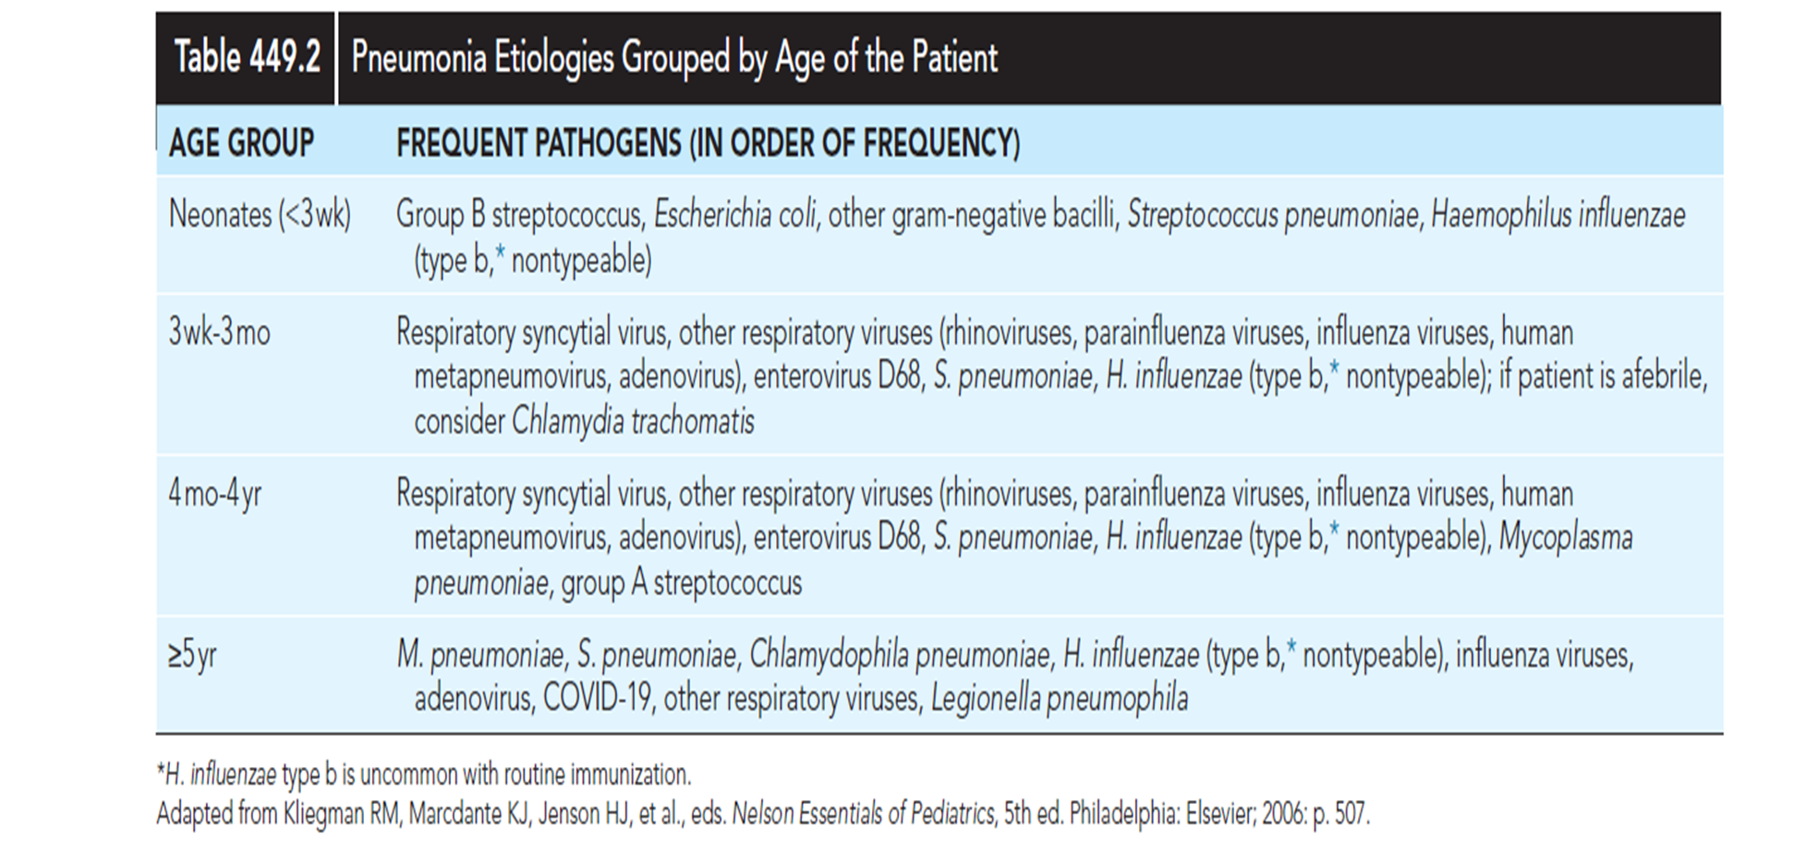
AGE SPECIFIC ETIOLOGY OF PNEUMONIA

Slide 20
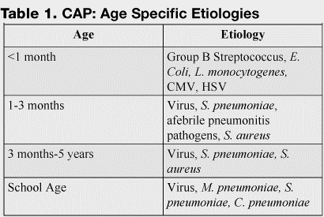

Slide 21
ANATOMICAL TYPES OF PNEUMONIA
● Lobar pneumonia :
Involvement of a single lobe or segment of a lobe; this is the classic pattern of S. pneumoniae pneumonia
●Bronchopneumonia :
Primary involvement of airways and surrounding interstitium; this pattern is sometimes seen in Streptococcus pyogenes and Staphylococcus aureus pneumonia
●Necrotizing pneumonia:
Associated with aspiration pneumonia and pneumonia resulting from S. pneumoniae, S. pyogenes, and S. aureus)
●Caseating granuloma (as in tuberculosis pneumonia)
●Interstitial and peribronchiolar with secondary parenchymal infiltration :
This pattern typically occurs when a severe viral pneumonia is complicated by bacterial pneumonia

Slide 22
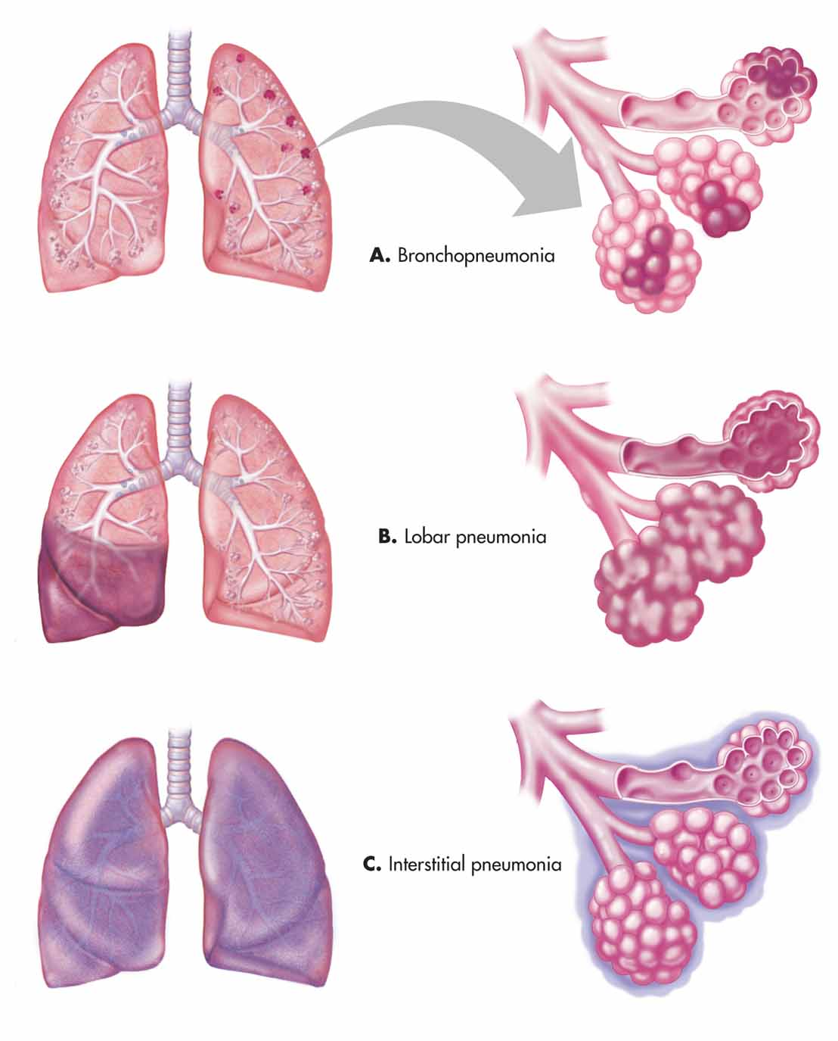
ANATOMICAL TYPES OF PNEUMONIA

Slide 23
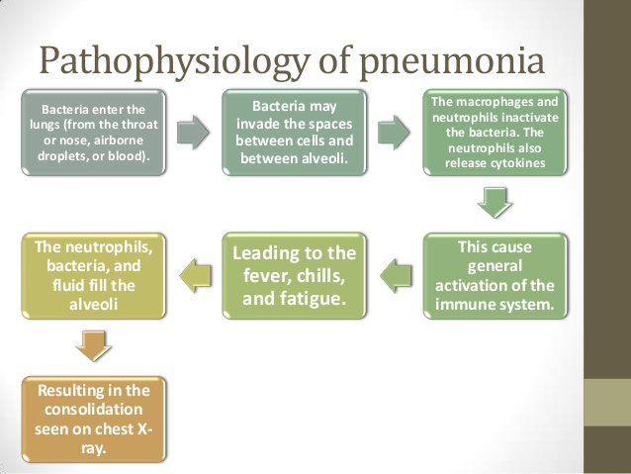

Slide 24
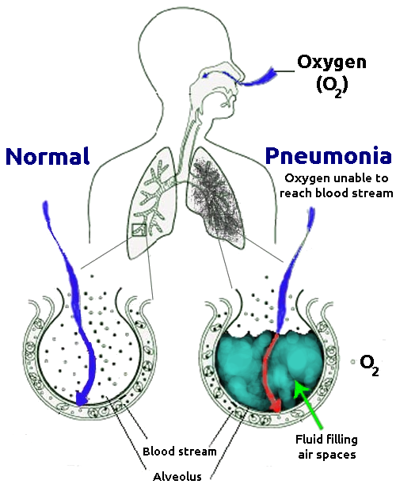

Slide 25
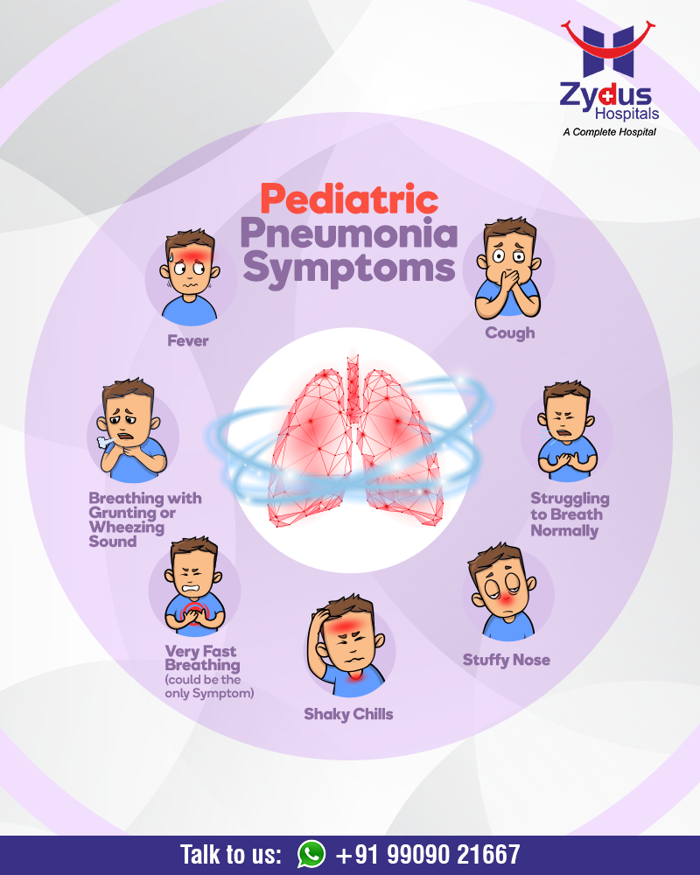
CLINICAL PICTURE
Presenting features vary with age, infectious agent, and severity or stage of the illness.
Fever, cough (productive or non-productive), and difficulty breathing are common presenting symptoms, often preceded by signs of a minor upper respiratory tract infection.
Chest or stomach pain.
Decrease in appetite.
Chills.
Breathing fast or hard.
Vomiting.
Headache.
Not feeling well.

Slide 26
CLINICAL PICTURE (CONTU.)
Examination
This includes assessment for:
Fever:
> 38.5o C is a feature of bacterial pneumonia
Oxygenation:
Cyanosis indicates severe illness.
Pulse oximetry identifies significant hypoxaemia (SaO2 <92% in air)
Respiratory rate:
Tachypnea is a useful indicator of pneumonia.
Rates defined by the WHO provide a 74% sensitivity for radiologically
defined pneumonia:
AGE | RESPIRATORY RATE
<2 months | >60 breaths/min
2–12 months | >50 breaths/min
1-5 years | >40 breaths/min
5-10 years | >30 breaths/min

Slide 27
CLINICAL PICTURE (CONTU.)
Work of breathing:
Chest recession, nasal flaring and grunting nasal flaring and grunting are most sensitive in children aged <3 years.
Percussion and auscultation:
Examination findings consistent with radiographically confirmed pneumonia include :
●Crackles, also called rales or crepitations; in a systematic review, crackles were 3.5 times more frequent in infants with radiographic pneumonia than without .
●Findings consistent with consolidated lung parenchyma, including:
Decreased breath sounds
Bronchial breath sounds.
Bronchophony (the distinct transmission of sounds such as the syllables of “ninety-nine”)
Whispered pectoriloquy (transmission of whispered syllables)
Tactile fremitus (eg, when the patient says “ninety-nine”) is increased
Dullness to percussion
●Wheezing is more common in pneumonia caused by atypical bacteria and viruses than bacteria .
●Findings suggestive of pleural effusion include chest pain with splinting, dullness to percussion, distant breath sounds, and a pleural friction rub

Slide 28
Examination feature | Possible significance
General appearance (state of awareness, cyanosis)* | Most children with radiographically confirmed pneumonia appear ill
Vital signs
Temperature | Fever may be the only sign of pneumonia in highly febrile young children; however, it is variably present and nonspecific
Respiratory rate | Tachypnea¶correlates with radiographically confirmed pneumonia and hypoxemia Absence of tachypnea helps to exclude pneumonia
Degree of respiratory distress | Respiratory distress is more specific than fever or cough for lower respiratory infection
Tachypnea
Hypoxemia | Predictive of pneumonia
Increased work of breathing:
Retractions | More common in children with pneumonia than without; absence does not exclude pneumonia
Nasal flaring | More common in children with pneumonia than without; absence does not exclude pneumonia
Grunting | Sign of severe disease and impending respiratory failure
Accessory muscle use | Sign of severe disease
Head bobbing | Sign of severe disease
Lung examination
Cough | Nonspecific finding of pneumonia
Auscultation | Findings suggestive of pneumonia include: crackles (rales, crepitations), decreased breath sounds, bronchial breath sounds, egophany, bronchophony, and whispered pectoriloquy Wheezing more common in viral and atypical pneumonias
Tactile fremitus | Suggestive of parenchymal consolidation
Dullness to percussion | Suggestive of parenchymal consolidation or pleural effusion
Mental status | Altered mental status may be a sign of hypoxia

Slide 29
INVESTIGATIONS
Full blood count and acute phase reactants
Total leukocyte and neutrophil count.
C-reactive protein.
ESR have poor sensitivity and specificity for distinguishing between viral and bacterial pneumonia.
Microbiological investigations
Blood cultures:
The yield is low and a positive result takes 48–72 h. Positive in 10–15% of patients with pneumococcal pneumonia.
Respiratory tract samples:
Sputum for culture is rarely available and samples are frequently contaminated.
Nasopharyngeal aspirate (NPA) for viral immunofluorescence assay or PCR is useful in infants. Bronchoscopy or pleural fluid aspiration may provide samples.
Serology:
Paired serology 14 days apart is available for diagnosis of mycoplasma but treatment is usually given on empirical grounds.

Slide 30
IMAGING
CXR:
The appearance of consolidation on CXR is reliable for the diagnosis of pneumonia ,but CXR appearances are not reliable for distinguishing between viral and bacterial infection as there is considerable overlap.
The CXR may
Appear normal early in the disease. However, as an approximate
guide:
Viral pneumonia:
Patchy perihilar infiltration, hyperinflation, atelectasis
Bacterial pneumonia:
Lobar consolidation (air bronchogram) occasionally with parapneumonic effusion. Pneumatocoele and abscesses suggest staphylococcal pneumonia
Mycoplasma pneumonia:
Patchy, segmental consolidation with hilar lymphadenopathy.

Slide 31
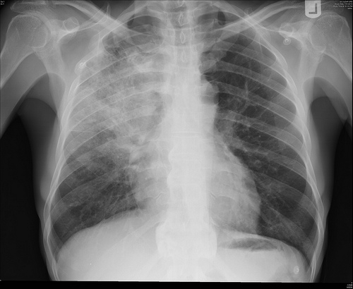
Chest X-Ray showing patch of pneumonia

Slide 32
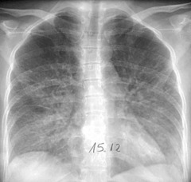
Image of chest x-ray displaying the interstitial pattern seen in viral pneumonia. The interstitial pattern shows fine lines radiating from the hila.

Slide 33
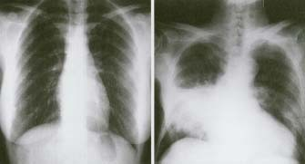
These chest X rays compare clear, healthy lungs with the cloudy, inflamed lung tissue of pneumonia.

Slide 34
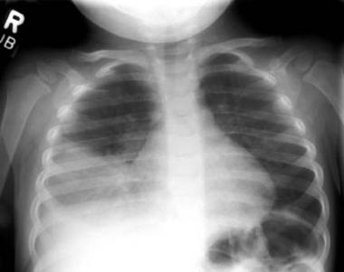
Right lower lobe consolidation in a patient with bacterial pneumonia.

Slide 35
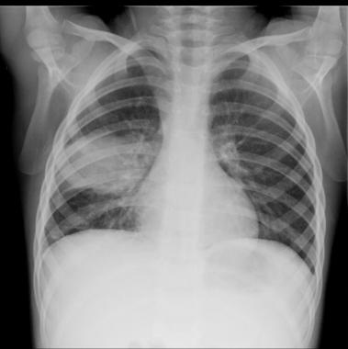
Anteroposterior radiograph from a child with a round pneumonia.

Slide 36
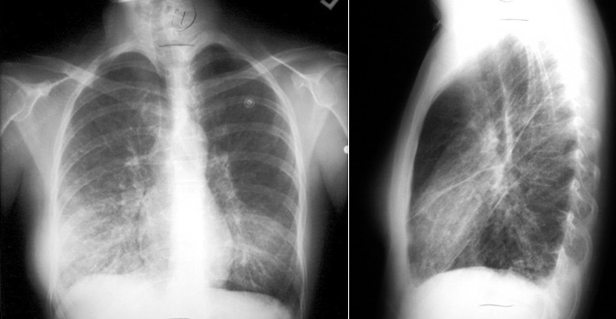
x-ray view of mycoplasma pneumonia

Slide 37
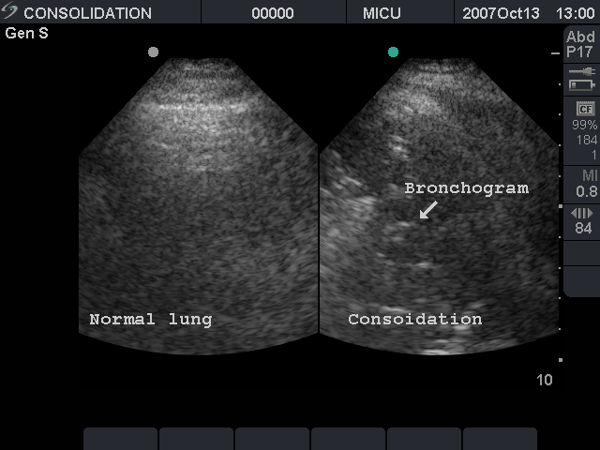
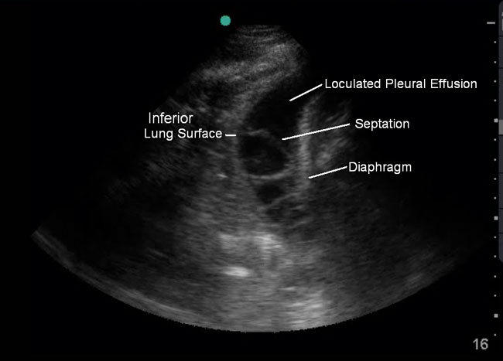
Ultrasound:
This is most useful if a pleural effusion is suspected on CXR. It can differentiate between clear fluid and fibrino-purulent effusions

Slide 38
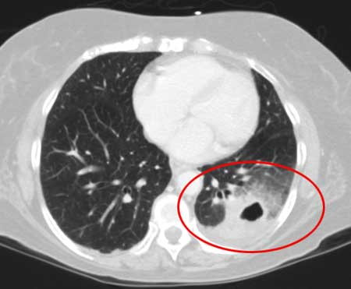
CT scan:
provides more detailed imaging of suspected abscess or empyema.

Slide 39
DIFFERENTIAL DIAGNOSIS
Foreign body aspiration must be considered in young children. The aspiration event may not have been witnessed.
Other causes of tachypnea, with or without fever and cough, in infants and young children include :
●Bronchiolitis .
●Heart failure
●Sepsis
●Metabolic acidosis .
These conditions usually can be distinguished from pneumonia by history, examination, and laboratory tests or additional imaging may be necessary.

Slide 40
Treatment
As viral and bacterial pneumonia are often difficult to distinguish treatment including use of antibiotics is based on age and severity.
Treatment may include:
Oxygen: to maintain SaO2 >92%
Fluids: restrict to 80% maintenance .
Antipyretics
Antibiotics:
outpatient
<5 years:
amoxicillin is first choice oral antibiotic, alternatives include co-amoxiclav and macrolides
>5 years:
a macrolide (erythromycin, clarithromycin or azithromycin) is the first choice oral antibiotic as mycoplasma infection is more likely.
Hospital
Oral antibiotics are safe and effective for many children with CAP, but in severe cases with sepsis, consolidation with effusion, failed response or intolerance to oral antibiotics, IV treatment is indicated with a third-generation cephalosporin(e.g. cefotaxime, ceftriaxone) or ampicillin.
A change to oral antibiotics can then be made if there is clear improvement.
Treatment duration is between 5 and 10 days depending on severity.

Slide 41
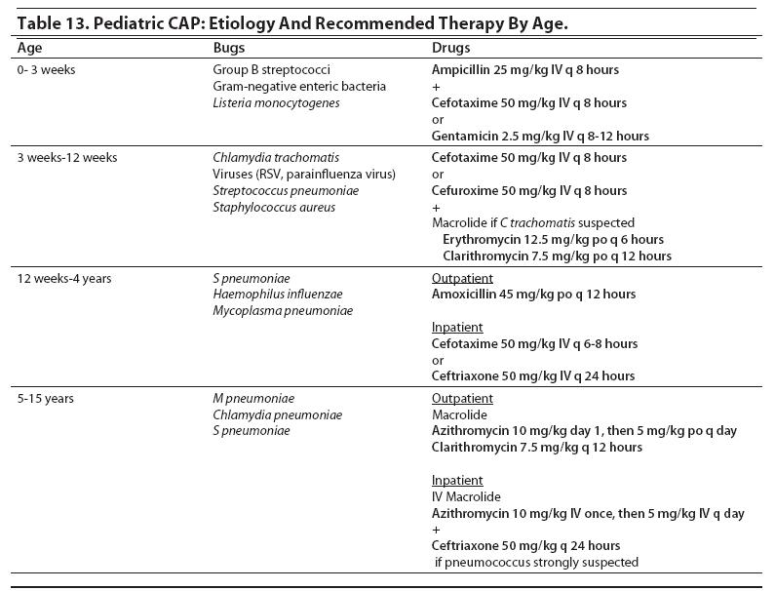

Slide 42
COMPLICATION
Most children with CAP improve without complications, but an unexplained trend of increased complications of bacterial pneumonia has been seen worldwide.
Treatment failure (antibiotic resistance)
Lung abscess.
Metatastic infection.
Pleural infection (effusion or empyema).
Pneumatoceles.
Necrotizing pneumonia
Hyponatraemia secondary to inappropriate ADH secretion is common.

Slide 43
Pleural effusion or empyema
Persistent or recurrent fever after 48 h treatment for pneumonia should raise suspicion of a parapneumonic effusion or empyema .
An AP or PA CXR and ultrasound should allow diagnosis and evaluation of the nature of pleural fluid.
A small unloculated effusion may resolve with IV antibiotics alone.
A diagnostic pleural tap is usually unnecessary.
A large loculated empyema with obvious pus and thickened pleura will require drainage.
Options include a pigtail chest drain with intrapleural fibrinolytics,
video-assisted thoracoscopic surgery (VATs) or early minithoracotomy
following chest CT scan.

Slide 44
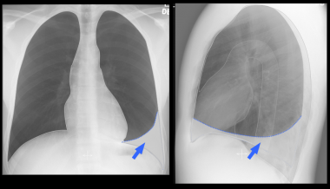
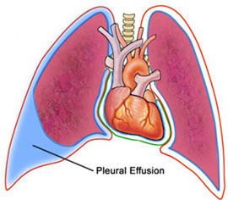
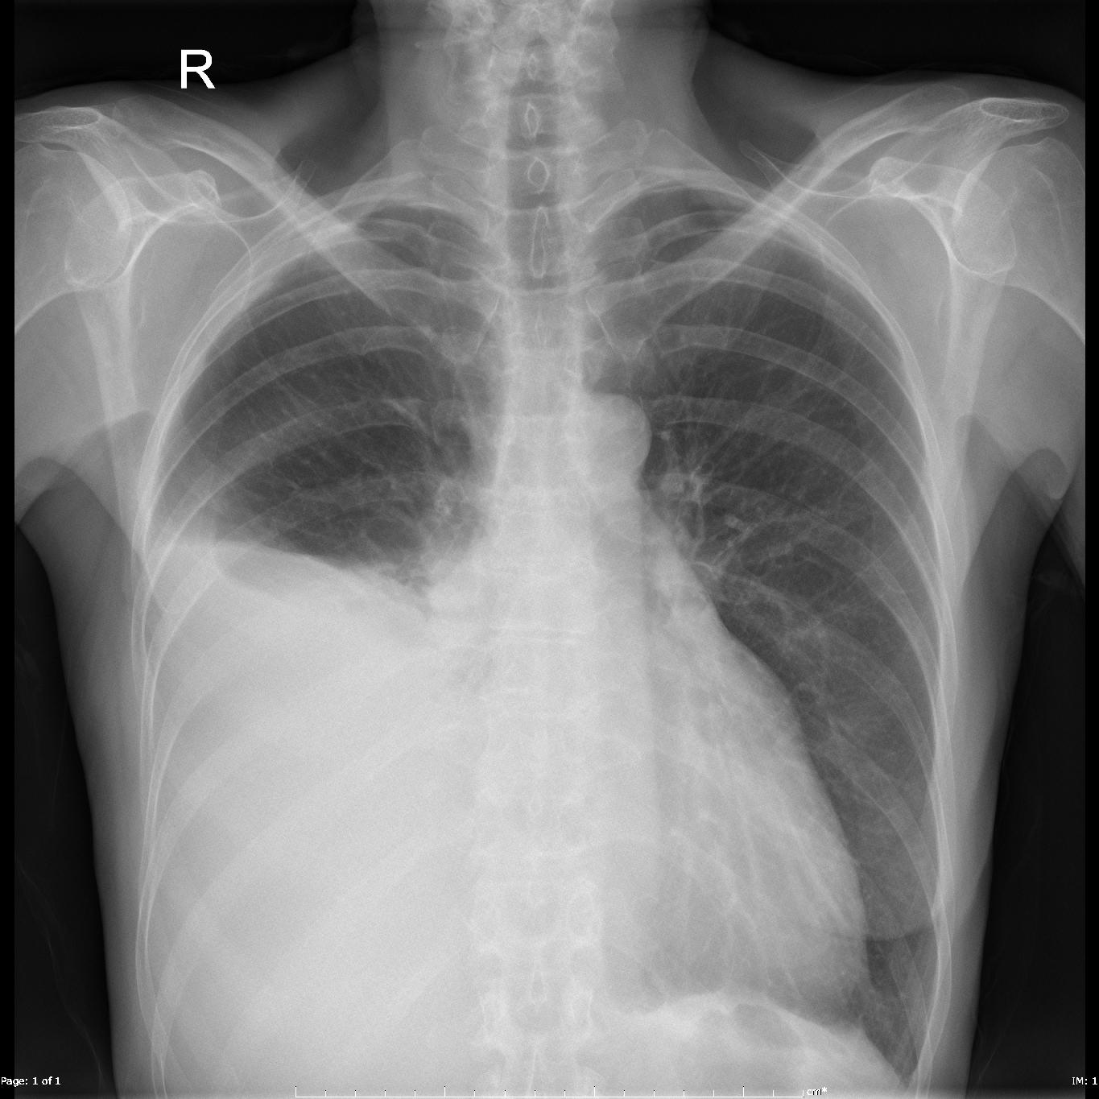

Slide 45
Necrotizing pneumonia :
Necrotizing pneumonia, necrosis, and liquefaction of lung parenchyma, is a serious complication of community-acquired pneumonia (CAP).
Necrotizing pneumonia usually follows pneumonia caused by particularly virulent bacteria e.g S. pneumoniae (especially serotype 3 and serogroup 19) is the most common cause of necrotizing pneumonia .
Necrotizing pneumonia also may occur with S. aureus and group A Streptococcus and has been reported due to M. pneumoniae, Legionella, and Aspergillus.
Clinical manifestations of necrotizing pneumonia are similar to those of uncomplicated pneumonia, but they are more severe .
Necrotizing pneumonia should be considered in a child with prolonged fever or septic appearance .
The diagnosis can be confirmed by chest radiograph (which demonstrates a radiolucent lesion) or contrast-enhanced computed tomography ,the findings on chest radiograph may lag behind those of computed tomography .

Slide 46
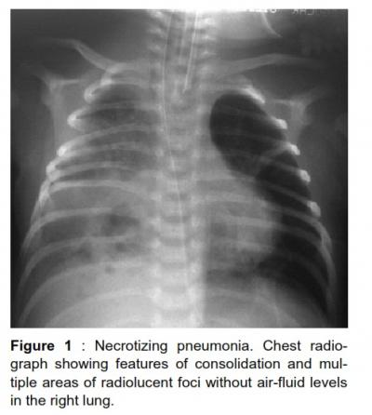
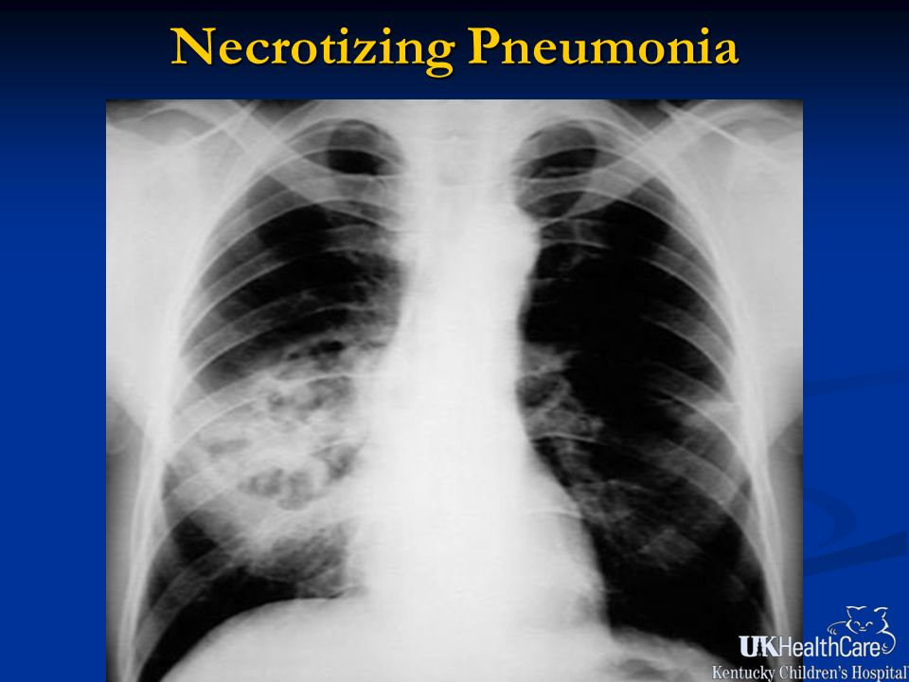

Slide 47
Lung abscess
Clinical manifestations of lung abscess are nonspecific and similar to those of pneumonia
They include fever, cough, dyspnea, chest pain, anorexia, hemoptysis, and putrid breath.
The diagnosis is suggested by a chest radiograph demonstrating a thick-walled cavity with an air-fluid level and confirmed by contrast-enhanced computed tomography .
The most common complication of lung abscess is intracavitary hemorrhage.
This can cause hemoptysis or spillage of the abscess contents with spread of infection to other areas of the lung .
Other complications of lung abscess include empyema, bronchopleural fistula, septicemia, cerebral abscess, and inappropriate secretion of antidiuretic hormone

Slide 48
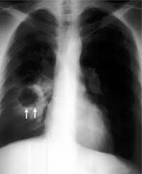
Anterior view of a chest radiograph in a patient with thick-walled right lung abscess. The patient later developed a brain abscess.

Slide 49
Pneumatocele :
Pneumatoceles are thin-walled, air-containing cysts of the lungs.
They are classically associated with S. aureus, but may occur with a variety of organisms .
Pneumatoceles frequently occur in association with empyema .
In most cases, pneumatoceles involute spontaneously, and long-term lung function is normal .
However, on occasion, pneumatoceles result in pneumothorax

Slide 50
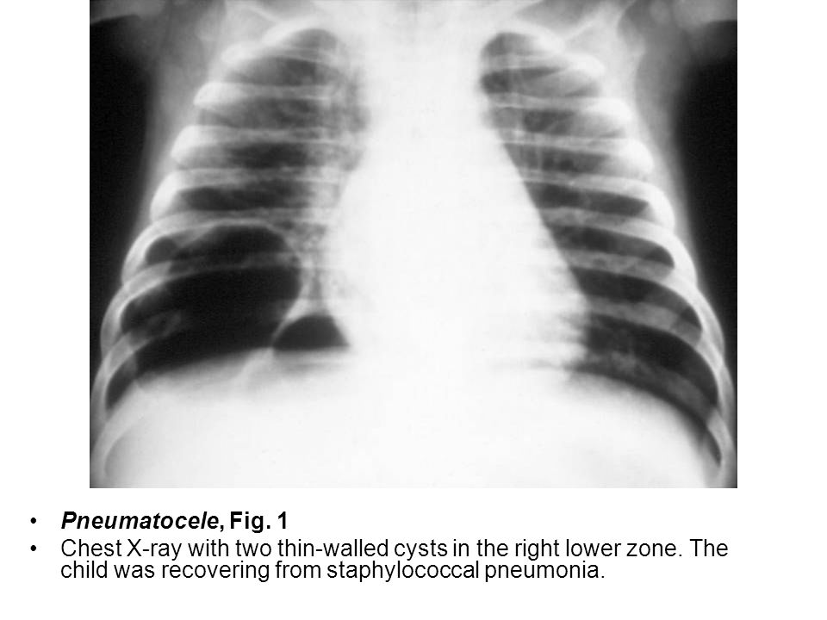

Slide 51
ASPIRATION PNEUMONIA
Causes:
Amniotic fluid or meconium (in newborns)
Foreign body.
Food.
Lipoid material.
Hydrocarbons→ kerosene pneumonia.

Slide 52
THANK YOU

