Slide 1
NEPHROTIC SYNDROME
DR Mansour ALQurashi

Slide 2
Definition
Manifestation of glomerular disease.
characterized by Nephrotic range proteinuria and a triad of clinical findings associated with large urinary losses of protein :
- Hypoalbuminaemia
-Edema
- Hyperlipidemia.
Nephrotic range proteinuria:
protein excretion of > 40 mg/m²/hr on a 24-hour collection
First morning protein / creatinine ratio of > 2

Slide 3
Demographic Factors
Incidence 2 – 7 cases per 100,000 children per year.
Most prevalent in children between the ages 1.5-6 years.
It affects more boys than girls 2:1 ratio.
MCNS typically presents between 2 and 8 years of age (peak, 3 years).

Slide 4
ETIOLOGY
Idiopathic or Primary
-Minimal Change disease ( >80 % )
Genetic:
-Finnish type Congenital Nephrotic Syndrome
--Alport Syndrome.
Secondary:
- Infectious
Hepatitis (B,C) , HIV-1, Malaria, Syphilis, Toxoplasmosis
-Inflammatory
Glomerulonephritis
-Immunological
Lupus nephritis, Bee sting, Food allergens
-Neoplastic
Lymphoma, Leukemia
- Traumatic ( Drug induced )
Penicillamine, Gold, NSAIDS, Pamidronate, Mercury, Lithium

Slide 5
Pathophysiology

Slide 6
Complex disturbances in
immune system
Genetic Mutations /
Mutations in proteins
Extensive effacement of podocyte foot processes
Increased permeability of the glomerular capillary wall
Massive proteinuria
Hypoalbuminaemia
Edema

Slide 7
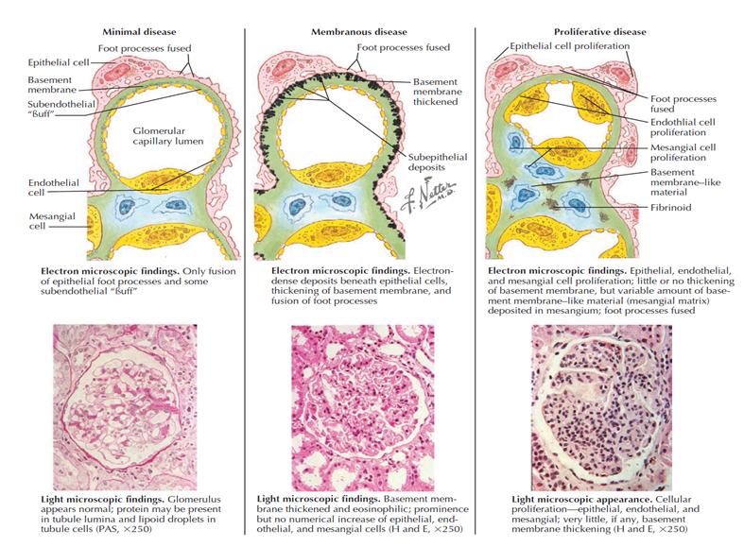

Slide 8
Cause |  | Light microscopy | Immunoflorescence | Electron Microscopy
Minimal Change Nephrotic Syndrome |  | Normal | Negative | Foot process fusion
Focal Segmental Glomerulosclerosis |  | Focal sclerotic lesions | IgM, C3 in lesions | Foot process fusion
Membranoproliferative Glomerulonephritis | Type I | Thickened GBM, proliferation | Granular IgG, C3 | Mesangial and subendothelial deposits
 | Type II | Lobulation | C3 only | Dense deposits

Slide 9
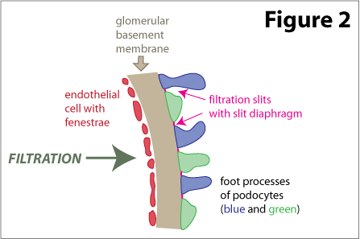
FILTRATION BARRIER AT THE GLOMERULUS
3 Layers
Capillary endothelium
of glomerulus
Basement memb. of
glomerulus
Visceral epithelium of
Bowman’s capsule
(podocytes w/foot
processes)

Slide 10
IDIOPATHIC
Minimal Change disease ( >80 % ).
Focal segmental Glomerulosclerosis (7%).
Membranoproliferative glomerulonephritis ( 4%).
IgA nephropathy (uncommon).
- About 20% to 30% percent of nephrotic syndrome in adolescence is MCNS.
- FSGS occurs at a median of 6 years of age and is more common in adolescents than in younger children.
-IgA nephropathy most common in the second and third decades of life.

Slide 11
Clinical Features

Slide 12
Edema
It is the main presenting feature (95%) and its onset may be rapid or insidious.
Mild pitting edema ,start with – peri orbital puffiness ( more pronounced in the morning ) and lower extremities.
Progression to generalized edema, ascites, pleural effusion, genital edema and sacral edema.
Pleural effusions are generally asymptomatic but if large may cause respiratory compromise.
Ascites may lead to umbilical or inguinal hernias as well as to more serious complications, such as spontaneous bacterial peritonitis (SBP).
Bowel wall edema may produce diminished appetite; abdominal colic; and diarrhea, which, if chronic, can lead to a protein-losing enteropathy.

Slide 13
Blood Pressure
Hypertension(12%): Resulting from fluid overload or primary kidney disease (unusual in minimal change disease),is suggestive of another underlying pathology, such as FSGS or glomerulonephritis.
Careful assessment of volume status is critical, The child with anasarca may be profoundly intravascularly volume depleted.
Children with nephrotic syndrome are at increased risk of cardiovascular collapse in the setting of ongoing volume loss particularly if compounded by adrenal insufficiency caused by long-term steroid administration.
Hypotension and signs of shock: Can be present in children presenting with sepsis.

Slide 14
urine
Nephrotic patients are often oliguric, and the urine appears concentrated and foamy.
Nephrotic-range proteinuria
Specific gravity may be artificially high secondary to the proteinuria.
Microscopic hematuria may be noted,
Gross or macroscopic hematuria is rare and may indicate a complication such as infection or renal vein thrombosis

Slide 15
Other signs and symptoms
Viral respiratory tract infection: A history of a respiratory tract infection immediately preceding the onset of nephrotic syndrome is frequent on initial presentation and on subsequent relapses.
Allergy: Approximately 30% of children with nephrotic syndrome have a history of allergy.
Symptoms of infection: May include fever, lethargy, irritability, or abdominal pain due to sepsis or peritonitis.
Respiratory distress: Due to either massive ascites and thoracic compression or frank pulmonary edema and effusions, or both.
Seizure: Caused by cerebral thrombosis.(urinary losses of antithrombotic proteins, increased synthesis of prothrombotic factors)
Anorexia.pallor. Muehrcke's lines ( double white lines that run across the fingernails horizontally).

Slide 16
CLINICAL FEATURES | Minimal Change Nephrotic Syndrome | Focal Segmental Glomerulosclerosis | membranoproliferative glomerulonephritis. (Low C3-70%)
Age ( yr ) | 2 - 6 | 2 - 10 | 2 - 18
Sex ( M : F ) | 2 : 1 | 1.3 : 1 | 1 : 1
Nephrotic Syndrome | 100 % | 90 % | 60 %
Asymptomatic proteinuria | 0 | 10 % | 20 %
Hematuria | 10 – 20 % | 60 – 80 % | 20 %
Hypertension | 10 % | 20 % early | 80%
Rate of progression to renal failure | Non progressive | 10 yrs | 50 % in 10 – 20 yrs
Associated Conditions | Usually none | None | thrombotic microangiopathies , SLE, Celiac Hepatitis B,C, Endocarditis

Slide 17
Differential Diagnosis
Protein losing enteropathy.
Hepatic failure.
Heart failure.
Acute/Chronic Glomerulonephritis.
Protein Malnutrition.

Slide 18
Diagnosis
Urinalysis : 3+ to 4+ proteinuria
Spot UPC ratio > 2.0
UPE > 40 mg/m²/hr
Renal Function : Azotemia (↑ BUN), Creatinine – normal or elevated
LFT : ALT,AST. Serum albumin - < 2.5 gm/dl
Serum Cholesterol/ TGA levels – elevated
Serum Complement levels (C3,C4)– C3 Normal or low.
CBC & Blood picture: Hemoconcentration (↑ hemoglobin). Thrombocytosis
Platelet hyperaggregability, ↑ V , VIII, and fibrinogen with blood hyperviscosity.
↑↑ ESR
Electrolytes :
Hyponatremia (Na :120 -130 mEq/L)
↓ Serum calcium (pseudohypocalcemia, truehypocalcemia)

Slide 19
Additional Tests
Antistreptolysin O titre
Chest X ray , Kidney ultrasonography and tuberculin test.
ANA , Anti–double-stranded DNA .
Hepatitis B surface antigen/Hepatitis C antibodies.
Indications for renal Biopsy:
Age below 12 months or older than 13 year.
Gross or persistent microscopic hematuria or RBC casts
Low blood C3
Significant hypertension or pulmonary edema .
Impaired renal Function
Failure of steroid therapy.(steroid resistance).
Extrarenal or constitutional symptoms, such as weight loss, recurrent fever, rash, or arthritis

Slide 20
MANAGMENT
Supportive Therapy
High protein diet.
Salt moderation
Treatment of infections
If significant edema – diuretics :Furosemide, spironolactone and metolazone, with or without 25% IV albumin

Slide 21
Corticosteroid therapy with Prednisolone or prednisone
( 2mg/kg per day for 6 weeks followed by
1.5 mg/kg single morning dose on alternate days for
6 weeks ). after which the dose is gradually tapered. with a minimum total duration of treatment of 12 weeks
The first morning urine sample should be monitored daily by urine dip.
Remission is defined as at least 3 consecutive days of negative to trace urine protein.
Approximately 95% of children with MCNS compared with 20% to 25% of those with FSGS go into remission after 8 weeks of prednisone.

Slide 22
Management of Relapse
Relapse: is defined by 3 consecutive days of 2+ or greater urine protein.
Infrequent Relapsers : 3 or less relapses per year
Frequent Relapsers : 4 or more relapses per year
Steroid therapy
Steroid dependant : relapse following dose reduction or discontinuation (within 2 weeks ).
Steroid resistant : Partial or no response to initial treatment.
(lack of remission by 8 weeks of standard steroid therapy)

Slide 23
Management of Relapse
Parent Education
Symptomatic therapy for infections in case of low grade proteinuria
Persistent proteinuria ( 3 - 4+ ) –
Prednisolone
( 2mg/kg/day until protein is negative for 3 days )
1.5 mg/kg on alternate days for 4 weeks ), after which the dose is gradually tapered.

Slide 24
Frequent Relapses
Alternate Day prednisolone
Steroid sparing agents
Levamisole ( 2 – 2.5 mg/kg )
Cyclophosphamide ( 2 – 2.5 mg/kg/day)
Mycophenolate Mofetil ( 20 – 25 mg/kg/day )
Cyclosporin ( 4 – 5 mg/kg/day )
Tacrolimus (0.1 – 0.2 mg/kg/day )
Rituximab ( 375mg/m² IV once a week )

Slide 25
Steroid Resistant Nephrotic Syndrome
Diagnosis – Lack of response to prednisolone therapy for 4 weeks
Indication for renal biopsy , BBVS
Etiology
10 – 20 % - Genetic ( Mutations in genes encoding podocyte proteins )
Indications for mutational analysis :
Congenital Nephrotic Syndrome
Family History of SRNS
Sporadic resistance to steroids
Girls with steroid resistant FSGS.
Adjunctive therapies for steroid resistance (or steroid dependence with serious steroid side effects) include alkylating agents (e.g., cyclophosphamide), calcineurin inhibitors (e.g., cyclosporine, tacrolimus), and renin-angiotensin blockade (ACE inhibitors , ARBs).
Steroids + statins + Diuretics

Slide 26
Complications
Edema (generalized edema, ascites, pleural effusion).
Infections (pneumonia, peritonitis and cellulitis).
Thromboembolic complications
Hypovolaemia and Acute renal Failure
Steroid Toxicity.
Children with nephrotic syndrome are at higher risk for infection with encapsulated organisms, especially Streptococcus pneumoniae, as well as with gram-negative organisms, measles, and varicella.

Slide 27
Prognosis
Steroid Responsive NS : Good prognosis
( MCNS )
Steroid Resistant NS : Poor prognosis
( FSGS ).
Children and adolescents with progressive renal failure may require renal replacement therapy and a renal transplant
FSGS may recur after transplant in 30% to 50% of cases

Slide 28
Congenital Nephrotic Syndrome
Presents in first 3 months of life
Anasarca, hypoalbuminaemia, oliguria
{ Finnish’ Type }
Antenatally detectable :
Raised AFP in maternal serum and amniotic fluid
Complications
Failure o thrive
Infections
Hypothyroidism
Renal Failure ( 2 – 3 yrs )

Slide 29
PROTEINURIA

Slide 30
Introduction
Up to 10% of children aged 8-15 yr test positive for proteinuria by urinary dipstick at some time
In a 24-hour urine collection:
Normal values : <4 mg of protein/m2/hr
Significant values 4–40 mg/m2/hr
Nephrotic range >40 mg/m2/hr "

Slide 31
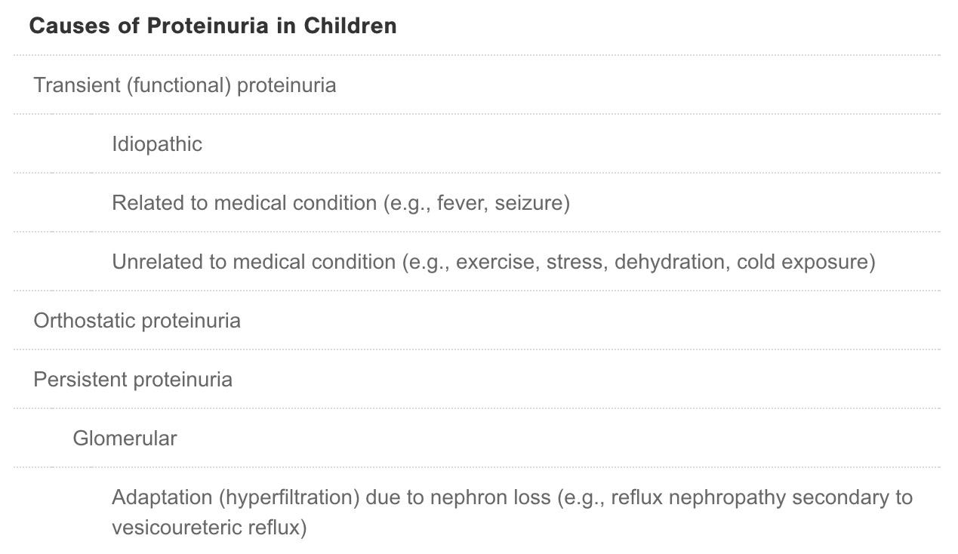


Slide 32
Transient Proteinuria
The majority of children found to have positive urinary dipstick values for protein ,have normal dipstick values on repeated measurements.
The proteinuria usually does not exceed 1-2+ on the dipstick.
No evaluation or therapy is needed

Slide 33
Orthostatic (Postural) Proteinuria
Orthostatic proteinuria is the most common cause of persistent proteinuria in school-aged children and adolescents.(60%).
Children are usually asymptomatic and the condition is discovered on routine urinalysis.
Patients with orthostatic proteinuria excrete normal or minimally increased amounts of protein in the supine position.
In the upright position, urinary protein excretion may be increased 10-fold, up to 1,000 mg/24 hr (1 g/24 hr).

Slide 34
Persistent Proteinuria
Significant proteinuria on a first morning urine sample on 3 consecutive days (>1+ on dipstick ,urine specific gravity >1.015 or protein : creatinine ratio >0.2).
A child is said to have persistent proteinuria if the dipstick is positive for protein on two of three random urine samples collected at least 1 week apart.
proteinuria indicates renal disease and may be caused by either glomerular or tubular disorders .
Initial evaluation of a child with persistent proteinuria should include :
- Measurement of serum creatinine and electrolyte
- First morning urine protein : creatinine ratio
- Serum albumin level
- Complement levels.

Slide 35
Glomerular Proteinuria
Glomerular proteinuria results from alterations in the permeability of any of the layers of the glomerular capillary wall to normally filtered proteins.
Glomerular proteinuria can range from <1 g to >30 g/24 hr.
Glomerular proteinuria should be suspected in any patient with:
- First morning urine protein : creatinine ratio >1.0.
- Proteinuria accompanied by:
. Hypertension
. Hematuria
. Edema
. Renal dysfunction

Slide 36
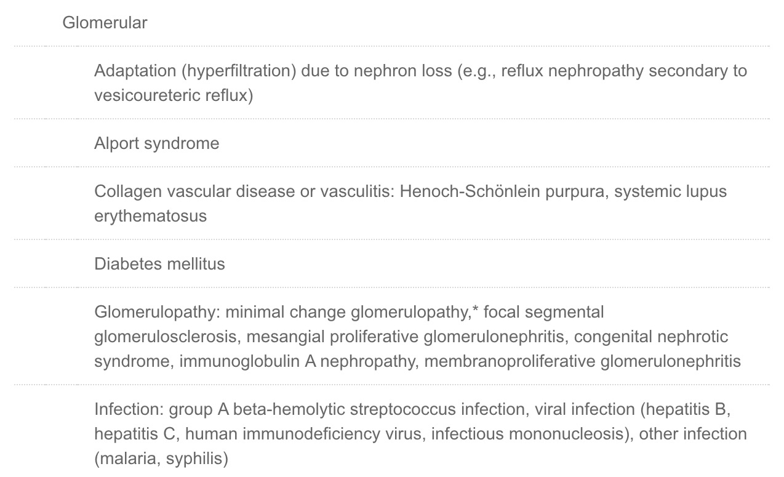

Slide 37
Tubular Proteinuria
A variety of renal disorders that primarily involve the tubulointerstitial compartment of the kidney can cause low-grade fixed proteinuria (protein : creatinine ratio <1.0.
Injury to the proximal tubules can result in:
Diminished reabsorptive capacity .
Loss of these low molecular weight proteins in the urine.
Tubular proteinuria is seen in acquired and inherited disorders and may be associated with other defects of proximal tubular function, such as:
-The Fanconi syndrome. (glycosuria, phosphaturia, bicarbonate wasting, and aminoaciduria).
- Dent disease ( X-linked recessive disorder of the proximal tubules that is characterized by low-molecular-weight proteinuria, hypercalciuria, nephrocalcinosis, kidney stones, kidney failure, and rickets ).

Slide 38
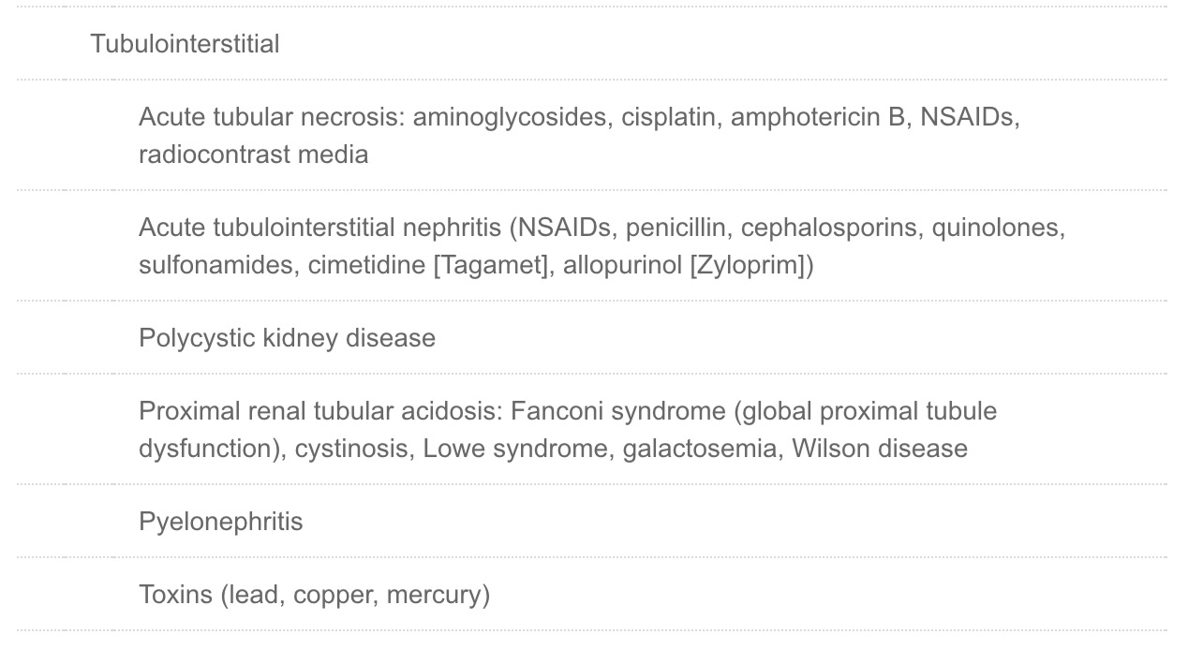

Slide 39
Glomerular Versus tubular proteinuria
Asymptomatic patients having persistent proteinuria generally have glomerular rather than tubular proteinuria .
In occult cases , glomerular and tubular proteinuria can be distinguished by electrophoresis of the urine.
In tubular proteinuria, little or no albumin is detected, whereas in glomerular proteinuria the major protein is albumin.

Slide 40
Clinical Approach
The initial workup should begin with a complete history and physical examination.
The physician should elicit history of recent infections (pharyngitis, impetigo), UTIs, oliguria or hematuria, and family history of renal disease.
The physical examination should be focused on looking for hypertension (glomerulonephritis), edema (nephrotic syndrome), rash or arthritis (vasculitis), and short stature (chronic renal disease).

Slide 41
Clinical Approach
Laboratory investigations should include a urine dipstick, a urine analysis including microscopic examination, and a random urine protein-to-creatinine ratio.
The dipstick measures the concentration of protein in urine.
A 24-hour urine collection can be done by asking the child to void as soon as he or she wakes up and discarding the specimen; then every void should be collected for the next 24 hours, including the first void the next morning.
A random urine specimen can be analyzed for protein and creatinine concentration.

Slide 42
MANAGEMENT
If the initial workup suggests the presence of an underlying renal disease, a referral to a pediatric nephrologist should be made.
A referral should be made in the following situations:
Persistent fixed (i.e., nonorthostatic) proteinuria
Family history of glomerulonephritis
Systemic complaints (e.g., fever, rash, arthralgias)
Hypertension
Edema
Cutaneous vasculitis or purpura
Hematuria
Abnormal renal function
Abnormal renal ultrasound
Increased parental anxiety

