Slide 1


Slide 2
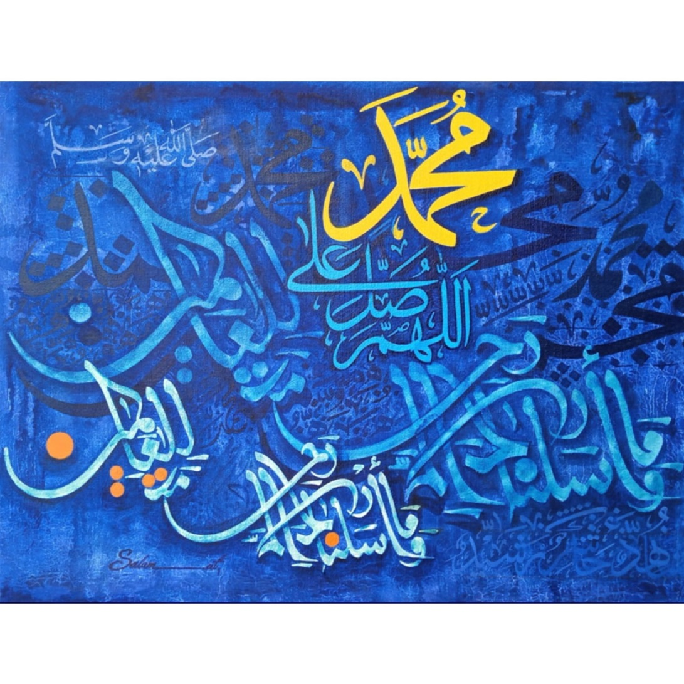

Slide 3
SYSTEMIC LUPUS ERYTHEMATOSUS
(SLE)
DR WAQAR
MBBS, MRCP, Int. Medicine( London)
MRCP, Endocrinology & DM(London)
ASST. PROFESSOR

Slide 4
OBJECTIVES
To know the epidemiology of SLE
To recognise the clinical presentation of SLE
Know the diagnostic investigations
Should know the effect of SLE on pregnancy and how to counsel the patient
Know APA syndrome, its presentation and associations

Slide 5
Definition of autoimmune disease
Autoimmune diseases are conditions in which antibodies are formed against the person’s own body tissues
In some diseases, ab. are formed against one organ only ( DM type1, Grave’s disease) while in others, ab. are formed against many tissues

Slide 6
DEFINITION OF SLE
SLE is an autoimmune disease in which antibodies are formed against many tissues of the body ( multisystem disease). These antibodies cause damage and inflammation in the tissues.

Slide 7
EPIDEMIOLOGY
Geographics : Occurs worldwide
Gender : F:M ratio is 9:1 ( usually young
women, aged 20 to 40).
Race : More in black Americans

Slide 8
ETIOLOGY
Like most autoimmune diseases, cause is unknown but some associations are observed:
If one twin is affected, more chances in the other ( ? Genetic role)
More chances in 1st degree relatives
More chances in premenopausal women ( ?
may be hormonal cause)
Some drugs can cause SLE like picture
* INH * Hydralazine * Penicillamine

Slide 9
S/S
S/S of SLE are “very” varied & may be mild to severe. SLE can affect any organ
BUT REMEMBER 3 MOST COMMON FEATURES
Fatigue Muscle & joint pain Fever
& malaise

Slide 10
Gen. features: Fatigue, fever, wt loss
2) Joint & Muscles:
*Pain in small joints of hands ( like R.A.)
* Other joints may also be affected
* Usually no joint swelling
* Myalgias

Slide 11
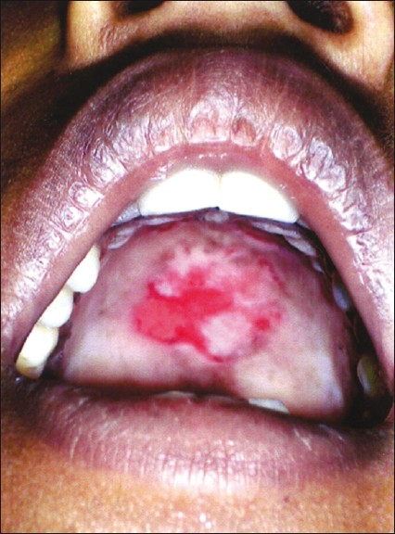
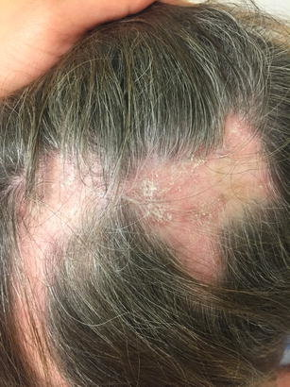
3) Scalp: hair fall, discoid alopecia
4) Brain: cerebritis, psychosis, depression
5) Eyes: Retinal infarcts, scleritis
6) Mouth: Ulcers

Slide 12
7) Skin rash: Skin is affected in 85% patients
Butterfly rash Discoid rash
Butterfly rash is characteristic of SLE
SLE rash gets worse in sunlight (photosensitive)

Slide 13
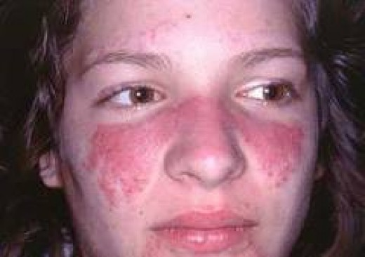
SKIN RASH IN SLE
* Butterfly rash on the face
a) involves the cheeks,
b) crosses over the nasal bridge
c) no involvement of the
nasolabial fold
d) May be slight pain or HAKKA

Slide 14
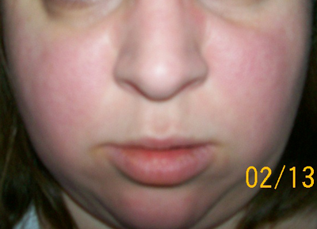

Slide 15
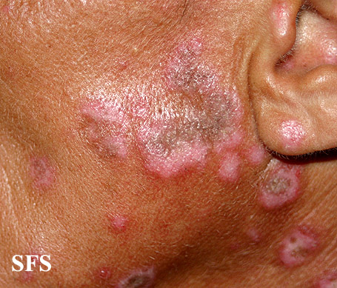
Sometimes discoid skin lesions are seen

Slide 16
Skin features (contd.)
8) Lungs:
* pleuritis, pleural effusions
* Interstitial lung disease
9) Heart: * Pericarditis * Myocarditis
* Non bacterial endocarditis of the mitral
valve ( Libman-Sacks endocarditis)
* Increased risk of coronary artery disease
( angina, MI)

Slide 17
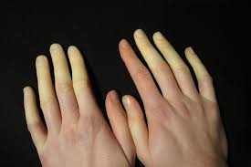
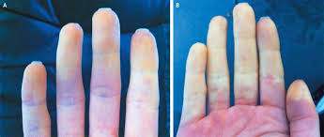
10) Raynaud’s phenomenon:

Slide 18
11) Kidneys( Lupus nephritis) : SLE causes various types of glomerulonephritis which present as either nephrotic
syndrome or nephritic syndrome.
W.H.O. has classified lupus nephritis into 6 classes based on histology of the renal lesion (class 1 to 6). Please remember the following two:
* Class 4: Most common renal lesion in SLE & causes nephritic syndrome. Also called diffuse proliferative GN or Membrano-proliferative GN (MPGN)
* Class 5: Also called Membranous nephropathy (MN). Causes nephrotic syndrome.
SLE NEPHRITIS HAS HIGH MORBIDITY & MORTALITY

Slide 19
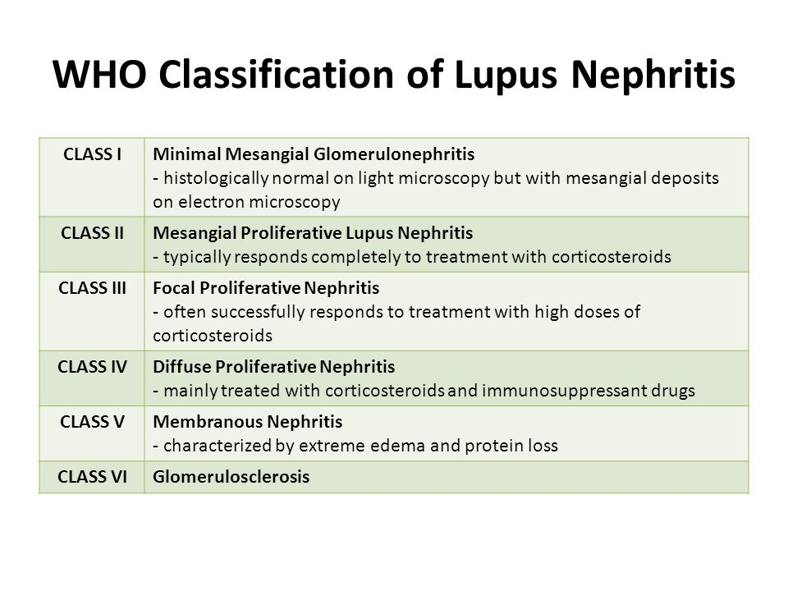

Slide 20
Lupus Nephritis (contd.)
1) Routinely check urine in SLE patients. If any
blood or protein, investigate further ( biopsy)
2) Treatment of lupus nephritis depends on the
class of lesion which is present, so biopsy is
important.

Slide 21
12) GIT :
* Vasculitis of the intestinal vessels
causing bowel infarction
13) Blood vessels: Vasculitis anywhere
14) BLOOD : * Anemia * Low WBC
* Low platelets
(antibodies are formed against RBC, WBC &
platelets)

Slide 22
INVESTIGATIONS
CBC : * Anemia * Low WBC * low plts.
Urea/creatinine :
* Raised in advanced renal disease ( lupus
nephritis)
3) Urine : * may show proteins & blood
4) ESR: Raised in acute flare
5) C3, C4 (complements) : reduced in acute flare &
lupus nephritis

Slide 23
Investigations (contd.)
6) Autoantibodies : Important ones are :
a) ANA (antinuclear ab.) : Present in almost all pts. Not specific for SLE but done as the first screening step. Titers should be at least 1:80
( if ANA negative, SLE is ruled out)
b) Anti double stranded DNA ( anti ds DNA) done
( * v. specific for SLE - Present in 70% pts., only
specially during acute flare) if
c) Anti Sm ab. : most specific ANA is
d) Anti Ro, anti La positive

Slide 24
7) Renal Biopsy :
* Done if nephritis is suspected ( abn. urine)
* Shows the class of renal disease, which helps us decide about drugs

Slide 25
WHEN TO SUSPECT SLE
Consider SLE in a female with multisystem symptoms
Confirm with blood tests
Rheumatology consultation for all patients

Slide 26
Points about drug induced Lupus
No CNS, renal or major organ involvement
ANA & anti-histone ab. positive
Can occur even years after starting the drug
Resolves after stopping the drug
Common symptoms fever, arthralgias, myalgias, mild pleuritis

Slide 27
DIAGNOSTIC CRITERIA
American College of Rheumatology has 11 criteria, at least 4 of which should be present to diagnose SLE.
BUT
These criteria were meant to enroll patients in clinical trials, not to diagnose individual patients.

Slide 28
TREATMENT
THERE IS NO CURE FOR SLE
Drugs used :
* Hydroxychloroquin
* NSAIDs
* Glucocorticoids
* Immunosuppressive drugs
( Cyclophosphamide,Myco-pheno-late mofetil,
Methotrexate, Azathioprine).Used for long term control of the disease.
* Belimumab (a monoclonal antibody)

Slide 29
Hydroxychloroquin is given long term to almost all symptomatic patients. For mild symptoms, this is enough.
In case of moderate to severe symptoms or major organ involvement, steroids, immuno-suppressives & /or monoclonal antibodies are added

Slide 30
TREATMENT
1) Fatigue, arthralgias, fever, pleuritis
* Hydroxychloro. Can cause
retinal toxicity, so regular eye checks
* NSAIDs
2) Skin rash: * Topical steroids * Sunscreens
* Hydroxychloroquin tabs.
Sometimes, oral steroids may be needed
3) Avoid long sun exposure ( SLE gets worse in sun)
4) Periods of rest during acute flares

Slide 31
Treatment of Nephritis
DRUGS USED FOR NEPHRITIS
Steroids
Immunosuppressives (eg Mycophenolate, azathioprine, methotrexate, cyclophosphamide)
Sometimes, monoclonal antibodies are also added.
Treatment may be long term

Slide 32
The following features in SLE also need aggressive treatment with steroids/ immunosuppressants:
a) Cerebritis
b) Anemia, low WBC, low platelets

Slide 33
COURSE OF SLE
Most patients have relapsing-remitting course
Features of an acute flare:
* Worsening of signs/symptoms
* Rise in ESR
* Fall in blood complement levels (C3, C4)
* Further rise in anti-ds-DNA ab. levels

Slide 34
PROGNOSIS
1) Mortality has fallen dramatically in the last 50 yrs due to advanced Rx.
2) 10 yr survival rate is 90%
3) Causes of death :
* Coronary artery disease: No. 1 cause of death
* Renal disease
* CNS disease
* Autoimmune hemolytic anemia

Slide 35
PREGNANCY & SLE
Fertility is normal but increased chances of miscarriage and fetal death
SLE is not a contraindication to pregnancy but tell the patient about the risks
Exacerbations can occur during pregnancy & even after delivery
Corticosteroids, azathioprine & hydroxychloroquine are safe in preg.

Slide 36
RAPID FIRE QUESTIONS
Most common symptoms of SLE?
Most common rash?
Features of the most common rash?
Treatment of the rash?
Features in the heart?
Which antibiotic to use in SLE endocarditis?
Features in the brain & lungs?
What happens during pregnancy?

Slide 37
9) Commonest cause of death in SLE?
10) Treatment of renal SLE?
11) Which drug to be given to all SLE patients?
12) Which drugs can cause SLE?
13) Any 2 features of acute flare?

Slide 38
SLE FINISHED

Slide 39
CASE 1
A 35 year old lady presents with pain and swelling in the right lower leg since 2 days.
Past history of recurrent abortions
Had a stroke 2 years ago
Also had popliteal artery thrombosis few years ago

Slide 40
ANTI PHOSPHOLIPID SYNDROME
Some patients with SLE have a condition called Antiphospholipid antibody syndrome ( APA syndrome, APLS)
Definition of APA syndrome:
It is an autoimmune condition where there are some abnormal antibodies in the blood, which cause thrombosis in blood vessels.
Thrombosis can occur anywhere in the body (arteries or veins)

Slide 41
TYPES OF APA SYNDROME
1) Primary: no known cause
2) Secondary APA: Secondary to some other
disease eg SLE

Slide 42
Signs & symptoms:
a) Venous thrombosis (eg DVT in the legs)
b) Arterial thrombosis eg stroke, MI
c) Pregnancy complications: recurrent miscarriage, still birth, intrauterine fetal death
( females with recurrent abortions should always be screened for APA)
d) Skin discoloration called “livedo reticularis”: this is a net like appearance of the skin

Slide 43
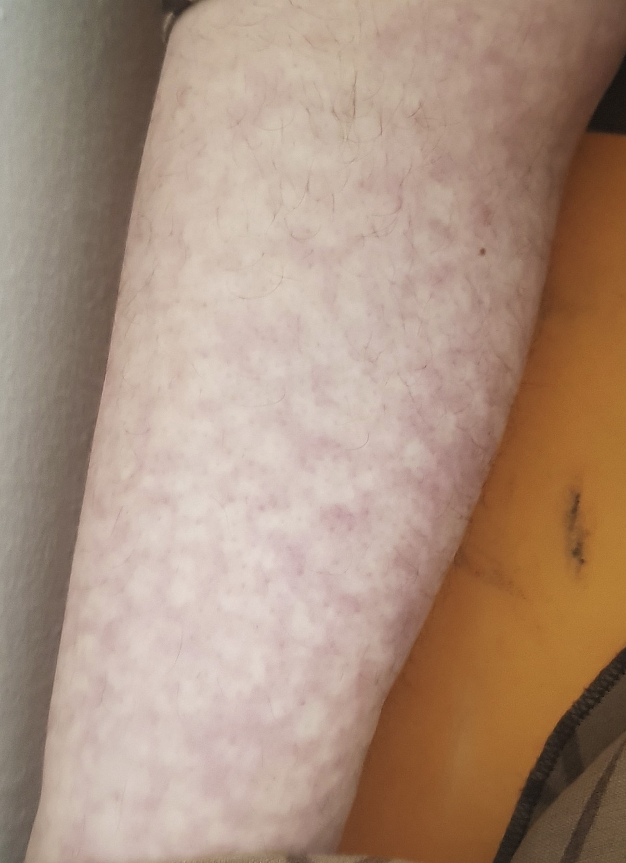
Livedo reticulitis

Slide 44
WHEN TO SUSPECT APA syndrome
1) Arterial thrombosis
Recurrent DVT
Thrombosis in unusual sites eg. : portal vein, hepatic veins, intracranial veins
Female with recurrent abortions, intrauterine fetal death

Slide 45
Blood tests:
Antiphopspholipid antibodies (3 types)
lupus anti- anticardio- antibody to
coagulant -lipin antibody β2 glycoprotein
2) Thrombocytopenia
3) High PTT ( ? Very strange, right?)

Slide 46
HOW TO DIAGNOSE
Signs and symptoms(arterial or venous throm
-bosis
PLUS
2) Positive antibodies ( do twice, 12 weeks
apart)
Diagnosis requires both 1 & 2
Either all 3 or just one or two antibodies may be present

Slide 47
If antibodies are present but no history of thrombosis, it is not APA syndrome

Slide 48
TREATMENT
For acute thrombosis: Heparin (i.v. or LMWH)
then
2) For long term secondary prophylaxis:
* Oral anticoagulants( warfarin, apixaban)
* LMWH (second choice)

Slide 49
VERY IMPORTANT
If a lady with APA syndrome, who was taking warfarin, now becomes pregnant stop warfarin & give LMWH.
Warfarin is contraindicated in pregnancy
Apixaban etc are category C drugs ( possible teratogenic but may be used if strongly needed)

Slide 50
RAPID FIRE QUESTIONS
How many types of APA syndrome?
What happens in APA?
Name the 3 antibodies?
How to diagnose APA syndrome?
What happens to the PTT?
What skin lesion is seen?
Name some unusual sites of thrombosis?
Treatment of APA syndrome?

